Slide 1
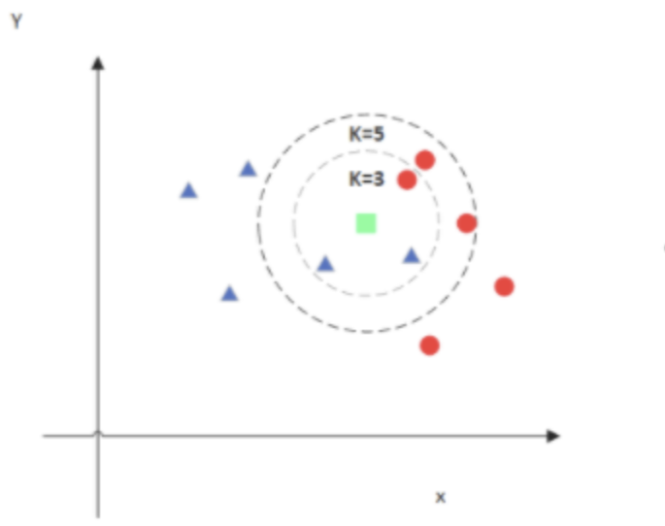
KNN: Classification Based on Local Similarity
How it works: KNN measures the Euclidean distance between a new sample and the training samples, then assigns the class voted for by its nearest k neighbors.
Why it fits Mushroom: All input attributes are nominal. After one-hot encoding, Euclidean distance reflects how differently two samples are described by these attributes.

Slide 2
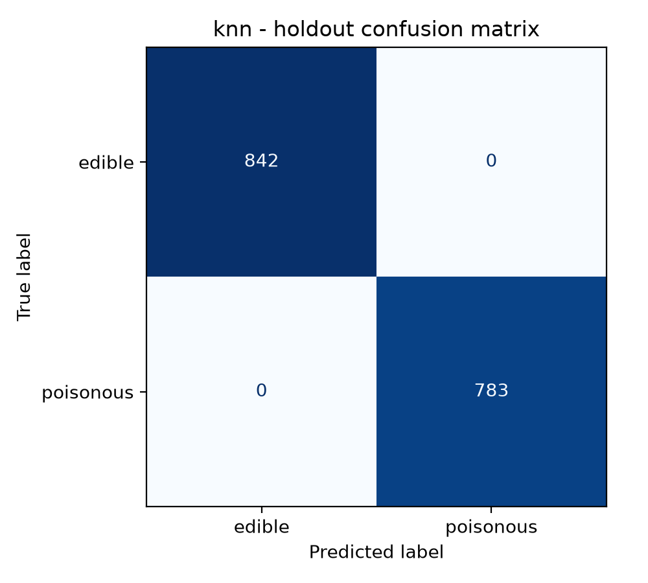
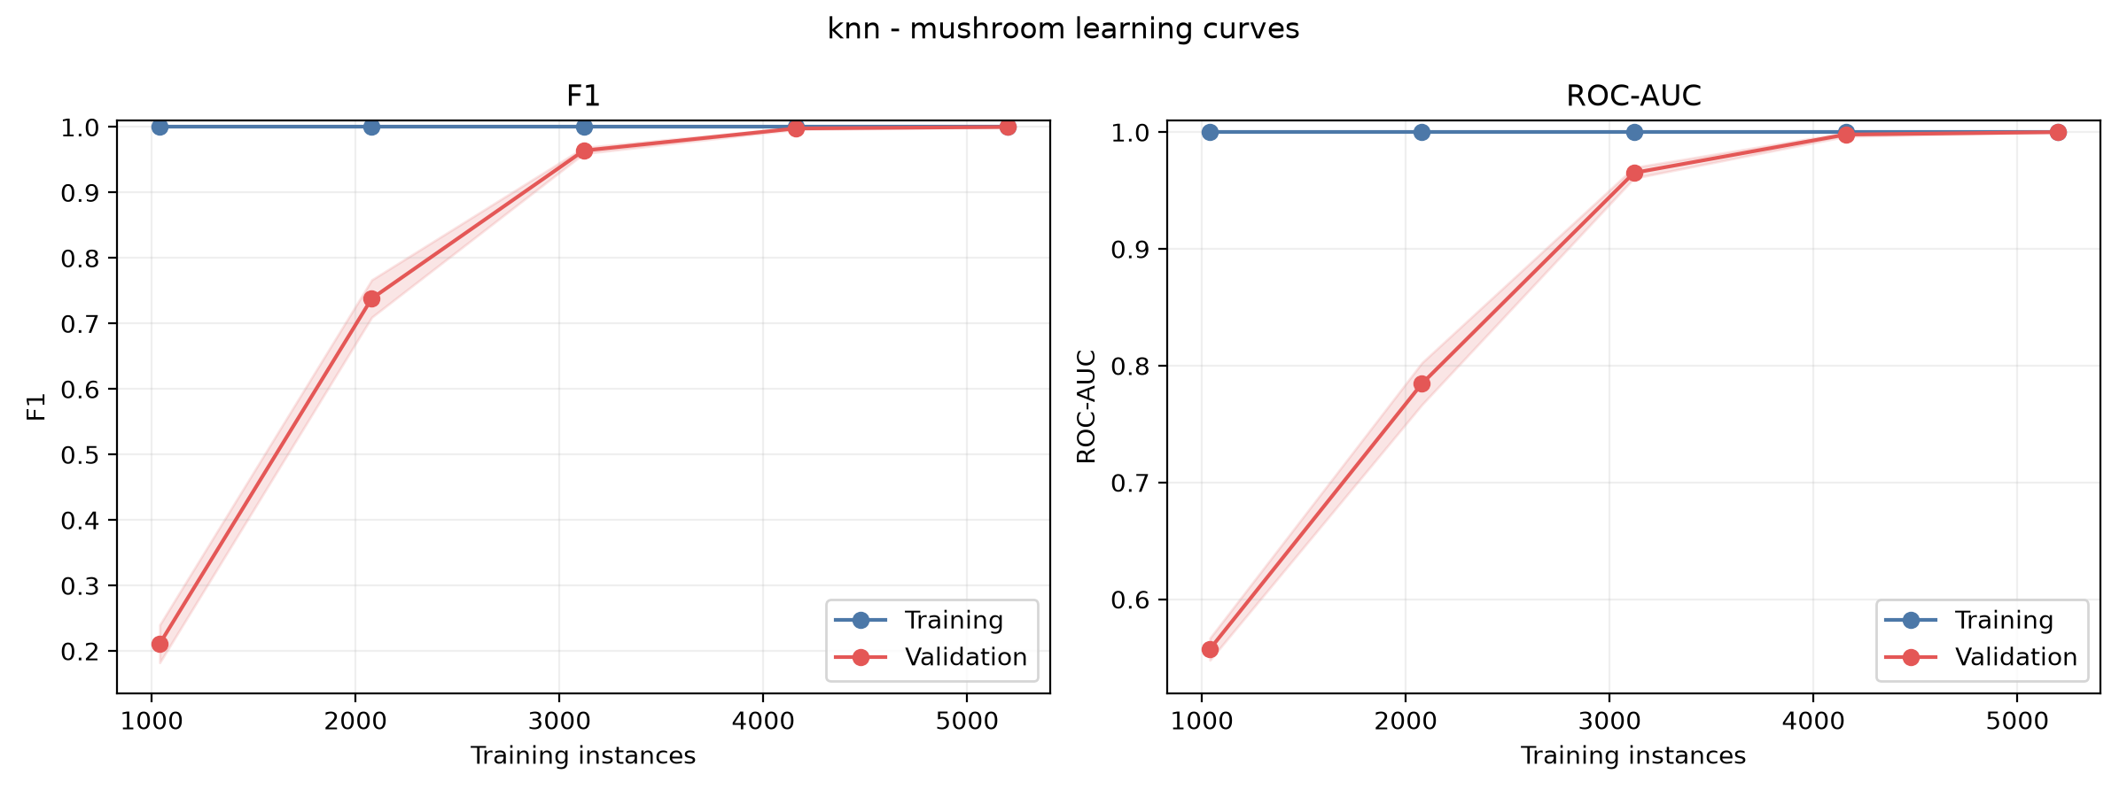
Parameter selection: We searched k=1–20 and compared uniform and distance voting within the training folds, using poisonous-class F1 for selection.
Final setting: All values from k=1 to k=9 achieved perfect scores. We recorded k=1, weights=uniform according to the tie order.
Key result: Both 10-fold F1 and ROC-AUC reached 1.0000, showing very strong local class consistency in this dataset.

Slide 3
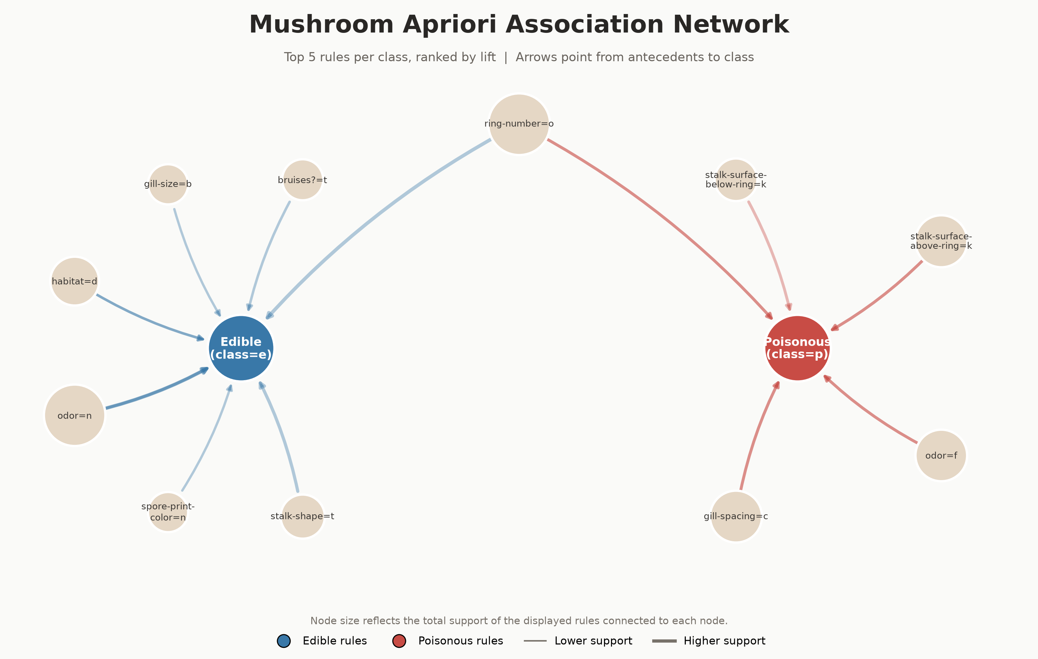
Apriori: Finding Strong Associations
How it works: Apriori first identifies attribute combinations that occur frequently, then generates association rules from them. We use Support, Confidence, and Lift to evaluate how common, reliable, and informative each rule is.
Why it fits Mushroom: All attributes are nominal, so each attribute value can be naturally treated as an item, such as odor=f. This makes Apriori suitable for discovering interpretable co-occurrence patterns without distance calculations or numerical assumptions.

Slide 4
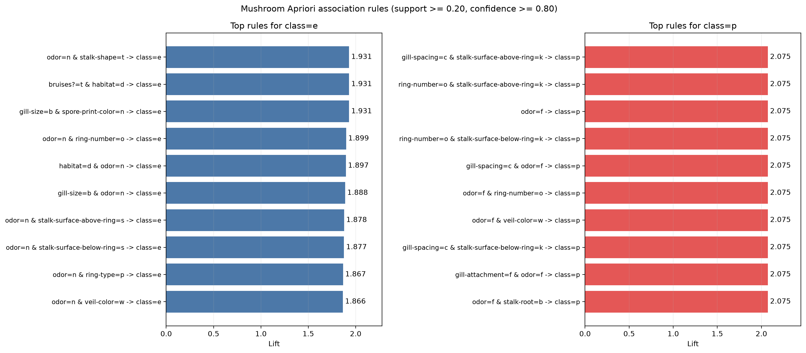
Settings: Support ≥ 0.20, Confidence ≥ 0.80, and a maximum itemset length of 3.
Results: We found 1,568 frequent itemsets, including 104 rules ending in class=e or class=p
Representative rules:
  odor=f → class=p: Support = 0.2659, Confidence = 1.0000, Lift = 2.0746.
  odor=n → class=e: Support = 0.4195, Confidence = 0.9660, Lift = 1.8649.
Interpretation: Odor and several other attributes show strong associations with the class labels.

Slide 5
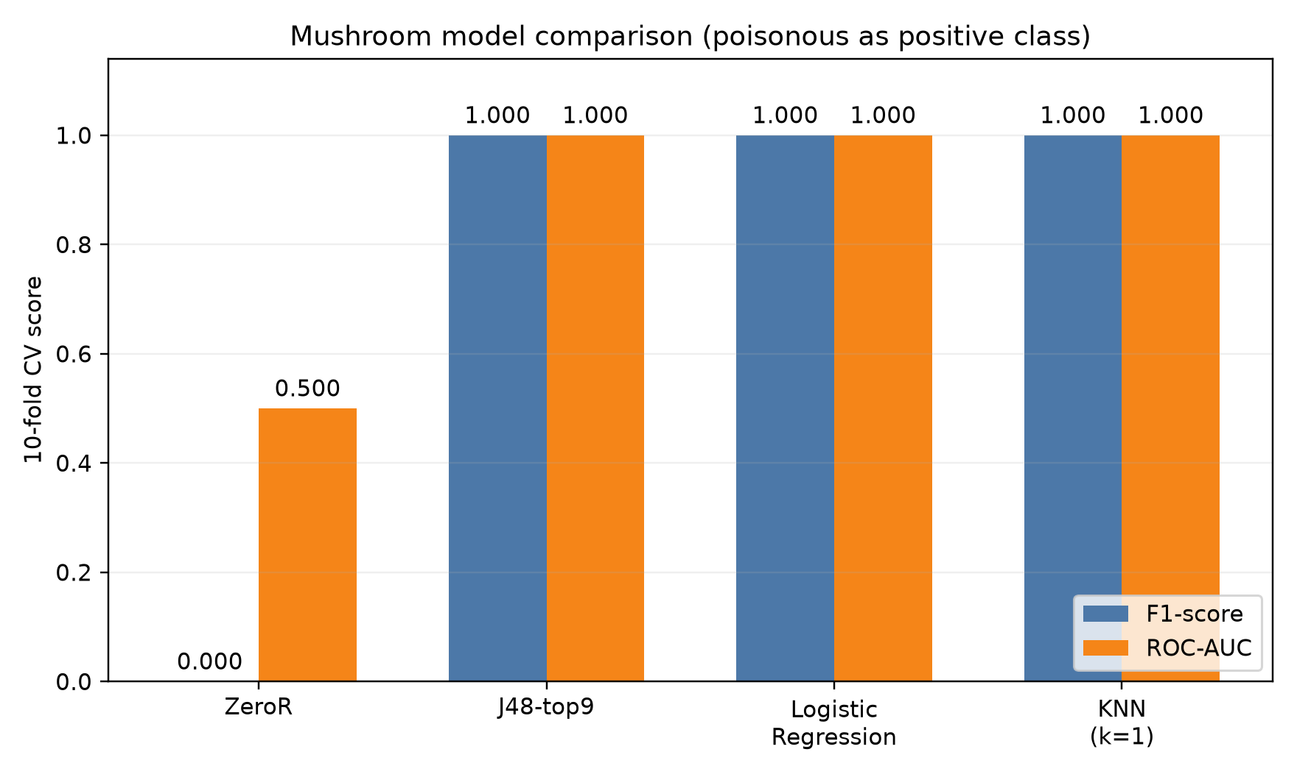
Model Comparison
Selection order:
1. F1
2. ROC-AUC
3. Model Complexity

