Slide 1

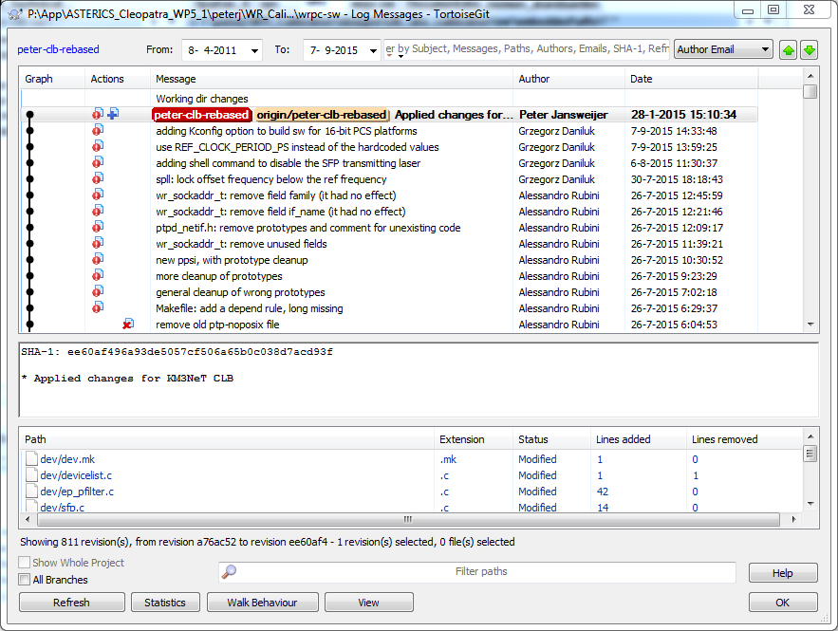

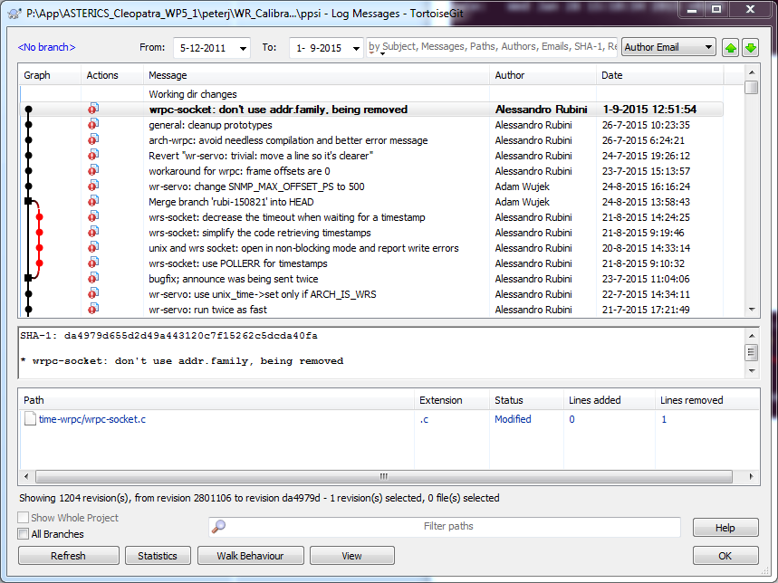

Branch peter_clb_rebased

Slide 2
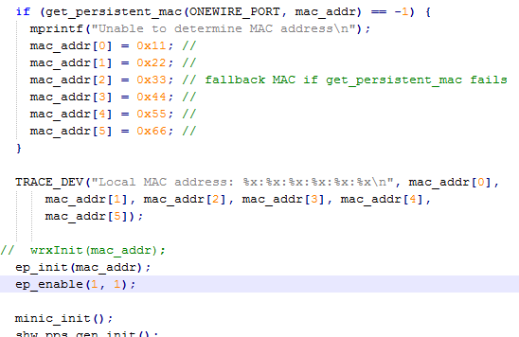
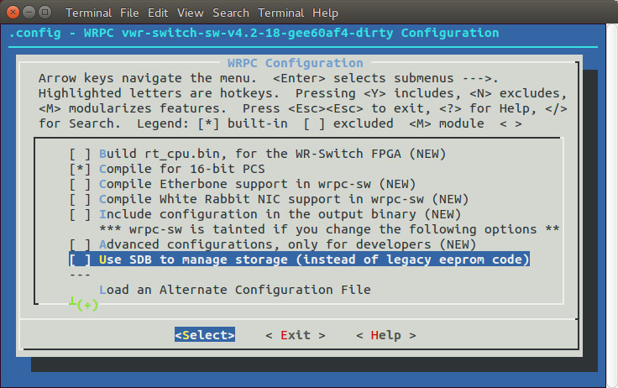
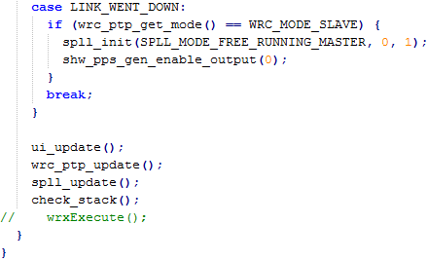
CLB firmware for clb_abs_calibration only has a plain wrpc lm32, no KM3Net 2nd-lm32.
Henche wrc_mian.c lines that are responsible for lm32-2nd exchange need to be commented out.

