Slide 1
Using Supervised Machine Learning to Predict the Bandgap energy of Inorganic Material
Timileyin Ojo
ID: 2426478
MRes Artificial Intelligence
Prof Celestine Iwendi 13-05-2025

Slide 2
Introduction
Bandgap energy decides how materials behave in electronics. Traditional methods like Density Functional Theory (DFT) are too slow and expensive, especially for large datasets. Machine learning (ML) offers fast and accurate predictions (Zeb et al., 2024; Varley, 2021).

Slide 3
Aim and Objectives
Aim
Build Machine learning models that predict bandgap energy of inorganic material based on their structural and compositional features.
Objectives
Compile a dataset of known bandgaps
Select features (formation energy, volume, etc.)
Train models: DT, RF, SVR, XGBoost
Evaluate performance (MAE, RMSE, R²)

Slide 4
Research Question & Significance
How can ML accurately predict bandgap from structural and compositional features? Significance
Using machine learning can lead to;
- Eco-friendly semiconductors
- Faster material discovery (Weng et al., 2016; Deng et al., 2024)

Slide 5
Literature Review - SEND Method
S - Similar: Zeb et al. (2024) used Random Forest, XGBoost.
E - Exceptional: Park et al. (2020) added deformation features like how the material bends or changes shape. They added more dynamic, real-world details that affect how a material behaves under stress.
N - Novel: Nguyen et al. (2023) used data augmentation, most machine learning studies in materials science use fixed, raw datasets. They adjusted the anion sites (a type of atom placement), which helped the model learn better and generalise more.
D - Different: de Oliveira Neto et al. (2025) used Tutton salts, while others focus on predicting bandgaps using machine learning; they explored how specific crystal structures affect bandgap in real-world applications without machine learning.

Slide 6
Methodology - Overview
Design: Quantitative, exploratory.
Dataset: ABX₃ Inorganic perovskite compounds.
Features: Formation energy, density, volume, etc.
Target: Bandgap (eV)
Models: DT, RF, SVR, XGBoost

Slide 7
Model Training & Tools
Data Split: 70% train / 30% test
Tools: Google Colab, Python
Validation: 5-fold on RF
Metrics: MAE, MSE, RMSE, R²

Slide 8
Results Overview
Best: Random Forest (R² = 0.643)
Next: XGBoost (R² = 0.624)
DT = 0.299, SVR = 0.008
Top features: formation energy, volume, density

Slide 9
Discussion and Insights
- RF and XGBoost outperformed others - Data lacks temp/pressure info - SVR struggled with generalisation (Shen et al., 2023; Park et al., 2020)

Slide 10
Conclusion and Recommendations
- RF most reliable - Add environmental factors - Test with hybrid datasets - Tune SVR settings

Slide 11
Acknowledgements & References
Thanks to Prof Celestine Iwendi & University of Bolton
References
Zeb, M.H. et al. (2024) Machine learning‐enhanced prediction of inorganic semiconductor bandgaps for advancing optoelectronic technologies. Advanced Theory and Simulations, 7(7), pp. n/a.
Varley, J.B. (2021) First-principles calculations of structural, electrical, and optical properties of ultra-wide bandgap (AlₓGa₁₋ₓ)₂O₃ alloys. Journal of Materials Research, 36(23), pp. 4790–4803.
Stanley, J.C., Mayr, F. and Gagliardi, A. (2020) Machine learning stability and bandgaps of lead‐free perovskites for photovoltaics. Advanced Theory and Simulations, 3(1), pp. n/a.
Shen, Y. et al. (2023) Machine learning‐assisted discovery of 2D perovskites with tailored bandgap for solar cells. Advanced Theory and Simulations, 6(6), pp. n/a.
Nguyen, T. et al. (2023) Exploring data augmentation and dimension reduction opportunities for predicting the bandgap of inorganic perovskite through anion site optimization. Photonics, 10(11), pp. 1232.

Slide 12
Questions
Thank you for listening. Any questions or suggestions?

Slide 13
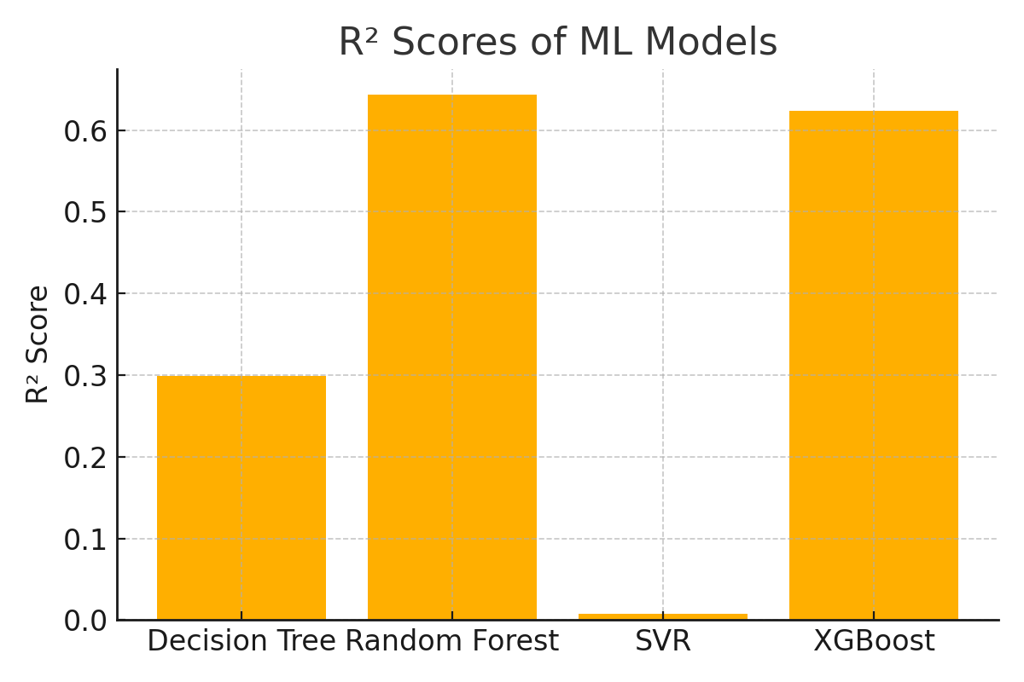
Model Performance: R² Scores

Slide 14
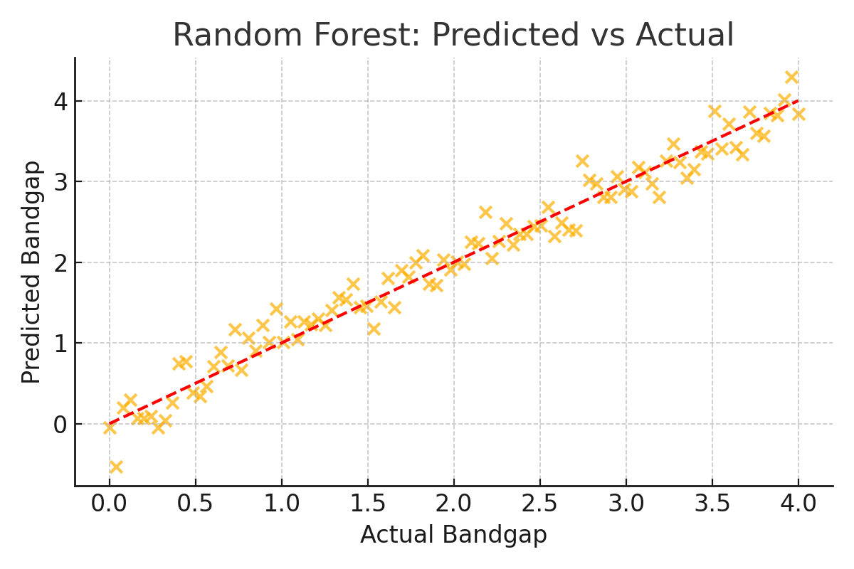
Predicted vs Actual: Random Forest

Slide 15
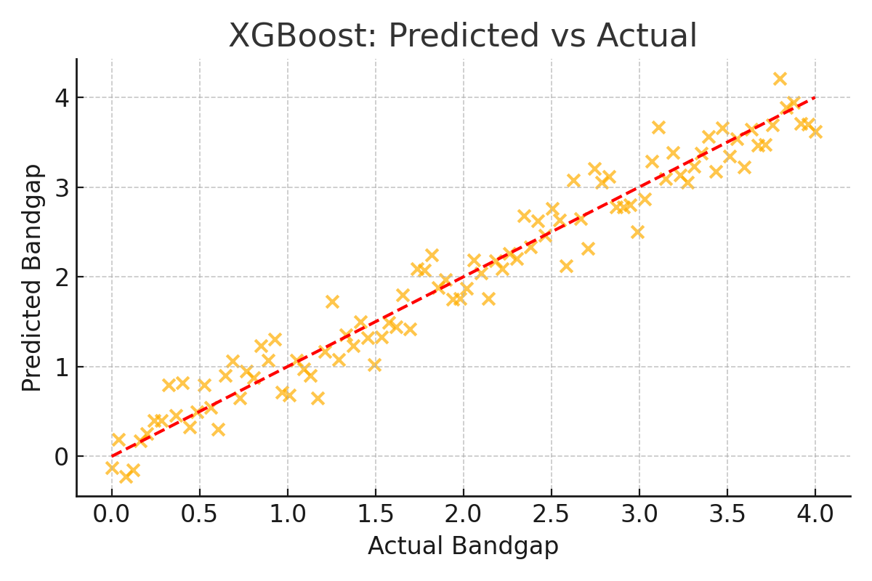
Predicted vs Actual: XGBoost

Slide 16
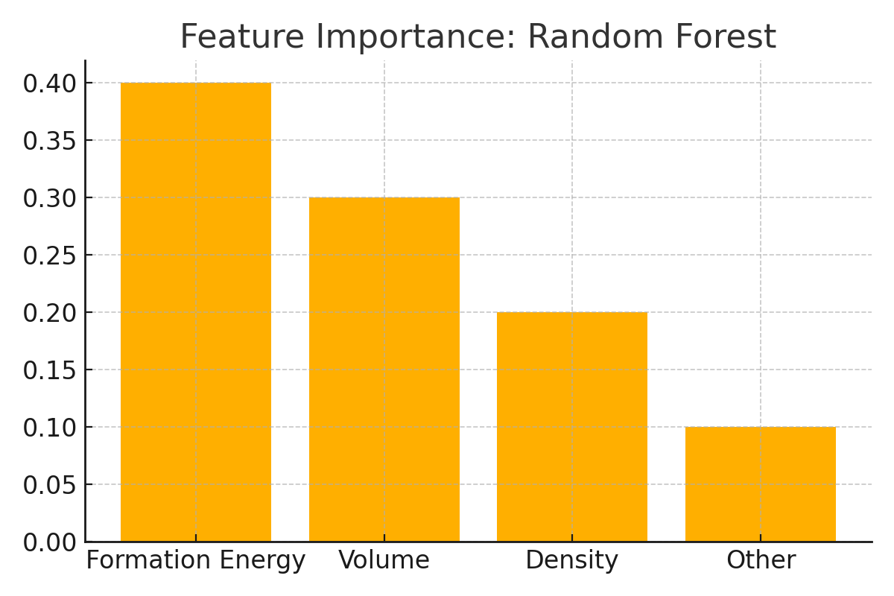
Feature Importance: Random Forest

Slide 17
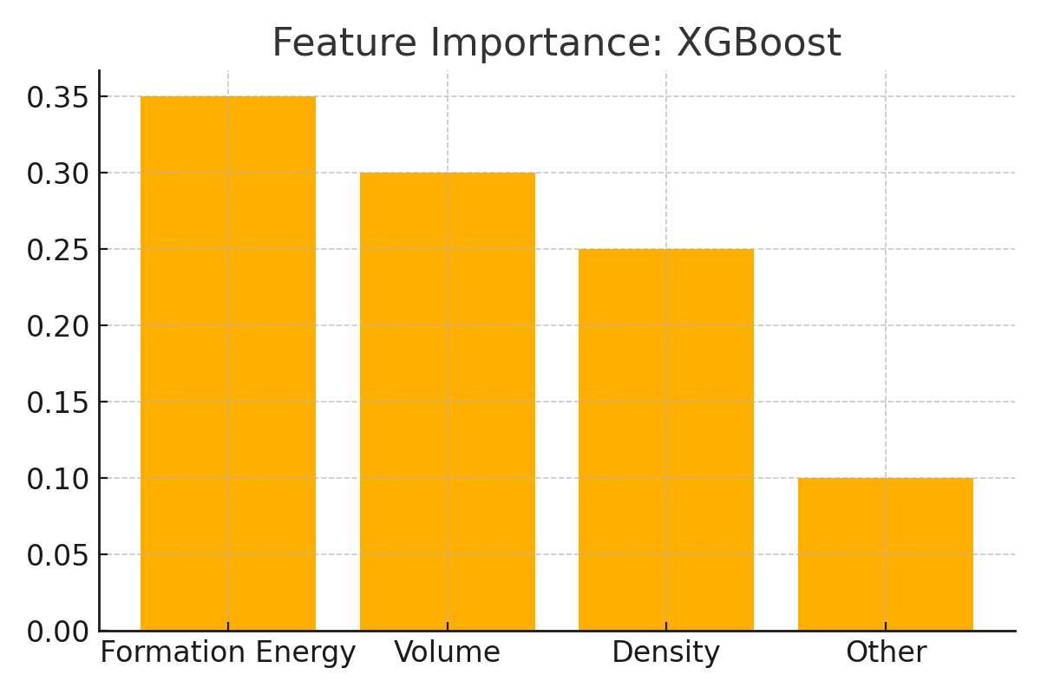
Feature Importance: XGBoost

