Slide 1
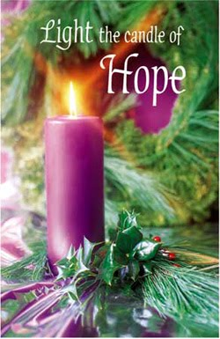
R.C. Church of the Immaculate Conception
1st Sunday of Advent
Year A 30th Nov.

Slide 2
Greeting
Priest: In the name of the Father, and
of the Son, and of the Holy Spirit.
People: Amen.
Priest: The Lord be with you.
OR Priest: The grace of Our Lord Jesus Christ, and the love of God, and the communion of the Holy Spirit be with you all.
People: And with your spirit.

