Slide 1
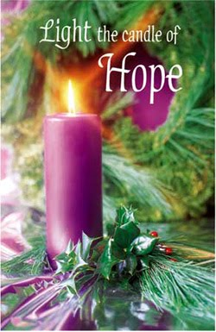
R.C. Church of the Immaculate Conception
1st Sunday of Advent
Year A 30th Nov.

