Slide 1
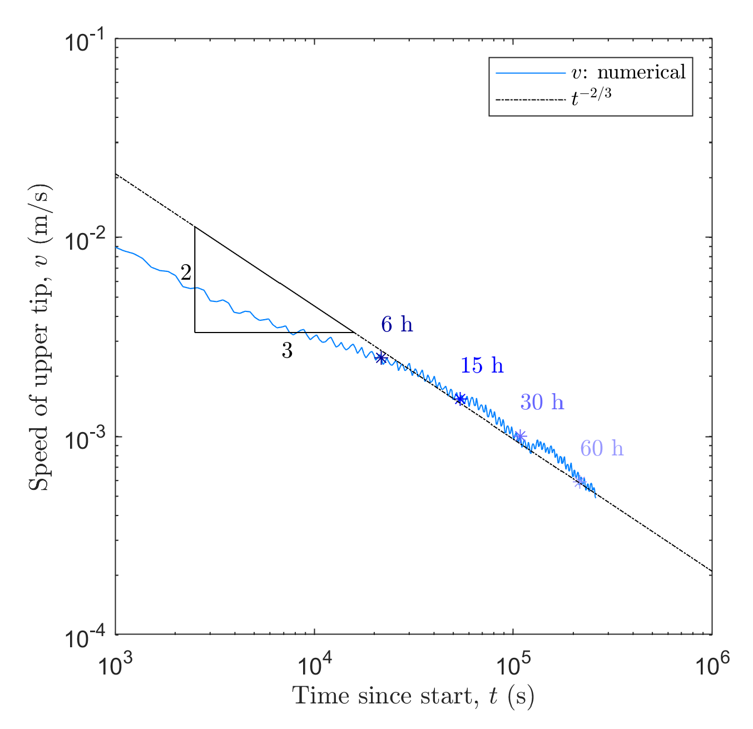
https://onlinelibrary.wiley.com/doi/full/10.1002/nag.2898
Numerical instability
Undulations

Slide 2
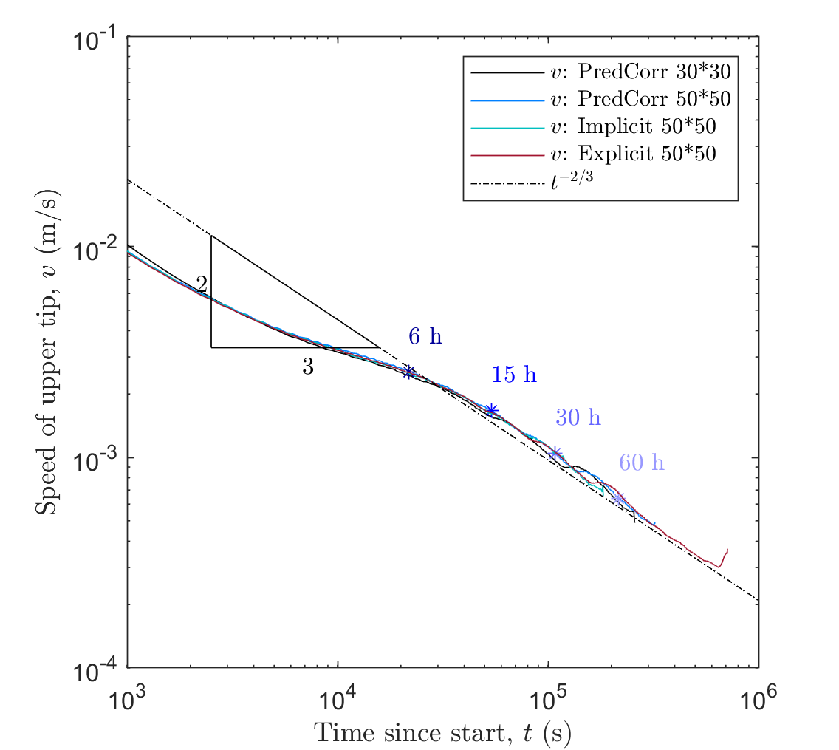
https://onlinelibrary.wiley.com/doi/full/10.1002/nag.2898
Numerical instability
Undulations smoothed with filter.
All schemes have same result.
Previous sampling was fine…

Slide 3
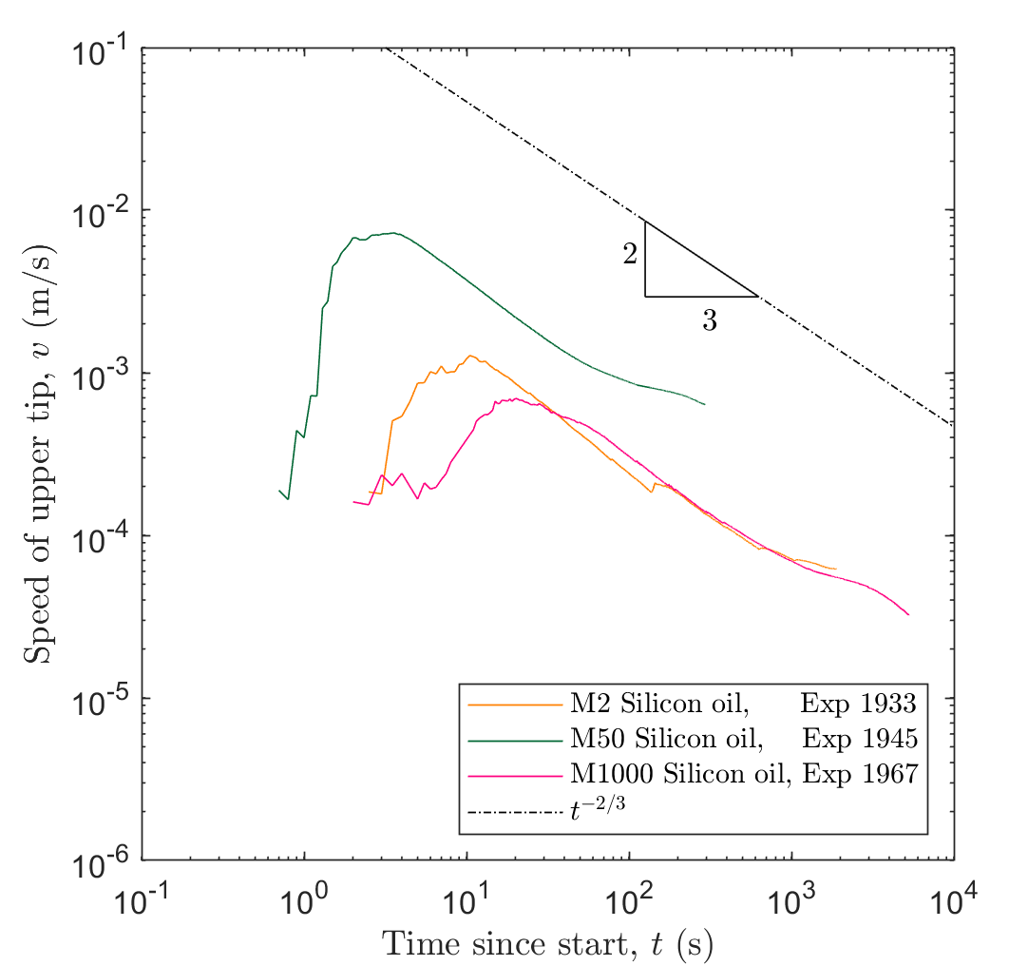

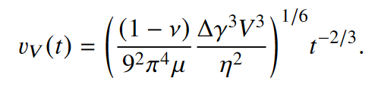
Analog results
Incorrectly computing velocity:
was taking the mean velocity since start
Time was in centiseconds…

Slide 4
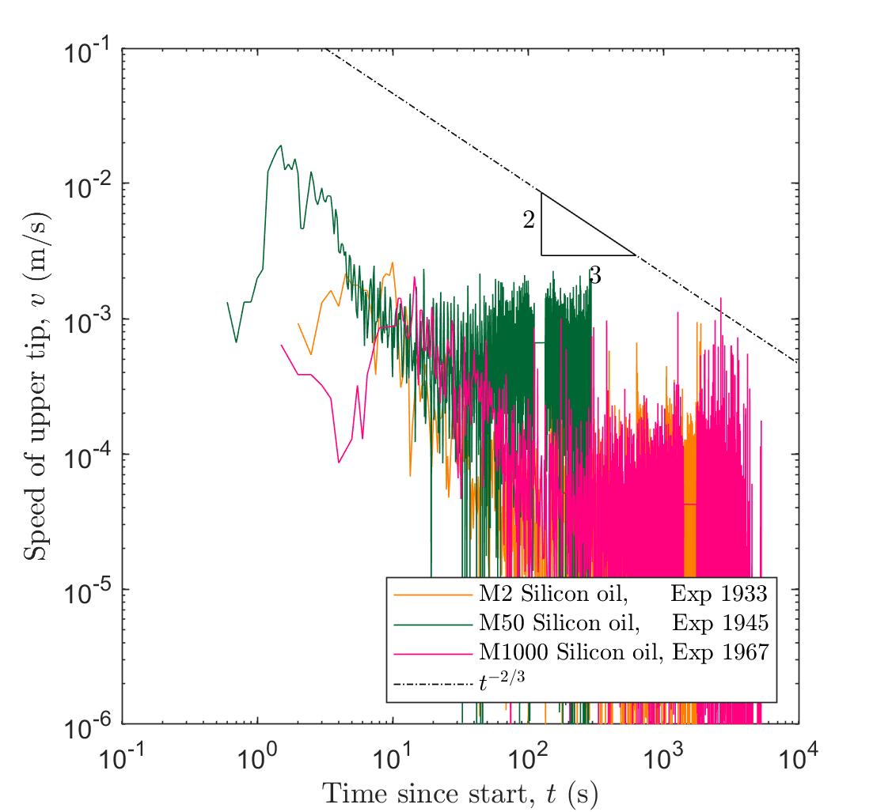
Analog results
Actual velocity must be filtered

Slide 5
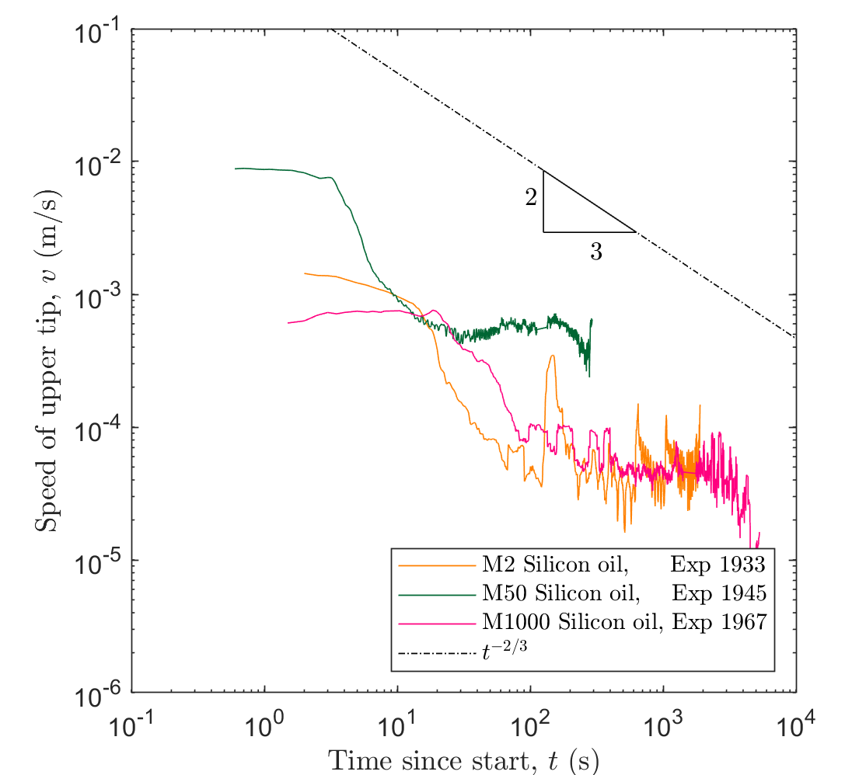

Analog results
Actual velocity must be filtered

Slide 6
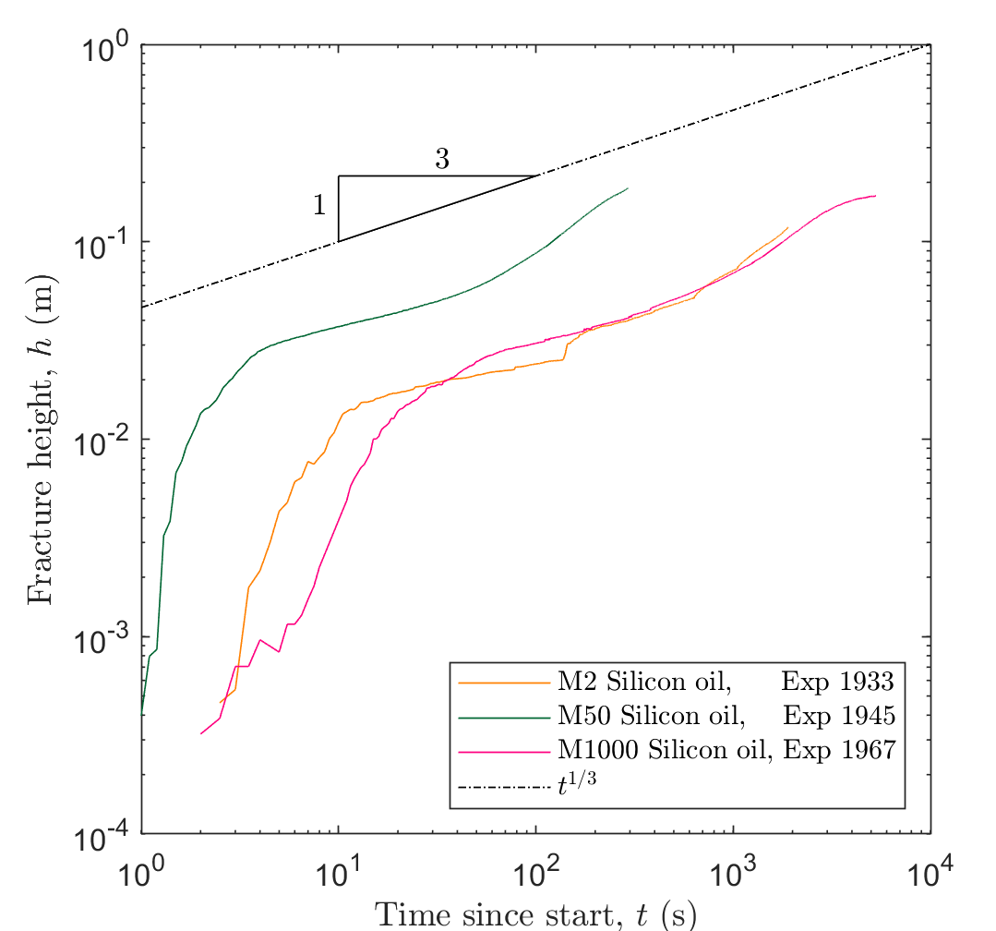
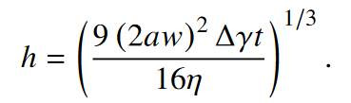
Analog results
Height does not need to be filtered

Slide 7
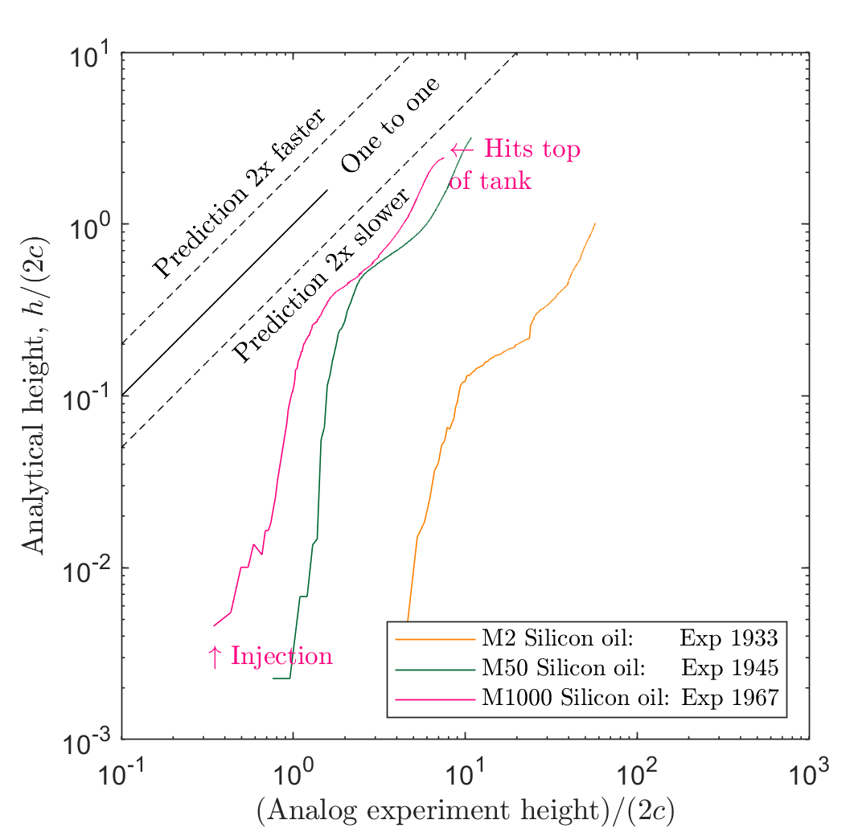
Analog results
Now the time unit has been corrected the fit the results is not as good

Slide 8
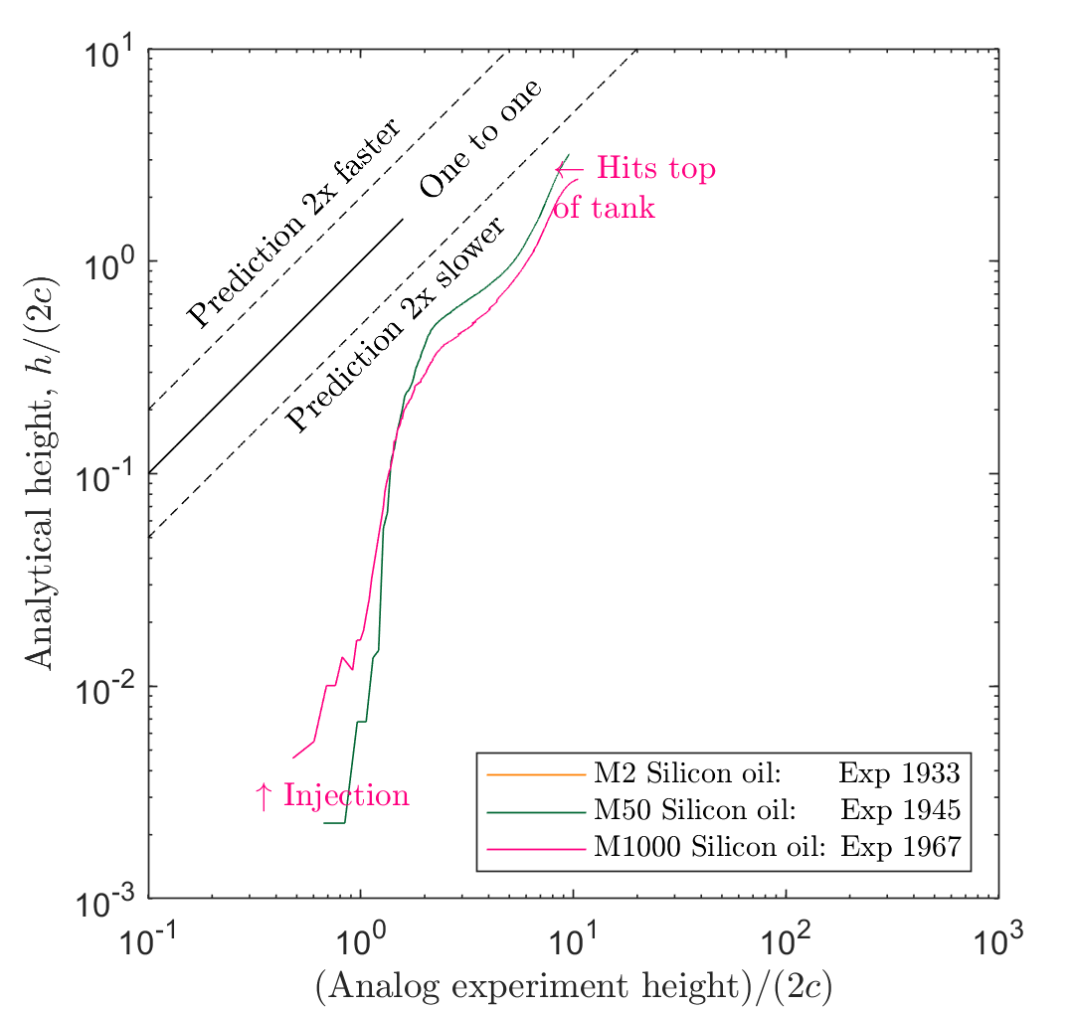
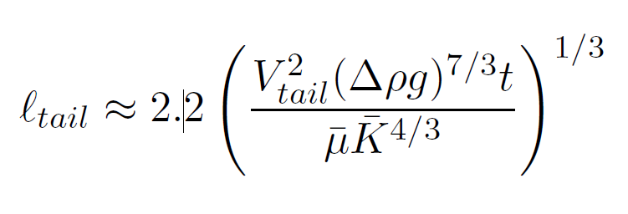
Garagash and Germanovich (2022) preprint
Analog results
Very similar issue for the preprint formulation.
Should I adjust for injection at start?

Slide 9
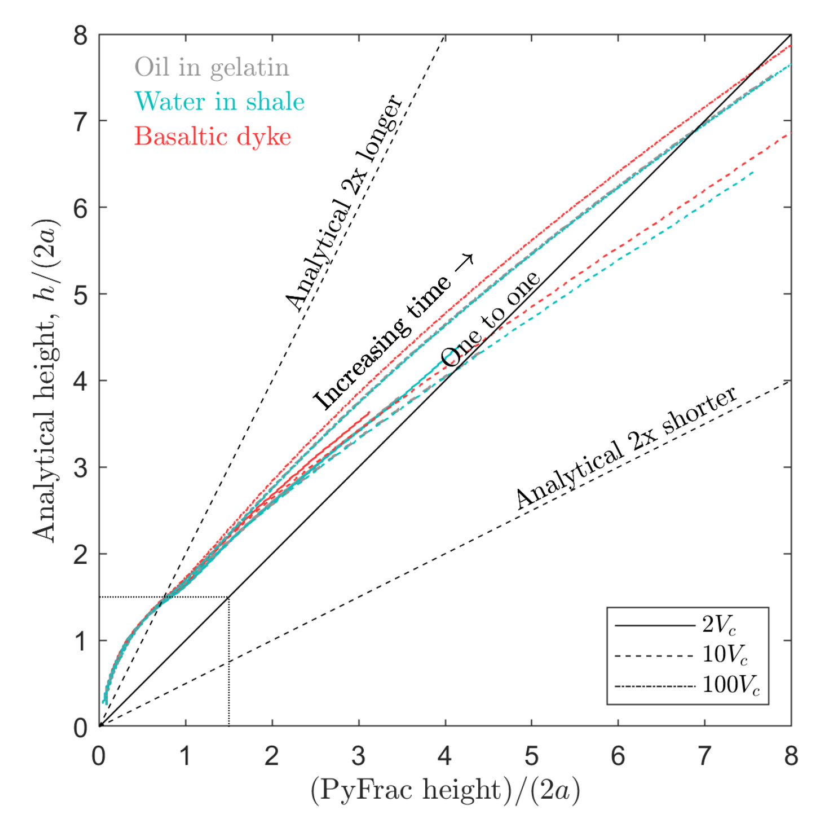
Numerical results
My eq has a good fit to the numerical results

Slide 10
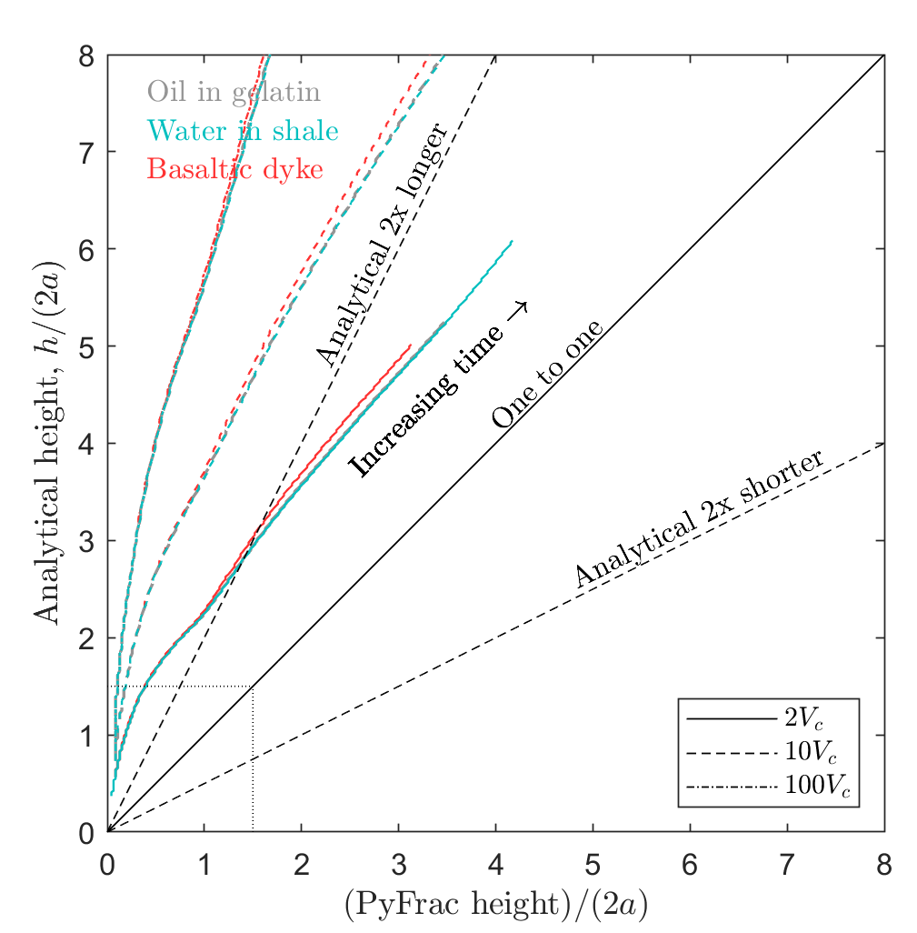
Garagash and Germanovich (2022) preprint
Only ‘good’ when vol is close to critical…
Numerical results
Other form only ‘good’ when vol is close to critical…

