Slide 1
Final Project Presentation
Tim Lin
PID: A10329279
Yiwen He
PID: A92067191

Slide 2
Our Goal in this Project
While trying to develop a simple program using nuerosky, we got interested in the process of training the app. Because we believe get a better understanding of how the brain response to different visual stimuli is essential for further control development.
More specifically, we want to explore how the brain responses to objects of different size.

Slide 3
Method
So we want to create an animation that changes in
Size in every second
Then we can collect and compare the brain wave of different channels when the person is exposed to the stimuli.
We did 5 trials and choose the first 10 data in each trial, so total we have 50 data

Slide 4
Reference
Brain Computer Interface, a review
Estimating workload using EEG spectral power and ERPs in the n-back task

Slide 5
Measured Channels
Delta
Theta
< 4Hzs
Usually detected in baby and decrease as they age
Abnormal in awake state in adult
4 – 7 Hz
Small amount in awake state
Large amount in young children
Found in adults in drowsy, meditative and sleep state.

Slide 6
Measured Channels
Alpha
Beta
8 – 12 Hz
Occipital region
Amplitude increases when relaxed and attenuate when mental effort increases
12 – 30 Hz
Frontal and central region
Associated with motor activities
More active when engaging in active movement

Slide 7
Measured Channels
Gamma
30 – 100Hz
Maximal muscle contraction
Weak contraction

Slide 8
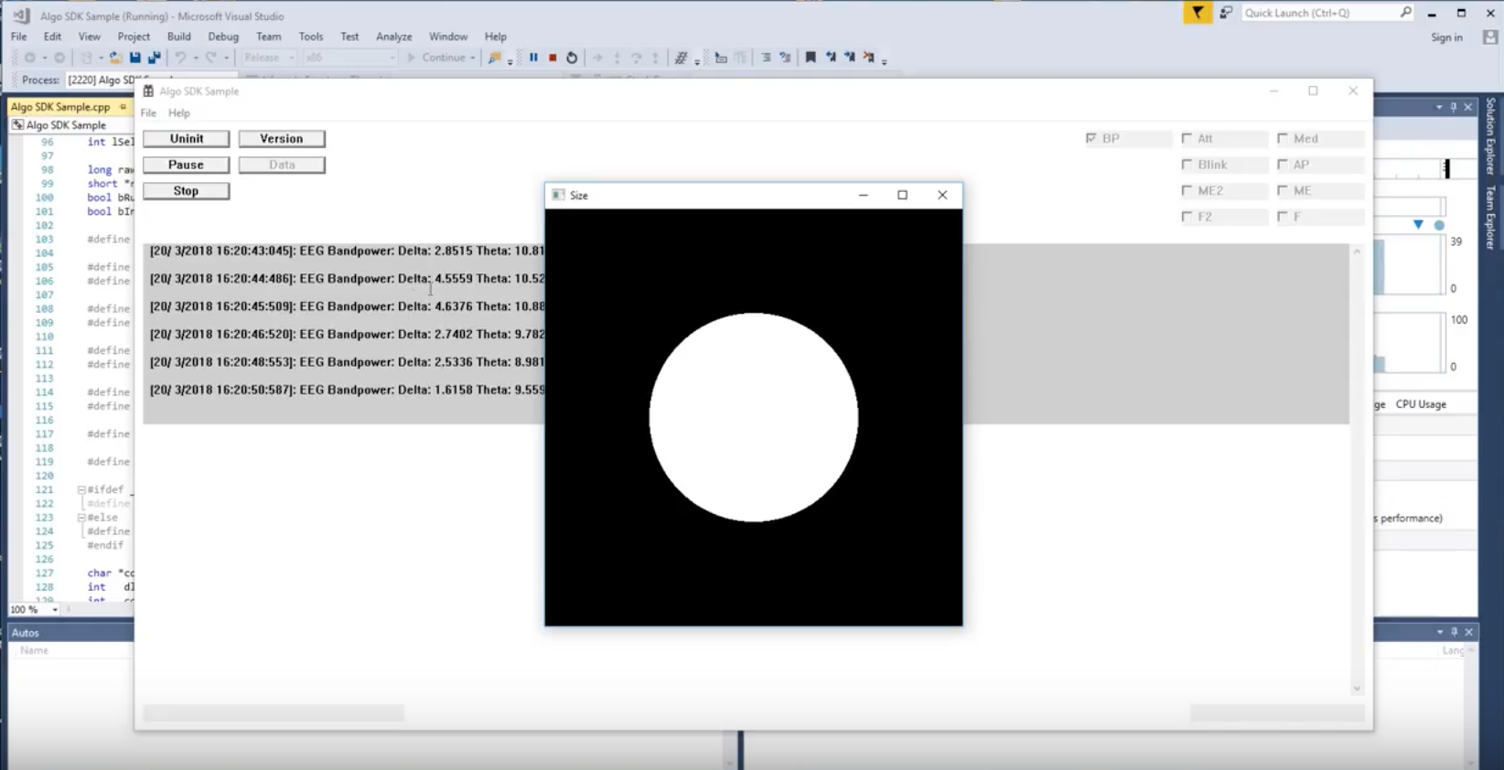
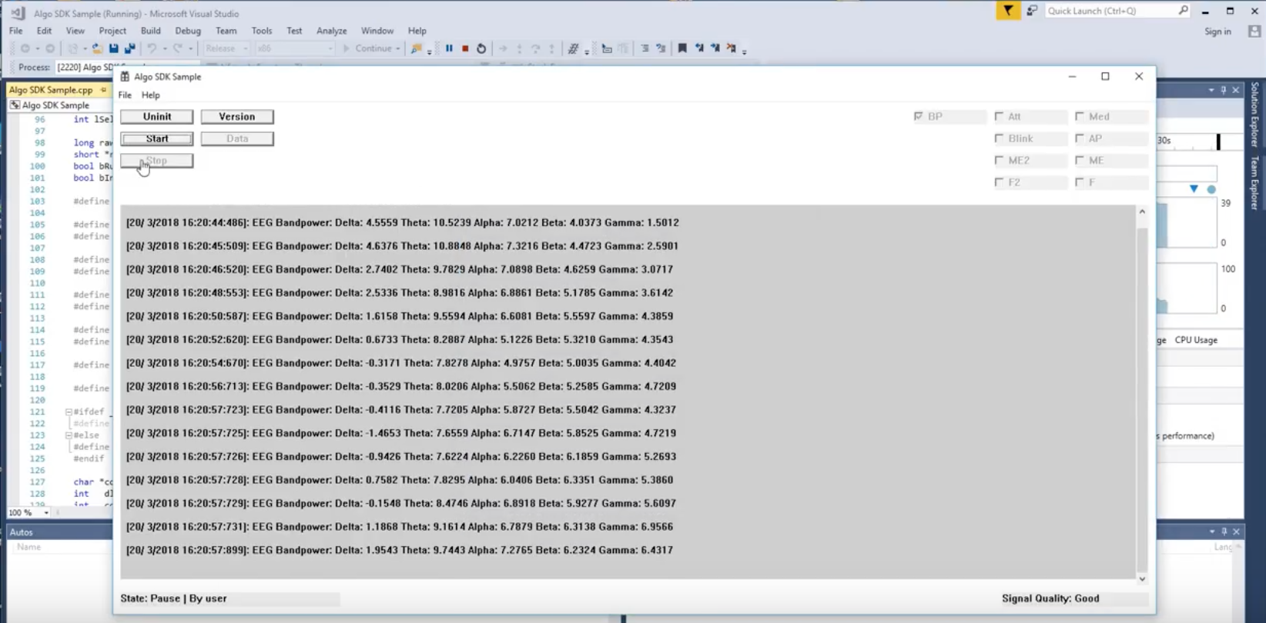
Screenshots of the Program

Slide 9
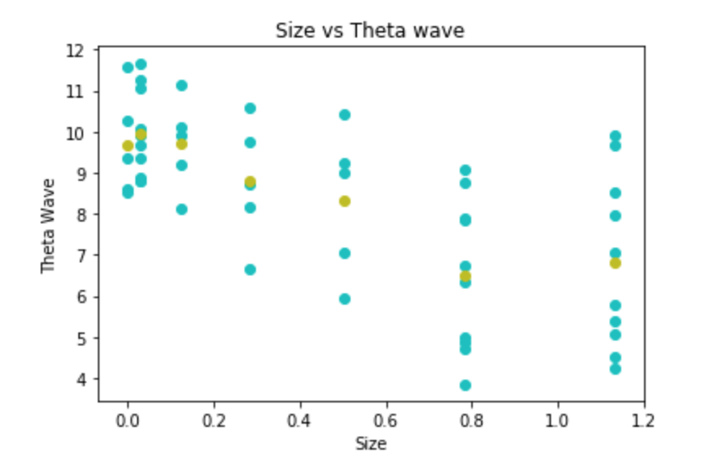
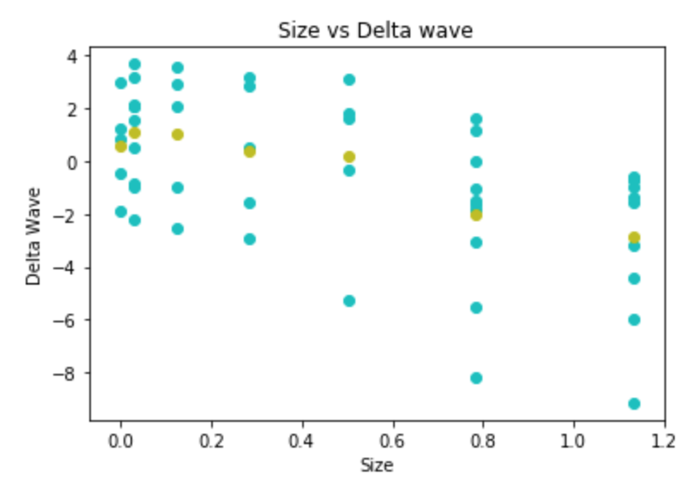
Data Analysis
We found some slight decrease in theta and delta wave as the size of the circle increases.
We think it might be due to the person was being more alert to the stimuli

Slide 10
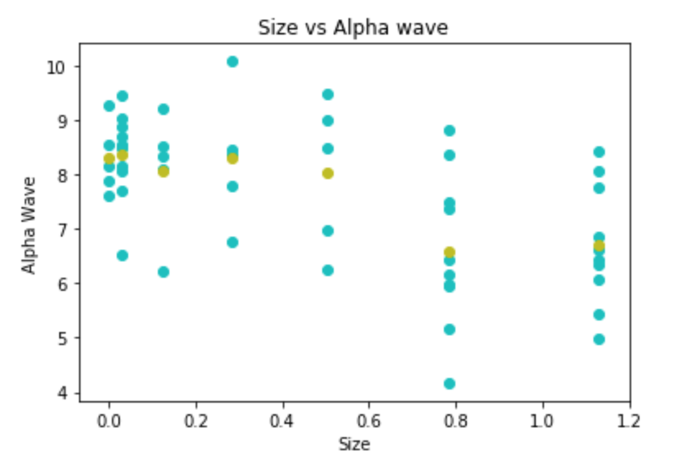
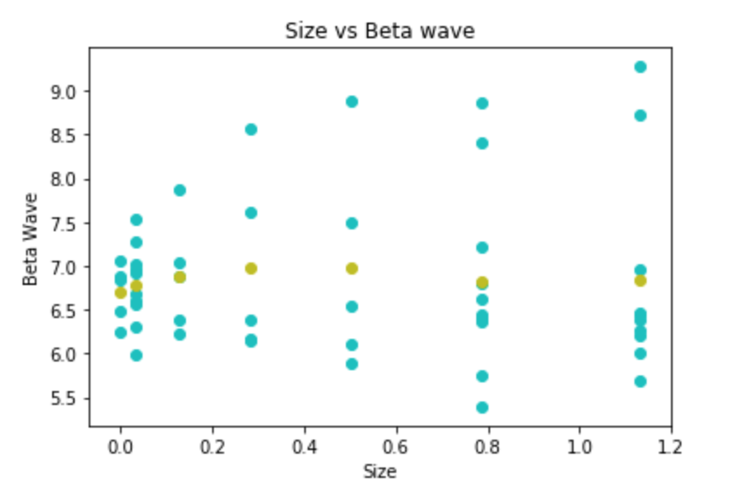
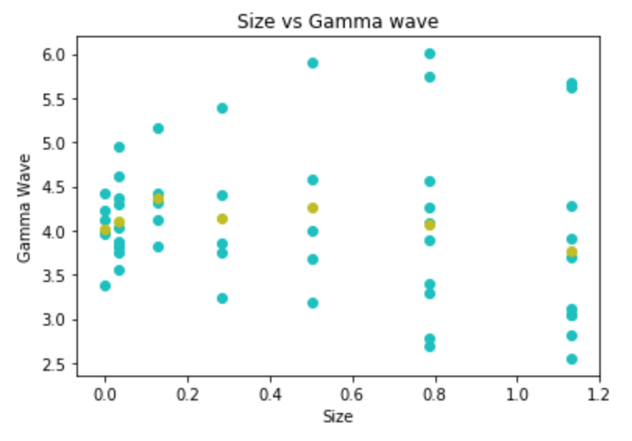
Data Analysis
Unfortunately, from the average value of alpha, beta, and gamma frequency when seeing different sizes of the picture. We couldn’t find any relation between them.

Slide 11
Thoughts
Due to the lack of data, both of the number of subjects and the variance of the shapes, we couldn’t draw a clear between the size and the change of brain waves
However we think this idea of different brain waves respond differently to objects could be useful in the training stage when using a BCI device; and could also be helpful in designing games using BCI.

