Slide 1
Module 1
A Quick Overview of Web Development
Notes:
This course requires an internet connection to download components from NuGet within Microsoft Visual Studio, to download source files for labs and demos. If there is no internet connection, modify the course to be delivered from a disconnected student device.
20480C
1: Overview of HTML and CSS

Slide 2
Module Overview
Brief description of HTML Client-side Programming vs Server-side programming
Technologies used for web development
Notes:
The content in this module is HTML version-neutral, except for the content that explains DOCTYPEs.
The new features of HTML5 and CSS3 are described starting in module 2, and JavaScript is introduced in module 3.
20480C
1: Overview of HTML and CSS

Slide 3
Lesson 1: Brief Description of HTML
HTML is an acronym for Hyper Text Markup Language.
It is a markup language because it uses special markings known as elements in presenting its contents to users over the internet.
It is a static language that determines the structure and semantic meaning of a web page.
HTML is just the basic structure of the web. The other parts are CSS and JavaScript.
Notes:
Much of the material in this lesson should be revision. Do not spend too much time on this material, but use it to get a feel for how familiar the students are with HTML.
20480C
1: Overview of HTML and CSS

Slide 4
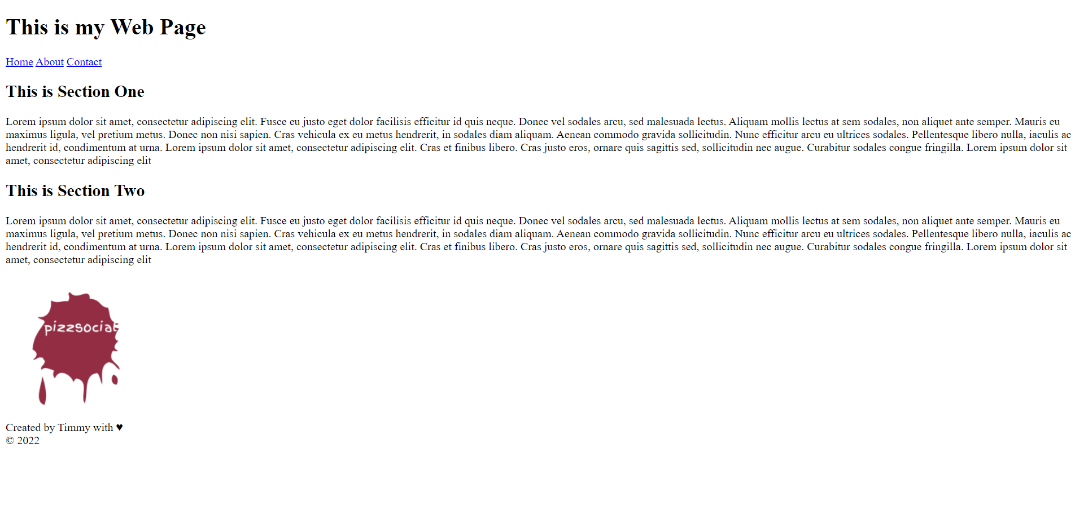
An example HTML Page
Notes:
Much of the material in this lesson should be revision. Do not spend too much time on this material, but use it to get a feel for how familiar the students are with HTML.
20480C
1: Overview of HTML and CSS

Slide 5
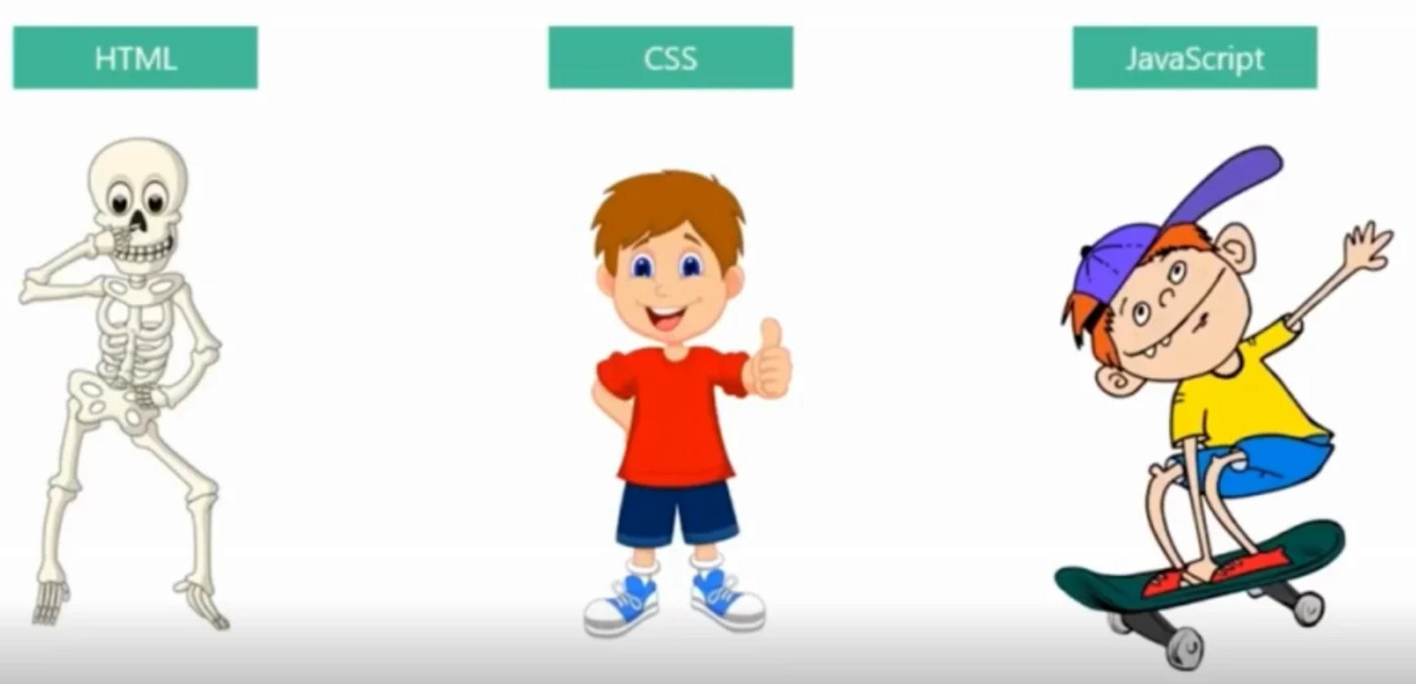
HTML vs CSS vs JavaScript
Notes:
Do not spend too long on this topic. The important points to get across are that an HTML page should include a DOCTYPE declaration to enable the browser to determine how to interpret the HTML markup in the page, and if you are using HTML5 you simply need to specify a DOCTYPE of html.
Note the inclusion of <meta charset="utf-8"/> in the first 512 bytes of the code example to prevent a security risk.
Note also that while including the HTML5 DOCTYPE is not mandatory, not doing so means the following:
Browsers don't recognize that the document is HTML5, and some browsers will ignore the new elements.
Browsers start working in quirks mode.
20480C
1: Overview of HTML and CSS

Slide 6
Client-side Programming
This is a program that runs on the browser or one that a user can interact with.
It also governs the behavior and appearance of the webpage.
It also helps with creating interactive webpages and communicating with the server.
Notes:
The global attributes from HTML4 are id, dir, title, lang, class, and style. HTML5 adds 15 more, including accesskey, hidden, spellcheck, tabindex, and translate.
20480C
1: Overview of HTML and CSS

Slide 7
Client-side Programming contd.
Some of the basic functions of client-side programming includes:
Creating the layouts of websites
Applying designs to user interfaces
Adding visual elements such as colors, images
Adding form validation
Notes:
The global attributes from HTML4 are id, dir, title, lang, class, and style. HTML5 adds 15 more, including accesskey, hidden, spellcheck, tabindex, and translate.
20480C
1: Overview of HTML and CSS

Slide 8
Client-side Technologies
Some of the technologies used for client-side development includes:
HTML
CSS
JavaScript
Notes:
The global attributes from HTML4 are id, dir, title, lang, class, and style. HTML5 adds 15 more, including accesskey, hidden, spellcheck, tabindex, and translate.
20480C
1: Overview of HTML and CSS

Slide 9
Server-side Programming
Programs that runs on the web server are known as server-side programs.
Theses programs enable us to create dynamic pages on the web
Some of the things they do includes:
Processing user inputs from the client-side
Interaction with the database to return a response to the user
Notes:
Do not spend too long on this topic as much of it should be review for students. Simply highlight the functionality and refer students to the W3C website (http://go.microsoft.com/fwlink/?LinkID=267709) if they need detailed information.
20480C
1: Overview of HTML and CSS

Slide 10
Server-side Technologies
The server-side or backend is created using some technologies and some of them includes:
JavaScript
Java
PHP
Ruby
Python
Notes:
Do not spend too long on this topic as much of it should be review for students. Simply highlight the functionality and refer students to the W3C website (http://go.microsoft.com/fwlink/?LinkID=267709) if they need detailed information.
20480C
1: Overview of HTML and CSS

Slide 11
Questions
Review Questions
Notes:
Review Questions
Question
What are the four elements that define the basic structure of an HTML page?
Answer
The DOCTYPE declaration, and the <html>, <head>, and <body> elements.
Question
What is the best way to apply CSS rules to HTML elements that occur in several different pages?
( )Option 1: Include all rules for each element in the <style> attribute of the element.
( )Option 2: Include the rules for each page in a <style> element in the <head> element.
( )Option 3: Write the rules for the whole site in one or more style sheets and reference them by using a <style> element in the <head> element of each page.
( )Option 4: Write the rules for the whole site in one or more style sheets and reference them by using a <link> element in the <head> element of each page.
( )Option 5: Write the rules for the whole site in one or more style sheets and reference them by using a <stylesheet> element in the <head> element of each page.
Answer
(√) Option -4: Write the rules for the whole site in one or more style sheets and reference them by using a <link> element in the <head> element of each page.
Feedback
If you are writing styles for a collection of pages, it is good practice to place them in a style sheet file and then reference the style sheet from each of the pages. Use the <link> element to reference the style sheet from an HTML page.
20480C
1: Overview of HTML and CSS

