Slide 1
ReLEAF navigation map · the 27 places
Every page of the wiki is a place in one painted valley. Each slide shows the current drawing on the left and an empty frame of exactly the same size on the right. Redraw the place in the right frame, in the style of the vision painting: flat shapes in two or three tones, no outlines, the sun high on the right (lit side right, shadow to the lower left), no words. Keep the thing standing on the dotted baseline and inside the frame; the frame is 1000 x 1000 and is exported as a transparent PNG at that size. The small label under each frame is the page the place stands for and what it must still be recognisable as.
github.com/Timmy97-TW/releaf-navmap · exports/manifest.json holds the canvas, baseline and footprint of every place.

Slide 2

PROJECT
Description
Current drawing · drawn in code, AI-assisted
Your drawing · same frame, same baseline, no words
/description/ · 1000 x 1000 px, transparent · export the right frame as PNG with the same name: description.png

Slide 3

PROJECT
Biomanufacturing
Current drawing · drawn in code, AI-assisted
Your drawing · same frame, same baseline, no words
/biomanufacturing/ · 1000 x 1000 px, transparent · export the right frame as PNG with the same name: biomanufacturing.png

Slide 4

PROJECT
Engineering
Current drawing · drawn in code, AI-assisted
Your drawing · same frame, same baseline, no words
/engineering/ · 1000 x 1000 px, transparent · export the right frame as PNG with the same name: engineering.png

Slide 5

PROJECT
Development
Current drawing · drawn in code, AI-assisted
Your drawing · same frame, same baseline, no words
/development/ · 1000 x 1000 px, transparent · export the right frame as PNG with the same name: development.png

Slide 6

PROJECT
Contribution
Current drawing · drawn in code, AI-assisted
Your drawing · same frame, same baseline, no words
/contribution/ · 1000 x 1000 px, transparent · export the right frame as PNG with the same name: contribution.png

Slide 7

PROJECT
Results
Current drawing · drawn in code, AI-assisted
Your drawing · same frame, same baseline, no words
/results/ · 1000 x 1000 px, transparent · export the right frame as PNG with the same name: results.png

Slide 8

WET LAB
Experiments
Current drawing · drawn in code, AI-assisted
Your drawing · same frame, same baseline, no words
/experiments/ · 1000 x 1000 px, transparent · export the right frame as PNG with the same name: experiments.png

Slide 9
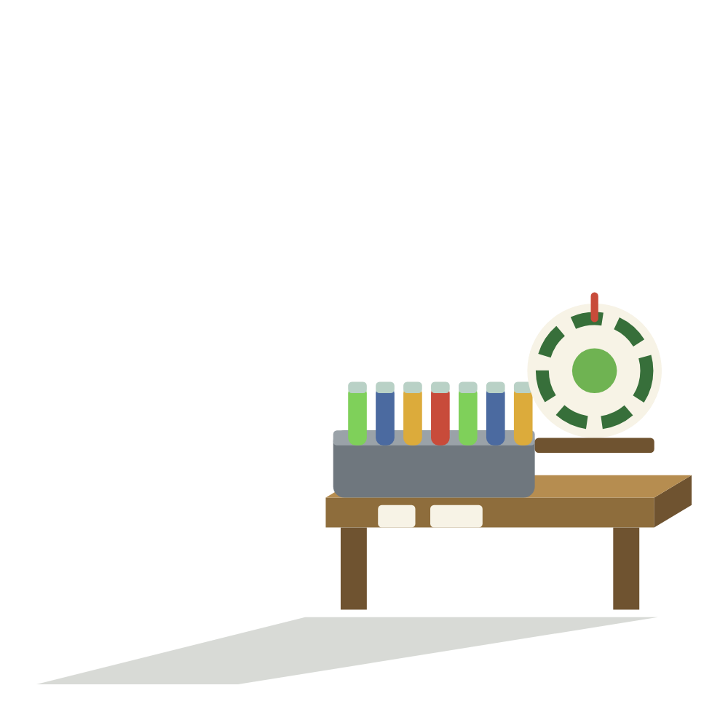
WET LAB
Parts
Current drawing · drawn in code, AI-assisted
Your drawing · same frame, same baseline, no words
/parts/ · 1000 x 1000 px, transparent · export the right frame as PNG with the same name: parts.png

Slide 10
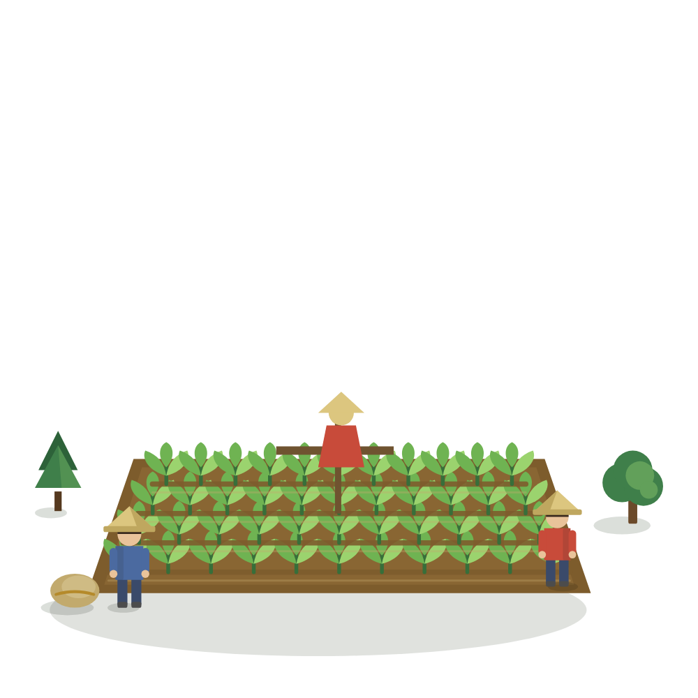
WET LAB
Plants
Current drawing · drawn in code, AI-assisted
Your drawing · same frame, same baseline, no words
/plant/ · 1000 x 1000 px, transparent · export the right frame as PNG with the same name: plant.png

Slide 11

WET LAB
Measurement
Current drawing · drawn in code, AI-assisted
Your drawing · same frame, same baseline, no words
/measurement/ · 1000 x 1000 px, transparent · export the right frame as PNG with the same name: measurement.png

Slide 12

WET LAB
Safety
Current drawing · drawn in code, AI-assisted
Your drawing · same frame, same baseline, no words
/safety-and-security/ · 1000 x 1000 px, transparent · export the right frame as PNG with the same name: safety-and-security.png

Slide 13

WET LAB
Notebook
Current drawing · drawn in code, AI-assisted
Your drawing · same frame, same baseline, no words
/notebook/ · 1000 x 1000 px, transparent · export the right frame as PNG with the same name: notebook.png

Slide 14
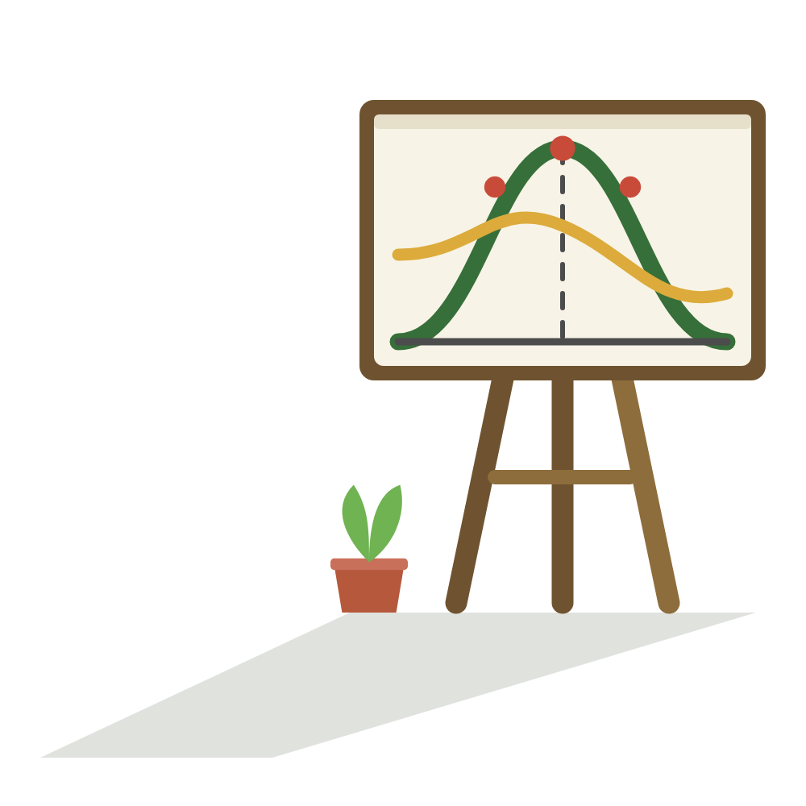
DRY LAB
Math Model
Current drawing · drawn in code, AI-assisted
Your drawing · same frame, same baseline, no words
/model/ · 1000 x 1000 px, transparent · export the right frame as PNG with the same name: model.png

Slide 15
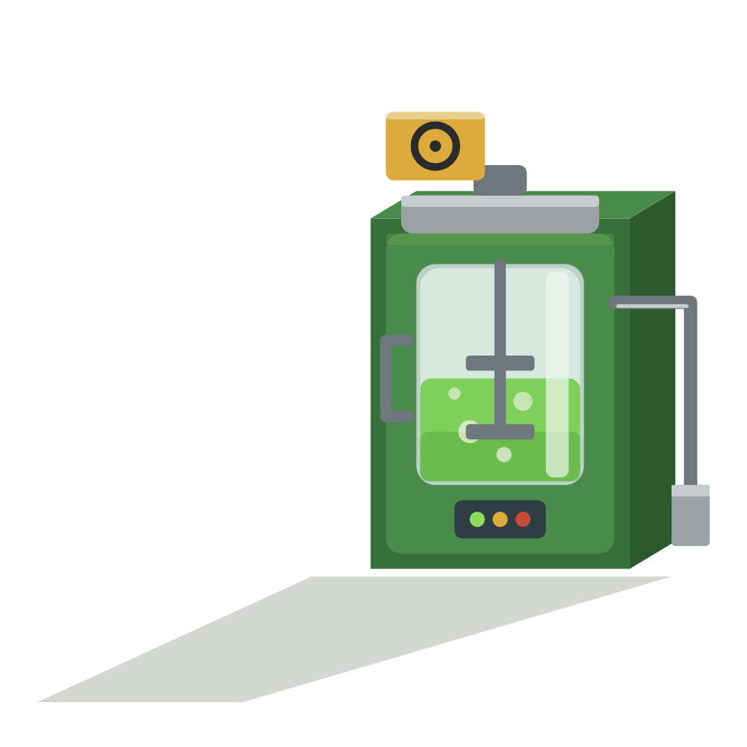
DRY LAB
Hardware
Current drawing · drawn in code, AI-assisted
Your drawing · same frame, same baseline, no words
/hardware/ · 1000 x 1000 px, transparent · export the right frame as PNG with the same name: hardware.png

Slide 16

DRY LAB
Digital Twin
Current drawing · drawn in code, AI-assisted
Your drawing · same frame, same baseline, no words
/software/ · 1000 x 1000 px, transparent · export the right frame as PNG with the same name: software.png

Slide 17
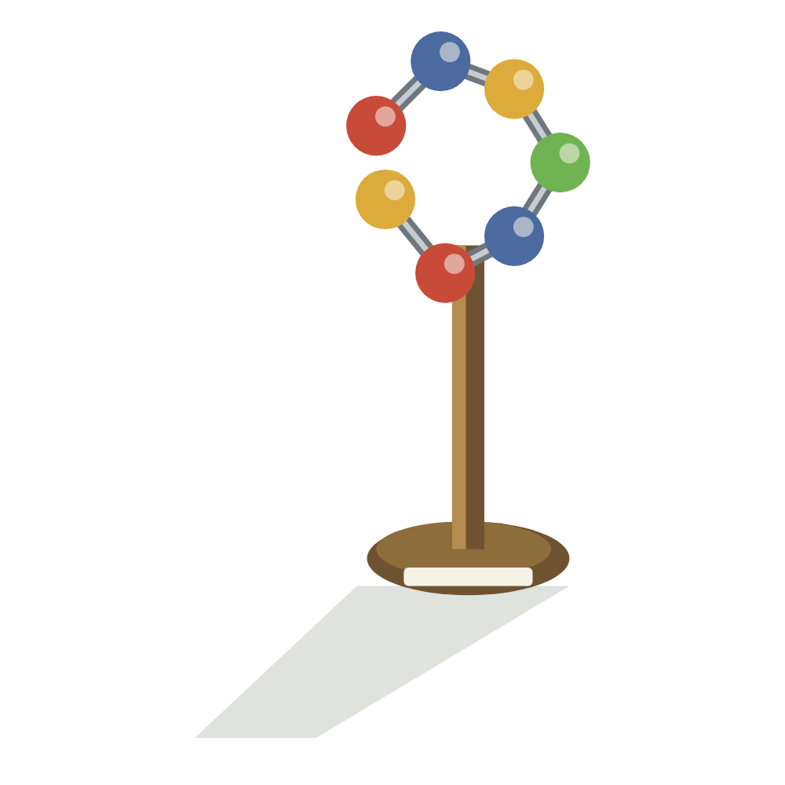
DRY LAB
Protein Design
Current drawing · drawn in code, AI-assisted
Your drawing · same frame, same baseline, no words
/protein-design/ · 1000 x 1000 px, transparent · export the right frame as PNG with the same name: protein-design.png

Slide 18

DRY LAB
Dry Lab Notebook
Current drawing · drawn in code, AI-assisted
Your drawing · same frame, same baseline, no words
/drylab-notebook/ · 1000 x 1000 px, transparent · export the right frame as PNG with the same name: drylab-notebook.png

Slide 19

ENGAGEMENT
Integrated Human Practices
Current drawing · drawn in code, AI-assisted
Your drawing · same frame, same baseline, no words
/human-practices/ · 1000 x 1000 px, transparent · export the right frame as PNG with the same name: human-practices.png

Slide 20
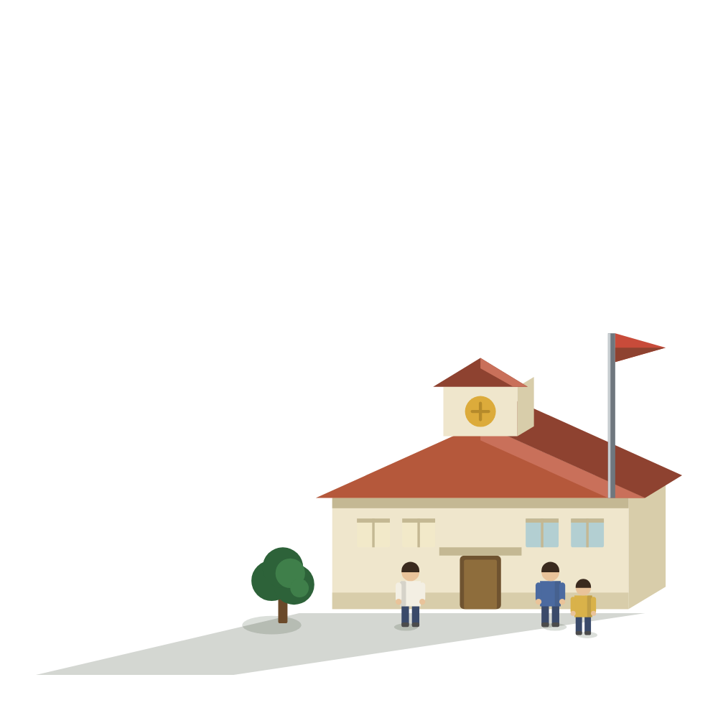
ENGAGEMENT
Education
Current drawing · drawn in code, AI-assisted
Your drawing · same frame, same baseline, no words
/education/ · 1000 x 1000 px, transparent · export the right frame as PNG with the same name: education.png

Slide 21

ENGAGEMENT
Entrepreneurship
Current drawing · drawn in code, AI-assisted
Your drawing · same frame, same baseline, no words
/entrepreneurship/ · 1000 x 1000 px, transparent · export the right frame as PNG with the same name: entrepreneurship.png

Slide 22
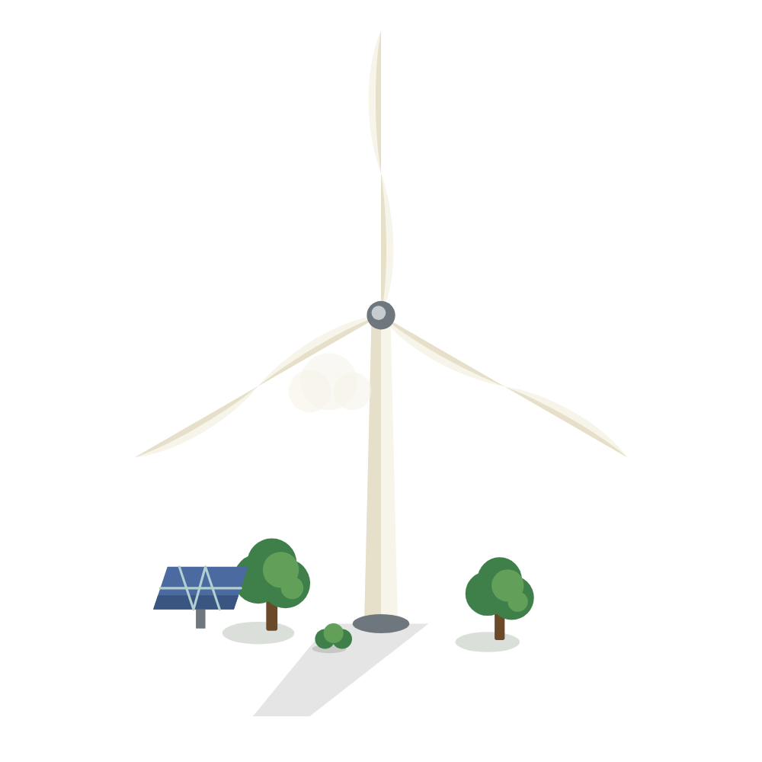
ENGAGEMENT
Sustainability
Current drawing · drawn in code, AI-assisted
Your drawing · same frame, same baseline, no words
/sustainability/ · 1000 x 1000 px, transparent · export the right frame as PNG with the same name: sustainability.png

Slide 23

ENGAGEMENT
Laws and Regulations
Current drawing · drawn in code, AI-assisted
Your drawing · same frame, same baseline, no words
/laws-and-regulations/ · 1000 x 1000 px, transparent · export the right frame as PNG with the same name: laws-and-regulations.png

Slide 24
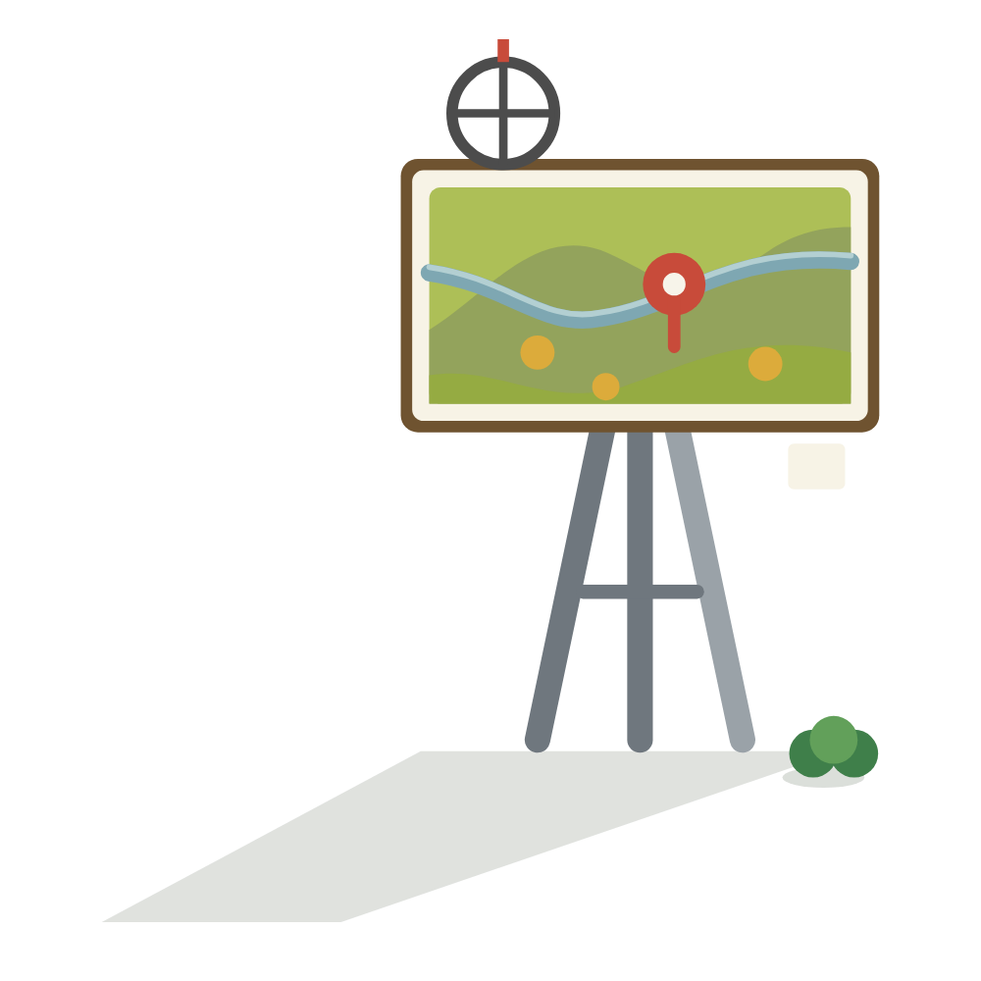
ENGAGEMENT
Geospatial Analysis
Current drawing · drawn in code, AI-assisted
Your drawing · same frame, same baseline, no words
/geospatial-analysis/ · 1000 x 1000 px, transparent · export the right frame as PNG with the same name: geospatial-analysis.png

Slide 25

ENGAGEMENT
Data Physicalization
Current drawing · drawn in code, AI-assisted
Your drawing · same frame, same baseline, no words
/data-physicalization/ · 1000 x 1000 px, transparent · export the right frame as PNG with the same name: data-physicalization.png

Slide 26
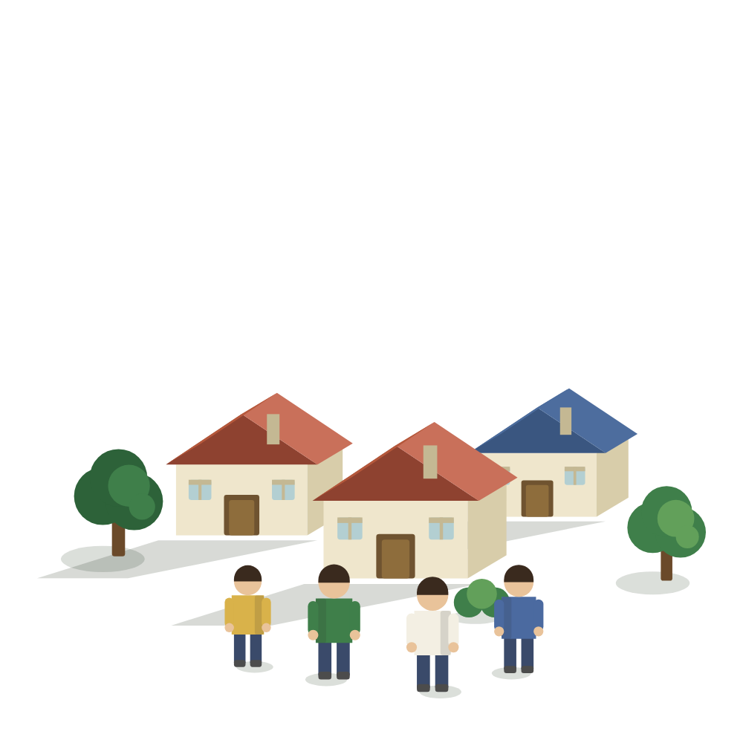
TEAM
Members
Current drawing · drawn in code, AI-assisted
Your drawing · same frame, same baseline, no words
/team/ · 1000 x 1000 px, transparent · export the right frame as PNG with the same name: team.png

Slide 27

TEAM
Attribution
Current drawing · drawn in code, AI-assisted
Your drawing · same frame, same baseline, no words
/attributions/ · 1000 x 1000 px, transparent · export the right frame as PNG with the same name: attributions.png

Slide 28

TEAM
Milestones
Current drawing · drawn in code, AI-assisted
Your drawing · same frame, same baseline, no words
/milestones/ · 1000 x 1000 px, transparent · export the right frame as PNG with the same name: milestones.png

