Slide 1
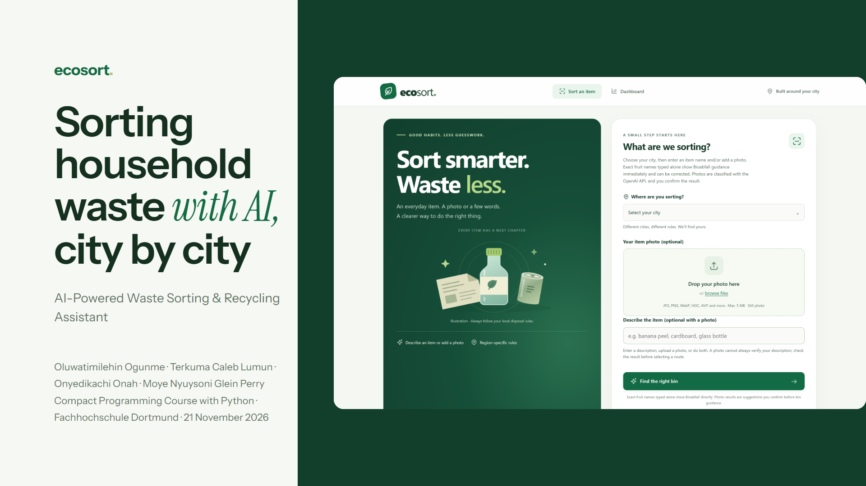
Notes:
Timi: Good morning. We are team EcoSort: Caleb, Onyedikachi, Moye and me, Timi. Our project is an AI-powered waste sorting and recycling assistant for households. In the next minutes each of us presents the subsystem they built: the class diagram, how it works and one piece of key code. At the end we show the unit test results.

Slide 2
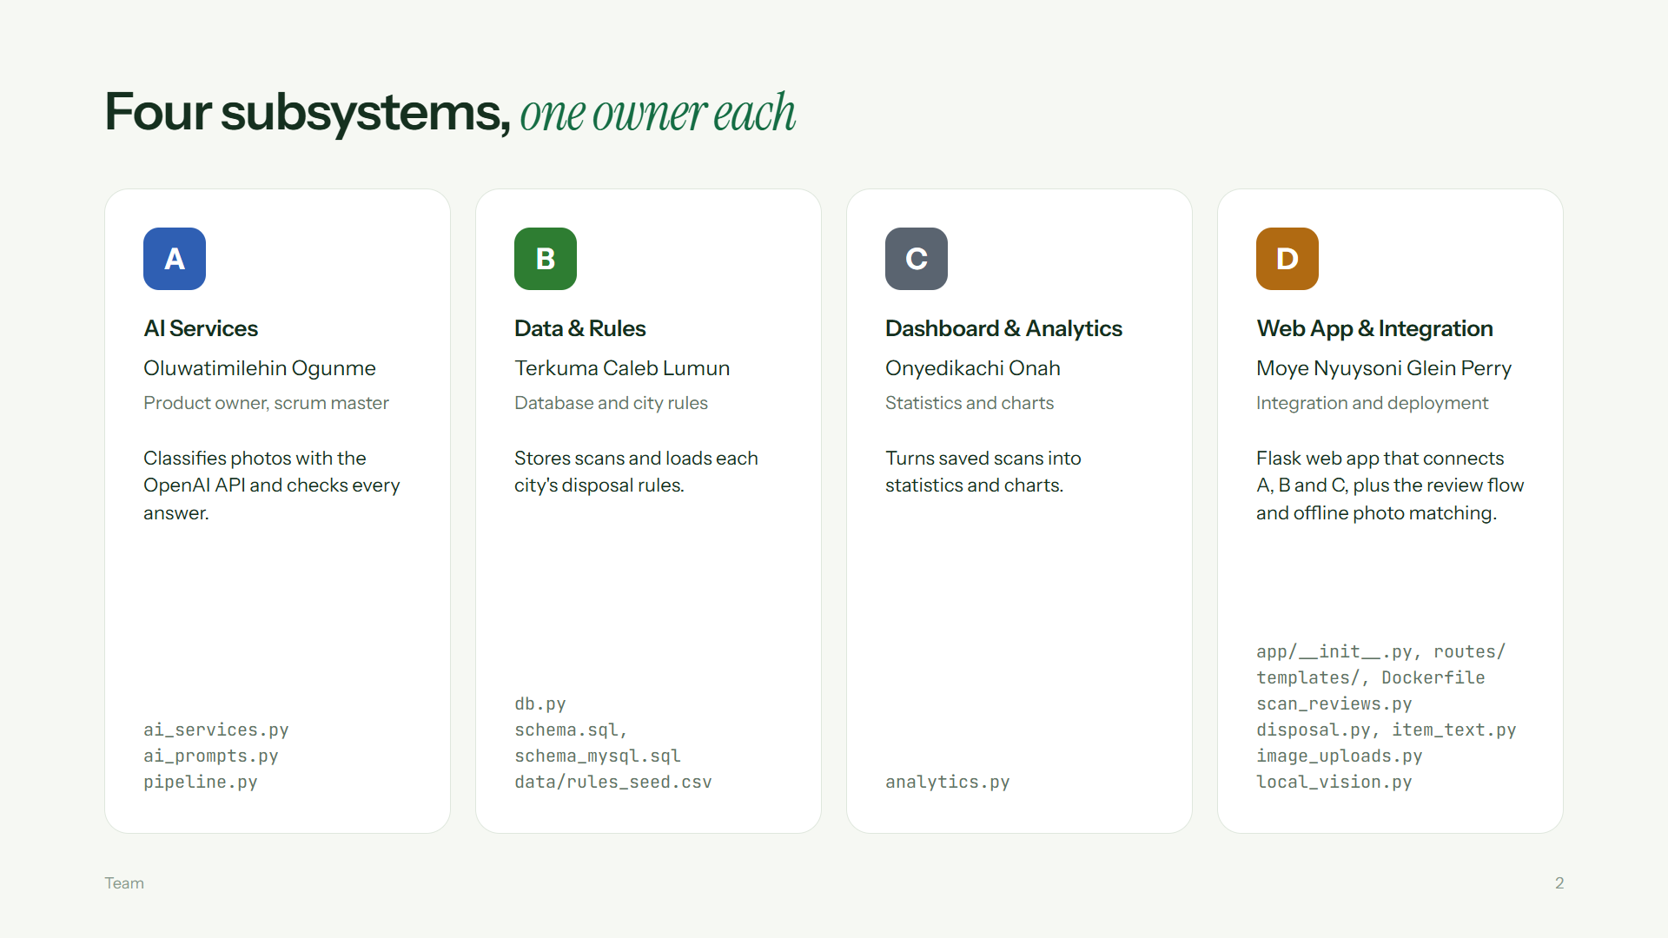
Notes:
Timi: We split the system into four subsystems with one owner each. I built A, the AI services, and was also product owner and scrum master. Caleb built B, the database and the city rules. Onyedikachi built C, the statistics and charts. Moye built D, the Flask web app that connects everything, and the Docker setup. Each subsystem is its own Python module with its own tests, and the bottom of each card lists the files that person owns. Onyedikachi starts with the domain.

Slide 3
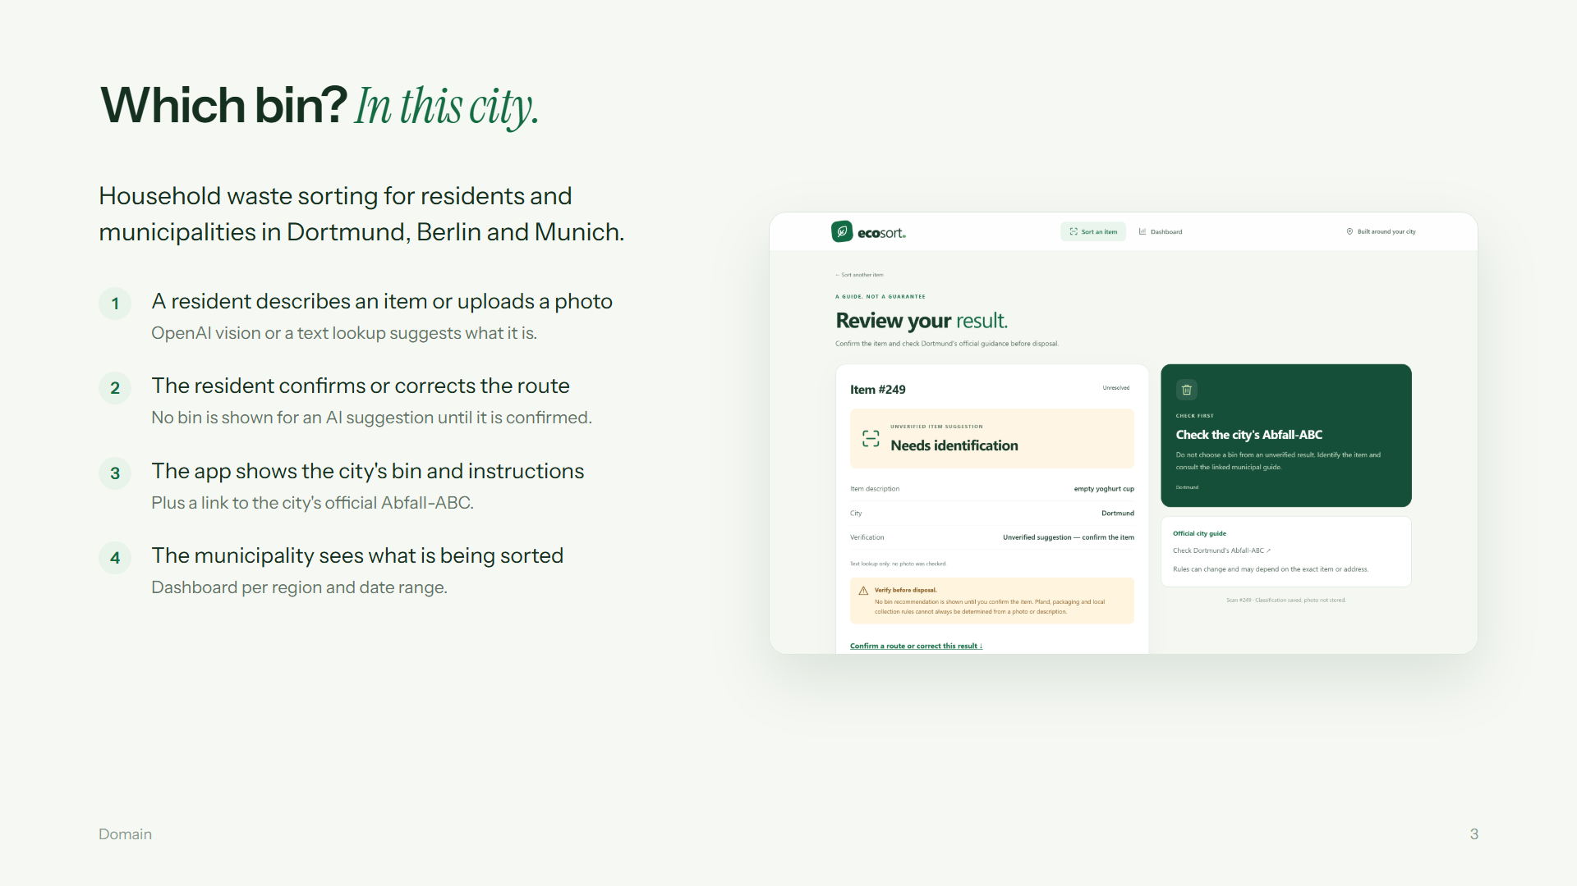
Notes:
Onyedikachi: We narrowed the topic to household waste in three German cities: Dortmund, Berlin and Munich. Packaging rules differ between cities, so the same item can go to a different bin. A resident types a description or uploads a photo. The AI only suggests what the item is. As you see on the screenshot, no bin is shown for a suggestion until the resident confirms the item. Then the app shows the bin for that city, the instructions and a link to the official city guide. Every scan is saved, and the municipality sees the totals on a dashboard. Moye now shows how the parts connect.

Slide 4
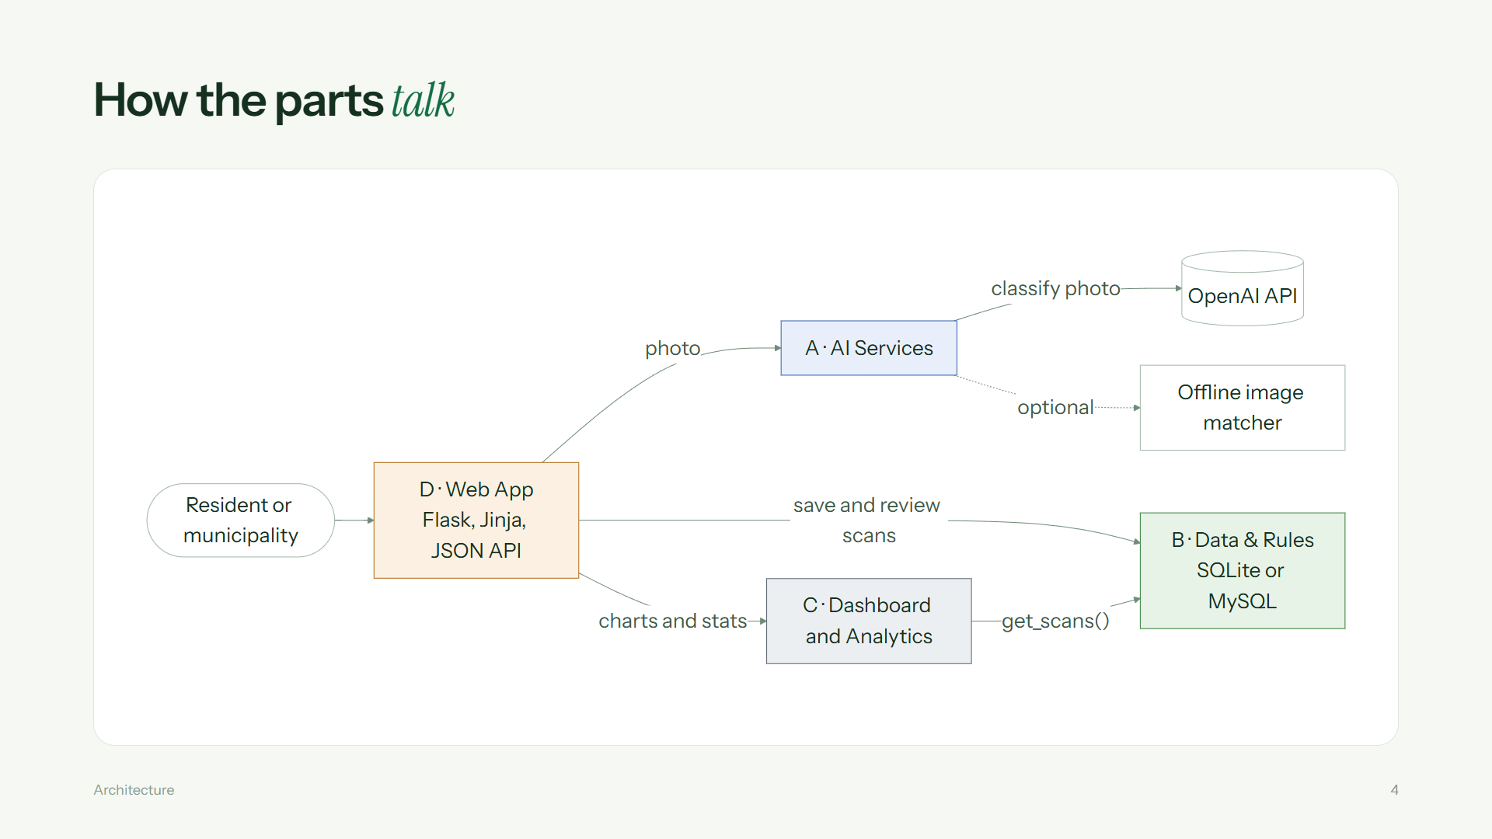
Notes:
Moye: This is how the parts connect. The user only ever talks to D, the web app. For a photo, D calls A, and A calls the OpenAI API. If an optional offline model is configured, A uses it instead of OpenAI. D then saves the scan in B. For the dashboard, D asks C, and C reads the scans from B through one method, get_scans. The API key only lives on the server, in an environment variable. Caleb shows the requirements.

Slide 5
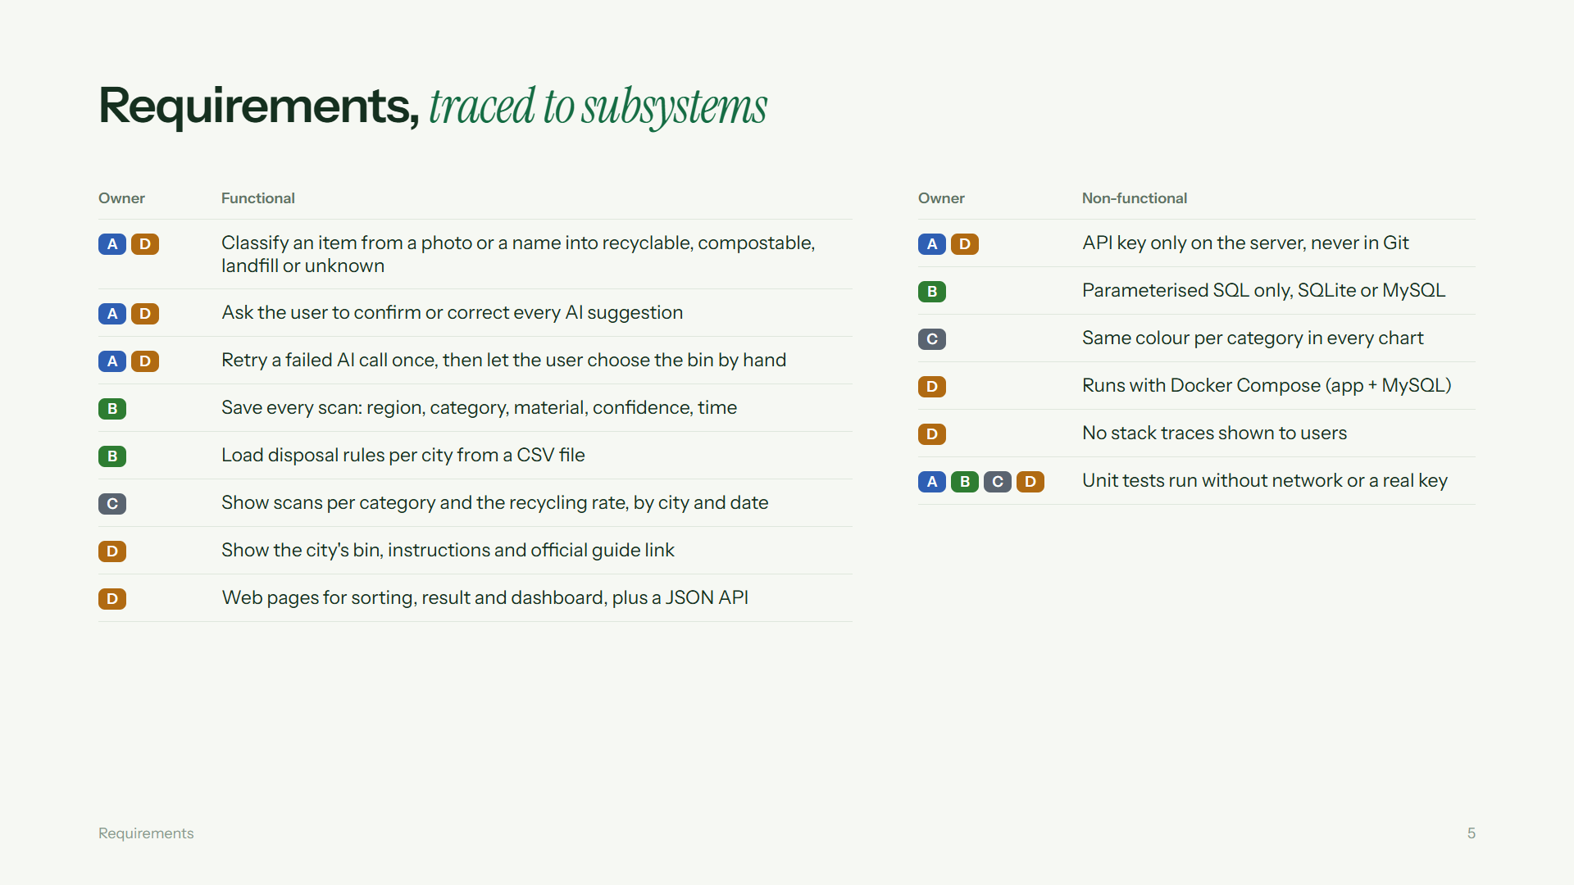
Notes:
Caleb: Here are all our requirements on one slide. The coloured tag shows which subsystem implements each one. On the left are the functional requirements: classify an item, confirm every suggestion, save every scan, load rules per city, show statistics, and the web pages and API. On the right are the non-functional ones: the key stays out of Git, SQL is always parameterised, chart colours are consistent, Docker runs the app with MySQL, users never see a stack trace, and every test runs without network access. Timi starts with subsystem A.

Slide 6
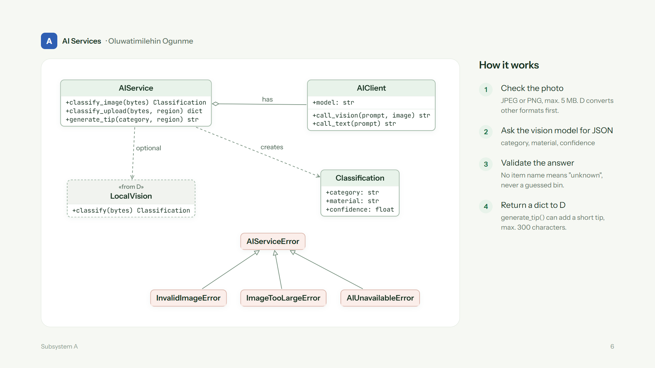
Notes:
Timi: This is subsystem A. AIService is the only class the rest of the app uses. It holds an AIClient, which wraps the OpenAI SDK: that is the aggregation diamond. AIService returns a Classification object with a category, a material and a confidence. All errors inherit from AIServiceError: an invalid image, an image that is too large, or the AI being unavailable. Each error has its own HTTP status, so D can show a clean message. The steps on the right: check the photo, ask the vision model for JSON, validate the answer, and return the result to D.

Slide 7
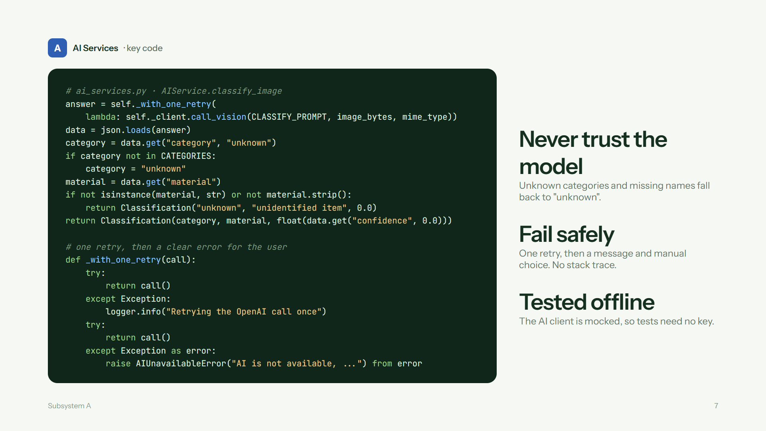
Notes:
Timi: Two pieces of key code. At the top, classify_image sends the photo and the prompt to the vision model through the retry helper, then parses the JSON. We never trust the model: if the category is not one of our four, it becomes unknown. If there is no material name, we return unknown with zero confidence instead of guessing a bin. At the bottom is the retry helper. It tries the call once, logs and tries again, and if the second call also fails it raises AIUnavailableError. D turns that into a friendly message, and the user can still choose the bin by hand. In the tests the AI client is mocked, so they need no key. Caleb, over to you.

Slide 8
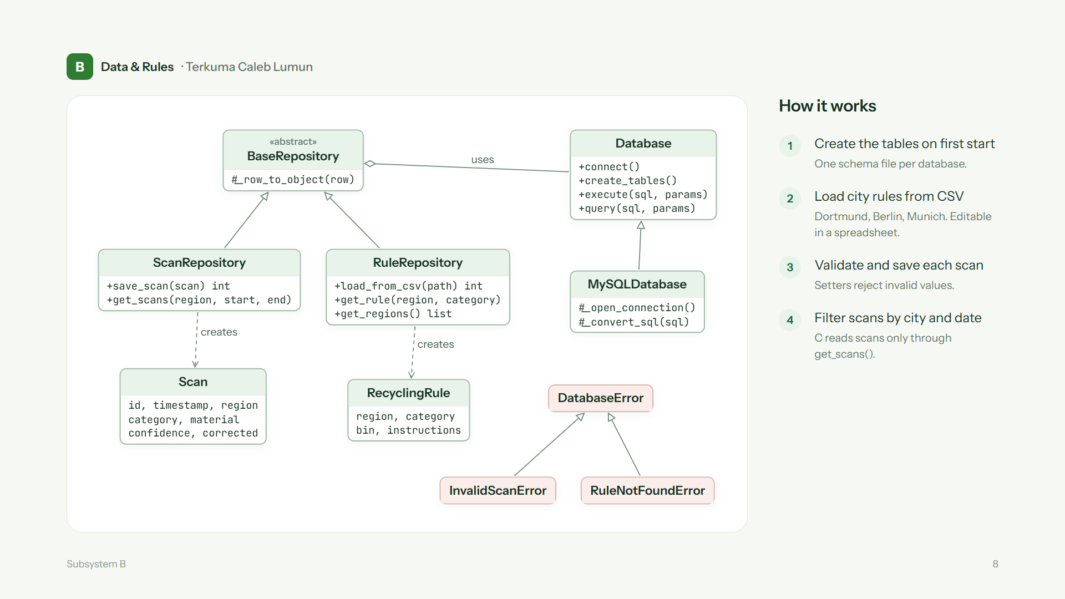
Notes:
Caleb: Subsystem B stores the data. Database wraps SQLite. MySQLDatabase inherits from it and only changes how it connects and converts the SQL placeholders, so we can use SQLite locally and MySQL in Docker. BaseRepository is abstract and uses a Database object: that is the aggregation diamond. ScanRepository saves and reads scans and creates Scan objects. RuleRepository loads the city rules from a CSV file and creates RecyclingRule objects. All errors inherit from DatabaseError. On first start the tables are created, the rules are loaded, and every scan is validated before it is saved.

Slide 9
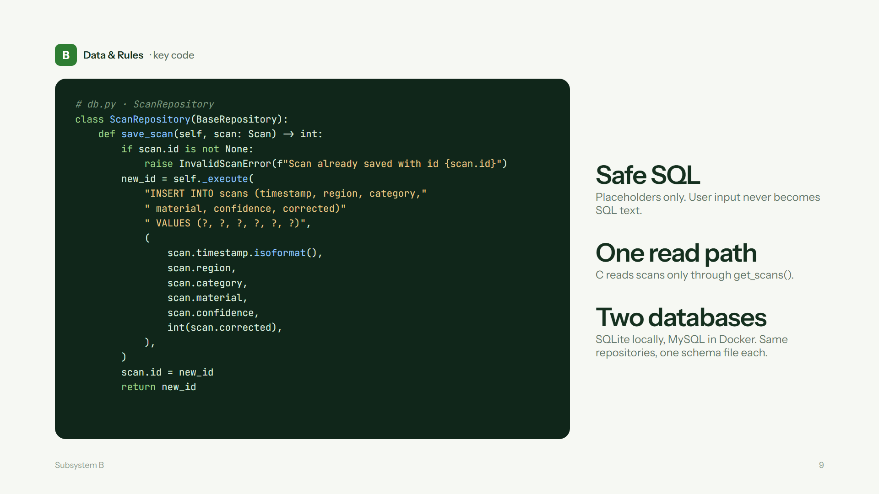
Notes:
Caleb: This is save_scan. First it checks that the scan was not saved before; otherwise it raises InvalidScanError. Then it runs the INSERT with question-mark placeholders. We never build SQL with string formatting, so user input can never change the query. The Python values are converted for the database: the datetime becomes ISO text and the corrected flag becomes 1 or 0. Finally the new id is written back to the Scan object and returned. On MySQL the same method runs, because MySQLDatabase converts the placeholders. Onyedikachi continues with the dashboard.

Slide 10
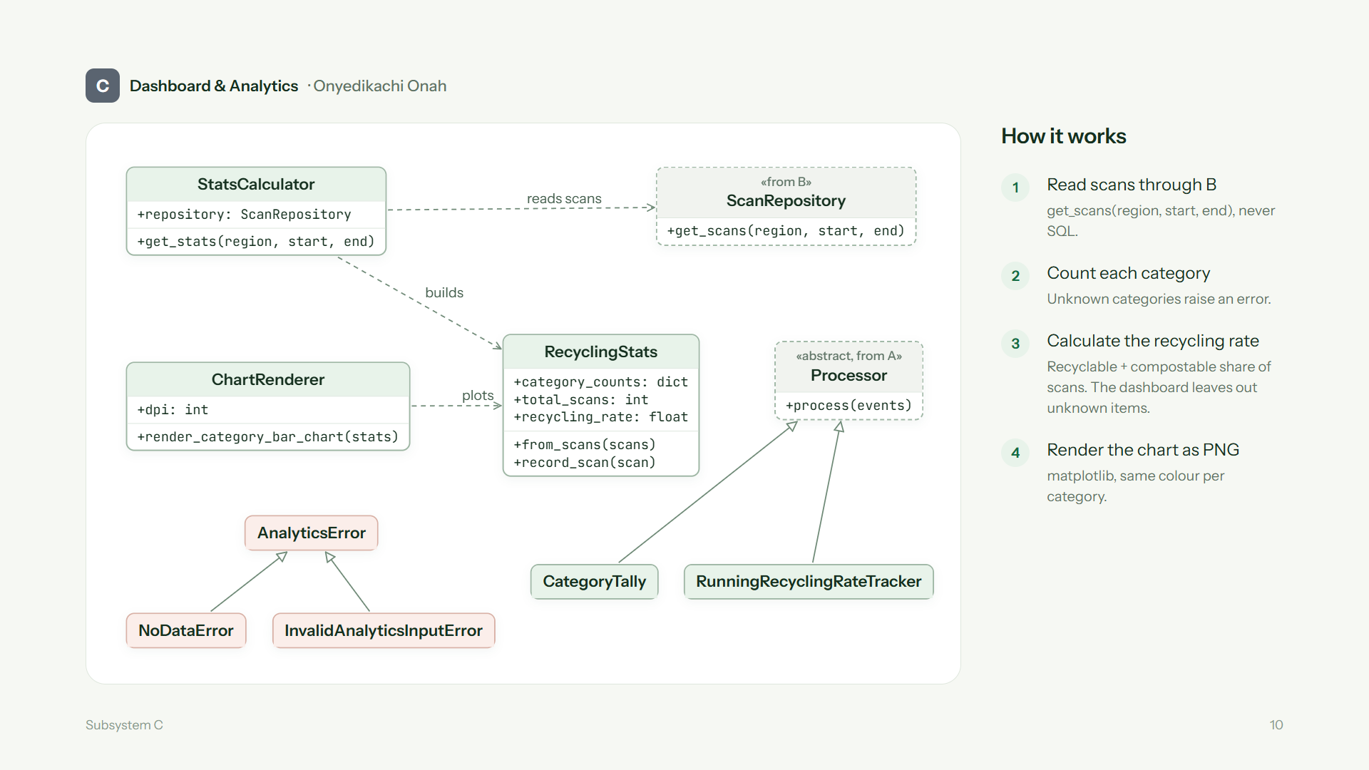
Notes:
Onyedikachi: Subsystem C turns saved scans into numbers and charts. StatsCalculator reads the scans only through ScanRepository from subsystem B, never with its own SQL. It builds a RecyclingStats object, which counts the scans per category and calculates the recycling rate: recyclable plus compostable divided by all scans. On the dashboard, D leaves unknown items out of the rate. ChartRenderer draws the bar chart with matplotlib and returns it as PNG bytes. CategoryTally and RunningRecyclingRateTracker are streaming processors that inherit from the Processor class in subsystem A's pipeline. All errors inherit from AnalyticsError.

Slide 11
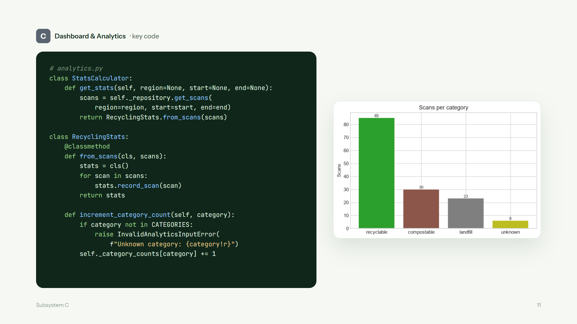
Notes:
Onyedikachi: This is the path from the database to the chart. get_stats in StatsCalculator asks B for the scans that match the city and date filter, and passes them to RecyclingStats.from_scans. from_scans is a class method: it creates an empty stats object and records every scan. increment_category_count checks the category first. An unknown category raises InvalidAnalyticsInputError instead of being counted in the wrong place. On the right is the chart that ChartRenderer draws from these numbers for Dortmund, with the same colour per category in every chart. Moye continues with the web app.

Slide 12
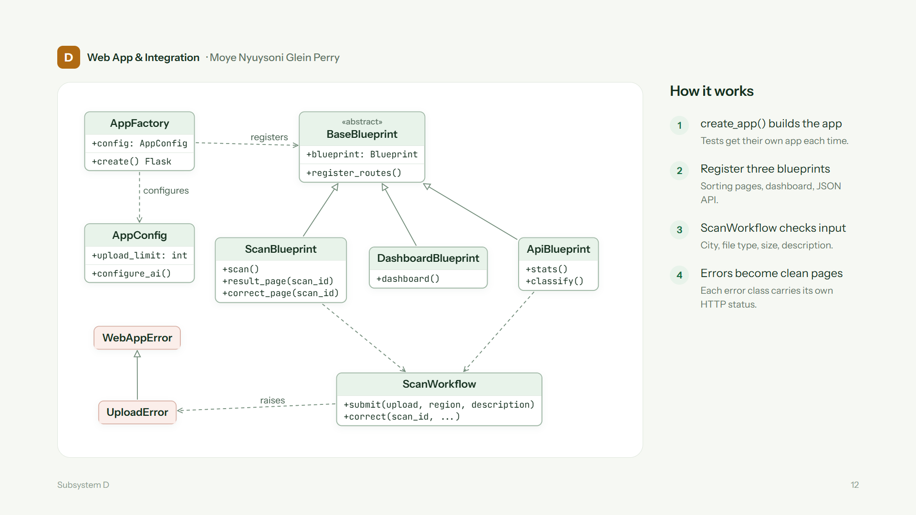
Notes:
Moye: Subsystem D builds the Flask app. AppFactory reads AppConfig, for example the 5 megabyte upload limit, and registers the routes. There are three route groups, called blueprints: the sorting pages, the dashboard and the JSON API. All three inherit from the abstract BaseBlueprint. The web form and the API share one ScanWorkflow, so the checks are the same for both. ScanWorkflow raises UploadError for bad input, and every error class has its own HTTP status, so the user sees a clean page and never a stack trace.

Slide 13
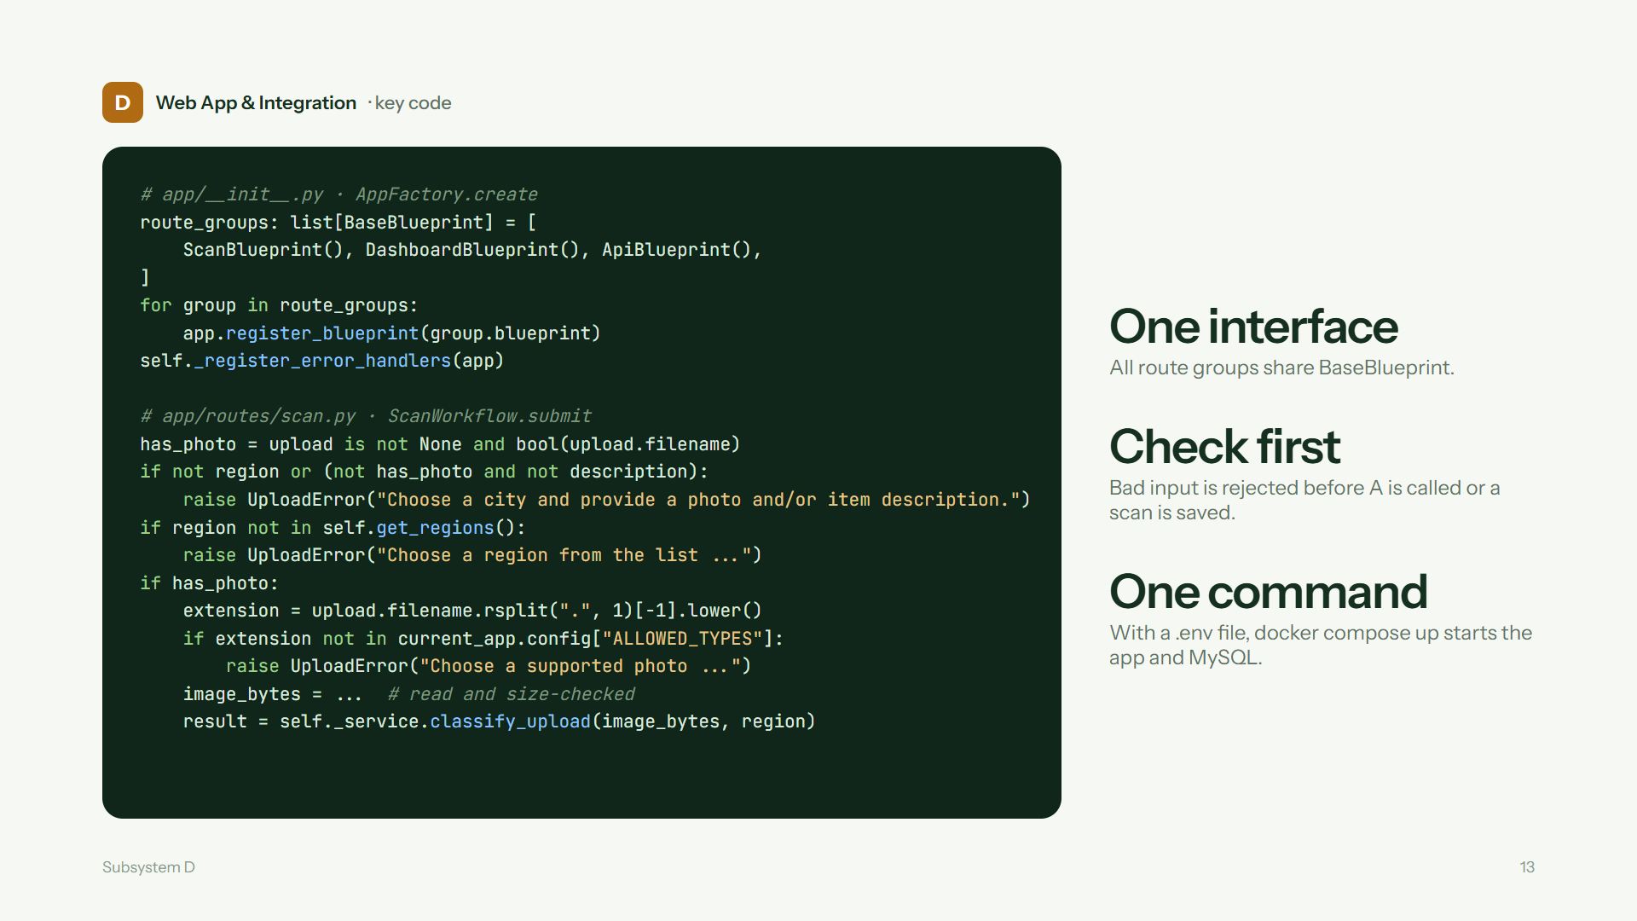
Notes:
Moye: At the top, the factory registers every route group in one loop. That works because they all share the BaseBlueprint interface. Then it registers the error handlers. At the bottom is the start of ScanWorkflow.submit. It checks the input in order: there must be a city and a photo or a description; the city must be in the list; and a photo must have a supported file type. Only then is the image read, checked for size, and sent to A with classify_upload. So bad input never reaches the AI and is never saved. To run everything, you add a .env file and run docker compose up, which starts the app and MySQL. Now a short demo of the running app. Afterwards Onyedikachi shows the test results.

Slide 14
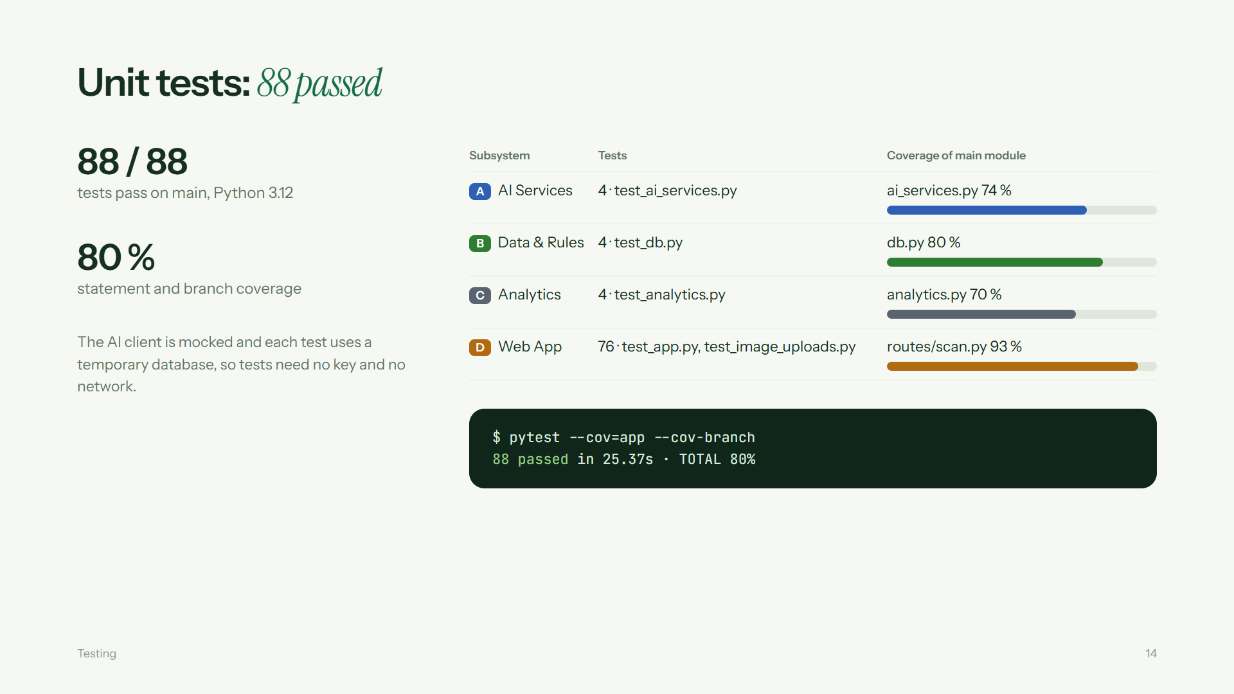
Notes:
Onyedikachi: All 88 unit tests pass on the final main branch, with 80 percent statement and branch coverage. The AI client is mocked and each test uses a temporary database, so the tests need no key and do not touch real data. Each of us now reads our own row. Timi: A has 4 focused tests and 74 percent coverage of ai_services; the pipeline and prompts are at 100 percent. Caleb: B has 4 tests and 80 percent coverage of db.py. Onyedikachi: C has 4 tests and 70 percent coverage of analytics.py. Moye: D has 76 tests, because they go through the whole app and also exercise A, B and C; scan routes are at 93 percent. Coverage shows which code ran, not that photo recognition is always right. Timi closes.

Slide 15
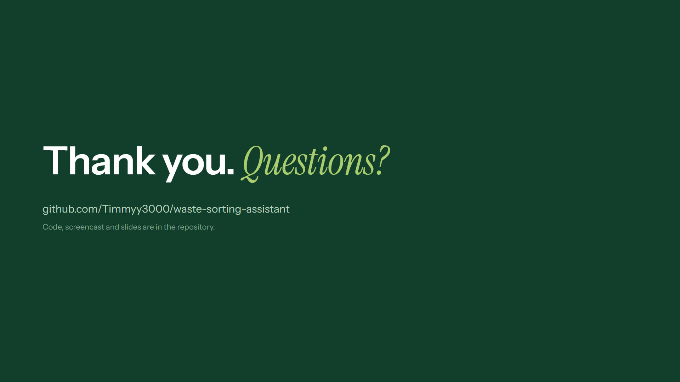
Notes:
Timi: Thank you for listening. The code, the screencast and these slides are in the repository. We can open the running app now if you have questions.

