Slide 1
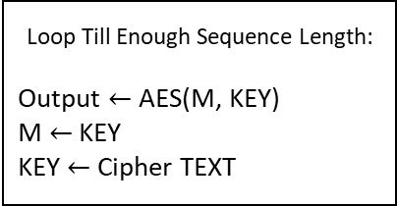
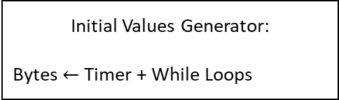
Introduce randomness
Initial Values Generator:
Bytes $←$ Timer + While Loops
Introduce Non-linearity/Confusion
Sub Bytes
Introduce Diffusion
Loop Till Enough Sequence Length:
Output $←$AES(M, KEY)
M $←$ KEY
KEY $←$ Cipher TEXT
Shift Rows
Introduce Diffusion
Mix Columns
Introduce Enough Random XOR Keys
Key Schedule
Output Text File:
test.txt

Slide 2
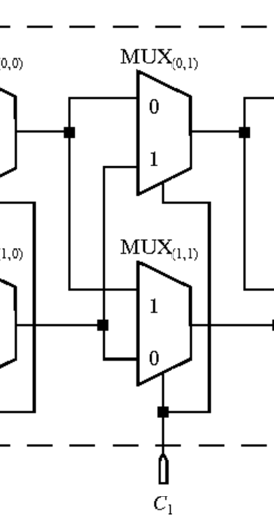
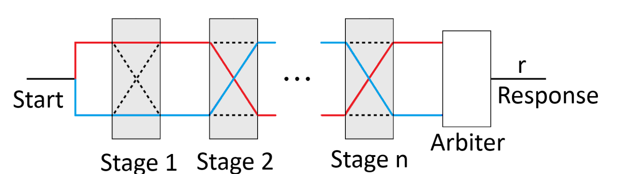

Slide 3
Bit 0 | Bit 1 | Result
0 | 0 | 0
0 | 1 | 1
1 | 0 | 1
1 | 1 | 0
1
0
1

