Slide 1
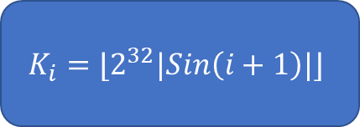



$$m_{i}$$
A
B
C
D
$$(X∧Y)⊕(\overline{X}∧Z)$$
$$\left(Z∧X\right)⊕\left(\overline{Z}∧Y\right)$$
$$X⊕Y⊕Z$$
$$Y⊕(X∨\overline{Z})$$
+
$$K_{i}=⌊2^{32}|Sin\left(i+1\right)|⌋$$
cyclicLeftRotate(X, $s_{i}$)
+
A’
B’
C’
D’

Slide 2
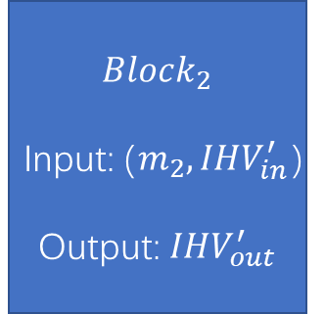
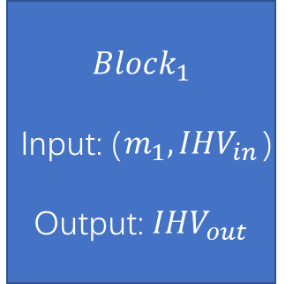
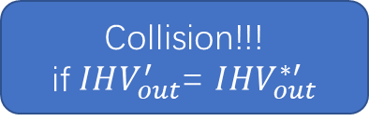
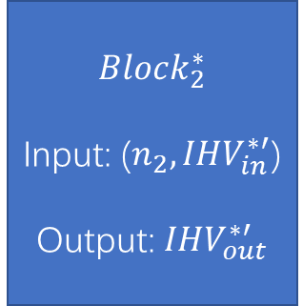

Differential Path 1
$$Block_{1}$$
Input: ($m_{1},IHV_{in}$)
Output: $IHV_{out}$
$$Block_{2}$$
Input: ($m_{2},IHV_{in}^{′}$)
Output: $IHV_{out}^{′}$
Initial IHV
Collision!!!
if $IHV_{out}^{′}$= $I{HV}_{out}^{∗′}$
$$Block_{1}^{∗}$$
Input: ($n_{1},IHV_{in}^{∗}$)
Output: $IHV_{out}^{∗}$
$$Block_{2}^{∗}$$
Input: ($n_{2},IHV_{in}^{∗′}$)
Output: $IHV_{out}^{∗′}$
Differential Path 2

Slide 3
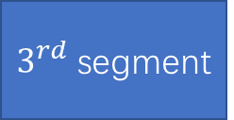

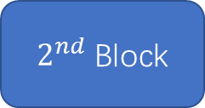


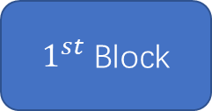
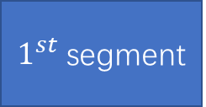

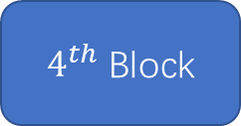

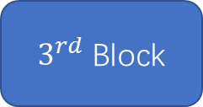


$1^{st}$ segment
$2^{nd}$ segment
$3^{rd}$ segment
$4^{th}$ segment
…
$1^{st}$ Block
$2^{nd}$ Block
$3^{rd}$ Block
$4^{th}$ Block
$$I{HV}_{0}$$
$$IHV_{1}$$
$$IHV_{2}$$
$$IHV_{3}$$
$$I{HV}_{4}$$
…

Slide 4
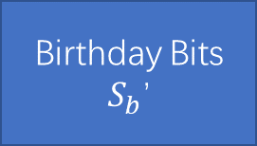
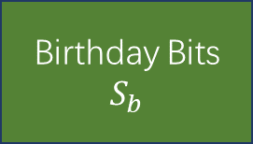


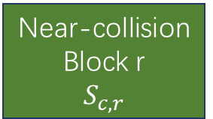
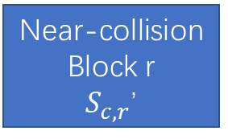
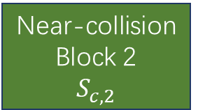
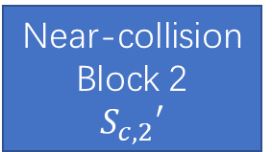
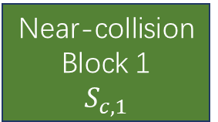
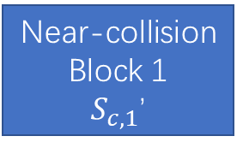
Prefix
P
Padding
$$S_{r}$$
Birthday Bits
$$S_{b}$$
Near-collision Block 1
$$S_{c,1}$$
Near-collision Block 2
$$S_{c,2}$$
Near-collision Block r
$$S_{c,r}$$
Suffix
Near-collision Block r
$S_{c,r}$’
Near-collision Block 2
$$S_{c,2}′$$
Prefix
P’
Padding
$S_{r}$’
Birthday Bits
$S_{b}$’
Near-collision Block 1
$S_{c,1}$’

