Slide 1
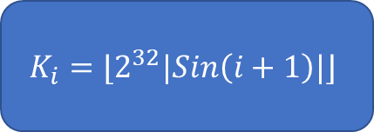



$$m_{i}$$
A
B
C
D
$$(X∧Y)⊕(\overline{X}∧Z)$$
$$\left(Z∧X\right)⊕\left(\overline{Z}∧Y\right)$$
$$X⊕Y⊕Z$$
$$Y⊕(X∨\overline{Z})$$
+
$$K_{i}=⌊2^{32}|Sin\left(i+1\right)|⌋$$
cyclicLeftRotate(X, $s_{i}$)
+
A’
B’
C’
D’

Slide 2
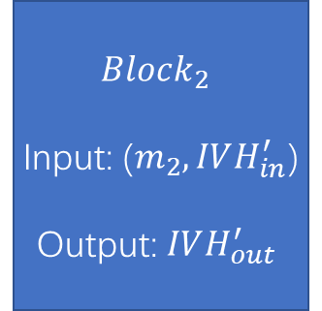
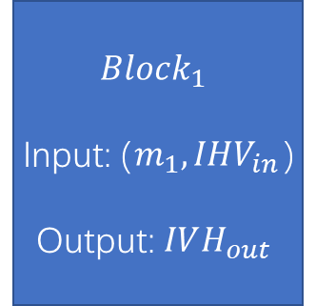

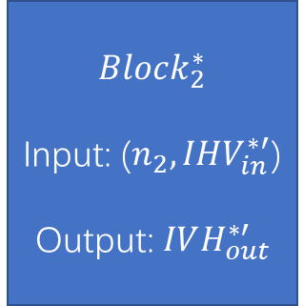

Differential Path 1
$$Block_{1}$$
Input: ($m_{1},IHV_{in}$)
Output: $IVH_{out}$
$$Block_{2}$$
Input: ($m_{2},IVH_{in}^{′}$)
Output: $IVH_{out}^{′}$
Initial IHV
Collision!!!
if $IVH_{out}^{′}$= $IVH_{out}^{∗′}$
$$Block_{1}^{∗}$$
Input: ($n_{1},IHV_{in}^{∗}$)
Output: $IVH_{out}^{∗}$
$$Block_{2}^{∗}$$
Input: ($n_{2},IHV_{in}^{∗′}$)
Output: $IVH_{out}^{∗′}$
Differential Path 2

