Slide 1
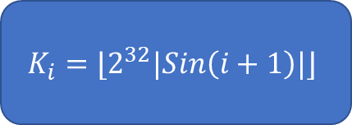



$$m_{i}$$
A
B
C
D
$$(X∧Y)⊕(\overline{X}∧Z)$$
$$\left(Z∧X\right)⊕\left(\overline{Z}∧Y\right)$$
$$X⊕Y⊕Z$$
$$Y⊕(X∨\overline{Z})$$
+
$$K_{i}=⌊2^{32}|Sin\left(i+1\right)|⌋$$
cyclicLeftRotate(X, $s_{i}$)
+
A’
B’
C’
D’

