Slide 1
Behat
Testing your own API with Behat

Slide 2
A bit of history
6 years ago...
Notes:
- Started at a new company 6 years ago
- First project as API only backend
- Unit tests
- End to end tests?

Slide 3
What is Behat?
Behaviour testing tool.
Written in PHP, for use in projects written in PHP.
Tests written in Gherkin.
Executed test code written in PHP.
Supports extensions.
Documentation is available on https://behat.org/

Slide 4
What is in this talk?
Gherkin: Writing tests
Contexts: Matching Gherkin with executable code
Hooks
Tags
Backgrounds and Scenario Outlines
Tips
Why we use Behat this way

Slide 5
Gherkin
Given, When, Then
Plain English text
Understandable without PHP knowledge
Features > Scenarios > Steps

Slide 6
Gherkin - Given
Set all the state needed to perform the test
Given there is a user "testuser@timobakx.dev"
And I am logged in as "testuser@timobakx.dev"

Slide 7
Gherkin - When
Perform the test itself
When I send a GET request to "/tasks"

Slide 8
Gherkin - Then
Check the results of the response and/or the new state
Then the response status code should be 200
And the response should be in JSON
And task "123" should exist

Slide 9
Example test
Feature: Deleting tasks
Scenario: As a user, I can delete my task
Given there is a user "testuser@timobakx.dev"
And there is a task "123" owned by "testuser@timobakx.dev"
And I am logged in as "testuser@timobakx.dev"
When I send a DELETE request to "/tasks/123"
Then the response status code should be 204
And task "123" should not exist

Slide 10
Example test
Feature: Deleting tasks
Scenario: As a user, I can delete my task
Given there is a user "testuser@timobakx.dev"
And there is a task "123" owned by "testuser@timobakx.dev"
And I am logged in as "testuser@timobakx.dev"
When I send a DELETE request to "/tasks/123"
Then the response status code should be 204
And task "123" should not exist

Slide 11
Example test
Feature: Deleting tasks
Scenario: As a user, I can delete my task
Given there is a user "testuser@timobakx.dev"
And there is a task "123" owned by "testuser@timobakx.dev"
And I am logged in as "testuser@timobakx.dev"
When I send a DELETE request to "/tasks/123"
Then the response status code should be 204
And task "123" should not exist

Slide 12
Example test
Feature: Deleting tasks
Scenario: As a user, I can delete my task
Given there is a user "testuser@timobakx.dev"
And there is a task "123" owned by "testuser@timobakx.dev"
And I am logged in as "testuser@timobakx.dev"
When I send a DELETE request to "/tasks/123"
Then the response status code should be 204
And task "123" should not exist

Slide 13
Using Contexts
A Context is a PHP Class
That provides executable code for your tests
Matching functions and Gherkin steps using regex or simpler matching
If you use Symfony, these can be autowired

Slide 14
Adding a new context - PHP
<?php
namespace App\Tests\Behat;
use Behat\Behat\Context\Context;
class UserContext implements Context
{
}

Slide 15
Adding a new context - Config
# behat.yml and/or behat.yml.dist
default:
suites:
default:
contexts:
- App\Tests\Behat\UserContext

Slide 16
Matching Gherkin to Context
Given there is a user "testuser@timobakx.dev"
/**
* @Given there is a user :email
*/
public function thereIsAUser(string $email): void
{
// ...
}

Slide 17
Matching Gherkin to Context
Given there is a user "testuser@timobakx.dev"
/**
* @Given there is a user :email
*/
public function thereIsAUser(string $email): void
{
// ...
}

Slide 18
Matching Gherkin to Context
Given there is a user "testuser@timobakx.dev"
/**
* @Given /^there is a user "([^"]*)"$/
*/
public function thereIsAUser(string $email): void
{
// ...
}

Slide 19
Matching Gherkin to Context
Given there is a user "testuser@timobakx.dev"
/**
* @Given /^there is a user "([^"]*)"$/
*/
public function thereIsAUser(string $email): void
{
// ...
}

Slide 20
Using open source contexts
# behat.yml and/or behat.yml.dist
default:
suites:
default:
contexts:
- behatch:context:json
- behatch:context:rest

Slide 21
behatch:context:rest
When I send a GET request to "/tasks"
When I send a DELETE request to "/tasks/123"
When I send a POST request to "/tasks" with body: """ { "title": "A task I need to do", "dueDate": null } """

Slide 22
behatch:context:mink
Then the response status code should be 200
Then the response status code should be 404

Slide 23
behatch:context:json
Then the response should be in JSON
Then the JSON node "hydra:member" should have 1 element
Then the JSON node "title" should be equal to "Updated task"
Then the JSON should be valid according to the schema "features/schemas/task.json"

Slide 24
Hooks
Execute code before or after each:
Suite (entire test)
Feature (test file)
Scenario (test)
Step (line within a test)

Slide 25
Hooks - Example
/**
* @BeforeScenario
*/
public function setGeneralHeaders(): void
{
// Set general headers
}

Slide 26
Hooks - Example
/**
* @BeforeScenario
*/
public function gatherContexts(BeforeScenarioScope $scope): void
{
// Gather contexts needed in this context
// using $scope->getEnvironment()->getContext();
}

Slide 27
Hooks - Example
/**
* @BeforeScenario
*/
public function gatherContexts(BeforeScenarioScope $scope): void
{
// Gather contexts needed in this context
// using $scope->getEnvironment()->getContext();
}

Slide 28
Tags
@resetDatabase
Feature: Editing tasks
@requiresExternalAPI
Scenario: Load user from external API
# ...

Slide 29
Tags - Scenario
@resetDatabase
Feature: Editing tasks
@requiresExternalAPI
Scenario: Load user from external API
# ...

Slide 30
Tags - Feature
@resetDatabase
Feature: Editing tasks
@requiresExternalAPI
Scenario: Load user from external API
# ...

Slide 31
Skipping tagged tests
behat --tags="~@requiresExternalAPI"
# behat.yml and/or behat.yml.dist
default:
suites:
default:
filters:
tags: "~@requiresExternalAPI"

Slide 32
Combining hooks and tags
/**
* @BeforeScenario @resetDatabase
*/
public function resetDatabase(): void
{
// Empty the database
}

Slide 33
Combining hooks and tags
/**
* @BeforeScenario @resetDatabase
*/
public function resetDatabase(): void
{
// Empty the database
}

Slide 34
Backgrounds
Are defined within a feature
Run before each scenario in that feature
Are executed after the @beforeScenario hooks are fired

Slide 35
Backgrounds - example
Feature: Editing tasks
Background:
Given there is a user "testuser@timobakx.dev"
And there is a task 123 owned by "testuser@timobakx.dev"
Scenario: As a user, I can edit my task
Given I am logged in as "testuser@timobakx.dev"
When ...

Slide 36
Scenario Outlines
Scenario Outline is a template
Has placeholders for variables
Can be executed for each of a set of values

Slide 37
Scenario Outline - Example
Scenario Outline: As a new user, I cannot register with an invalid data
When I send a POST request to "/users/register" with body:
"""
{
"email": "testuser@timobakx.dev",
"password": "MyP@ssw0rd!",
"<key>": <value>
}
"""
Then the response status code should be 422

Slide 38
Scenario Outline - Example
Scenario Outline: As a new user, I cannot register with an invalid data
When I send a POST request to "/users/register" with body:
"""
{
"email": "testuser@timobakx.dev",
"password": "MyP@ssw0rd!",
"<key>": <value>
}
"""
Then the response status code should be 422

Slide 39
Scenario Outline - Example
Examples:
| key | value |
| email | "" |
| email | "invalid" |
| password | "" |
| password | "short" |
| password | "no-uppercase" |

Slide 40
Tips & tricks running Behat CLI
behat --stop-on-failure
behat features/tasks/editing_task.feature
behat features/tasks/editing_task.feature:4
behat --format=progress

Slide 41
When using JSON schema checks
{
"type": "object",
"properties": {...},
"required": [
"@id",
"title",
],
"additionalProperties": false
}

Slide 42
Why we use Behat this way
Feature files are readable.
Always the correct (database) state.
Test through the entire application, including all configuration.
Check both the API response and the new database state.
Easy to run individual tests.
Good integration with PHPStorm through a plugin:
Autocompletion of steps.
Adding step definition for steps that don't have one.
Click-through from feature to context.

Slide 43
Conclusion
It's a tool, like any other.
Does not replace unit testing.
Talk with your team.
Include QA if you have it.
Think about what you want to test.

Slide 44
Questions?

Slide 45
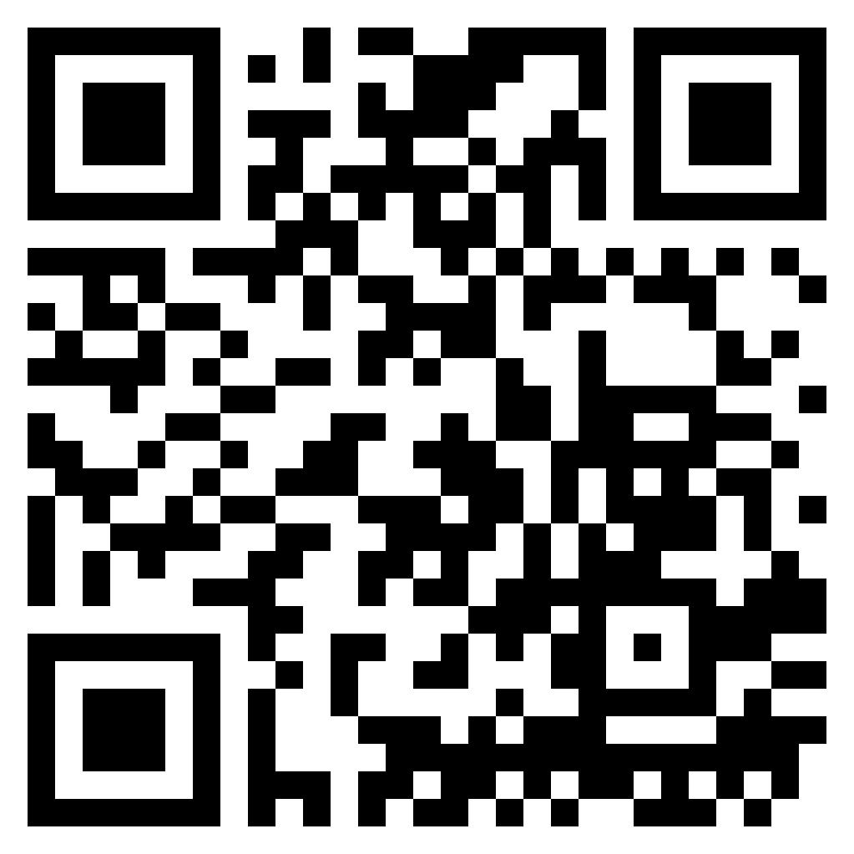
Thank you
Reach out:
Timo Bakx
phpc.social/@timobakx
twitter.com/TimoBakx
github.com/TimoBakx
Demo project:
github.com/TimoBakx/behat-demo

