Slide 1

T Square Project Step 3: Cleaning & Showcase
Timo Scheerer, Timo Büchert

Slide 2
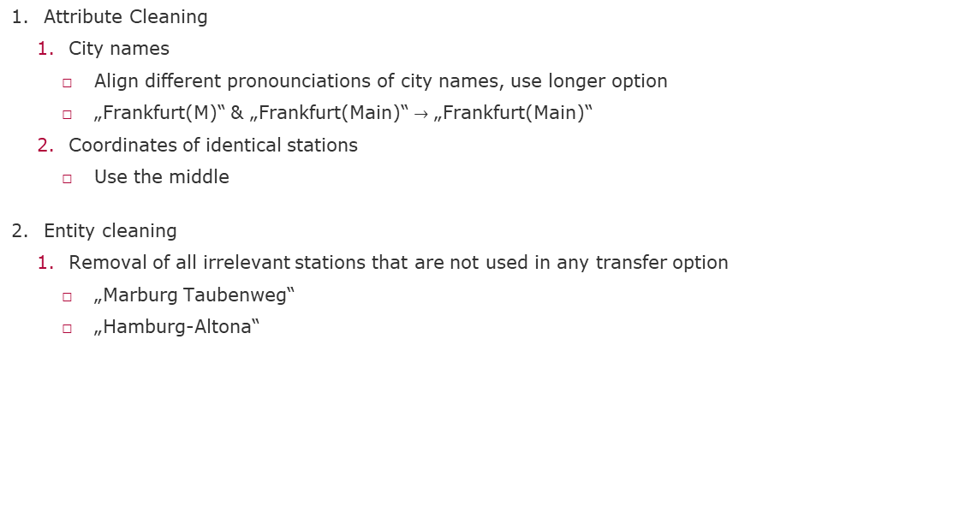
Cleaning Pipeline
Attribute Cleaning
City names
Align different pronounciations of city names, use longer option
„Frankfurt(M)“ & „Frankfurt(Main)“ $→$ „Frankfurt(Main)“
Coordinates of identical stations
Use the middle
Entity cleaning
Removal of all irrelevant stations that are not used in any transfer option
„Marburg Taubenweg“
„Hamburg-Altona“

Slide 3
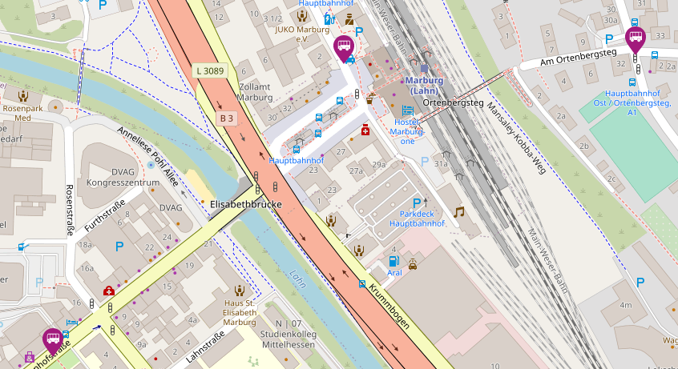

Showcase

Slide 4
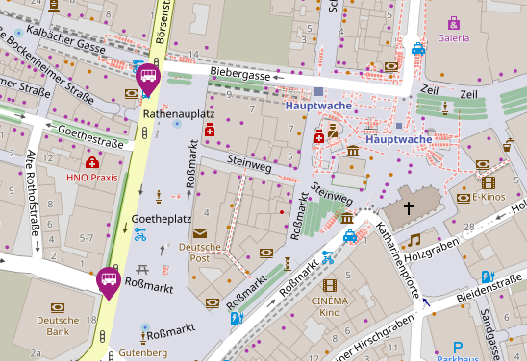

Showcase

