Slide 1

T Square Project Step 2: Integration
Timo Scheerer, Timo Büchert

Slide 2
Integration Pipeline
Integrated Schema (ER Model)
Integration Pipeline Architecture
Filling the DB and RMV tables
Cluster relevant transfer option candidates using the city associated to the RMV and DB stations
Calculate distances within clusters and fill the table if distance is below threshold
Identification of identical stations
Filter by distance (lower threshold)
String similarity of the station names
Identification of best options

Slide 3
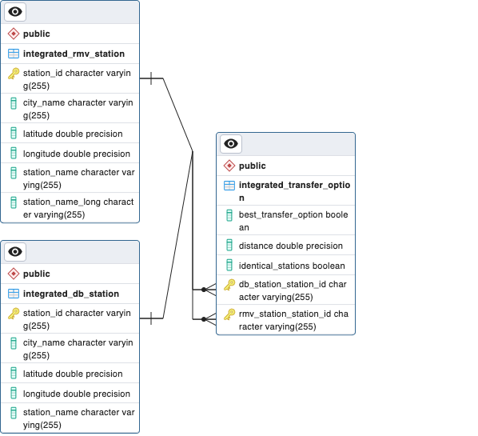
Integrated Schema (ER Model)

Slide 4

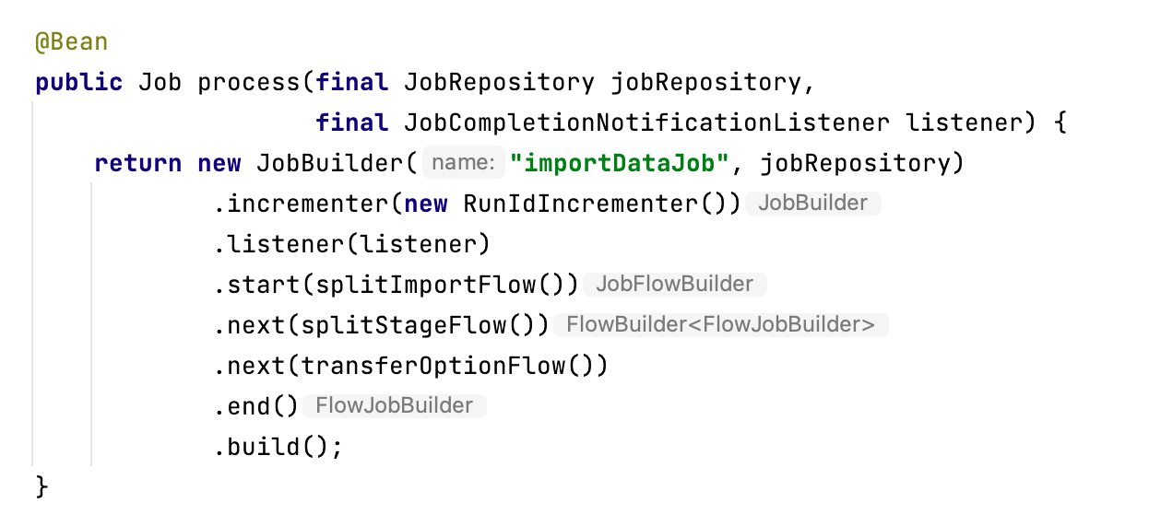

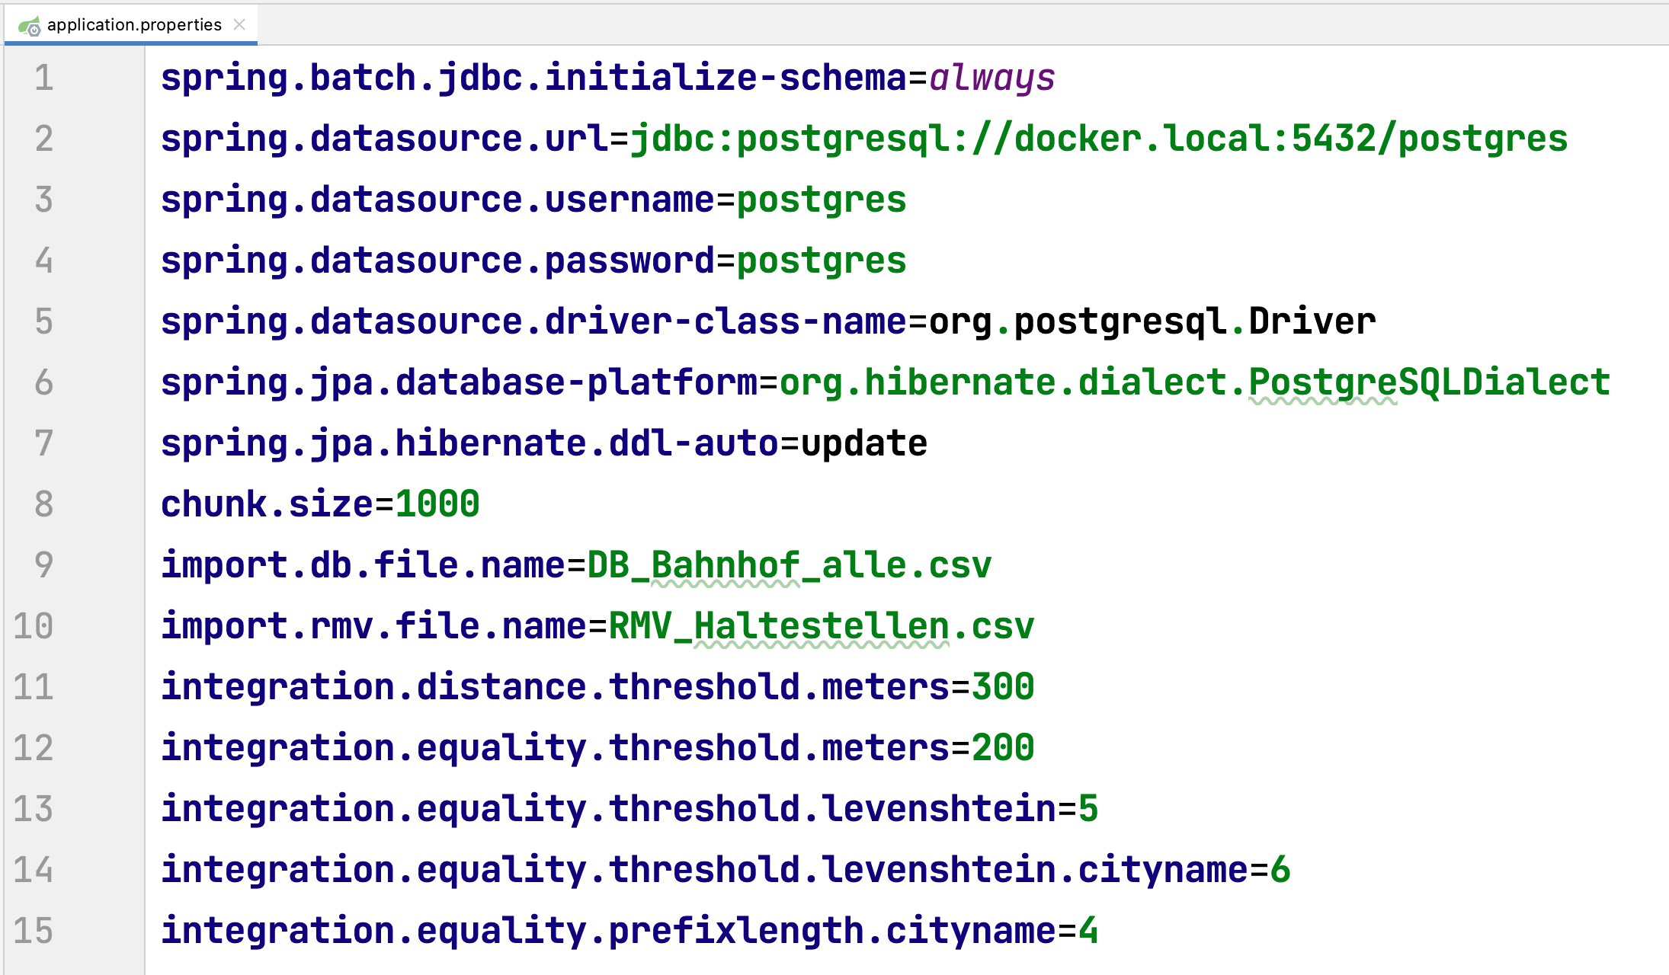
Integration Pipeline Architecture

Slide 5
Filling the DB and RMV tables through mapping / calculating the relevant attributes
RMV Station → | Integrated RMV Station
hafasId
rmvId
dhid | stationId
hstName | stationName
nameFahrplan
xIplWert, yIplWert | longitude
xWgs84, yWgs85 | longitude, latitude
lno
gueltigAb, gueltigBis
verbund1IstgleichRmv
gemeindename | cityName
land, rp, ortsteilname
ags values
DB Station → | Integrated DB Station
evaNr | stationId
ds100
ifopt
name | stationName, cityName (extracted from name)
verkehr
laenge | longitude
breite | latitude
betreiberName
betreiberNr
status

Slide 6
Clustering by city names
For each DB station we search for RMV stations in the same city
One word city names like 'Marburg' are easy wins
Cities like 'Frankfurt a.M.' have different string representations
If no exact match is found candidates are searched and best is used
Candidates...
… have common 4 char prefix
… have a Levenshtein distance below 6

Slide 7
Identification of similar stations example
RMV | DB
Marburg Hauptbahnhof | Marburg(Lahn)
Marburg Südbahnhof | Marburg Süd
Frankfurt (Main) Hauptwache | Frankfurt(M)Hauptwache

Slide 8
Identification of similar stations
Take all stations in a specific range as equality candidates
Take the station names and remove parts between brackets
Compute three Levenshtein distances and take the minimum
Take RMV station name and append 'Bahnhof' to DB station name
Take RMV station name and append 'Hauptbahnhof' to DB station name
Take RMV station name and DB station name
If a pair of stations has a Levenshtein distance below a certain threshold assume its equal

Slide 9
Best Options
All identical station transfers are best options
The transfer option with the smallest distance which is no identical station transfer is best option
There may be two best options for one station (one identical and one non-identical)

