Slide 1


Introduction to (Scientific) Programming with Python
Jelka Stojanov, Timo Flesch
MT 2021
University of Oxford

Slide 2
Outline
Why Python?
Practical
Part 1: Intro to Python
Part 2: Python for scientific programming
Part 3: Python for statistical data analysis
Additional resources

Slide 3






Why Python?
It’s a general-purpose programming language, used to power many of the apps you use every day!

Slide 4
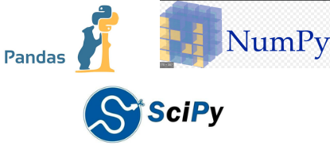

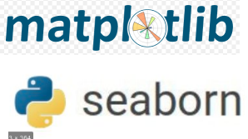
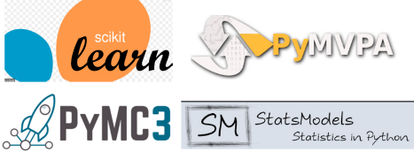
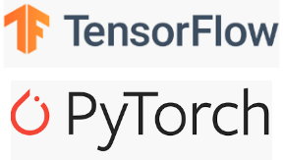
Why Python?
There are free (!) add-ons for everything:
Organise and analyse numerical data!
Create your own experiments!
Perform sophisticated
statistical analyses!
Hop on the machine learning hype train!
Make beautiful figures!

Slide 5

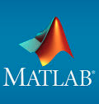
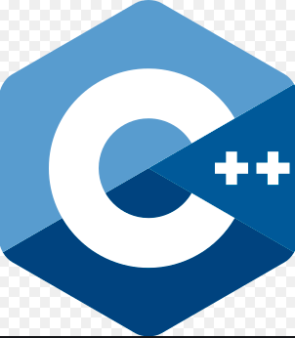


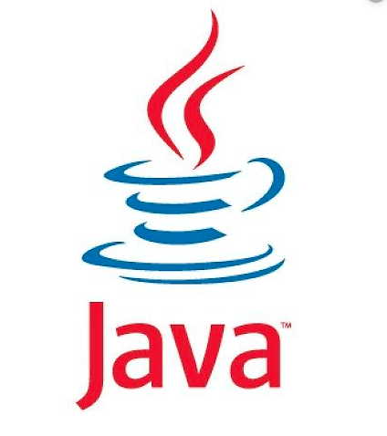
Why Python?
It’s just better than its competitors!
Matlab is very expensive! Python is free. When using the right
packages/add-ons, Python has the same functionality and syntax as Matlab.
>
Python is much easier to learn, as the syntax is less complex.
At least for science, there is a better community/ecosystem.
Some Python packages run C(++) code in the background, which makes them almost as fast as their C++ counterparts.
Python is a general-purpose language. It can be used for almost everything. R was developed for statistical analyses.
Again, much simpler syntax. You can achieve the same results with fewer lines of code.

Slide 6
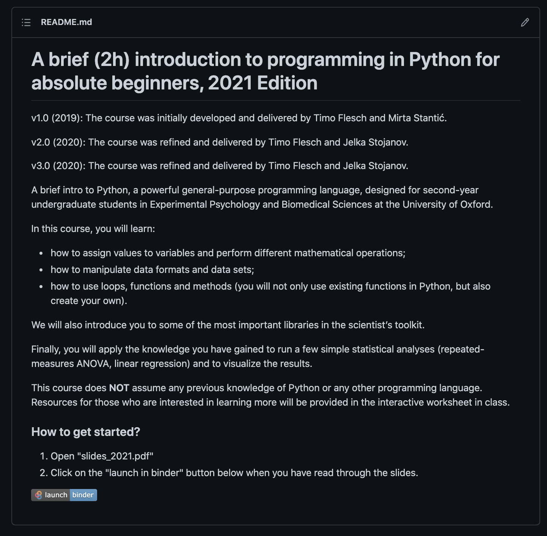
Python Practical
1. Go to http://www.github.com/timoflesch/intro2python

Slide 7
Python Practical
2. Click on the “launch binder” button:

Slide 8
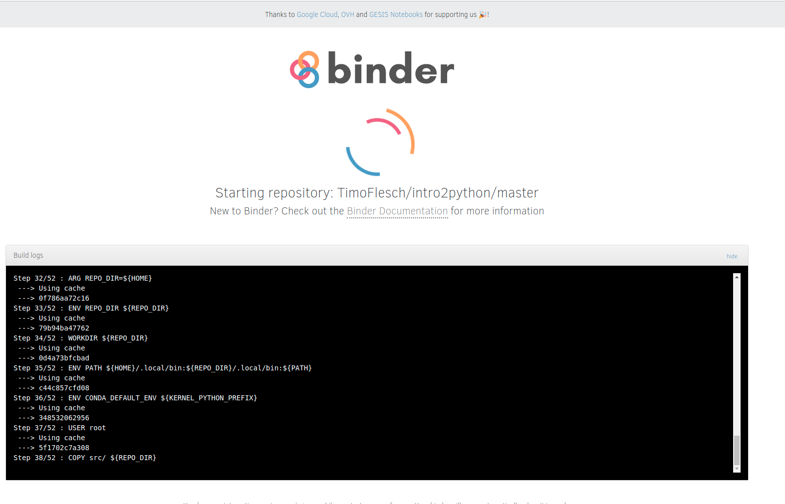
Python Practical
3. Stare at this screen for a while:

Slide 9
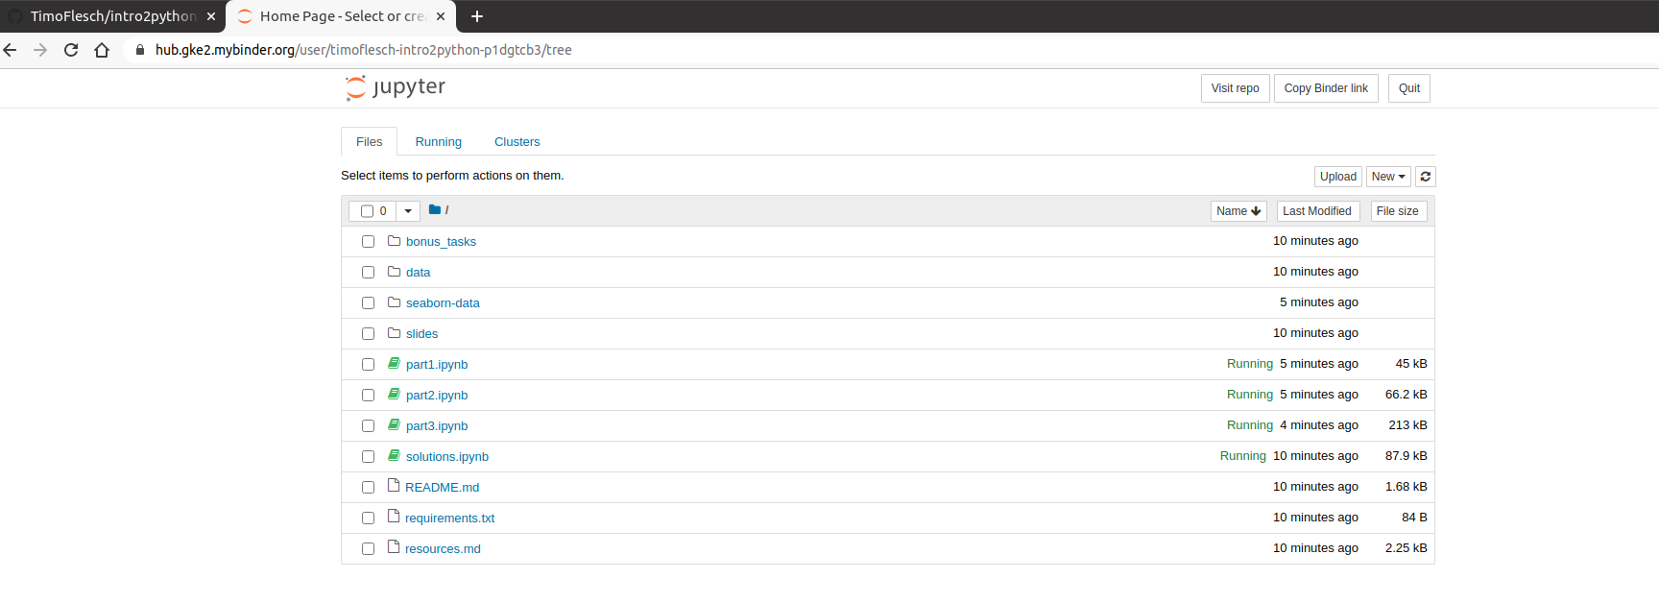

Python Practical
4. Now this screen (or similar) should show up:
From here you can open the worksheets that we have provided for you.
This will run an interactive Python session in your browser, where you can write and execute your own Python programs.

Slide 10
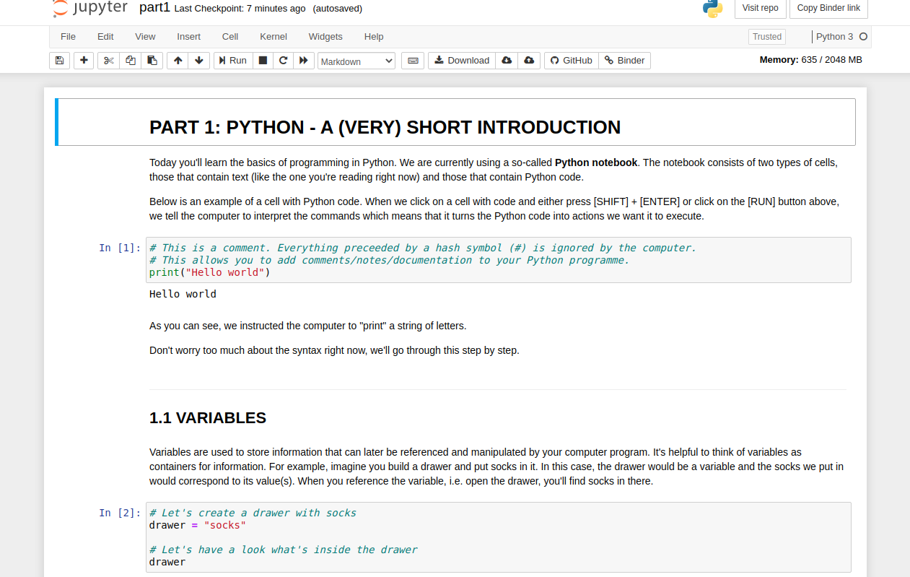
Python Practical
5. You are now running an interactive worksheet with Python code in your web-browser. Have fun ☺

Slide 11
Outlook
Learn to code!
1. A complete course https://www.learnpython.org
2. Ditto https://www.w3schools.com/python/
3. Advanced course https://automatetheboringstuff.com
How to install Python?
Just Python https://www.python.org/downloads/
Jupyter Notebook (that you have used/will use today) https://jupyter.org/install
Anaconda (a collection of useful packages and other software for data scientists)
https://www.anaconda.com/distribution/

Slide 12
Outlook
Text editors
1. Atom https://atom.io/
2. Visual Studio Code https://code.visualstudio.com/
3. Sublime https://www.sublimetext.com/
All-in-one solutions (similar to the Matlab interface or R-Studio)
1. Spyder (free) https://www.spyder-ide.org/
2. Pycharm (free basic and commercial pro version) https://www.jetbrains.com/pycharm/

Slide 13
Outlook
Coding challenges
1. Hackerrank https://www.hackerrank.com/
2. Leetcode https://leetcode.com
Python for psychologists
https://www.marsja.se/best-python-libraries-psychology/

