Slide 1
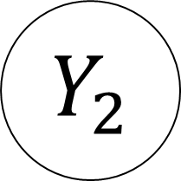
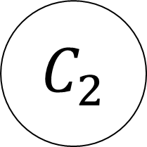


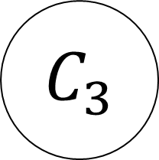
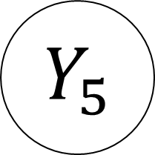
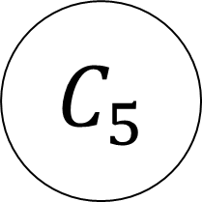
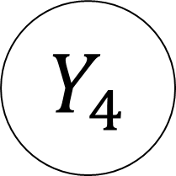
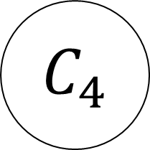
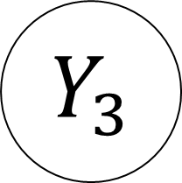
$${ Y}_{1}$$
$${ Y}_{2}$$
$${ Y}_{3}$$
$${ Y}_{4}$$
$${ Y}_{5}$$
$${ C}_{1}$$
$${ C}_{2}$$
$${ C}_{3}$$
$${ C}_{4}$$
$${ C}_{5}$$

