Slide 1

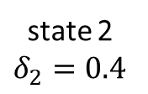

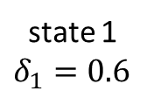



Markov chain
state-dependent distributions
state 1 $δ_{1}=0.6$
state 2 $δ_{2}=0.4$
$$p_{1}(y)$$
$$p_{2}(y)$$
$$p_{1}(y)$$
0.7
0.3
$$p_{2}(y)$$
0.8
0.2
$$p_{1}(y)$$

