Slide 1
2026 SHENZHEN FINTECHATHON · INTERNATIONAL TRACK · TOPIC C
TuitionPilot
An AI agent that helps Indian families pay university fees abroad: it checks the invoice is genuine, explains every rupee, and pays only after the parent’s own device signs the exact plan.
1
Signed invoices instead of payee lists
2
The parent’s device signs every payment
3
Every number traced to a rule and source
Chandan · Nishanth | Synthetic data only · Sandbox bank, no real money · Not tax advice · Not RBI-approved
Notes:
About 45 seconds. TuitionPilot is an AI agent for Indian families who pay university fees abroad. It does three things that matter: it proves the invoice really comes from the university and its real bank account, it explains every rupee of tax and cost, and it can pay only after the parent's own device signs the exact plan. Everything you will see uses synthetic data and a simulated bank. It is not tax advice.

Slide 2
Paying fees abroad: four hard questions, one big fraud risk
1
2
THE FRAUD
“Our bank details have changed. Please pay within 24 hours.”
How much of the yearly LRS limit is left?
How much TCS tax will the bank add?
USD 250,000 per person per year, all purposes together (RBI Master Direction)
2% above Rs 10 lakh if self-funded; 0% with an education loan
A classic way to steal tuition fees. In TuitionPilot this attack fails by design: the university’s signature covers its bank account.
3
4
Which route is really cheapest?
Which papers does the bank want?
A low fee can hide a worse exchange rate; the markup is never shown as a fee
A2 form, PAN, invoice, admission letter, passport, visa document
Rates come from our versioned rule pack; six rules are verified against RBI and the Income-tax Act 2025, the rest are flagged (slide 11).
Notes:
About 50 seconds. Before paying, a family has to answer four questions on their own: how much of the yearly LRS limit is left, how much TCS tax the bank will add, which bank or provider is really cheapest once the exchange-rate markup is counted, and which papers the bank wants. One mistake costs money. And there is a fraud risk: an e-mail saying the university's bank details have changed is a classic way to steal fees. TuitionPilot is built so that this attack fails by design.

Slide 3
One guided flow, from invoice to receipt
1
2
3
4
5
6
Welcome
Invoice
Questions
Best route
Review & sign
Receipt
Two consents before any data is read
Animated check of the university’s signature chain
One at a time; the agent asks, never guesses
Cost chart, what-if sliders, LRS limit gauge
PIN pad; the parent’s device signs the plan
Transaction, certificate, signature, audit entry
Agent, live panel
Attack lab
Family devices and vault
Every step and policy decision as it happens, the rule trace with sources, exactly what the AI saw (masked), and the audit chain.
Runs 16 attacks against a separate copy of the agent and shows which defence stopped each one.
Passwordless sign-in on each enrolled device. A student prepares the payment; only a parent device can sign it. Documents are encrypted in the browser.
Code computes; the AI explains. Tax, cost and limits come from tested code. The AI only reads the invoice and words results, sees masked text only, and runs offline by default (hosted Claude optional).
Notes:
About 50 seconds. The app tells the payment as a guided six-step story: consent, the invoice with an animated signature check, one question at a time, the best route with a cost chart and what-if sliders, review and sign with a PIN while the parent's device signs the plan, and the receipt. Beside it, a live agent panel shows the next action and why, every decision, and exactly what the AI saw. Code computes and the AI explains: it runs offline by default, and a hosted Claude model can be switched on behind the same guards.

Slide 4
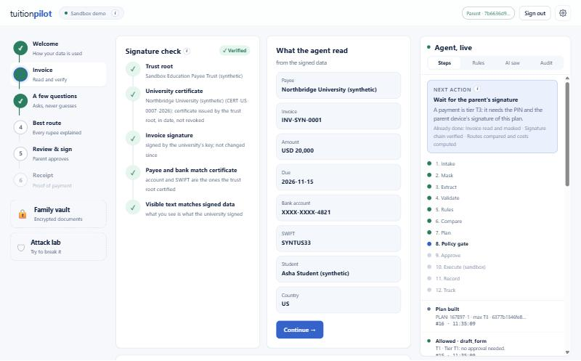
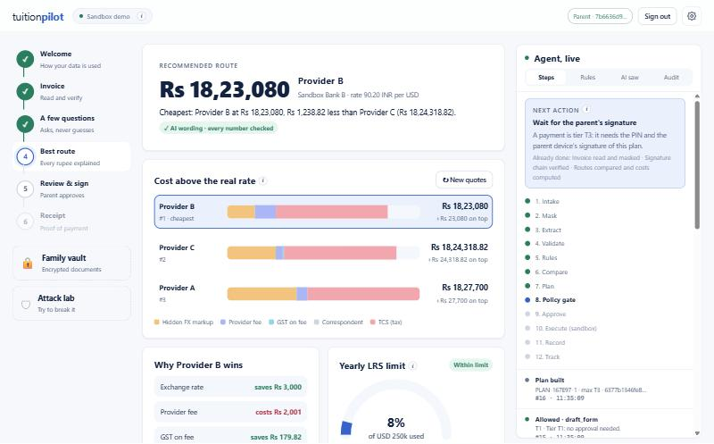
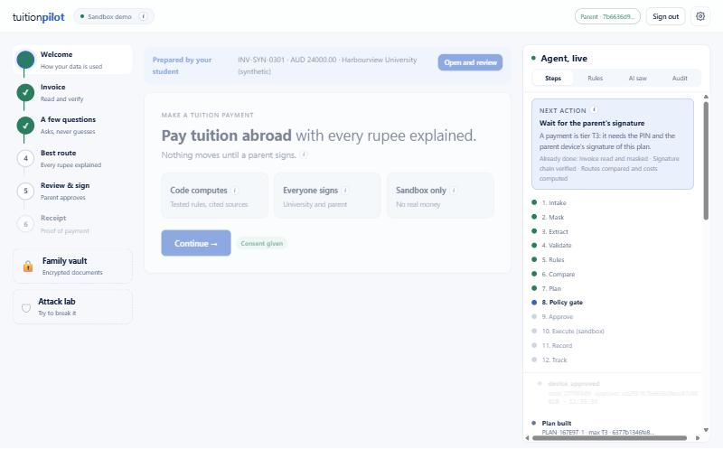
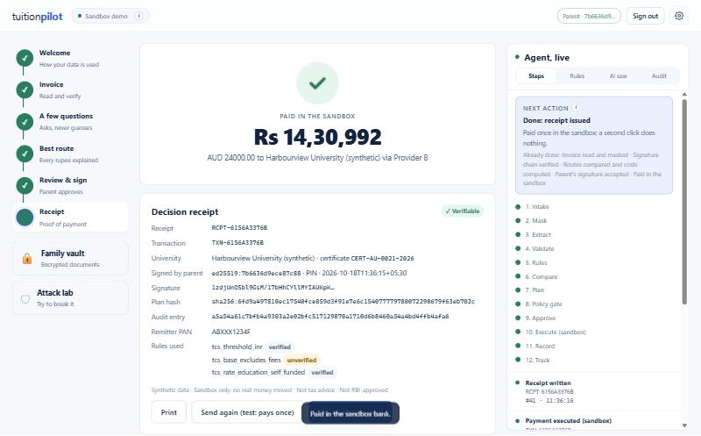
Student prepares, parent signs: the real app
Topic C's own user does the work
1 The student signs in on their own device: no password, a key that never leaves the browser
2 Uploads the invoice; the agent checks the university's signature and asks only what is missing
3 Taps 'Ask a parent to sign'
4 The parent opens it on their own device, the browser re-checks the plan hash, the parent signs, and the sandbox pays once
The student's session is retired the moment a parent opens it, so a student device can never act as the parent.
Signature chain checked, link by link
Every route costed against the real rate
The parent sees what the student prepared
Signed, paid once in the sandbox, receipt
Notes:
About 45 seconds. This is the real app. Topic C is about international students, so the student does the work: they sign in on their own device without a password, upload the invoice, the agent verifies the university's signature and asks only what is missing, and the student taps 'Ask a parent to sign'. The parent sees the request on their own device, opens it, the browser re-checks the plan hash, the parent signs with the PIN, and the sandbox pays once. The student's session is retired the moment the parent opens it, so a student device can never act as the parent.

Slide 5
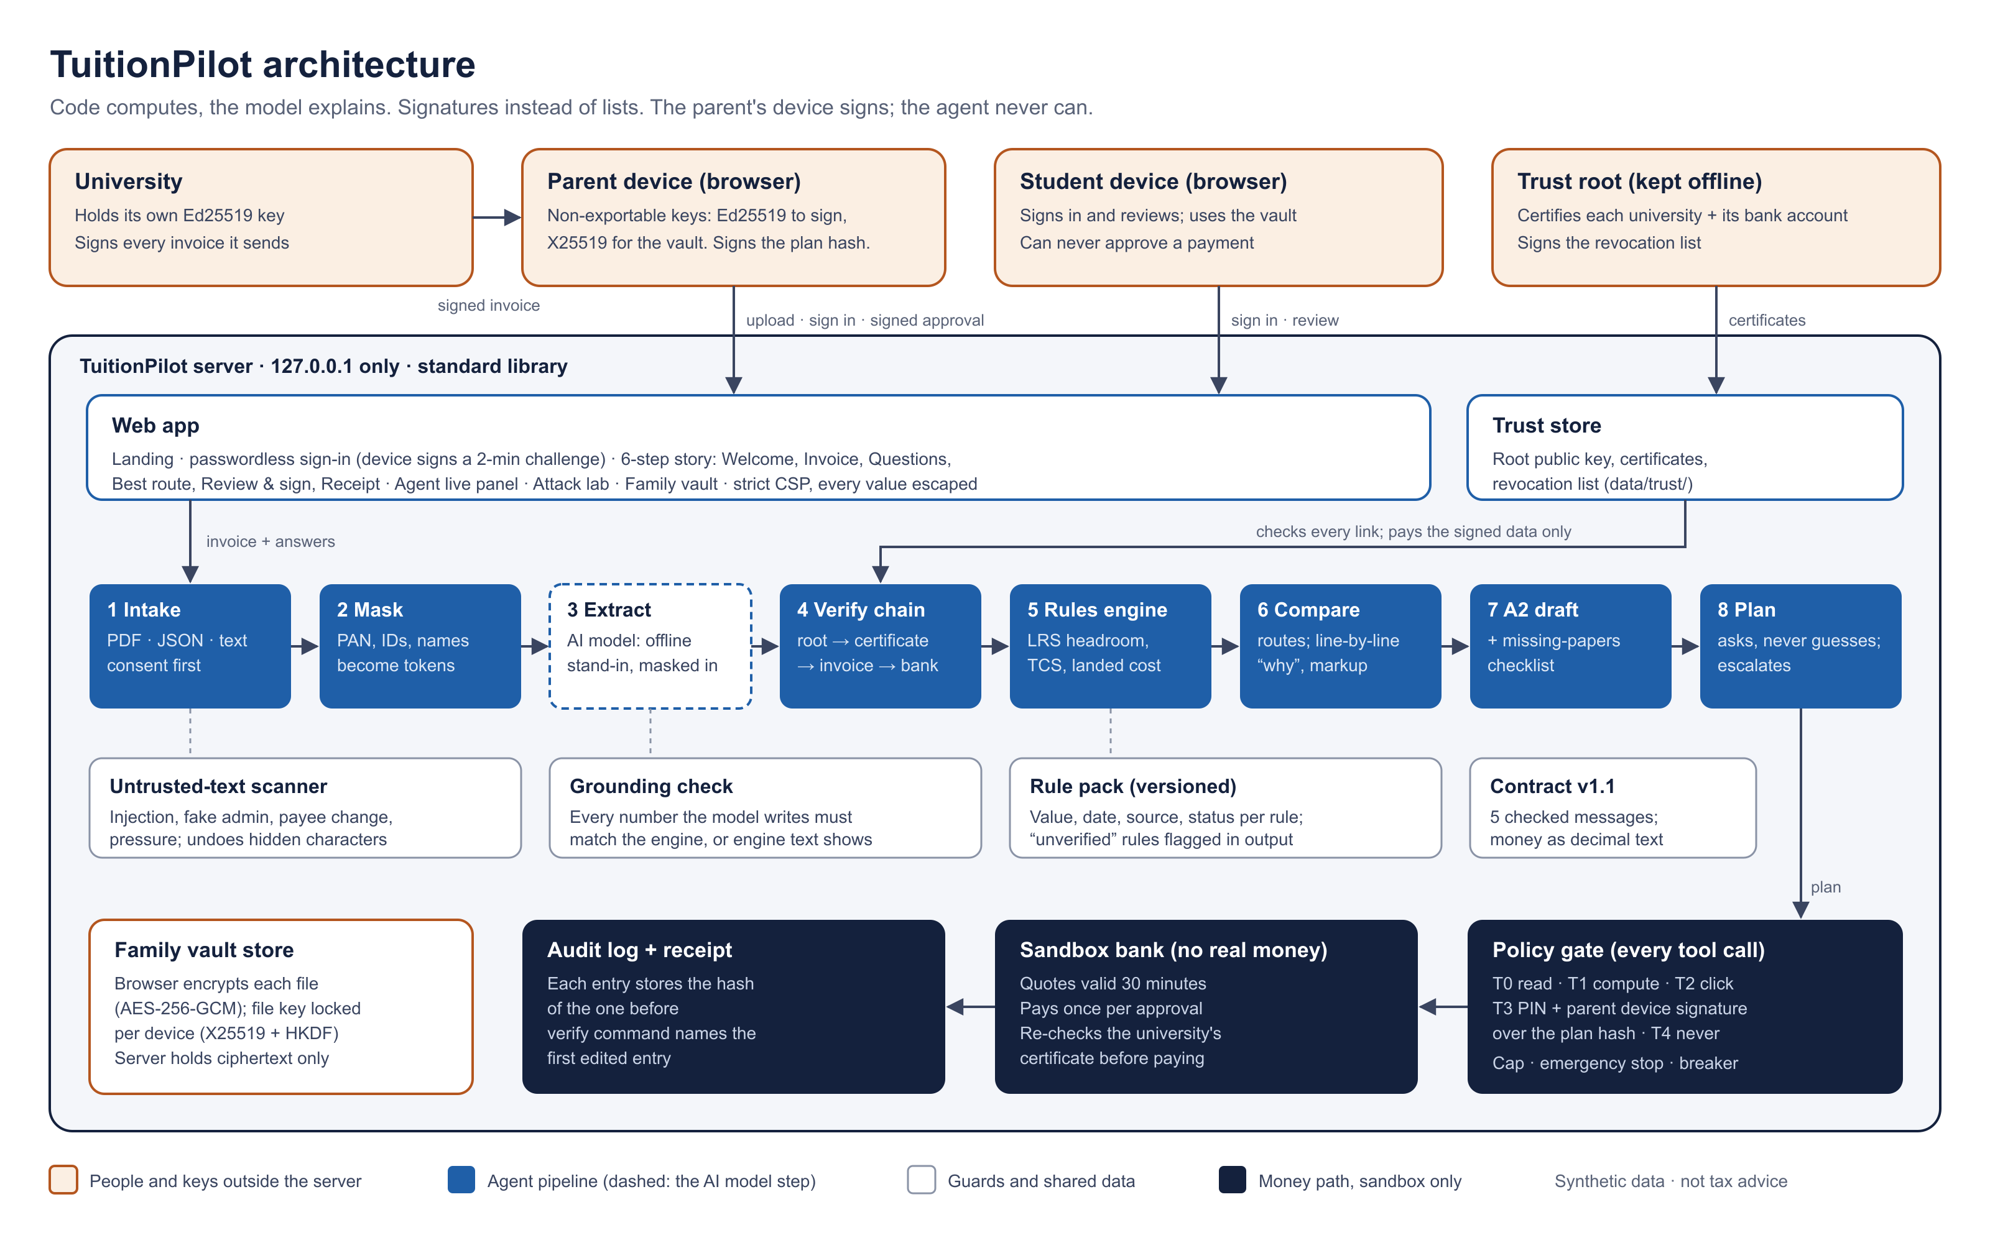
Architecture: keys with people, money in the sandbox
Orange: outside the server
University, parent and student devices, trust root. Every private key lives here.
Blue: agent pipeline
Intake to plan in 8 steps. The dashed step is the only AI step; it sees masked text.
Navy: money path
Policy gate → sandbox bank → hash-chained audit log and receipt.
Notes:
About 1 minute. Orange is outside our server: the university, the parent's and student's browsers, and the trust root. Every private key lives there, never on the server. Blue is the agent pipeline from intake to plan; the dashed box is the only step that uses an AI model, and it sees masked text only. White boxes are guards: the text scanner, the grounding check, the versioned rule pack and the message contract. Navy is the money path: every tool call goes through the policy gate, then the sandbox bank, then a hash-chained audit log and receipt. The whole server is Python standard library and listens only on this computer.

Slide 6
India’s LRS and TCS rules, turned into tested code
Rule | Value in the rule pack | Status (18 Oct)
LRS yearly cap | USD 250,000 per person, April–March | Verified
TCS threshold | Rs 10 lakh per PAN per year, all purposes | Verified
Education, self-funded | 2% above the threshold (from 1 Apr 2026) | Verified
Education, loan-funded | No TCS on an education loan from a financial institution | Verified
No PAN | 5% above the threshold | Verified
Worked example (scenario A2)
Self-funded Rs 15 lakh, no earlier payments
This year’s total
Rs 15,00,000
Minus the threshold
− Rs 10,00,000
Taxable part
Rs 5,00,000
TCS at 2%
Rs 10,000
TCS = rate x (this year's total - the larger of earlier payments or Rs 10 lakh)
Never below zero. Every result carries the rule id, pack version, effective date and source. Verified against RBI and the Income-tax Act 2025 (s.394, s.397); rules still open are flagged in every output.
With an education loan instead (A3): TCS is Rs 0.
Notes:
About 55 seconds. Every rate lives in a versioned rule pack with its value, start date, source and status. On 18 October we checked them against the primary texts: the RBI Master Direction for the USD 250,000 cap, and sections 394 and 397 of the Income-tax Act 2025 for the 10 lakh threshold, 2 percent for self-funded education, no TCS on an education loan, and 5 percent without a PAN. Worked example A2: 15 lakh self-funded, so 5 lakh is taxable and TCS is 10,000 rupees. Two rules still need a bank's confirmation, and every output that uses them says so.

Slide 7
Route comparison: the lowest fee is not the cheapest
Why Provider B wins, line by line
Better rate (90.20 vs 90.50)
+ Rs 6,000
Higher provider fee
− Rs 1,500
Less TCS (less rupees sent)
+ Rs 120
Saving with B
Rs 4,620
Totals: B Rs 18,23,080 vs A Rs 18,27,700. Code writes every line, and the lines add up exactly to the saving.
Scenario A8, engine output. Mid-market rate 90.00 is the example value from our tests, not a live rate. No GST or correspondent charges in this example.
Notes:
About 1 minute 15. Same USD 20,000, two providers. Provider A has the lower fee, so most people pick A. But B is 4,620 rupees cheaper. The chart shows what each route costs on top of the real exchange value: A hides 10,000 rupees inside its exchange rate, B only 4,000. The why breakdown, written by code, adds up exactly: B's better rate saves 6,000, A's fee is 1,500 lower, and TCS is 120 less with B. The mid-market rate of 90.00 is an example value from our tests.

Slide 8
Security: signatures instead of payee lists
University invoice. A changed bank account breaks the signature.
Trust root
Certificate
Invoice signature
Bank details
Printed text
One key we trust, kept offline
Names the university and its bank account; not revoked
Made by the university with Ed25519
Must equal the certificate
Must match the signed data; we pay the signed data
Parent approval. The agent never holds the parent’s key, so it cannot forge an approval or change the plan.
Device key
Register
Recompute
Sign
Verify
Made in the browser; cannot be exported
Public key only; PIN plus a parent device's approval
The browser re-derives the plan hash itself
The approval for that exact plan
Policy gate checks it before any payment
Ed25519 written in plain Python following RFC 8032, nothing to install; checked against the RFC test vectors and a signature made by the browser’s WebCrypto.
Notes:
About 55 seconds. We keep no list of good payees. One trust root certifies each university together with its bank account, and the university signs every invoice. The agent checks every link, so changing the bank account breaks the signature. For payments, the parent's browser makes its own key that cannot be exported. The first parent device enrols with the PIN; every later device also needs a signature from an enrolled parent device. The browser recomputes the plan hash itself and signs that exact plan, so the agent can neither forge an approval nor change the plan afterwards.

Slide 9
Defence in depth: each layer assumes the one before can fail
Tier | What the agent may do | Approval
T0 | Read the invoice, check signatures | None
T1 | Compute and draft | None
T2 | Save or share drafts | A click
T3 | Sandbox payment to a signature-verified payee | PIN + parent device signature over the plan hash
T4 | New or unverified payee, change limits, skip approval | Never
Masking
Grounding check
PAN, Aadhaar, passport, account, phone and names become tokens before the AI sees text
Every number the AI writes must match the engine, or the engine’s text is shown
Text scanner
Breaker + emergency stop
Flags injection, fake admin, payee change and pressure, even when disguised
Per-payment cap; 3 denied money actions freeze the agent until a PIN reset
Hash-chained audit log
Encrypted family vault
The AI model has no payment tool. Every tool call passes the policy gate. Sign-in is passwordless: the device signs a one-time 2-minute challenge, and a new device needs a parent device’s signature.
Each entry stores the hash of the one before; edits are detected
AES-256-GCM in the browser; keys locked per device (X25519); server sees ciphertext
Notes:
About 1 minute. Security is 30 percent of the score, so we layered it. Every action has a permission tier. Reading and computing need no approval, saving needs a click, a sandbox payment needs the PIN plus the parent device's signature over the plan hash, and tier 4 is never allowed. The AI model has no payment tool at all. Around that: masking before the model sees anything, a grounding check on every number it writes, a text scanner for injection and fake-admin tricks, a cap, emergency stop and circuit breaker, a hash-chained audit log, and a family vault where documents are encrypted in the browser so the server only ever holds ciphertext.

Slide 10
Evidence: run it yourself, one command each
248
27 / 27
16 / 16
153
tests pass
scenarios pass
attacks stopped in the attack lab
audit entries; the hash chain verifies
Scenarios by group
Finance audit: 400 random cases
A Task completion
10 / 10 pass
The engine matched an independent formula in every case. The audit found 3 agent bugs, all fixed with tests:
an earlier in-app payment was not counted
inconsistent USD answers were accepted
no PAN + loan applied 0% silently (now a warning)
B Safe execution
6 / 6 pass
C Attacks, incl. forged approval and revoked key
9 / 9 pass
D Privacy
2 / 2 pass
python -m unittest discover -s tests -t . · python -m scenarios.runner · python -m app.demo_run
TuitionPilot · 2026 Shenzhen FinTechathon · Synthetic data · Not tax advice
Notes:
About 45 seconds. Everything here can be rerun with one command each. 248 tests pass. All 27 scenarios pass: ten task-completion, six safe-execution, nine attacks including a forged approval and a revoked university key, and two privacy scenarios. The attack lab stops all 16 attacks. The scripted sandbox run writes a ledger, the log of what the AI saw, and an audit log whose hash chain verifies. A finance audit of 400 random cases matched an independent formula.

Slide 11
Honest limits, and what comes next
Tax rules: what is still open
Prototype limits
Next steps
Verified 18 Oct: LRS cap, Rs 10 lakh threshold, 2% and loan-free education rates, 5% without PAN
Still open: earlier other-purpose payments using up the threshold; TCS on the amount sent, not fees
Not modelled: GST on the currency conversion itself
Hosted Claude is optional; the default AI step is offline
Ed25519 code is not hardened (not constant-time, not audited)
Demo keys are synthetic; one trust root
Demo PIN is fixed; scanned PDFs need OCR
A bank's confirmation for the two open rules
Credit building and more destination countries for students
Vetted crypto library or hardware keys; offline parent recovery key
Cookie sessions with idle timeouts
Synthetic data only · Sandbox bank, no real money · Drafts, not official RBI or bank forms · Not tax advice
Notes:
About 45 seconds. Limits, plainly. Six tax rules are now verified against RBI and the Income-tax Act; two still need a bank's confirmation, and GST on the conversion itself is not modelled. The default AI step is offline, our signature code is not hardened, and the demo keys are synthetic. Next: bank confirmation, credit building and more destinations for students, a vetted crypto library or hardware keys, and cookie sessions. Thank you.

