Slide 1
RESTFood
Von Timofey & Luis

Slide 2

Planung
Agile Scrum
Jira Software

Slide 3

Backend
Spring 3.1.0
JWT

Slide 4
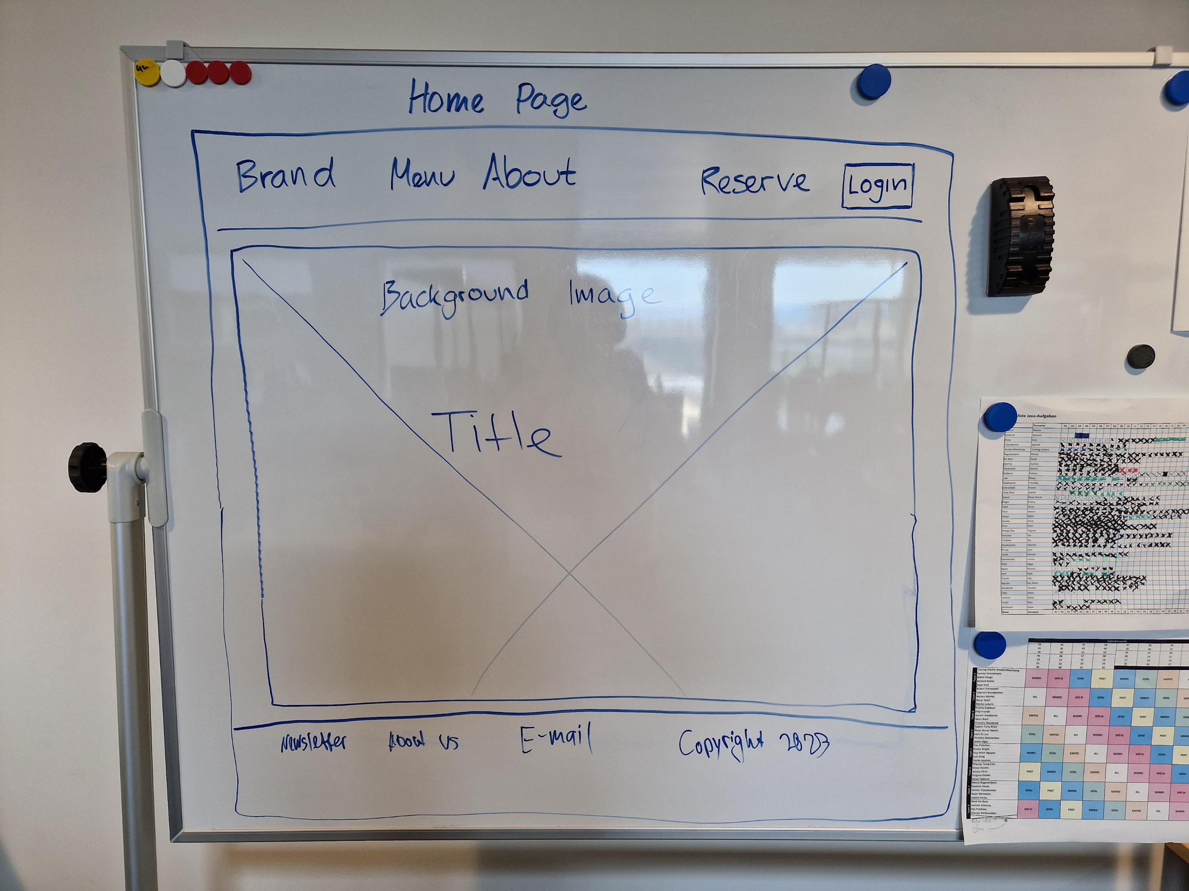
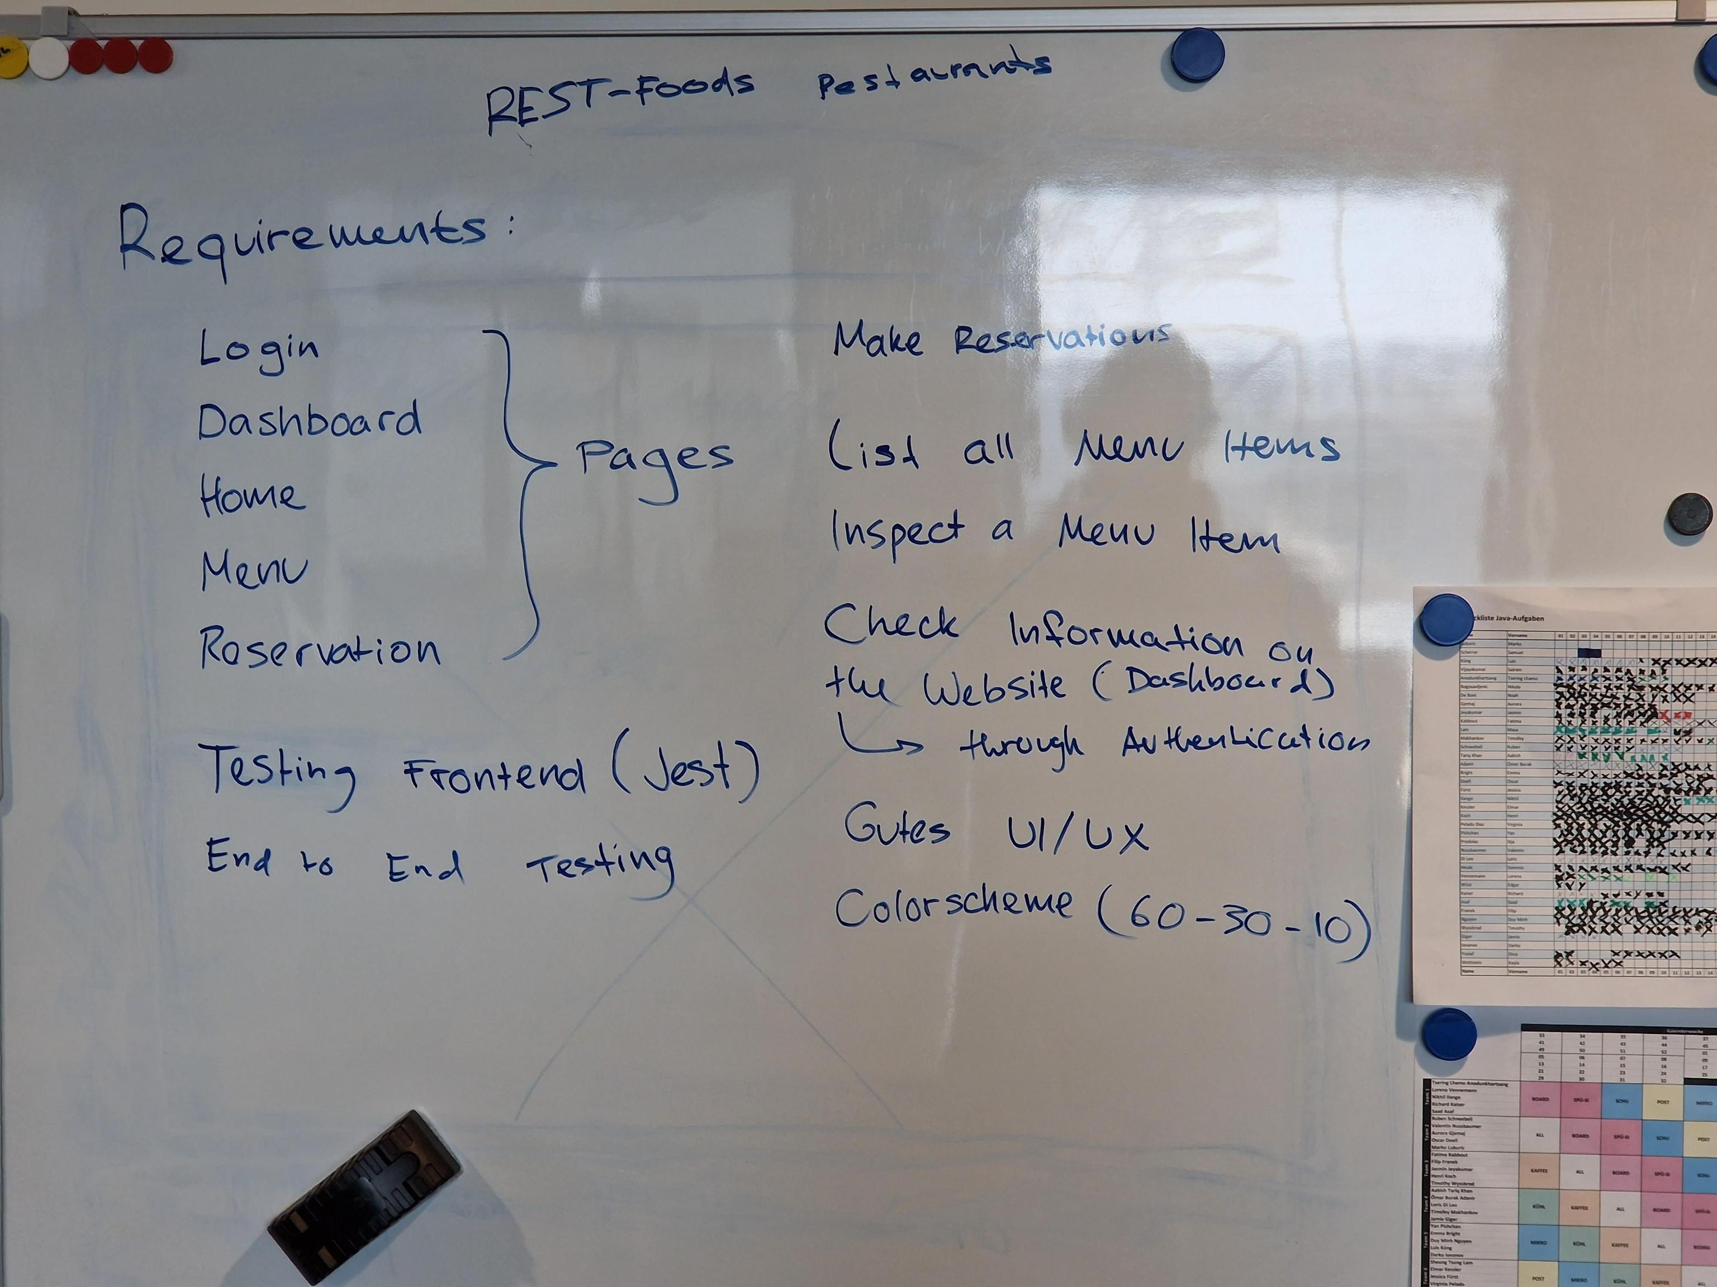
Frontend

Slide 5
Demo

