Slide 1
Project Assignment
A Tic-Tac-Toe Website
By Timofey, Ruben & Aurora

Slide 2
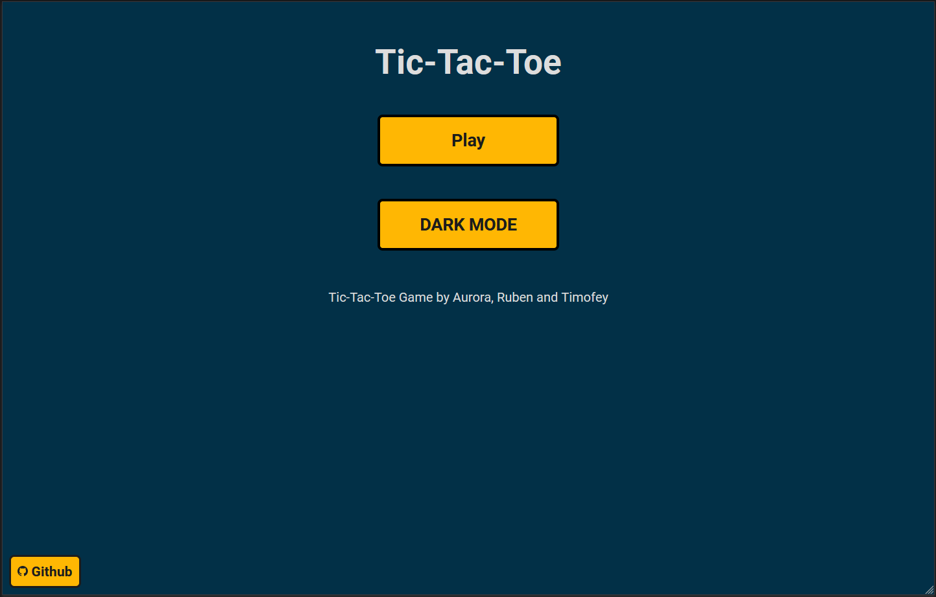
The Website
The Ability to play Tic-Tac-Toe
Vercel for hosting
HTML, CSS & JavaScript

Slide 3
Assessment
The Good
The Difficulties
- Good Teamwork
- Bring an idea to reality
- Time Management
- Work Distribution

Slide 4
Take Aways
For Next Time
- Improve Time management
- better work distribution
technicality
- Work on ‘dev’ branch
- know your skills
Source:
https://github.com/Timofey-Makhankov/Tic-Tac-Toe-Website

