Slide 1
Image rotator

Slide 2
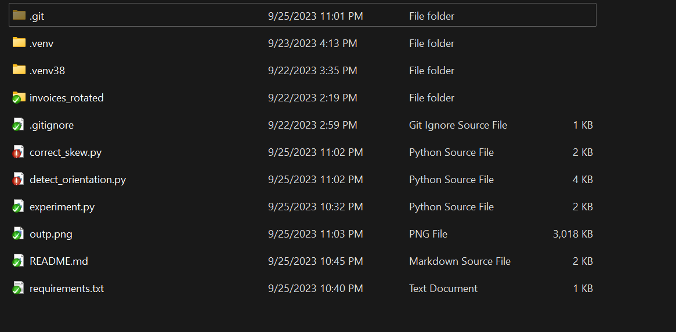
Structure
.git, .gitignore, .README.md, requirements.txt – git folder, gitignore file, readme file, requirements
.venv, .venv38 – first virtual environment, virtual environment for python3.8 (was chosen because of dependencies)
invoices_rotated – data
correct_skew.py – first working solution
detect_orientation.py – second working solution
experiment.py – testing out ML approaches on the task

Slide 3
Correct_skew solution
Detect_orientation
solution
This solution is based on Open-CV function minAreaRect. Basically, the image into black and white and we collect coordinates of all the pixels that have value > 0. Then based on the coordinates we find the rectangle and calculate it’s angle. Using rotation matrix we fix the position of the image.
Having analyzed additional data ( in our case invoices ) I have come to conclusion that every invoice includes some horizontal line. Having the degree of it’s skewness we can fix our image. I had been searching for any possible way to find solution and encountered with Hough lines. Using popular library scikit and it’s methods hough_line, hough_line_peaks I got the angle of the lines and rotated the image.
Advantages:
-Optimal solution for different types of images
-Easy to implement
-Speed
Disadvantages:
-Limit of -30 to 30 degrees
Advantages:
-Speed
-No limitation for degrees
Disadvantages:
-Tied up to horizontal line feature

Slide 4
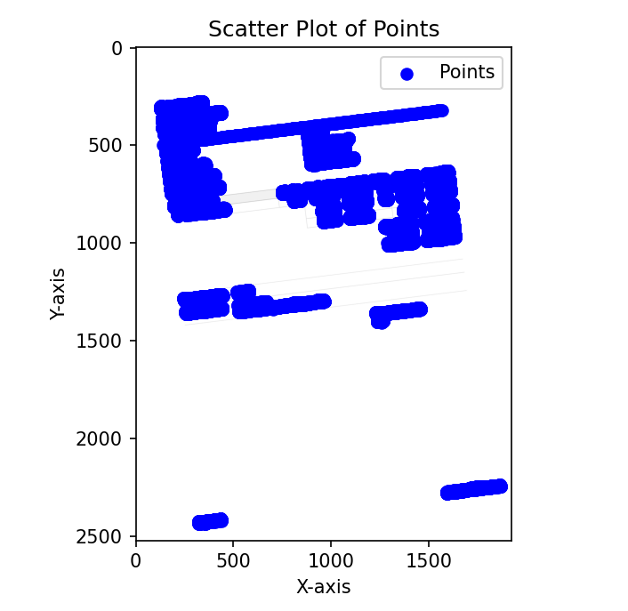
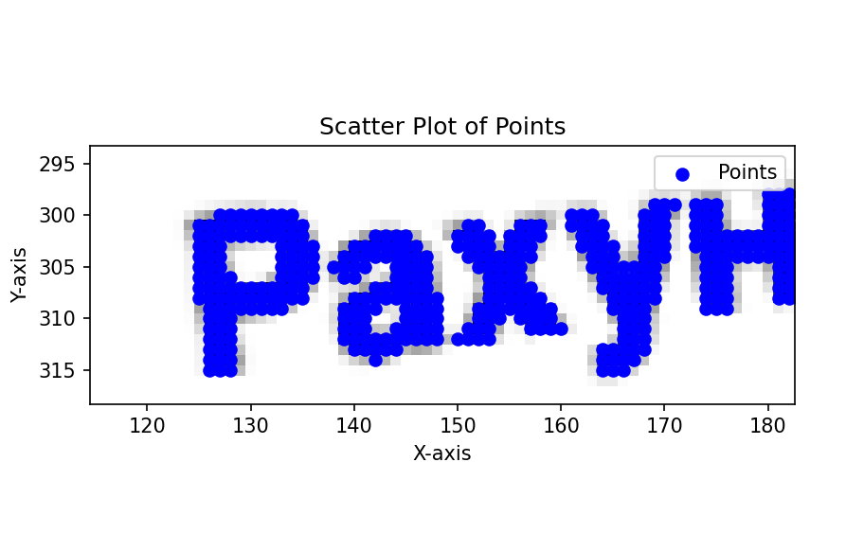
Experiment
The ML solution was too complicated for this task so I avoided it, but during the process I have come across different ideas, one of them is:
- Create ML model that detects rotation angle for printed Ukrainian letters https://d4nst.github.io/2017/01/12/image-orientation/ is a nice example, but we need to use letters, so for this occasion I found this database https://github.com/olekscode/UkrainianOCR
- Detect characters and convert them into 28x28 (or any other format) for further usage in rotation angle ML model.
- Based on angle of several letters we can summarize what is the angle for the image
Note: I also thought about using tesarract for text detection but the idea of installing tesseract exe seemed to be way to complicated for such task. I think that this program would be way too complicated and heavy with tesseract.exe

Slide 5

Conclusions
The task was completed successfully. Two different approaches were created and 1 theoretical solution of the given task. During the process I have learnt lots of new ways to detect image angle, developed my programming skills, library knowledge and solution thinking.
I am very grateful to INNORA team for this amazing opportunity to test myself

Slide 6
Special thanks to content creators:
https://github.com/olekscode/UkrainianOCR
https://pyimagesearch.com/2017/02/20/text-skew-correction-opencv-python/
https://github.com/pidahbus/deep-image-orientation-angle-detection/tree/main
https://d4nst.github.io/2017/01/12/image-orientation/
https://youtu.be/5zAT6yTHvP0?si=hJbcclj-rwKxJdIx
https://youtu.be/a5yDWeSoudE?si=s5nAf_klKdLNb8d3

