Slide 1
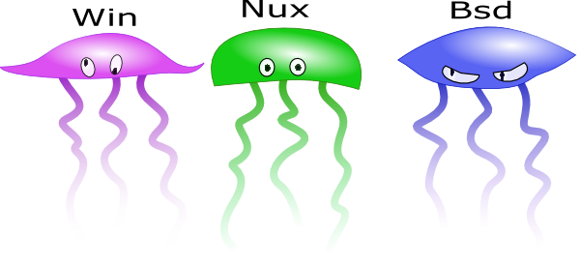

Rr0d: The Rasta Ring0
Debugger
Rr0d.droids-corp.org

Slide 2
Summary
What is a debugger?
Why os independent - ring0 ?
Which x86 feature should be handled?
Core debugger

Slide 3
What is a debugger?
The best sentence that fits to programming: « errare humanum est »
A debugger is there to correct those errors (note: a debugger can be buggy).
There are 2 debugger families:
  Source code debugger
  debugger *without* source code
Rr0d is a debugger without source code

Slide 4

What is a debugger?
What can be done with this kind of debugger?
  Study of viruses, exploits, backdoors
  Reverse engineering of applications
  Debugging of low level drivers
Some of those debuggers:
  Softice, Ollydbg, twr2000, …

Slide 5
Debugger versus Disassembler
Disassembler:
  It allows the static study of the whole assembly code of the target (W32dasm, IDA).
Debugger:
  It can show the behavior of a program during its run time. This allows dynamic study.
Conclusion: The full study of code needs both tools.

Slide 6

Goal of Rr0d
To be a Debugger for x86 architecture.
To be able to debug low level code.
To keep it not aggressive for the target machine (no kernel modification, …).
To be Kernel-independent
To be Rasta.

Slide 7
Quick overview of the x86
2 major modes:
  real mode: only one processus controls the whole processor and the whole memory.
  protected mode: nowadays’ OS mode.
4 level of segregation: ring 0 to 3
  the rule: a ring can only interfere with a ring less or equal to itself.
  a processus can only interfere in its memory mapping (in a perfect world by the way)
  only ring 0 can execute privileged instructions

Slide 8
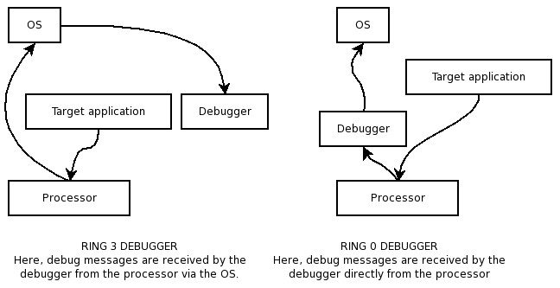

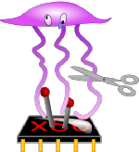
Why ring0?
A ring 0 debugger can in theory, debug everything.
A ring 3 debugger needs the help of the OS in order to receive debug messages of the target.
As we are on x86, we know how those messages are triggered: interruptions & exceptions. This is OS independent ☺

Slide 9
Lets ride x86

Slide 10
Basic stuffs we need to hook
Debug interruptions:
  Int 3 for software breakpoint
  Int 1 for step by step and hardware debugger
This should be enough to do a light debugger. But what if the application does div/0 or general protection fault?
We need more hooks

Slide 11

Hurt me plenty
Interruptions we monitor (at least):
  Int 0: If the app does null division
  Int 6: invalid opcode . The app execute non existing mnemonics
  Int 13: General protection fault
  Int 14 (semi) page fault
  ...
But some others should be monitored; for example:
  Int 8: Double fault
  Int 12: Stack exception
  ...
But rr0d is not finished yet! ☺

Slide 12
Mechanism of software breakpoint
Why software breakpoints?
  easy: only 4 HW breakpoints are not enough. Did you already try to play piano with only 3 fingers? Did you ever try to edit a text with vi?
Installing a software breakpoint is just replacing an instruction we want a break on, by another instruction that will trigger the debugger if it is executed (and replace back the instruction).

Slide 13
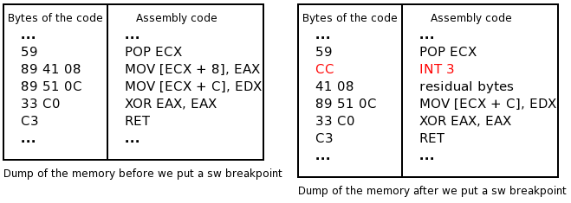
Mechanism of software breakpoint
As we hook int 3, debugger will be triggered by executing the mnemonic

Slide 14
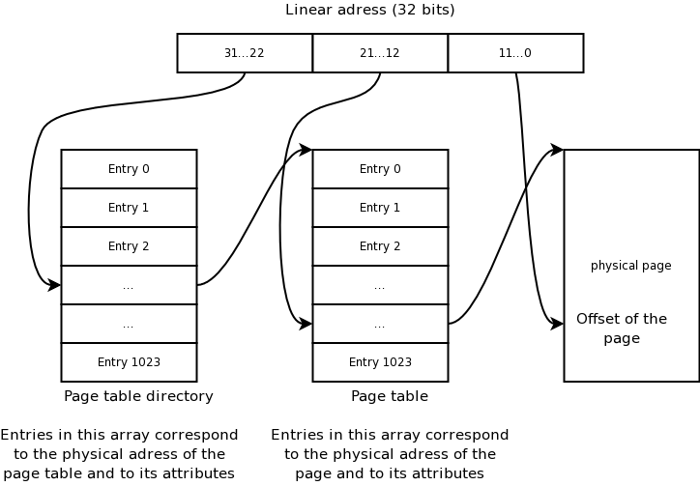
Writing Software breakpoints
We have to support pagination in order to edit memory. On X86, 2 indirections are used

Slide 15
Writing Software breakpoints
On X86 the physical address of the page table directory is stored in the register CR3. But we can only access to LINEAR addresses.
Solution: read OS sources!
  On *nux: 16 first Mo of physical memory are mapped to 0xC0000000-0xC1000000 and we are *lucky*: CR3 is in this range! (0xC2690000 on win98).
  On *bsd: problem, CR3 is not in these range so we cannot use this trick. But sources says kernel manages to map PGD at a fixed linear address.
  On win XP: well, read sources too: PGD is at 0xC0300000 So we are a bit dependant of the OS because of those addresses (shame on rr0d).

Slide 16
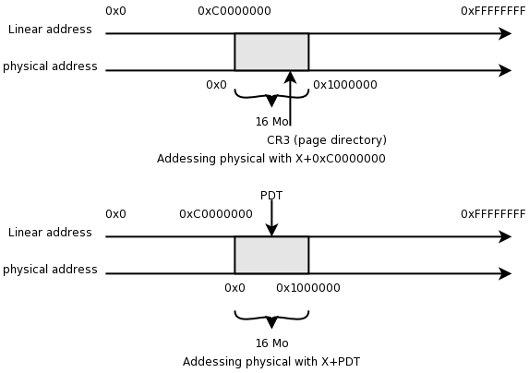
Writing Software breakpoints

Slide 17

Side effect
Rr0d has to write breakpoints even in read only pages. Solution: turn off write protection.
Problem: the breakpoint is written to disk!
Why?
  Because a binary is mapped into memory. So as we directly write in the binary image (no copy on write) when the binary is unmapped, modifications are written.
This is a little side effect ☺

Slide 18
Side effect
Bad solutions:
  Hooking of the functions responsible of this. But its heavily OS dependent.
  Substitute the physical page we want to write in by another one. But reverse mapping of recent kernels doesn’t seem to enjoy the trick
Solution: when writing a page for first time, x86 marks the page as dirty. If we clear back this bit, the OS doesn’t know the page has been written and won’t update it to the disk.

Slide 19
Rr0d input/output
To keep rr0d kernel independent we need:
  A PS2 driver: rr0d directly control the keyboard/mouse controller 8042 (port 0x60, 0x64). As we read keys directly in the controller, the OS is not aware of that.
  A screen driver.
    Console mode: VGA console is at 0xb8000 in physical addresses. This is mapped in the first 16Mo by the kernel.
    “X mode”: we use frame buffer to directly write to the video memory. (*nux, win*).

Slide 20
To Do
Script language
  Bypass encryption layer
  Garbage code
Symbol loader
Binary loder
Plugins:
  Heap Visualizator (win, nux, …)
  …

Slide 21
Conclusion
Being kernel independent has advantages:
  no ptrace detection
  no IsDebuggerPresent detection
  No modification of the heap structure while debugging (win)
Debugging ring0 backdoors can be simple
There are still many things to do!
Rr0d is rasta.

Slide 22
Question?
rr0d.droids-corp.org www.droids-corp.org
serpilliere at droids-corp dot org

