Slide 1
Java
Coding Standards
Created at: 8/11/2007
Author: Duy Do – Java Senior Engineer of VC

Slide 2
Overview
Introduce coding standards.
Why coding standards are important.
When we should use coding standards.
Common coding standard for VietCore ( Java, C/C++, PHP & Action Script)

Slide 3
Introduce Coding Standards
A set of rules for naming, formatting, and documentation requirements.

Slide 4
Why coding standards
Make it easier for developers to read and understand each other's code.
Learn code more quickly on new project.
Reduce name proliferation. Ex: pointTotal, totalPoints.

Slide 5
Why coding standards
Emphasize relationship among related items. Ex: Employee { employeeName, employeeAddress,…)
Transfer knowledge across projects.
Compensate for language’s weakness.

Slide 6
When We Should Use CS
Multiple developers are working on a project.
Plan to turn a program over to another programmer for modifications and maintenance (which is nearly always).
Your programs are reviewed by other programmers in your organization.

Slide 7
When We Should Use CS (con’t)
Your program is so large that you can’t hold the whole thing in your brain at once and must think about it in pieces.
The program will be long-lived enough that you might put it aside for a few weeks or months before working on it again.

Slide 8
CCS: File Name
For all files, only alphanumeric characters, underscores, and the dash character ("-") are permitted. Spaces and are prohibited.

Slide 9
CCS: File Name (Con’t)
File type | Suffixes | Example
Java source Java byte code | .java .class | VietCore.java VietCore.class
C/C++ header file C source file C++ source file | .h .c .cpp | VietCore.h VietCore.c VietCore.cpp
PHP source file PHP class PHP interface | .php .class.php .interface.php | VietCore.php VietCore.class.php VietCore.interface.php
Action Script file Flash File | .as .fla | VietCore.as VietCore.fla

Slide 10
CCS: File Organization
A file consists of sections that should be separated by blank lines and an optional comment identifying each section.
Files longer than 2000 lines are cumbersome and should be avoided.

Slide 11
CCS: File Organization (con’t)
Each source file has following ordering:
Beginning comments.
Package, import, include, require statements.
Class or interface declaration.

Slide 12
CCS: File Organization (con’t)
Beginning comments
All source files should begin with a c-style comment that lists the programmer(s), the date, a copyright notice, and also a brief description of the purpose of the program.
For example:
    /*
    * Classname
    *
    * Version info
    *
    * Copyright notice
    */

Slide 13
CCS: File Organization (con’t)
Package, import, include, require statements
Example:
Java, Action Script:
  package net.vietcore.abc;
  import net.vietcore.*;
  import net.vietcore.VietCore;
  #include “VietCore.as”;
C/C++
  include <iostream>;
  include “VietCore.h”;
  include “VietCore.cpp”

Slide 14
CCS: File Organization (con’t)
Package, import, include, require statements
Example:
PHP
  include ‘VietCore.php’

Slide 15
CCS: File Organization (con’t)
Class or Interface declaration
Class or interface document comments
Ex:
/**
* Class description or interface
*
* @author Duy Do <duy.do@vietcore.net>
* @version 1.0.0
*/

Slide 16
CCS: File Organization (con’t)
Class or Interface declaration
Class or interface statement.
Class or interface implementation comment, if necessary.
Class (static) variables: public, protected, private.
Instance variables: public, protected, private.
Constructors.
Method: grouped by functionality rather than by scope.

Slide 17
CCS: File Organization (con’t)
Indentation
Four spaces should be used as the unit of indentation.

Slide 18
CCS: File Organization (con’t)
Line length
Avoid lines longer than 80 characters, since they’re not handled well by many terminals and tools.

Slide 19
CCS: File Organization (con’t)
Wrapping line
When an expression will not fit on a single line, break it according to these general principles:
    Break after a comma.
    Break before an operator.
    Align the new line with the beginning of the expression at the same level on the previous line.
    If the above rules lead to confusing code just indent 8 spaces instead.

Slide 20
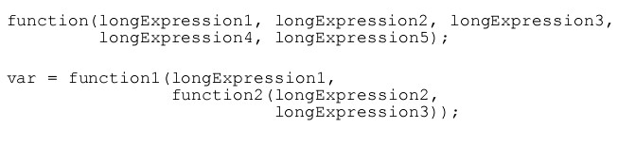
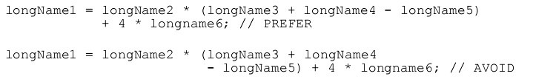
CCS: File Organization (con’t)
Wrapping line

Slide 21
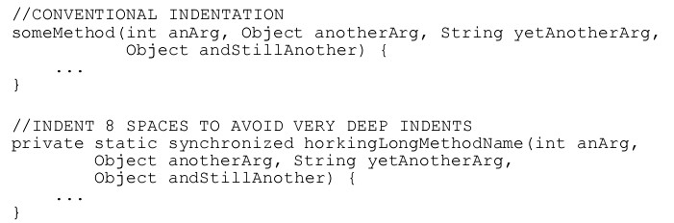
CCS: File Organization (con’t)
Wrapping line

Slide 22
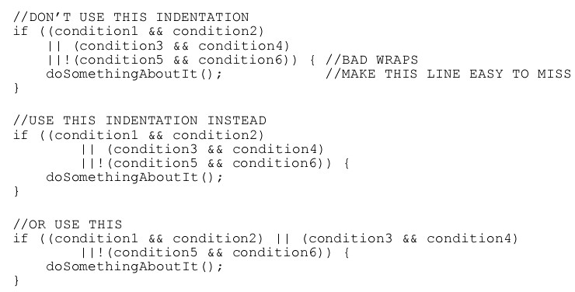
CCS: File Organization (con’t)
Wrapping line

Slide 23
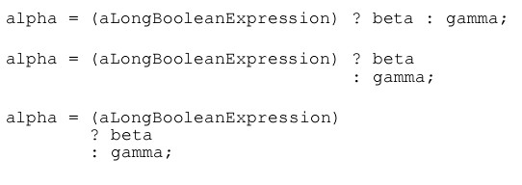
CCS: File Organization (con’t)
Wrapping line

Slide 24

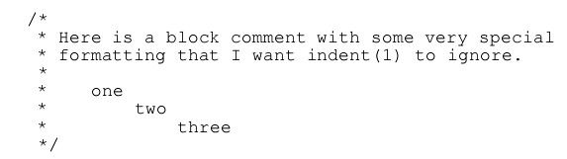
CCS: Comments
Block comment: Block comments can start with/*-, which is recognized byindent(1) as the beginning of a block comment that should not reformatted.

Slide 25
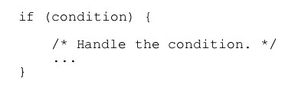
CCS: Comments
Single-line comment: A single-line comment should be preceded by a blank line.

Slide 26
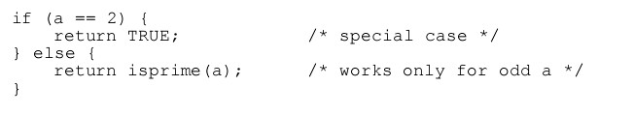
CCS: Comments
Trailing comment: Very short comments can appear on the same line as the code they describe, but should be shifted far enough to separate them from the statements.

Slide 27
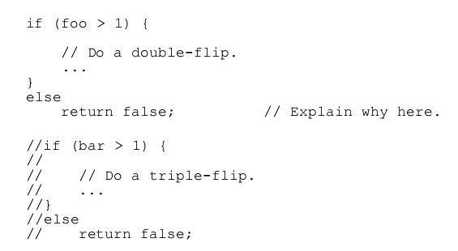
CCS: Comments
End of line comment: The// comment delimiter begins a comment that continues to the new line. It can comment out a complete line or only a partial line

Slide 28


CCS: Declarations
Number per line: One declaration per line is recommended since it encourages commenting. In other words,

Slide 29
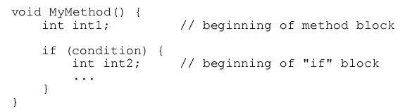
CCS: Declarations
Placement: Put declarations only at the beginning of blocks. (A block is any code surrounded by curly braces “{” and “}”.)

Slide 30
CCS: Declarations
Initialization:
- Try to initialize local variables where they’re declared.
- The only reason not to initialize a variable where it’s declared is if the initial value depends on some computation occurring first.

Slide 31
CCS: Declarations
Class & Interface declaration:
No space between a method name and the parenthesis “(“ starting its parameter list
Open brace “{” appears at the end of the same line as the declaration statement

Slide 32
CCS: Declarations
Class & Interface declaration:
Closing brace “}” starts a line by itself indented to match its corresponding opening statement, except when it is a null statement the “}” should appear immediately after the “{“.
Methods are separated by a blank line.

Slide 33
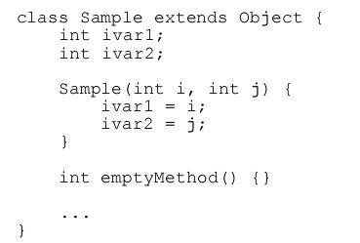
CCS: Declarations
Class & Interface declaration:

Slide 34
CCS: Statements
Simple Statement:
Each line should contain at most one statement.
int a, b; // AVOID
Do not use the comma operator to group multiple statements unless it is for an obvious reason.
if (err) {
//VERY WRONG!
Format.print(System.out, “error”), exit(1);
}

Slide 35
CCS: Statements
Compound Statement:
The opening brace should be at the end of the line that begins the compound statement the closing brace should begin a line and be indented to the beginning of the compound statement.

Slide 36
CCS: Statements
Compound Statement (con’t):
Braces are used around all statements, even singletons, when they are part of a control structure, such as aif-else or for statement. This makes it easier to add statements without accidentally introducing bugs due to forgetting to add braces.

Slide 37
CCS: Statements
return Statement:
A return statement with a value should not use parentheses unless they make the return value more obvious in some way. Example:
    return;
    return myDisk.size();
    return (size ? size : defaultSize);

Slide 38
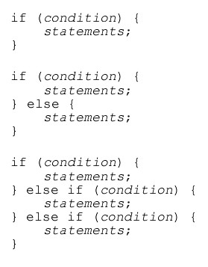
CCS: Statements
if/if-else/if-else-if-else statement:
The if-else class of statements should have the following form:

Slide 39

CCS: Statements
for Statement:
The for statement should have the following form:

Slide 40


CCS: Statements
while Statement:
The while statement should have the following form:

Slide 41

CCS: Statements
do-while Statement:
The do-while statement should have the following form:

Slide 42
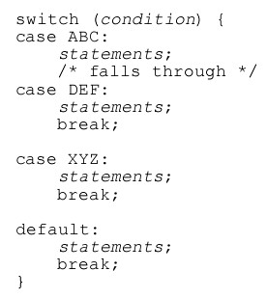
CCS: Statements
switch Statement:
The switch statement should have the following form:

Slide 43
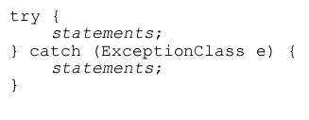
CCS: Statements
Try-catch Statement:
The try-catch statement should have the following form:

Slide 44
CCS: White space
Blank line:
Blank lines improve readability by setting off sections of code that are logically related.
Two blank lines should always be used in the following circumstances:
- Between sections of a source file
- Between class and interface definitions

Slide 45
CCS: White space
Blank line:
One blank line should always be used in the following circumstances:`
    - Between methods.
    - Between the local variables in a method and its first statement.
    - Before a block or single-line comment.

Slide 46
CCS: White space
Blank space:
Blank spaces should be used in the following circumstances:
- A keyword followed by a parenthesis should be separated by a space.
- A blank space should appear after commas in argument lists.
- All binary operators except . should be separated from their operands by spaces. Blank spaces should never separate unary operators such as unary minus, increment (“++”), and decrement (“--”) from their operands.

Slide 47


CCS: White space
Blank space:
- The expressions in a for statement should be separated by blank spaces.
- Casts should be followed by a blank

Slide 48
CCS: Naming Conventions
Identify | Rule for naming | Example
Classes & interfaces | Capitalize the first letter of each word, including the first | class VietCore; interface VietCore;
Methods | Use lowercase for the first word with the first letter of each following word capitalized. | getFirstName(); run();

Slide 49
CCS: Naming Conventions
Identify | Rule for naming | Example
Variables | -Naming same methods. ch: character. i, j: a loop index. p: a pointer (c/c++) -n: a number. | firstName; //all $firstName; //PHP only
Constants | All capitalize with underscore separator each word. | final int MAX_VALUE = 1; const MAX_VALUE = 1; //PHP, C/C++/ AS

Slide 50
CCS: Naming Conventions
Identify | Rule for naming | Example
Macro(C/C++/PHP) | Same constants. | FOREVER { for(; ; ;) }

Slide 51
References
Code Complete I.
Java Coding Conventions.
PHP Coding Standing.

