Slide 1
Version Control with SubVersion
Presenter: Hau Nguyen – Technical Director of VC
Created date: 17 Nov 2006
Last updated date: 17 Nov 2006

Slide 2
Why is version control ?
"Hey, Jane, could you send me a copy of those changes you made last Tuesday?"
"Bob, this function doesn't work anymore. Did you change something?"
"Sorry, I can't seem to find those old classes. I guess you'll just have to re-implement them."
"Ok, we've all been working hard for the last week. Now let's integrate everyone's work together."

Slide 3
What is version control ?
Version control system is the tool to keep track of the changing states of files over time and merge contributions of multiple developers. It stores a history of changes made over time by different people. In this way, it is possible to roll back those changes and see what the files looked like before they were applied. Additionally, a version control system will provide facilities for merging the changes, using one or more methods ranging from file locking to automatic integration of conflicted changes

Slide 4
Advantages
Gives the team a project-wide undo button; nothing is final, and mistakes are easily rolled back.
Allows multiple developers to work on the same code base in a controlled manner.
Keeps a record of the changes made over time.
Distribution of Work
Allows you to support multiple releases of your software at the same time as you continue with the main line of development.
Productivity

Slide 5
Versioning Models
File Sharing
Lock-Modify-Unlock Solution
Copy-Modify-Merge Solution

Slide 6
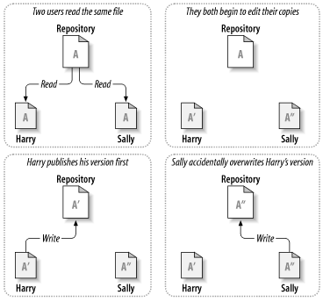
File Sharing model

Slide 7
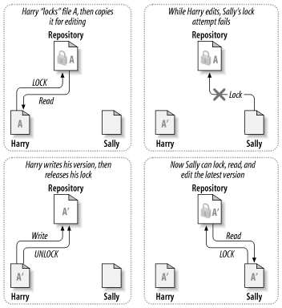
Lock-Modify-Unlock Solution

Slide 8
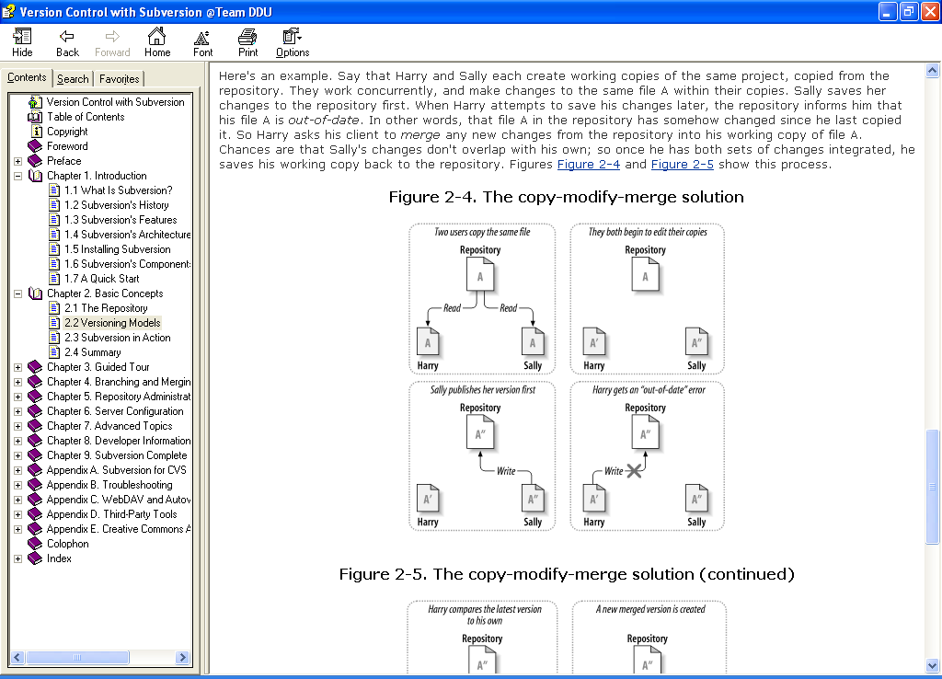
Copy-Modify-Merge Solution

Slide 9
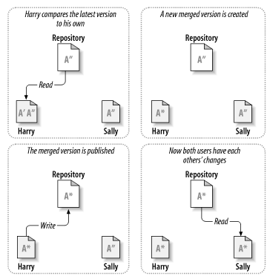
Copy-Modify-Merge (cont.)

Slide 10
Elements of Version control
Repository
Working Directory
Revisions
Logs
Tagging
Branching
Locking versus Merging

Slide 11
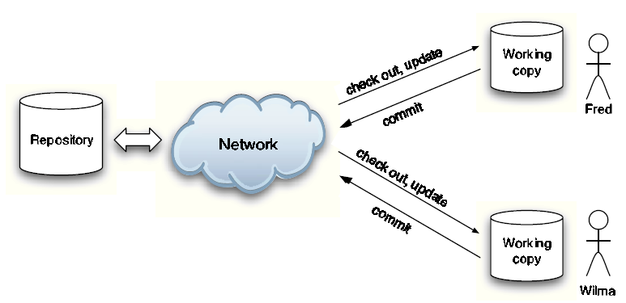
Repository
Filesystem-based
Berkeley DB

Slide 12
Working directory
Working directories generally allow individual developers to work locally, adding and testing changes as necessary, during the development process. Once a change or set of changes is deemed complete, the developer is able to commit the changes back into the repository, where they become a part of the project.

Slide 13
Revision
Version control systems don't just store the most recent state of a project. Instead, they store a history of changes to the project over time. Whenever a developer commits changes to a project, those changes are stored in a revision.
2 revision type:
  File-level revisions that refer to the state of an individual file.
  Global point revision that refer to the state of the entire repository at a given point

Slide 14
Version Identification
It is a good idea to decide on a convention for version numbers (or identifiers)
Examples:
  Linux kernel: 2.n, odd n indicates development branch and even n the stable branch
  Hypothetical: x.y.z-TAG
    x — major version number
    y — minor revision
    z — bug-fix release
    TAG — eg operating system, special features, etc

Slide 15
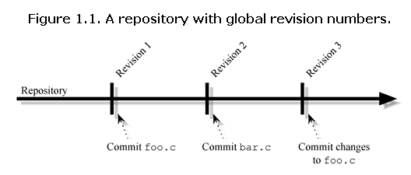
Global point revision

Slide 16
Logs
To show changes that have occurred from one project release to another.
A much better solution to tracking logical project changes is to include a log along with each repository commit.
The log would allow developers to enter the reason and substance of the change they are committing, in plain English.

Slide 17
Tagging
Most version control systems provide a means by which you can tag revisions, so that they can be referred back to at a later date. This frees the developer from reliance on references with poor contextual relation, such as revision numbers or dates. Tags can be placed at development milestones, to allow development in a project to continue, without hurting the ability for someone to later go back and see a snapshot of the project's source at that milestone.

Slide 18
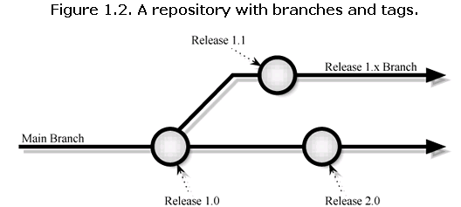
Branching
At any given revision, a branch can be created, with development continuing from that point in two parallel paths. Each branch can be worked on independently, and changes committed to one branch will not affect any other branches of the project.
It is usually possible to merge all or part of two branches together.

Slide 19
Locking
Locking: locks a versioned file when beginning to make changes. While the file is locked, no other developer will be allowed to make any changes. Then, when the developer has finished, the changed file can be committed back into the repository and the file can be unlocked.

Slide 20
Merging
Merging: developers can modify files in their working copies of the repository without regard for what others are doing. Then, once the developers have finished making their changes, they can commit those changes, and the version control system will check to see if there are any collisions caused by two people simultaneously editing a file.
In many cases, the system will automatically merge two files together; but if it can't, most systems will provide the developer making the commit with information about the conflicted area, to allow the developer to merge the changes by hand.

Slide 21
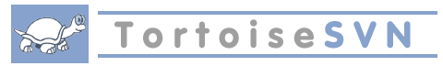
Using tools
TortoiseSVN tool
Embed IDE SubVersion tool
  Subversion plugin for the Eclipse
  Subversion plugin for JDeveloper

Slide 22
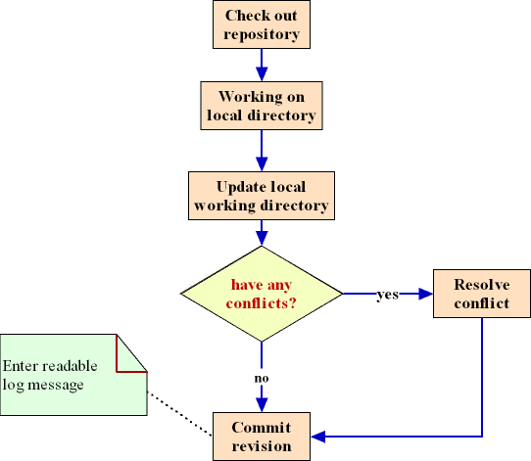
Workflow When Using Version Control (For developer)

Slide 23
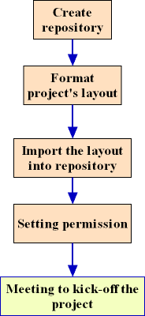
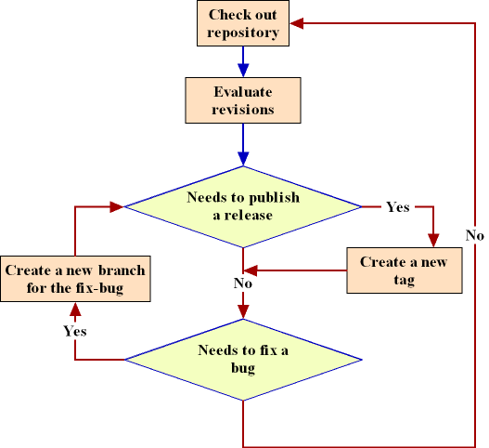
Workflow When Using Version Control (For PM)
(1)
(2)

Slide 24
Repository Layout
/repository
  /trunk → The main development branch
    /src → source code
    /docs → documents
    ./libs → used libraries
  /branches → stores project branches
  /releases → stores project releases
  /spd → stores project specification documents
  /buildDaily → stores project build daily

Slide 25
Accessing a Repository
There are 3 types of accessing:
  Direct Access Control
  svnserve Access Control
  WebDAV/DeltaV protocol
VietCore Corp. use WebDAV/DeltaV protocol
Url: http://192.168.0.250/svn (temporary)
(https://192.168.0.250/svn) (SSL)

Slide 26
Using SubVersion commands
Checking out resource
Keeping Up-to-Date
Viewing Differences
Undo Changes

Slide 27
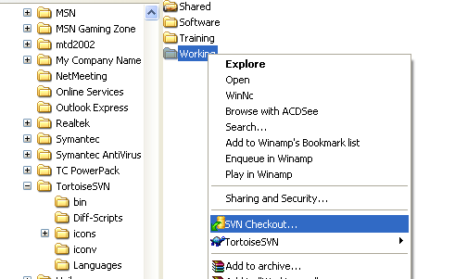
Checking out resource
TortoiseSVN → Checkout...

Slide 28
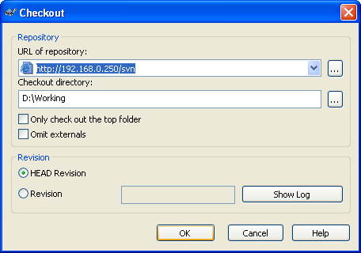
Checking out resource (cont.)
Provide URL of repository

Slide 29
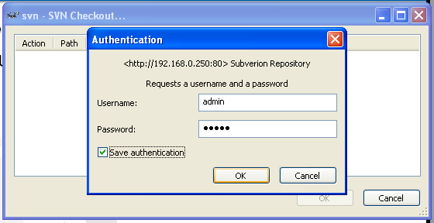
Checking out resource (cont.)
Provide username, password for authentication

Slide 30
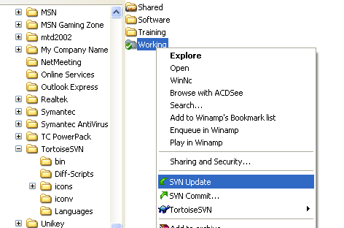
Keeping Up-to-Date
TortoiseSVN → Update

Slide 31
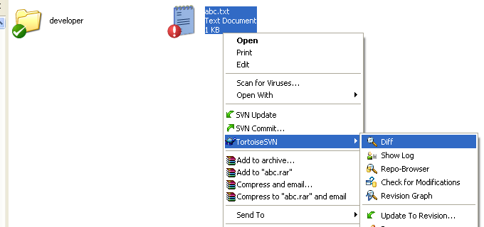
Viewing Differences
Local changes: TortoiseSVN → Diff

Slide 32
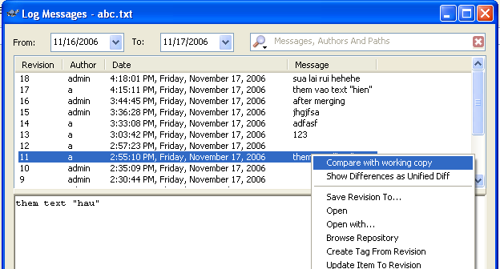
Viewing Differences (cont.)
Difference from a previous revision

Slide 33
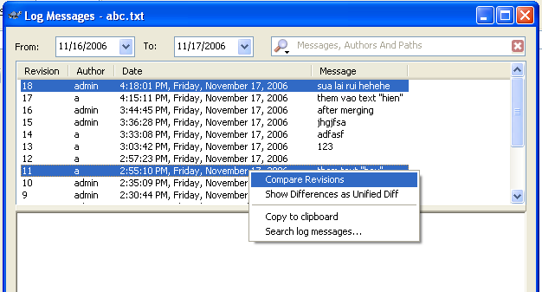
Viewing Differences (cont.)
Difference between two previous revisions

Slide 34
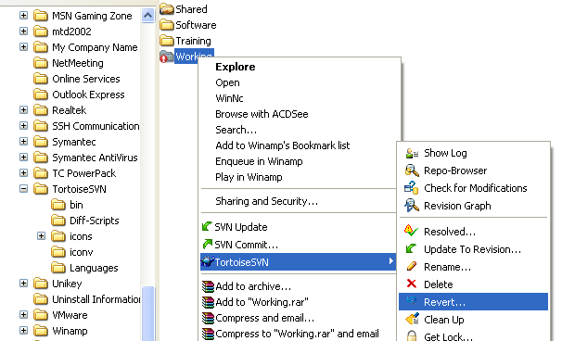
Undo Changes
TortoiseSVN → Revert

Slide 35
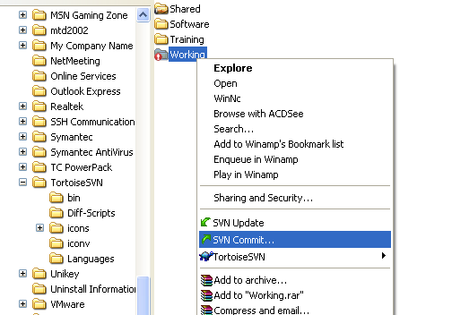
Commit changes
Right click → SVN Commit

Slide 36
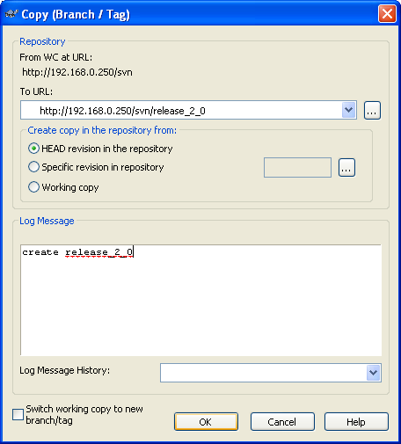
Creating a branch or tag
TortoiseSVN → Branch/Tag...

Slide 37
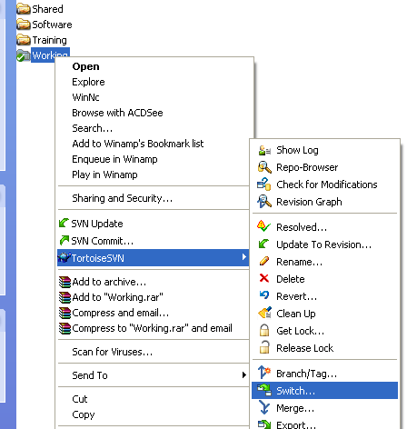
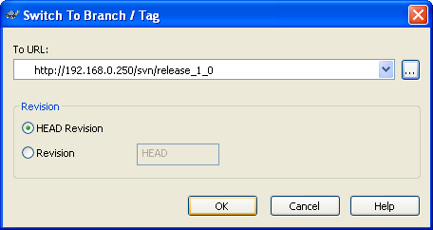
Switch to a Branch or Tag
TortoiseSVN → Switch...

Slide 38
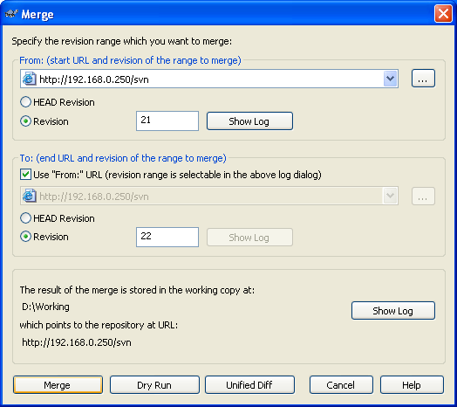
Merging
TortoiseSVN → Merge...

Slide 39
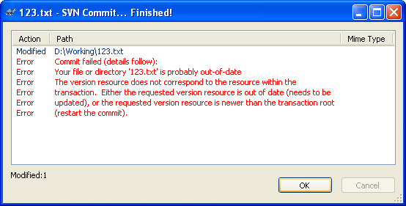
Conflicts
The error message when having any conflict

Slide 40
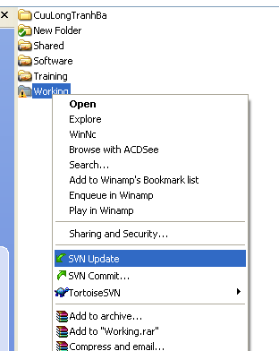
Resolve conflicts
Firstly, updates with lastest revision

Slide 41
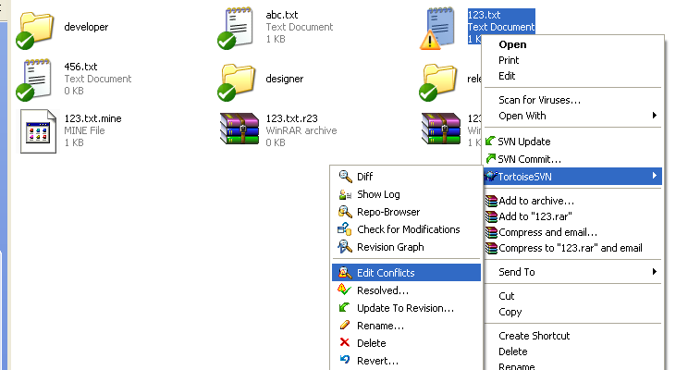
Edit conflicts
TortoiseSVN → Edit Conflicts

Slide 42
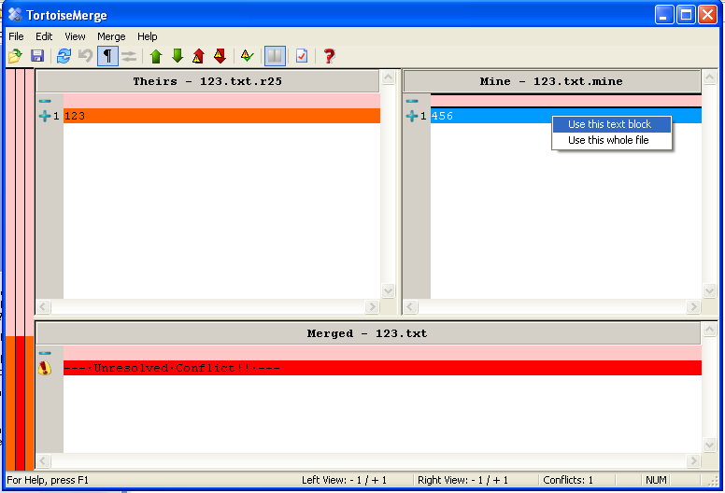
Edit conflicts (cont.)

Slide 43
Q&A

