Slide 1
Advance Android Application
By Loc Nguyen
Senior Engineer of GCS

Slide 2
Outline
User Interface
Using database on Android
Remote Procedure Calls (RPCs)
Using service
SMS message
Working with file on Android
Upload file on sever
Widget
2D Graphics
Customized UI
XML and RSS
SOAP
Confidential
Page <number>

Slide 3
Outline
User Interface
  Layout
  Menu
  Dialog
  Handle UI Events
Using database on Android
Remote Procedure Calls (RPCs)
Using service
SMS message
Working with file on Android
Upload file on sever
Widget
2D Graphics
Customized UI
XML and RSS
SOAP
Confidential
Page <number>

Slide 4
User interface
The user interface is built using View and ViewGroup objects
Common component in user interface
  Layout
  Menu
  Dialog
  Handling User interface event

Slide 5
User interface - Declaring Layout
Layout is the architecture for the user interface in an Activity
It defines the layout structure and holds all the elements that appear to the user
Have two way to declare layout:
  Declare UI elements in XML.
  Instantiate layout elements at runtime

Slide 6
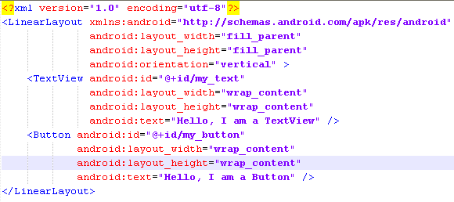
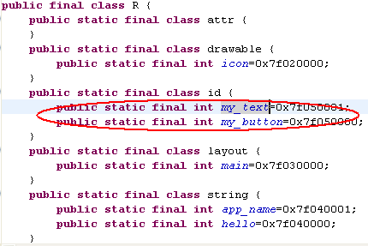
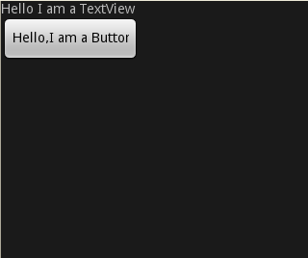
User interface - Declaring Layout
Declare UI elements in XML.
  Write hardcode
  Use GUI in Eclipse
This command specify const “my_button” in subclass id in R.java file
//To get element from java code
Button myButton;
…
myButton=(Button) findViewById(R.id.my_button);

Slide 7
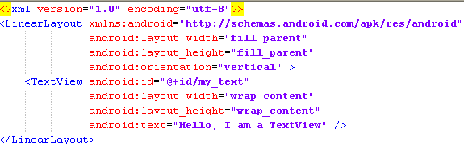
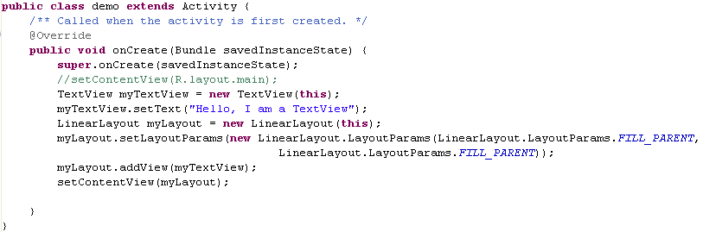
User interface - Declaring Layout
Instantiate layout elements at runtime
  Element names in XML file correspond to class names and attribute names correspond to methods

Slide 8
User interface - Menu
Android offers three fundamental types of application menus:
  Options Menu
  Context Menu
  Submenu

Slide 9
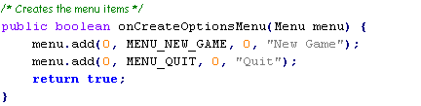
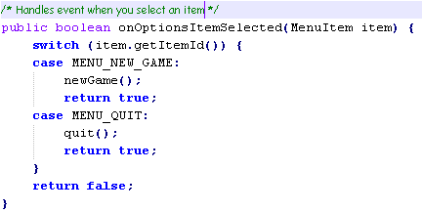
Menu – Option Menu
To create option menu, in activity class add method onCreateOptionMenu() and use menu.add() to add menu
Menu.add (group_Id, item_Id, order, title )
To control event cause by click on menu item, in activity class add method onOptionsItemSelected().
Id Number for handle event on item

Slide 10
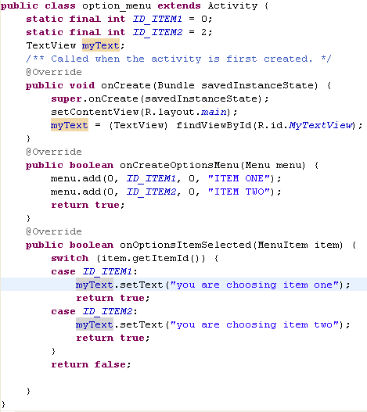
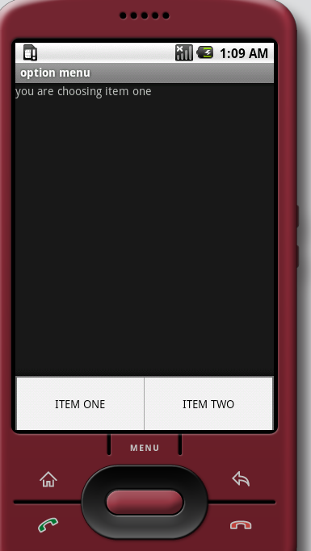
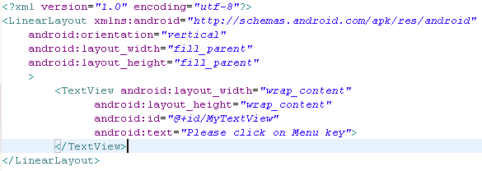
Menu – Option Menu
Example:
Layout file and activity file
Confidential
Page <number>

Slide 11
Menu – Context Menu
Context Menu
  The Android context menu is similar, in concept, to the menu revealed with a "right-click" on a PC
  It’s appear when perform a long-press.
  Most often used for items in a ListView
To create a context menu, you must override the Activity's context menu callback methods: onCreateContextMenu()
To handle event cause by click on item you also must override the Activity's context menu callback methods:onContextItemSelected();

Slide 12
Menu – Submenu
Submenus
  A sub menu can be added within any menu, except another sub menu.
  Useful when your application has a lot of functions that may be organized in topics
  Like the items in a PC application's menu bar (File, Edit, View, etc.)
A sub menu is created by adding it to an existing Menu with addSubMenu().

Slide 13
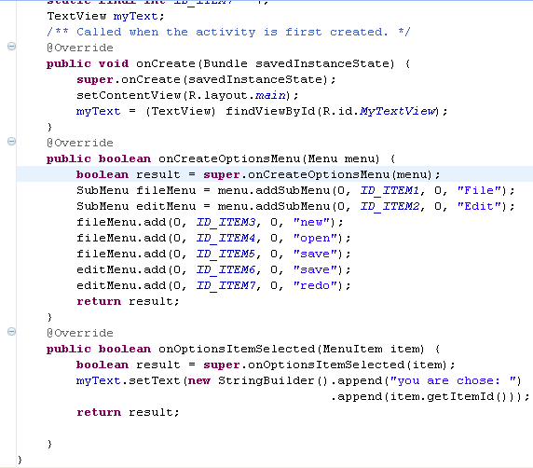
Menu – Submenu
Example: assume your layout only has 1 TextView specify id by MyTextView. This code below look like with option menu:
Confidential
Page <number>

Slide 14
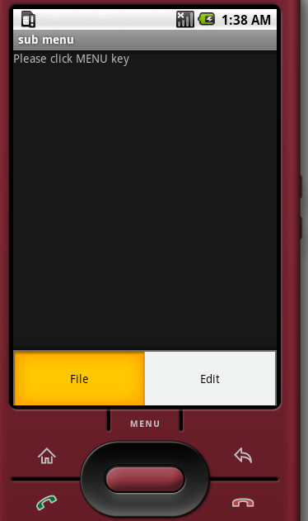
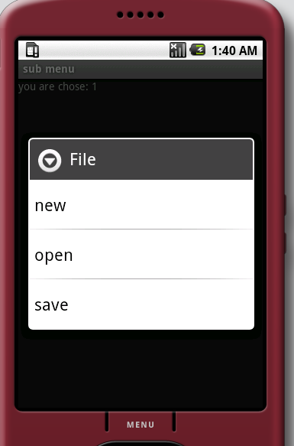
Menu – Submenu
Result:
Confidential
Page <number>

Slide 15
Dialog
A dialog is usually a small window that appears in front of the current Activity
The Android API supports the following types of dialog objects:
  AlertDialog
  ProgressDialog
  DatePickerDialog
  TimePickerDialog
To show and handle a dialog do some step below:
  Call shoDialog(id_of_dialog) method.
  Override onCreateDialog(int id) to setup the kind of dialog
To dismiss dialog use dismissDialog(<Dialog_id>) method.

Slide 16
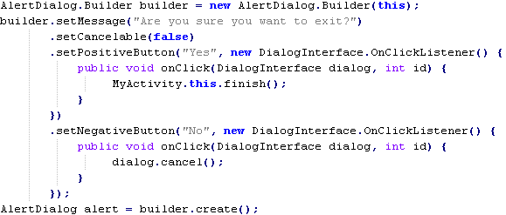
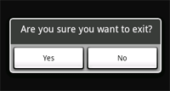
Dialog - AlertDialog
A dialog that can manage zero, one, two, or three buttons, and/or a list of selectable items that can include checkboxes or radio buttons
Example: Copy this code to onCreate() method

Slide 17
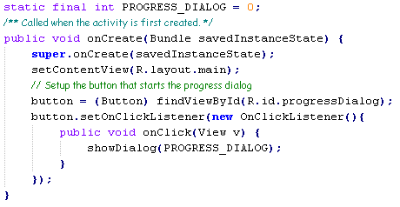
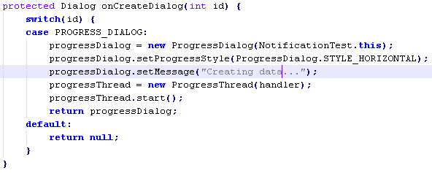
Dialog - ProgressDialog
A dialog that displays a progress wheel or progress bar
It also supports buttons
You can create a new thread run background to calculate state of progress
Example
Setup to show dialog
Setup for dialog before run
Add thread run in background

Slide 18
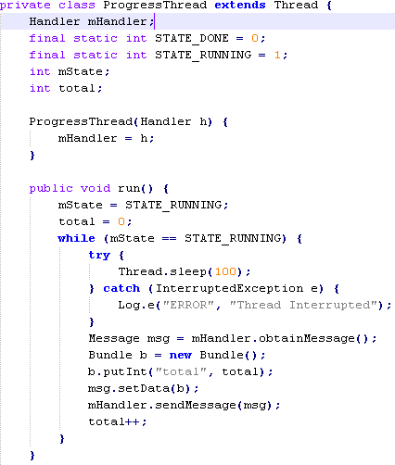
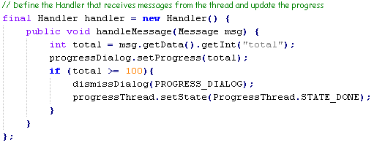
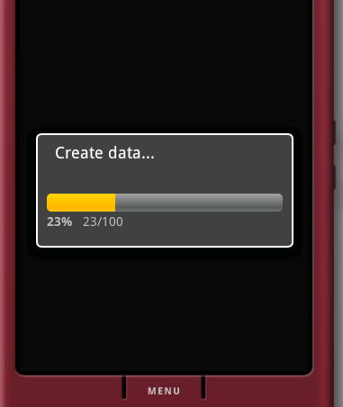
Dialog - ProgressDialog
Control thread in background and handle message
Setup how many percent to complete

Slide 19
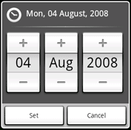
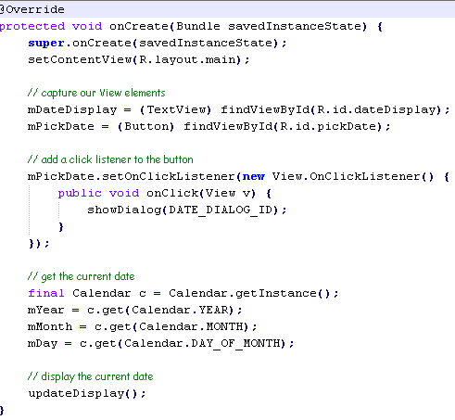
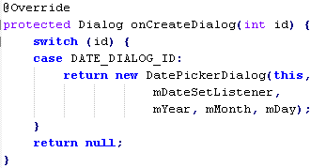
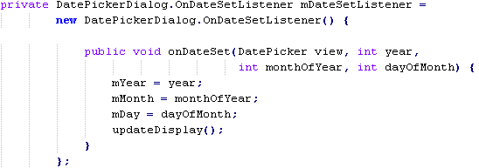
Dialog - DatePickerDialog
A dialog that allows the user to select a date
Example:

Slide 20
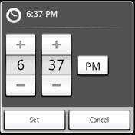
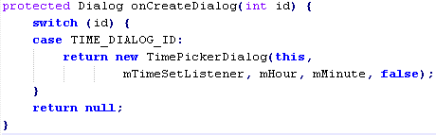
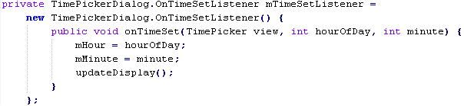
Dialog - TimePickerDialog
Almost look like DatePickerDialog, but for select time
Example to setup and get time from
TimePickerDialog

Slide 21
Handle UI Events
Android provide some kind of handler to control event:
  Event listener.
  Handler event
  Touch mode
  Handle focus
Confidential
Page <number>

Slide 22
Handle UI Events - Event listener
Android provide some event listener:
  onClick
  onLongClick
  onFocusChange
  onKey
  onTouch
  onCreateContextMenu
Confidential
Page <number>

Slide 23
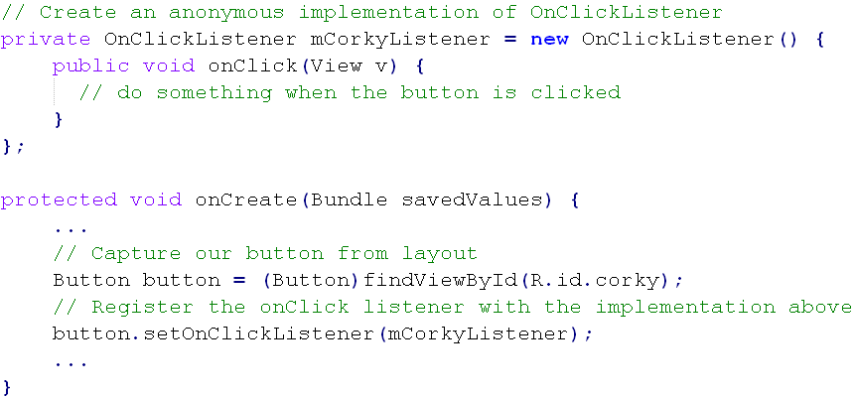
Handle UI Events - Event listener
The example below shows how to register an on-click listener for a Button.
Confidential
Page <number>

Slide 24
Handle UI Events - Handlers Event
Handlers Event
  onKeyDown(int, KeyEvent) - Called when a new key event occurs.
  onKeyUp(int, KeyEvent) - Called when a key up event occurs.
  onTrackballEvent(MotionEvent) - Called when a trackball motion event occurs.
  onTouchEvent(MotionEvent) - Called when a touch screen motion event occurs.
  onFocusChanged(boolean, int, Rect) - Called when the view gains or loses focus.
Confidential
Page <number>

Slide 25
Handle UI Events - Touch mode
Touch mode
  When user use keyboard or trackball to input data, the view object have focus and lost focus event.
  When user begins interacting with the interface by touching it, then it is no longer necessary to highlight items ==> “Touch mode”
  Once the user touches the screen, the device will enter touch mode
  To verify View enter touch mode or not, we can use isFocusableInTouchMode() method. Return true is in touch mode, return false if not.
  And to set focus in touch mode we use setFocusableInTouchMode()
Confidential
Page <number>

Slide 26
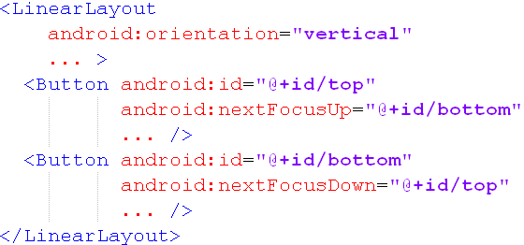
Handle UI Events - Focus Handling
Focus Handling
  To verify an object View is focused or not, we use isFocusable() method.
  To set focus for view object, we use setFocusable()
  Focus movement is based on an algorithm which finds the nearest neighbor in a given direction
  you can provide explicit overrides with the following XML attributes in the layout file
Confidential
Page <number>

Slide 27
Example – Event handler
Draw button by layout file.
Get id of button by use findViewById(R.id.<id_of_button>)
Catch event click by use setOnClickListener() method of button object
Confidential
Page <number>

Slide 28
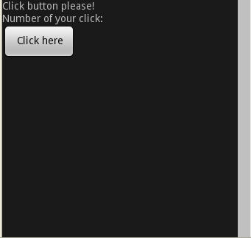
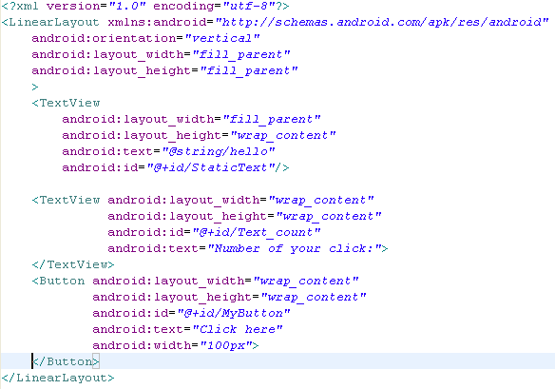
Example – Event handler
In layout file you have 2 TextView and 1 Button:
Confidential
Page <number>

Slide 29
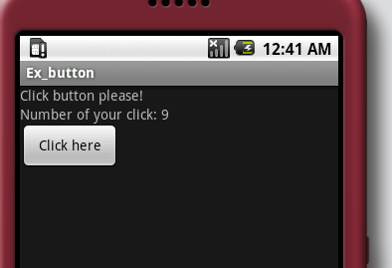
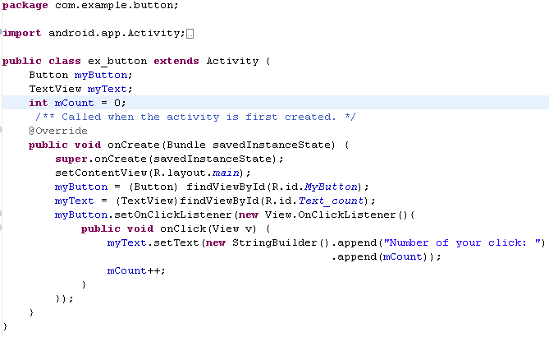
Example – Event handler
In activity file write code below->run project and get result:
Confidential
Page <number>

Slide 30
Outline
User Interface
Using database on Android
Remote Procedure Calls (RPCs)
Using service
SMS message
Working with file on Android
Upload file on sever
Widget
2D Graphics
Customized UI
XML and RSS
SOAP
Confidential
Page <number>

Slide 31
Using database on Android
Android support SQLite library to make and query a database easily
To execute a SQL comment you can use SQLiteDatabase.execSQL() method:
  Example: to create a database have 3 field: _id, title, body:
  myDatabase.execSQL(“_id integer primary key autoincrement, title text not null, body text not null”);
To make a query you can use: SQLiteDatabase. Query().
It’s also support some method: update(), delete(), insert()…
Example: see example Notepad on SDK document

Slide 32
Outline
User Interface
Using database on Android
Remote Procedure Calls (RPCs)
Using service
SMS message
Working with file on Android
Upload file on sever
Widget
2D Graphics
Customized UI
XML and RSS
SOAP
Confidential
Page <number>

Slide 33
Remote procedure calls
a method is called locally, but executed remotely (in another process), with any result returned back to the caller.
All methods are executed synchronously (the local method blocks until the remote method finishes), even if there is no return value

Slide 34
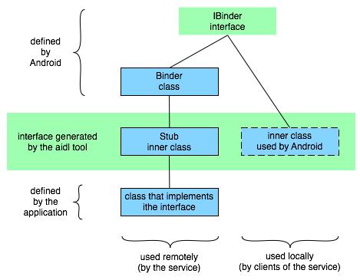
Remote procedure calls
Mechanism works (continue):
  Declaring the RPC interface you want to implement using a simple IDL (interface definition language). This file have extension is .aidl. Java interface definition that must be made available to both the local and the remote process.
  The inner classes have all the code needed to administer remote procedure calls for the interface you declared with the IDL.

Slide 35
Outline
User Interface
Using database on Android
Remote Procedure Calls (RPCs)
Using service
SMS message
Working with file on Android
Upload file on sever
Widget
2D Graphics
Customized UI
XML and RSS
SOAP
Confidential
Page <number>

Slide 36
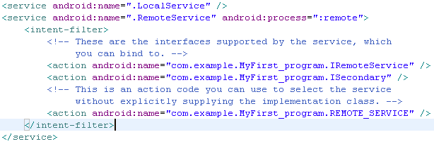
Using service
A service doesn't have a visual user interface
Runs in the background for an indefinite period of time
You can specify service run with own process or another process.
  Local service
  Remote service
Add element service in Manifest file. Ex:
In local service you don’t need to add interface for RPC
In Remote service you need add interface by using adl tool.

Slide 37
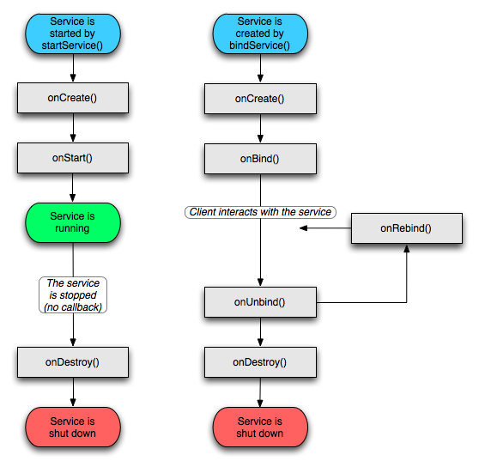
Using service
A service can be used in two ways:
  Start/Stop service:
    Context.startService()
    Context.stopService()
    Service.stopSelf()
    Service.stopSelfResult()
  Clients establish a connection
  to the Service object:
    Context.bindService()
    Context.unbindService()

Slide 38
Using service
Steps to bind a service:
  Clients of the service (on the local side) would implement onServiceConnected() and onServiceDisconnected()
  Clients will call bindService() to set up the connection
  The service's onBind() method would be implemented to either accept or reject the connection. If the connection is accepted, it returns an instance of the Stub subclass
  Android calls the client's onServiceConnected() method and passes it an IBinder object, a proxy for the Stub subclass managed by the service

Slide 39
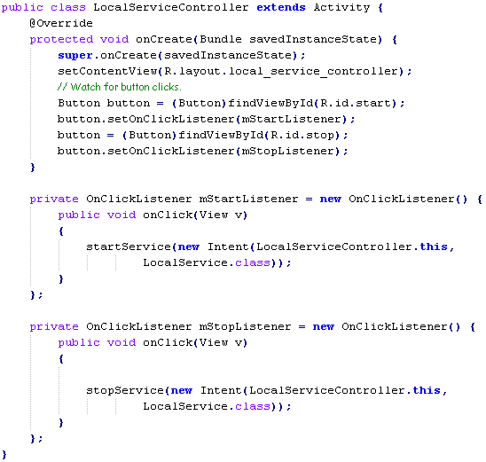
Using service
Example local service – unbind service. Activity file

Slide 40
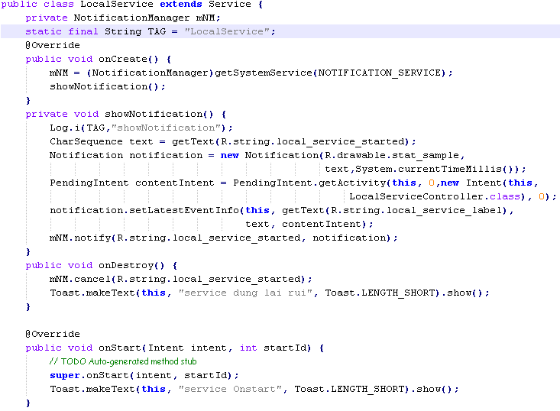
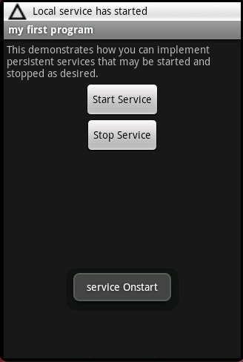
Using service
Example local service – unbind service. Service file

Slide 41
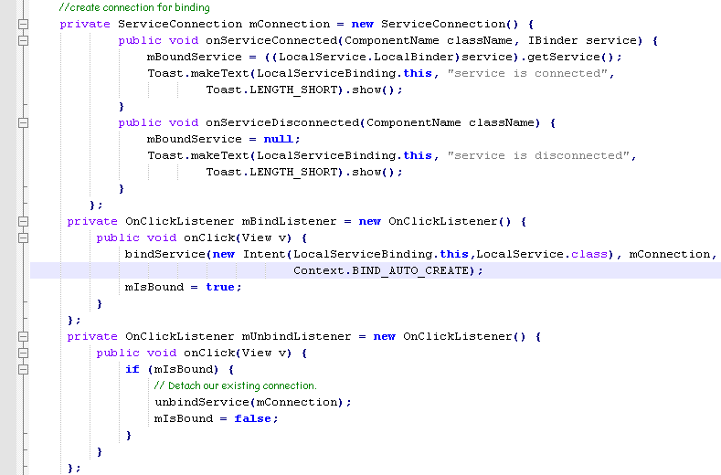
Using service
Example for using local service – bind service
Code in activity file

Slide 42
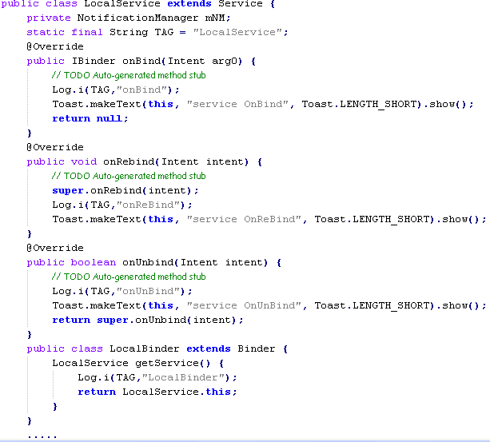
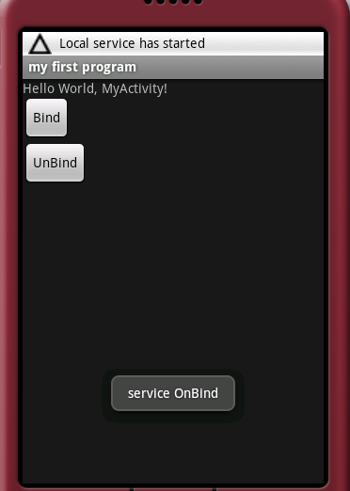
Using service
Example for using local service – bind service

Slide 43

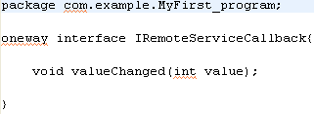
Using service
Using Remote service
  Create 2 interface which implement in service and client. This file will be saved with extension .aidl
Implement in service
Implement in client

Slide 44
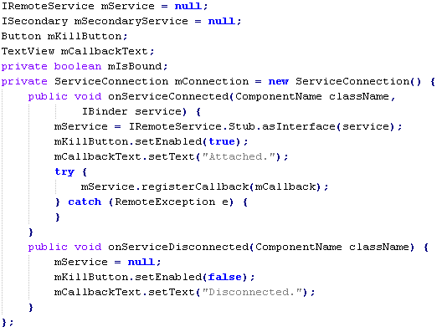
Using service
  Create connection to bind service

Slide 45
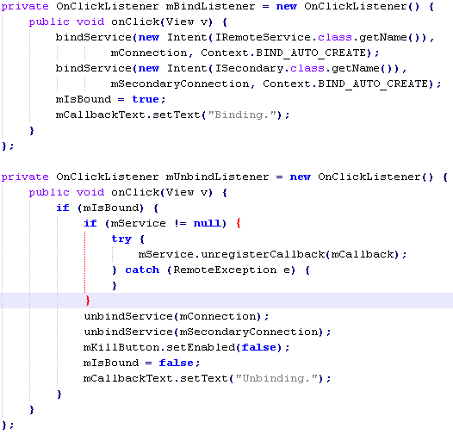
Using service
  Bind/UnBind service

Slide 46
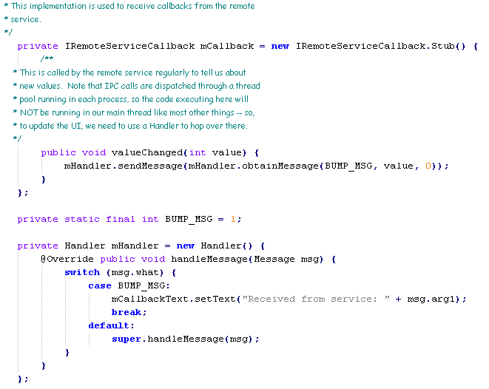
Using service
Implement interface for callback from service

Slide 47
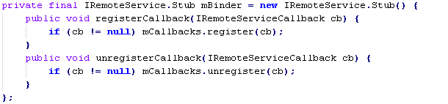
Using service
On service file: you have to Implementation service interface.
On service file: Define an RemoteCallbackList object. Look like:

Slide 48
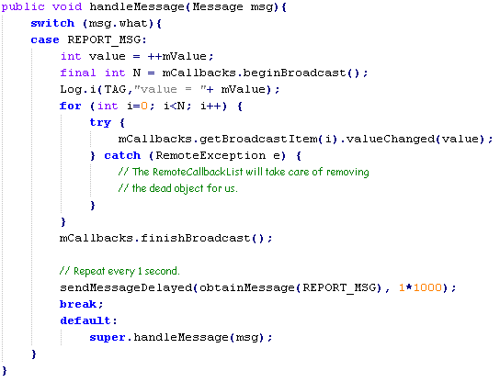
Using service
On service file make a callback to return result for activity (or another component).
Callback to activity

Slide 49
Outline
User Interface
Using database on Android
Remote Procedure Calls (RPCs)
Using service
SMS message
Working with file on Android
Upload file on sever
Widget
2D Graphics
Customized UI
XML and RSS
SOAP
Confidential
Page <number>

Slide 50
SMS message
Android provide classes to help us working with message, these are:
android.telephony.gsm.SmsMessage;
  android.telephony.gsm.SmsManager;
If an application wants to work with messages, it must define with permission: READ_SMS, RECEIVE_SMS, SEND_SMS,..
<uses-permission
android:name="android.permission.RECEIVE_SMS">
</uses-permission>

Slide 51
SMS message
When our phone receive an SMS message , a service which has action filter is: “android.provider.Telephony.SMS_RECEIVED” is called for processing received SMS.
<intent-filter>
<action android:name="android.provider.Telephony.SMS_RECEIVED" />
</intent-filter>
For processing received messages we use class: android.telephony.gsm.SmsMessage;

Slide 52
SMS message
An Example processing SMS when SMS is received.
public class SMSReceiver extends BroadcastReceiver {
@Override
public void onReceive(Context context, Intent intent) {
// every time a message is received this function will be called.
Bundle bundle = intent.getExtras();
Object messages[] = (Object[]) bundle.get("pdus");
SmsMessage smsMessage[] = new SmsMessage[messages.length];
for (int n = 0; n < messages.length; n++) {
smsMessage[n] = SmsMessage.createFromPdu((byte[]) messages[n]);
}
// do every thing you want with received messages
}
}

Slide 53
SMS message
For sending message we can use class:
  android.telephony.gsm.SmsManager;
An Example send SMS using SmsManager:
public class SMS extends Activity {
  @Override
  public void onCreate(Bundle savedInstanceState)
  { }
  private void sendSMS(String phoneNumber, String message) { PendingIntent pi = PendingIntent.getActivity(this, 0, new Intent(this, SMS.class), 0);
  SmsManager sms = SmsManager.getDefault(); sms.sendTextMessage(phoneNumber, null, message, pi, null);
  }
}

Slide 54
Outline
User Interface
Using database on Android
Remote Procedure Calls (RPCs)
Using service
SMS message
Working with file on Android
Upload file on sever
Widget
2D Graphics
Customized UI
XML and RSS
SOAP
Confidential
Page <number>

Slide 55
Working with file on Android
Because the Security-Model of Android, we cannot use standard java file access.
  Each *.apk File that is installed on Android gets its own User-ID from the Linux System. This ID protects the application (and its files) from other apps
  Every file that is generated by our code gets is 'signed' with the User-ID of the Application that created it.
  Our app can set flags to make the file accessible (read and/or write) for other applications with other User-IDs (Flags: MODE_WORLD_READABLE and/or MODE_WORLD_WRITEABLE).
  The file is located in the following folder on your android : /data/data/your_project_package_structure/files/
But on SD-Cards, it is still possible with 'normal' Java methods.
  FileWriter f = new FileWriter("impossible.txt");

Slide 56
Working with file on Android
An Example create a file for writing.
private boolean SaveDataToFile(String data)
{
try
{
String FILENAME = "log.txt";
FileOutputStream fos = openFileOutput(FILENAME, Context.MODE_WORLD_WRITEABLE);
fos.write(data.getBytes());
fos.close();
return true;
} catch(IOException e) {
e.printStackTrace();
return false;
}
}

Slide 57
Working with file on Android
An Example open a file for writing.
private boolean apendToFile(String data){
try {
  String FILENAME = "log.txt";
FileOutputStream fos = openFileOutput(FILENAME, Context.MODE_APPEND);
OutputStreamWriter ouwriter = new OutputStreamWriter(fos);
ouwriter.append(data);
ouwriter.close();
  fos.close();
return true;
}catch(IOException e) {
e.printStackTrace();
return false;
}
}

Slide 58
Working with file on Android
An Example open a file for reading.
public String Readfile(){
FileInputStream fIn = null;
InputStreamReader isr = null;
char[] inputBuffer;
String data = null;
try{
fIn = openFileInput("log.txt");
isr = new InputStreamReader(fIn);
inputBuffer = new char[fIn.available()];
isr.read(inputBuffer);
data = new String(inputBuffer);
  isr.close();
fIn.close();
}catch (Exception e) {
e.printStackTrace();
}
return data;
}

Slide 59
Outline
User Interface
Using database on Android
Remote Procedure Calls (RPCs)
Using service
SMS message
Working with file on Android
Upload file on sever
Widget
2D Graphics
Customized UI
XML and RSS
SOAP
Confidential
Page <number>

Slide 60
Upload file on sever
For upload file from Android to sever we can use the standard lib of java:
  java.net.HttpURLConnection;
  java.net.URL;
Reference to this example below:
    upload file Aplication

Slide 61
Outline
User Interface
Using database on Android
Remote Procedure Calls (RPCs)
Using service
SMS message
Working with file on Android
Upload file on sever
Widget
  Overview
  Basic steps to create a widget
  Advance steps to create a widget
  Notes
2D Graphics
Customized UI
XML and RSS
SOAP
Confidential
Page <number>

Slide 62
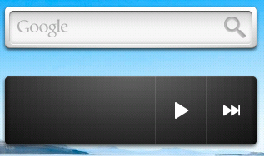
Widget - Overview
App Widgets are miniature application views that can be embedded in other applications (such as the Home screen) and receive periodic updates
An application component that is able to hold other App Widgets is called an App Widget host. To add a widget into app widget host, long press on app widget host and choose widget from popup menu.
Widgets use 4 intents:
  ACTION_APPWIDGET_UPDATE
  ACTION_APPWIDGET_DELETED
  ACTION_APPWIDGET_ENABLED
  ACTION_APPWIDGET_DISABLED

Slide 63
Widget – Basic steps to create a widget
To create an App Widget, you need the following:
  AppWidgetProviderInfo object: This object is XML file
    Describes the metadata for an App Widget, such as the App Widget's layout, update frequency, and the AppWidgetProvider class.
  AppWidgetProvider class implementation
    Defines the basic methods that allow you to programmatically interface with the App Widget, based on broadcast events. Through it, broadcasts event will be received when the App Widget is updated, enabled, disabled and deleted.
  View layout
    Defines the initial layout for the App Widget, defined in XML.
  Additionally, an App Widget configuration Activity can be implemented if needed. This is an optional if we want user modifies App Widget settings at create-time.
  Configure the AndroidManifest.xml

Slide 64
Widget – AppWidgetProviderInfo Object
Define the AppWidgetProviderInfo object in an XML resource using a single <appwidget-provider> element and save it in the project's res/xml/ folder.
  < appwidget-provider xmlns:android="http://schemas.android.com/apk/res/android"
  android:minWidth="146dip"
  android:minHeight="72dip"
  android:updatePeriodMillis="10000"
  android:initialLayout="@layout/main“ />
The updatePeriodMillis attribute defines how often the App Widget framework should request an update from the AppWidgetProvider by calling the onUpdate() method.
The initialLayout attribute points to the layout resource that defines the App Widget layout.

Slide 65
Widget – AppWidgetProvider Class
The AppWidgetProvider class extends BroadcastReceiver as a convenience class to handle the App Widget broadcasts:
  public class HelloWidget extends AppWidgetProvider
The AppWidgetProvider receives only the event broadcasts that are relevant to the App Widget, such as when the App Widget is updated, deleted, enabled, and disabled:
  onUpdate(Context, AppWidgetManager, int[])
  onDeleted(Context, int[])
  onEnabled(Context)
  onDisabled(Context)
  onReceive(Context, Intent)
Note: In Android 1.5, there is a known issue in which the onDeleted() method will not be called when it should be. To work around this issue, implement onReceive() to receive the onDeleted() callback.

Slide 66
Widget – View Layout
Define an initial layout for your App Widget in XML and save it in the project's res/layout/ directory.
Example: Create a layout which contains a textview to show a message:
<LinearLayout xmlns:android="http://schemas.android.com/apk/res/android"
android:orientation="vertical"
android:layout_width="fill_parent"
android:layout_height="wrap_content"
android:layout_gravity="center"
android:background="@drawable/widget_bg_normal“ >
<TextView android:id="@+id/widget_textview“ android:text="@string/widget_text"
android:layout_width="wrap_content"
android:layout_height="wrap_content"
android:layout_gravity="center_horizontal|center"
android:layout_marginTop="5dip"
android:padding="10dip"
android:textColor="@android:color/black“ />
</LinearLayout>

Slide 67
Widget – Configure the AndroidManifest.xml
Declare the AppWidgetProvider class in your application's AndroidManifest.xml file
<application android:icon="@drawable/icon“ android:label="@string/app_name">
<receiver android:name=".HelloWidget“ android:label="@string/app_name">
<intent-filter>
<action android:name=
"android.appwidget.action.APPWIDGET_UPDATE"/>
</intent-filter>
<meta-data android:name="android.appwidget.provider“ android:resource="@xml/hello_widget_provider" />
</receiver>
</application>
The android:name attribute of action tag specifies that the AppWidgetProvider accepts the ACTION_APPWIDGET_UPDATE broadcast. This is the only broadcast that you must explicitly declare. The AppWidgetManager automatically sends all other App Widget broadcasts to the AppWidgetProvider as necessary.

Slide 68
Widget – Advance steps to create a widget
Create a Widget with an App Widget configuration Activity
  Basic steps
  Modify the AppWidgetProviderInfo Object
  Modify AndroidManifest.xml file
  Implement Configure Activity Class
Create a Widget with an App Widget configuration Activity and an Service
  Steps to create a widget with configuration activity
  Implement Service class
  Modify the AndroidManifest.xml
  Modify code to start and stop the service, start the service when we want to update and stop the service when we disable the widget.

Slide 69
Widget – Advance steps to create a widget
Create a Widget with an App Widget configuration Activity
  Modify the AppWidgetProviderInfo Object
    Add android:configure attribute
      android:configure="com.helloandroid.countdownexample.CountdownConfiguration"
  Modify AndroidManifest.xml file
    Add Activity in Application tag
      <activity android:name="CountdownConfiguration"
      android:label="@string/app_name">
      <intent-filter>
      <action android:name = "android.appwidget.action.APPWIDGET_CONFIGURE" />
      </intent-filter>
      </activity>

Slide 70
Widget – Advance steps to create a widget
Create a Widget with an App Widget configuration Activity (cont)
  Implement Configure Activity Class
    Create layout for Configure Activity
      XML format, save it in the project's res/layout/ directory
    In Configure Activity Class, load the Configure layout in OnCreate function
      public class CountdownConfiguration extends Activity {
      @Override
      protected void onCreate(Bundle savedInstanceState) {
      super.onCreate(savedInstanceState);
      // get the appWidgetId of the appWidget being configured
      Intent launchIntent = getIntent();
      Bundle extras = launchIntent.getExtras();
      appWidgetId = extras.getInt(AppWidgetManager.EXTRA_APPWIDGET_ID,
      AppWidgetManager.INVALID_APPWIDGET_ID);
      // set the result for cancel first
      Intent cancelResultValue = new Intent();
      cancelResultValue.putExtra(AppWidgetManager.EXTRA_APPWIDGET_ID,
      appWidgetId);
      setResult(RESULT_CANCELED, cancelResultValue);
      // load the layout
      setContentView(R.layout.configuration);
      …………
      }

Slide 71
Widget – Advance steps to create a widget
Create a Widget with an App Widget configuration Activity and an Service
  Implement Service class
    public class CountdownService extends Service {
    @Override
    public void onStart(Intent intent, int startId) {
    // hanlde any thing which you want
    // apply changes to widget
    appWidgetManager.updateAppWidget(appWidgetId, remoteView);
    super.onStart(intent, startId);
    }
    @Override
    public IBinder onBind(Intent arg0) {
    return null;
    }
    }
  Modify the AndroidManifest.xml
  Modify code to start and stop the service, start the service when we want to update and stop the service when we disable the widget.

Slide 72
Widget – Advance steps to create a widget
Create a Widget with an App Widget configuration Activity and an Service (cont)
  Modify code to start and stop the service, start the service when we want to update and stop the service when we disable the widget.
    To stop service, we will add code in onDisable function:
      public void onDisabled(Context context) {
      context.stopService(new Intent(context,CountdownService.class));
      super.onDisabled(context);
      }
    To start service, we will write function to start, this function will be called in onUpdate function:
      public static PendingIntent makeControlPendingIntent(Context context, String command, int appWidgetId) {
      Intent active = new Intent(context,CountdownService.class);
      active.setAction(command);
      active.putExtra(AppWidgetManager.EXTRA_APPWIDGET_ID, appWidgetId);
      //this Uri data is to make the PendingIntent unique, so it wont be updated by FLAG_UPDATE_CURRENT
      //so if there are multiple widget instances they wont override each other
      Uri data = Uri.withAppendedPath(Uri.parse("countdownwidget://widget/id/#"+command+appWidgetId), String.valueOf(appWidgetId));
      active.setData(data);
      return(PendingIntent.getService(context, 0, active, PendingIntent.FLAG_UPDATE_CURRENT));
      }

Slide 73
Widget – Advance steps to create a widget
Create a Widget with an App Widget configuration Activity and an Service (cont)
  Modify the AndroidManifest.xml
    At Service Tag in Application Tag:
      <service android:name=".CountdownService“/>

Slide 74
Widget – Notes
There is a bug in android 1.5 that the onDeleted method isn’t called. To fix this bug, make a work around in onRecive function:
In Android Emulator 2.0, we can’t make an updated widget. We only can verify on Device.
In some situations, if a widget is running, we re-install the widget → hang device, so please make sure that the widget runs well in this case.
The update period is limited, for example in 1.5 it is said to refresh every 30 min even if we set a shorter period.
If device is asleep when it is time for an updated then the device will wake up in order to perform the update → lost phone’s power
Use AlarmManager class to update the widget if you want to save phone’s power.

Slide 75
Outline
User Interface
Using database on Android
Remote Procedure Calls (RPCs)
Using service
SMS message
Working with file on Android
Upload file on sever
Widget
2D Graphics
  Overview
  Simple Graphics inside View
  Draw with a Canvas
Customized UI
XML and RSS
SOAP
Confidential
Page <number>

Slide 76
2D Graphics - Overview
Android offers a custom 2D graphics library for drawing and animating shapes and images.
The android.graphics.drawable and android.view.animation packages are the common classes used for drawing and animating.
Supported file types are PNG (preferred), JPG (acceptable) and GIF (discouraged)
When drawing 2D graphics, we can use one of two ways:
  Draw graphics or animations into a View object from layout.
    Handled by the system's normal View hierarchy drawing process
    Simply define the graphics to go inside the View
    Using this way when we want to draw simple graphics that do not need to change dynamically and are not part of a performance-intensive game.
  Draw graphics directly to a Canvas.
    Call the appropriate class's draw() method
    Call one of the Canvas drawXXX() methods (like drawPicture()). In doing so, we are also in control of any animation.
    Using this way when the application needs to regularly re-draw itself.

Slide 77
2D Graphics – Simple Graphics inside View
Create from the resource image
  Load the graphic by using ImageView object (prefer to ImageBasic project)
  ImageView jpg = new ImageView(this); jpg.setImageResource(R.drawable.balloons); jpg.setAdjustViewBounds(true);
  jpg.setLayoutParams(new Gallery.LayoutParams(LayoutParams.WRAP_CONTENT, LayoutParams.WRAP_CONTENT));
Create from the resource XML
  Define the graphics in the layout file
  <ImageView android:id="@+id/ImageView01" android:layout_width="wrap_content" android:layout_height="wrap_content" android:src="@drawable/balloons" />
  Load the layout file
  setContentView(R.layout.main);

Slide 78
2D Graphics – Draw with a Canvas
Draw with a Canvas on a View – refer to Tutorial2DEx1 project
  Using this way when application does not require a significant amount of processing or frame-rate speed
  Extend the View class (or descendant thereof) and define the onDraw() callback method.
  class Panel extends View {
    public Panel(Context context) {
    super(context);
    }
    @Override
    public void onDraw(Canvas canvas) {
    Bitmap bitmap = BitmapFactory.decodeResource(getResources(), R.drawable.icon);
    canvas.drawColor(Color.BLACK);
    canvas.drawBitmap(bitmap, 10, 10, null);
    }
    }

Slide 79
2D Graphics – Draw with a Canvas
Draw with a Canvas on a SurfaceView – refer to Tutorial2DEx3 project
  SurfaceView Object
    The SurfaceView is a special subclass of View that offers a dedicated drawing surface within the View hierarchy.
    The aim is to offer this drawing surface to an application's secondary thread, so that the application isn't required to wait until the system's View hierarchy is ready to draw. Instead, a secondary thread that has reference to a SurfaceView can draw to its own Canvas at its own pace.
  SurfaceHolder Object
    SurfaceHolder is an interface that will notify you with information about the underlying Surface, such as when it is created, changed, or destroyed.
    These events are important so that you know when you can start drawing, whether you need to make adjustments based on new surface properties, and when to stop drawing and potentially kill some tasks. Inside your SurfaceView class is also a good place to define your secondary Thread class, which will perform all the drawing procedures to Canvas.

Slide 80
2D Graphics – Draw with a Canvas
Draw with a Canvas on a SurfaceView (cont)
  Create a new class that extends SurfaceView and implement SurfaceHolder.Callback
    class Panel extends SurfaceView implements SurfaceHolder.Callback
  Create a Thread which will control the drawings. This class will use the SurfaceHolder to get the canvas, paint the graphic into the canvas.
    class DrawThread extends Thread
  Override the surfaceCreated and surfaceDestroyed in Panle class to start and stop the drawing thread.
  Implement the run function in drawing thread to paint the graphic.

Slide 81
Outline
User Interface
Using database on Android
Remote Procedure Calls (RPCs)
Using service
SMS message
Working with file on Android
Upload file on sever
Widget
2D Graphics
Customized UI
  Overview
  The Basic Approach
  Fully Customized Components
  Compound Controls
  Modifying an Existing View Type
XML and RSS
SOAP
Confidential
Page <number>

Slide 82
Customized UI - Overview
Android offers a sophisticated and powerful componentized model for building UI, based on the fundamental layout classes: View and ViewGroup.
If none of the prebuilt widgets or layouts meets your needs, you can create your own View subclass.
Purpose:
  Create a completely custom-rendered View type, for example a "volume control" knob rendered using 2D graphics, and which resembles an analog electronic control.
  Combine a group of View components into a new single component, perhaps to make something like a ComboBox (a combination of popup list and free entry text field), a dual-pane selector control (a left and right pane with a list in each where you can re-assign which item is in which list), and so on.
  Override the way that an EditText component is rendered on the screen.
  Capture other events like key presses and handle them in some custom way (such as for a game).

Slide 83
Customized UI - The Basic Approach
Below is what is needed to create customized View components:
  Extend an existing View class or subclass with your own class.
  Override some of the methods from the superclass. The superclass methods to override start with 'on', for example, onDraw(), onMeasure(), and onKeyDown(). This is similar to the on... events in Activity and ListActivity that you override for lifecycle and other functionality hooks.
  Use new extension class. Once completed, new extension class can be used in place of the view upon which it was based.

Slide 84
Customized UI - The Basic Approach
Below is what is needed to create customized View components:
  Extend an existing View class or subclass with your own class.
  Override some of the methods from the superclass. The superclass methods to override start with 'on', for example, onDraw(), onMeasure(), and onKeyDown(). This is similar to the on... events in Activity and ListActivity that you override for lifecycle and other functionality hooks.
  Use new extension class. Once completed, new extension class can be used in place of the view upon which it was based.

Slide 85
Customized UI - Fully Customized Components
Use this way to create graphical components that appear however we wish.
Prefer to https://ghosvn.cybersoft-vn.com/emb/emb_me/Training/Android/PracticeProjects/CustomizedUI CustomUIEx2 project
To create a fully customized component:
  The most generic view we can extend is, unsurprisingly, View, so we will usually start by extending this to create your new super component.
  Supply a constructor which can take attributes and parameters from the XML, and Consume our own such attributes and parameters.
  Create our own event listeners, property accessors and modifiers, and possibly more sophisticated behavior in our component class as well.
  Override onMeasure() and onDraw() to show something. The default onDraw() will do nothing, and the default onMeasure() will always set a size of 100x100 — which is probably not what we want.
  Other on... methods may also be overridden as required.

Slide 86
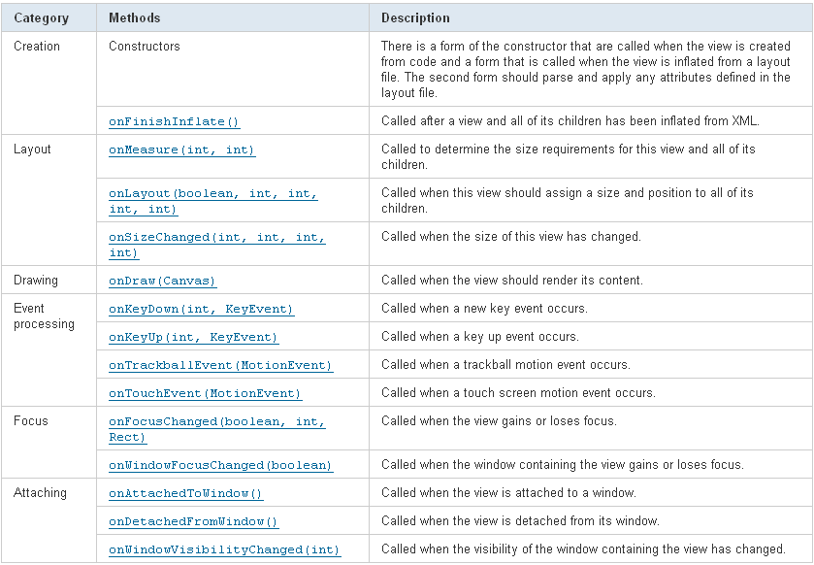
Customized UI - Fully Customized Components
Below are methods which we can override:

Slide 87
Customized UI - Compound Controls
Use this way to create a reusable component that consists of a group of existing controls.
Prefer to https://ghosvn.cybersoft-vn.com/emb/emb_me/Training/Android/PracticeProjects/CustomizedUI CustomUIEx3 project
To create a compound component:
  The usual starting point is a Layout of some kind, so create a class that extends a Layout. Note that just like with an Activity, we can use either the declarative (XML-based) approach to creating the contained components, or we can nest them programmatically from our code.
  In the constructor for the new class, take whatever parameters the superclass expects, and pass them through to the superclass constructor first. Then we can set up the other views to use within our new component.
  Create listeners for events that our contained views might generate if needed.
  Create our own properties with accessors and modifiers, for example, allow the EditText value to be set initially in the component and query for its contents when needed.
  In the case of extending a Layout, we don't need to override the onDraw() and onMeasure() methods since the layout will have default behavior that will likely work just fine. However, we can still override them if we need to.
  Override other on... methods, like onKeyDown() if we need to.

Slide 88
Customized UI - Modifying an Existing View Type
Use this way if there is a component that is already very similar to what we want.
We can simply extend that component and just override the behavior that we want to change.
We can do all of the things we would do with a fully customized component, but by starting with a more specialized class in the View hierarchy, we can also get a lot of behavior for free that probably does exactly what we want.
Example: Define a new class which extends from EditText class:
  public class MyEditText extends EditText

Slide 89
Outline
User Interface
Using database on Android
Remote Procedure Calls (RPCs)
Using service
SMS message
Working with file on Android
Upload file on sever
Widget
2D Graphics
Customized UI
XML and RSS
  XML
  RSS
  RSS 2.0 format
  SAX Parser
  DOM Parser
  SAX vs DOM
  Example
SOAP
Confidential
Page <number>

Slide 90
XML
XML: Extensible Markup Language
The Java platform has supported many different ways to work with XML for quite some time, and most of Java's XML-related APIs are fully supported on Android.
Java's Simple API for XML (SAX) and the Document Object Model (DOM) are both available on Android.
The newer Streaming API for XML (StAX) and the Java XML Binding API are not available in Android.

Slide 91
RSS
RSS: Really Simple Syndication
RSS formats are specified using XML, a generic specification for the creation of data formats.
RSS 2.0 format

Slide 92
RSS 2.0 format
<?xml version="1.0"?>
  <rss version="2.0">
    <channel>
      <title>Birthday Bash Interviews</title>
      <link>http://kccnfm100.com/</link>
      <description>Natural Vibrations.</description>
      <language>en-us</language>
      <pubDate>Tue, 10 Jun 2003 04:00:00 GMT</pubDate>
      <lastBuildDate>Tue, 10 Jun 2003 09:41:01 GMT</lastBuildDate>
      <docs>http://blogs.law.harvard.edu/tech/rss</docs>
      <generator>Weblog Editor 2.0</generator>
      <managingEditor>editor@example.com</managingEditor>
      <webMaster>webmaster@example.com</webMaster>
      <item>
        <title>Star City</title>
        <link>http://liftoff.msfc.nasa.gov/news/2003/news-starcity.asp</link>
        <description>How do Americans get ready to work with Russians aboard the International Space Station? They take a crash course in culture, language and protocol at Russia's Star City.</description>
        <pubDate>Tue, 03 Jun 2003 09:39:21 GMT</pubDate>
        <guid>http://liftoff.msfc.nasa.gov/2003/06/03.html</guid>
      </item>
      <item>……</item>
    </channel>
  </rss>

Slide 93
SAX Parser
Was developed by the XML-Dev mailing list
Provide faster and less costly processing of XML data when you do not need to access all of the data in an XML document.
Used only for reading XML documents and not for the manipulation of the underlying XML data.
Accesses data through a series of events, eliminating the need to build a tree structure in memory. Speed of data retrieval is faster than with the DOM API.
Allows you to access a small number of elements at one time rather than an entire document.
Best for applications that need to access a specific piece of data and do not need to understand its relationship to surrounding elements.
Cannot traverse the data.

Slide 94
DOM Parser
Was developed by W3C (World Wide Web Consortium)
Used for both read and write of the data in an XML document
Used for a random processing of XML docs
Uses a tree representation of the underlying XML document and facilitates random access/manipulation of the underlying XML data
Allows you to dynamically traverse and update the XML document

Slide 95
SAX vs DOM
 | DOM | SAX
Type of interface | Object-based | Event-based
Object model | Created automatically | Must be created by application
Element sequencing | Preserved | Ignored in favor of single events
Use of z/TPF memory | Higher | Lower
Speed of initial data retrieval | Slower | Faster
Stored information | Better for complex structures | Better for simple structures
Ability to update XML document | Yes (in memory) | No

Slide 96
SAX or DOM? How to choose?
If the underlying XML data requires manipulation then almost always DOM will be used as SAX doesn't allow.
If the nature of access is random (for example, if you need contextual info at every stage) then DOM will be the way to go in most of the cases.
If the XML document is only required to be read and that too sequentially, then SAX will probably be a better alternative in most of the cases.
if you need to process an XML document maybe to update a datasource, SAX will probably make a alternative.

Slide 97
Example: Parse RSS by using default Android handler
To parse a XML/RSS document, we will create a parser class.
Import some Android classes which support to parse XML/RSS file
  import android.sax.Element;
  import android.sax.EndElementListener;
  import android.sax.EndTextElementListener;
  import android.sax.RootElement;import android.util.Xml;
  import java.io.InputStream;
  import java.net.MalformedURLException;
  import java.net.URL;
Create a function to parse XML/RSS file
  public List<Object> parse()
The Example code is available at https://ghosvn.cybersoft-vn.com/emb/emb_me/Training/Android/PracticeProjects/RSSReader/RSSReader.zip

Slide 98
Example: Parse RSS by using default Android handler
public List<Message> parse() {
  final Message currentMessage = new Message();
  RootElement root = new RootElement(RSS);
  final List<Message> messages = new ArrayList<Message>();
  Element itemlist = root.getChild(CHANNEL);
  Element item = itemlist.getChild(ITEM);
  item.setEndElementListener(new EndElementListener(){
    public void end() { messages.add(currentMessage.copy());}});
  item.getChild(TITLE).setEndTextElementListener(new EndTextElementListener(){
    public void end(String body) { currentMessage.setTitle(body);}});
  item.getChild(LINK).setEndTextElementListener(new EndTextElementListener(){
    public void end(String body) { currentMessage.setLink(body);}});
  item.getChild(DESCRIPTION).setEndTextElementListener(new EndTextElementListener(){
    public void end(String body) { currentMessage.setDescription(body);}});
  item.getChild(PUB_DATE).setEndTextElementListener(new EndTextElementListener(){
    public void end(String body) { currentMessage.setDate(body);}});
  try {
    Xml.parse(this.getInputStream(), Xml.Encoding.UTF_8, root.getContentHandler());
  } catch (Exception e) { throw new RuntimeException(e); }
  return messages;
}

Slide 99
Example: Parse RSS by using SAX method
The same when we use default parse but we will create private handler class to parse the XML document.
public List<Item> parse() {
  SAXParserFactory factory = SAXParserFactory.newInstance();
  try {
    SAXParser parser = factory.newSAXParser();
    SAXHandler handler = new SAXHandler(); //private class handler
    parser.parse(this.getInputStream(), handler);
    return handler.getItems();
  } catch (Exception e) {
    throw new RuntimeException(e);
  }
}
The example code is available at https://ghosvn.cybersoft-vn.com/emb/emb_me/Training/Android/PracticeProjects/RSSReader/RSSReaderSAX.zip

Slide 100
Example: Parse RSS by using DOM method
The same when we use default parse but we will use another lib and re-write the parse function because DOM uses a tree representation.
Import some Android classes which support to parse XML/RSS file
  import javax.xml.parsers.DocumentBuilder;
  import javax.xml.parsers.DocumentBuilderFactory;
  import org.w3c.dom.Document;
  import org.w3c.dom.Element;
  import org.w3c.dom.Node;
  import org.w3c.dom.NodeList;
Parse the XML/RSS file by using DOM method:
  Create DocumentBuilderFactory object by using DocumentBuilderFactory.newInstance() function
  Create DocumentBuilder object by using newDocumentBuilder() from DocumentBuilderFactory object
  Get Element Objects by using getDocumentElement() from DocumentBuilder object.
  Get NodeList by using getElementsByTagName() from Element Object.
The example code is available at https://ghosvn.cybersoft-vn.com/emb/emb_me/Training/Android/PracticeProjects/RSSReader/RSSReaderDOM.zip

Slide 101
Outline
User Interface
Using database on Android
Remote Procedure Calls (RPCs)
Using service
SMS message
Working with file on Android
Upload file on sever
Widget
2D Graphics
Customized UI
XML and RSS
SOAP
  Introduction
  SOAP message
  Transport methods
  KSOAP
  AndroidSOAP
Confidential
Page <number>

Slide 102
Introduction
SOAP:
  stands for Simple Object Access Protocol
  a communication protocol
  communicate between applications
  a format for sending messages
  platform and language independent
  based on XML
  simple and extensible
A better way to communicate between applications is over HTTP, because HTTP is supported by all Internet browsers and servers. SOAP was created to accomplish this.
SOAP provides a way to communicate between applications running on different operating systems, with different technologies and programming languages.

Slide 103

SOAP message
A SOAP message is an ordinary XML document containing the following elements:
  An Envelope element that identifies the XML document as a SOAP message
  A Header element that contains header information
  A Body element that contains call and response information
  A Fault element containing errors and status information

Slide 104

SOAP message (cont)
Rules:
  MUST be encoded using XML
  MUST use the SOAP Envelope namespace
  MUST use the SOAP Encoding namespace
  NOT contain a DTD reference
  NOT contain XML Processing Instructions
Skeleton SOAP Message:

Slide 105
Transport methods
SMTP and HTTP are valid application layer protocols used as Transport for SOAP
HTTP protocol is better:
  works well with today's Internet infrastructure
  works well with network firewalls.
A SOAP method is an HTTP request/response that complies with the SOAP encoding rules.
  HTTP + XML = SOAP
A SOAP request could be an HTTP POST or an HTTP GET request.
The HTTP POST request specifies at least two HTTP headers: Content-Type and Content-Length.

Slide 106

Example: SOAP Message
SOAP message request

Slide 107

Example: SOAP Message (cont)
SOAP message respone

Slide 108

Example: SOAP Message (cont)
SOAP message

Slide 109
KSOAP2 LIB
Provides a lightweight and efficient SOAP library for the Android platform.
Using MIT license: http://ksoap2.svn.sourceforge.net/viewvc/ksoap2/trunk/ksoap2/ksoap2/LICENSE.txt?revision=149&view=markup
Main page: http://code.google.com/p/ksoap2-android/
API document: http://ksoap2.sourceforge.net/doc/api/
Source code: http://ksoap2.svn.sourceforge.net/viewvc/ksoap2/trunk/ksoap2/ksoap2/
Binary file: http://code.google.com/p/ksoap2-android/source/browse/m2-repo/com/google/code/ksoap2-android/ksoap2-android-assembly/2.5.4/ksoap2-android-assembly-2.5.4-jar-with-dependencies.jar

Slide 110


KSOAP2 LIB (cont)
How to use:
  Create new android project
  Add KSOAP2 lib into project by using: right click on project → choose Build Path → Add External Archives → choose the KSOAP2 lib
  Implement SOAP request and send to server
    Define SOAP service URLs and methods
    Make request and send to server:

Slide 111
KSOAP2 LIB (cont)
How to use (cont):
  Get data from SOAP response
    Base on the SOAP method data return, we will use the type to store the result.
      SoapObject resultsRequestSOAP = (SoapObject) envelope.bodyIn;
    Get a value from a property
      SoapPrimitive XXXXX = (SoapPrimitive) resultsRequestSOAP.getProperty("AddIntegerResult");
  Source code example is available at https://ghosvn.cybersoft-vn.com/emb/emb_me/Training/Android/PracticeProjects/SOAP/KSOAP

Slide 112
AndroidSOAP LIB
AndroidSOAP is "yet another" SOAP client for Android platform, it is compatible with 1.5+ versions and uses Reflection API
Main page: http://wiki.javaforum.hu/display/ANDROIDSOAP/Home
Source code: http://svn.javaforum.hu/svn/android/AndroidSOAP/trunk/AndroidSOAP/
Binary file: https://ghosvn.cybersoft-vn.com/emb/emb_me/Training/Android/PracticeProjects/SOAP/AndroidSOAP/AndroidSOAPLIB.jar

Slide 113

AndroidSOAP LIB (cont)
How to use:
  Create new android project
  Add AndroidSOAP lib into project by using: right click on project → choose Build Path → Add External Archives → choose the AndroidSOAP lib
  Implement SOAP request and send to server
    Based on the service function which you want to use, we will implement the function class and function response class
      Example: use HelloWorld function → create HelloWorld class and HelloWorldResponse class.
    When we create the function class, we will make connection to server and send request:

Slide 114
AndroidSOAP LIB (cont)
How to use:
  Get the data from the SOAP response
    HelloWorldResponse response = transport.call(envelope, HelloWorldResponse.class);
  Source code example is available at: https://ghosvn.cybersoft-vn.com/emb/emb_me/Training/Android/PracticeProjects/SOAP/AndroidSOAP

Slide 115

How to reuse AndroidSOAP with another web service
To reuse the AndroidSOAP with another web service protocol, example: XML-RPC, we will port the SOAP message Object (header, body, etc… classes) to XML-RPC message Object.
Create a new Object for XML-RPC in <AndroidSOAP folder>\src\hu\javaforum\android\androidsoap\soap\impl
XML-RPC message:

Slide 116
How to reuse KSOAP2 with another web service
To reuse the KSOAP2 with another web service, we will must create new message Object (header, body, etc…)
Create a new Object for XML-RPC in <ksoap2 folder>/src/org/ksoap2 and <ksoap2 folder >/src/org/ksoap2/serialization

Slide 117
Android Web Applications

Slide 118
Overview
Support for viewport properties that allow you to properly size your web application based on the screen size.
CSS and JavaScript features that allow you to provide different styles and images based on the screen's pixel density (screen resolution).
Provide Android APIs to your web-based application.

Slide 119
Viewport
Viewport is the area in which your web page is drawn.
Viewport determine the number of pixels available to a web page.

Slide 120
Viewport property
viewport size: the number of pixels available to the web page before it goes off screen.
viewport scale: defines the level of zoom applied to the web page.
viewport target density: number of dots per inch for showing webpage page.

Slide 121
Configure Viewport property in HTML
<meta name="viewport"
content="
height = [pixel_value | device-height] ,
width = [pixel_value | device-width ] ,
initial-scale = float_value ,
minimum-scale = float_value ,
maximum-scale = float_value ,
user-scalable = [yes | no] ,
target-densitydpi = [dpi_value | device-dpi |
high-dpi | medium-dpi | low-dpi]
" />

Slide 122
WebView
A View that displays web pages.
Allow to roll, zoom in and out the web page.
Support JavaScript.

Slide 123
Binding JavaScript code to Android code
When enable JavaScript for WebView, we can create an interface. So that JavaScript can call these methods in this interface.
When using addJavascriptInterface() method of WebView to bind a class between android source and webpage we will also allows JavaScript to control your Android application.

Slide 124

We welcome your questions
Thank you!
Confidential
Page <number>

