Slide 1
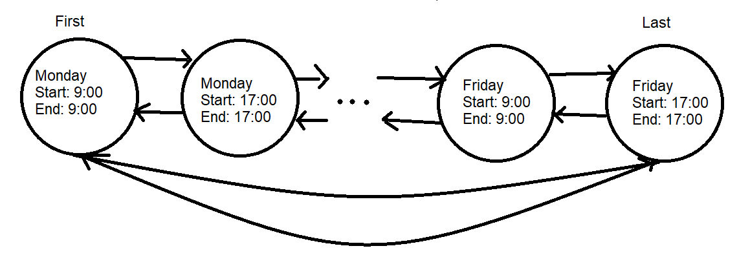
Sentinel Nodes

Slide 2
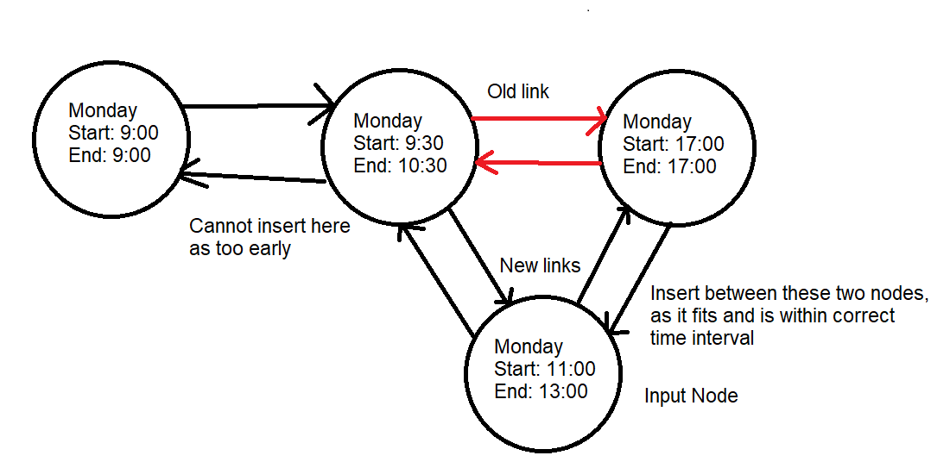
Module 1: Insertion at correct time

Slide 3
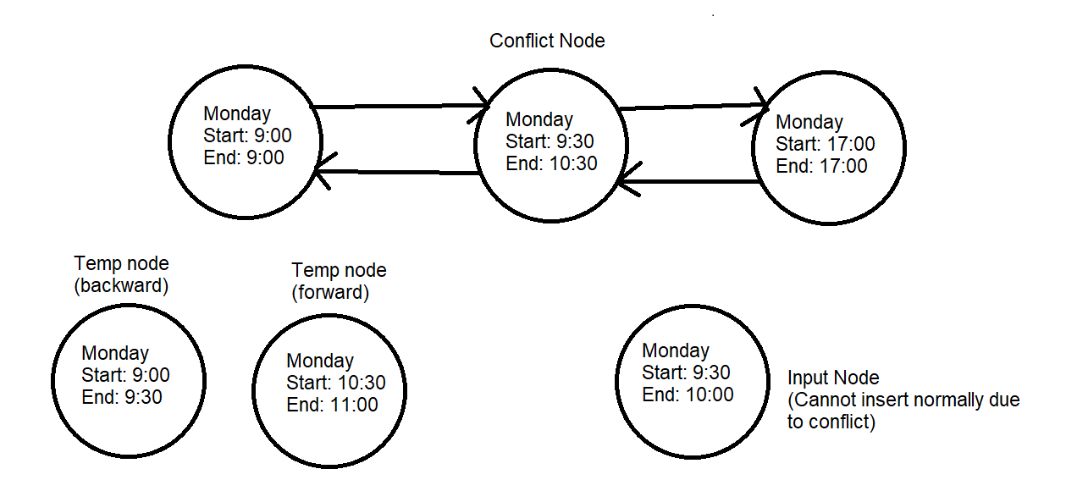
Module 2: Insertion at correct day, different time

Slide 4
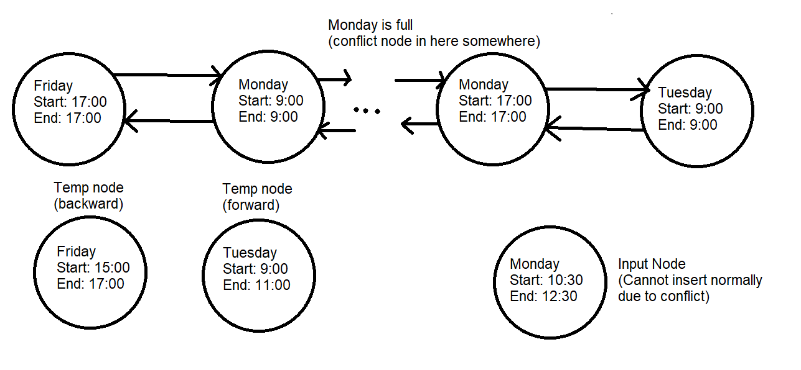
Module 3: Insertion at different day

