Slide 1
CS370 – Section 46 Group 9 Project
Project: Cafeteria
Group members:
Timothy Dakis (captain)
Tanjinul Hoque
Daniel Saavedra

Slide 2
Requirements / Specifications

Slide 3
Title
Cafeteria Inventory Management (CIM)
Prepared by: Queens College Software Engineers (QCSE)
Prepared for: Cafeteria Inc. (CI)

Slide 4
Group 9
Group Members:
Timothy Dakis (Captain)
Tanjinul Hoque
Daniel Saavedra

Slide 5
Project Description
This is a requirements specification document for a cafeteria managed by Cafeteria Inc. (CI). CI manages this cafeteria within New York City. CIM will allow customers and suppliers to see real time stock remaining for items and allow customers to place orders. Customers will access the CIM through either a phone application or a website. Suppliers will be notified when stock hits certain level to resupply.

Slide 6
Purpose
CIM will provide CI with a means of automating inventory tracking
Customers will enjoy the benefit of conveniently being able to see what is in stock to place an order
CI will enjoy the benefit of suppliers automatically being notified when needed to resupply
CI management will benefit by being able to track user purchases to generate data to see what items are popular or trending

Slide 7
Business Drivers / Model
CI wants to be able to quickly adapt to trends as well as reduce personnel necessary to count inventory to reduce personnel cost
Profits should increase by 25% the first year, and 55% the year after
Profits will be lower the first year due to cost of implementing the new necessary software and hardware, as well potential customer loss due to unfamiliarity of a new system.

Slide 8
Scope
CIM will include the design of a web site and a smart phone application
CIM will not include any database services. CI is expected to find their own vendor to handle this and have them connect it with CIM output
CIM will also not manage the connection between CI and their supplier(s), but will create an output for suppliers to create a connection to

Slide 9
Definitions
Stock refers to the amount of a product remaining on site (i.e., in the cafeteria in this context)
Database refers to a means of storing data
Qty is an abbreviation for “quantity”

Slide 10
Use Case
Actor: user accessing website or app
Precondition: the item must be listed on the website or app
Triggers: the user clicks an item
Basic Flow:
User accesses website / app → goes to item → item is in stock → purchase item
Alternative Flow:
User accesses website / app → goes to item → item not in stock → purchase fails
Postcondition: item purchase successful

Slide 11
Acceptance Criteria
Stock Remaining | Qty Purchased | Expected Result | Expected Message
1 | 1 | Pass | Successful transaction
0 | 1 | Fail | No stock remaining
1 | 2 | Fail | Not enough stock for successful transaction
2 | 2 | Pass | Successful transaction

Slide 12
Assumptions and Constraints
Assumptions:
Someone from management will be available to test if stock is being updated accurately
Constraints
Tight deadline – 1 month to implement
Team size – 3 people

Slide 13
Platform Requirements Specification
Users will be required to use a browser (i.e., Chrome, Edge, Firefox, etc.) version released within the last 2 years to ensure compatibility with the website
The smartphone application will be limited to Android and Apple smartphones

Slide 14
Diagrams

Slide 15
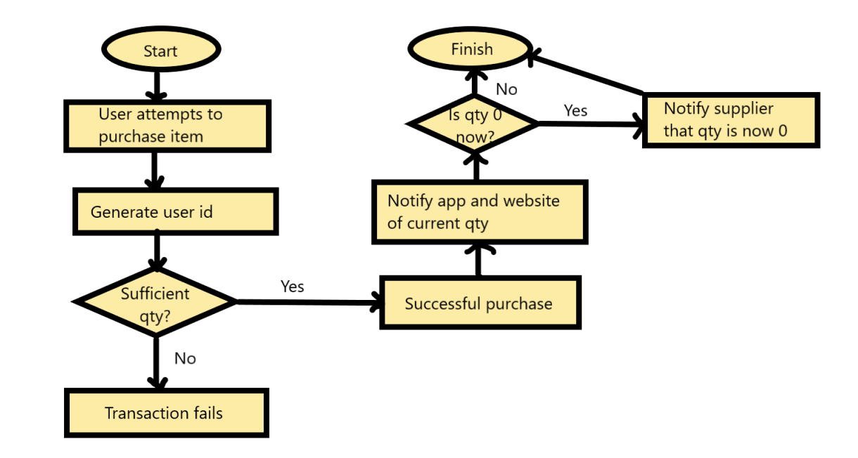
Process Flowchart Diagram

Slide 16
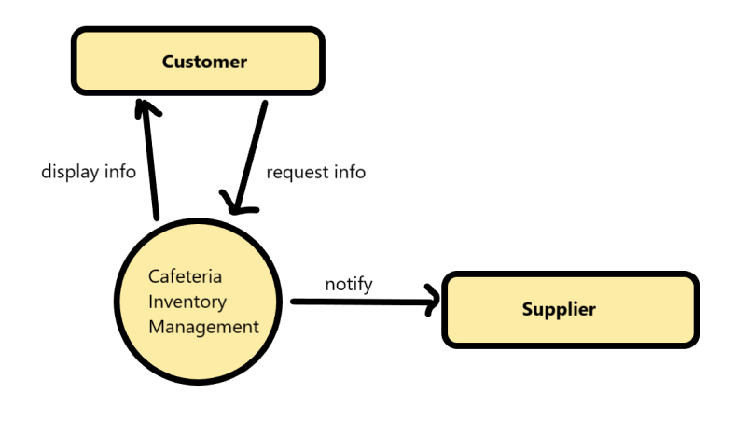
User Context Diagram

Slide 17
Individual Work
Timothy Dakis – Decorator Pattern
Tanjinul Hoque – Observer Pattern
Daniel Saavedra – Singleton Pattern

Slide 18
Timothy Dakis Work – Decorator
Files to implement pattern:
CafeteriaServiceProvided.java
BuyFood.java
BuySoda.java
BuyCoffee.java
File for unit test: BuyFoodTest.java

Slide 19
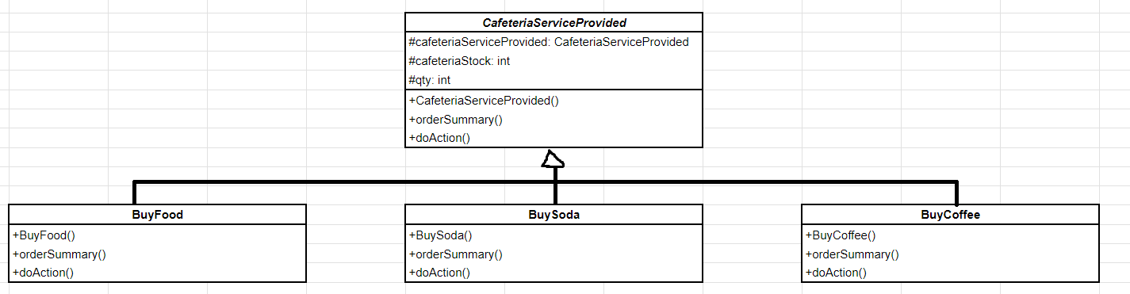
Decorator UML

Slide 20
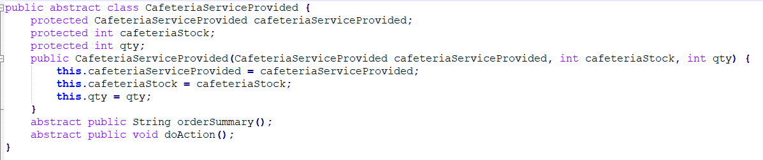
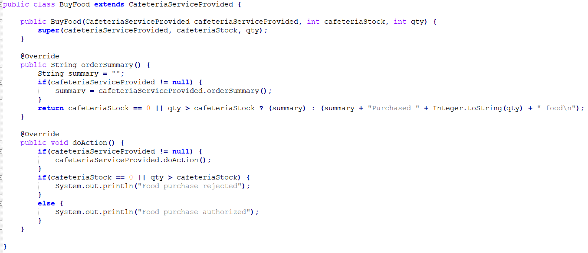
The Code (Part 1 of 3)

Slide 21
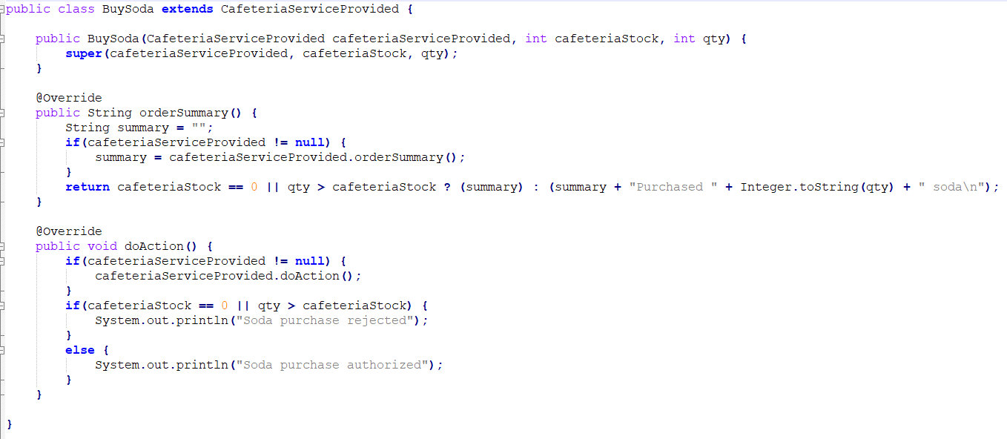
The Code (Part 2 of 3)

Slide 22
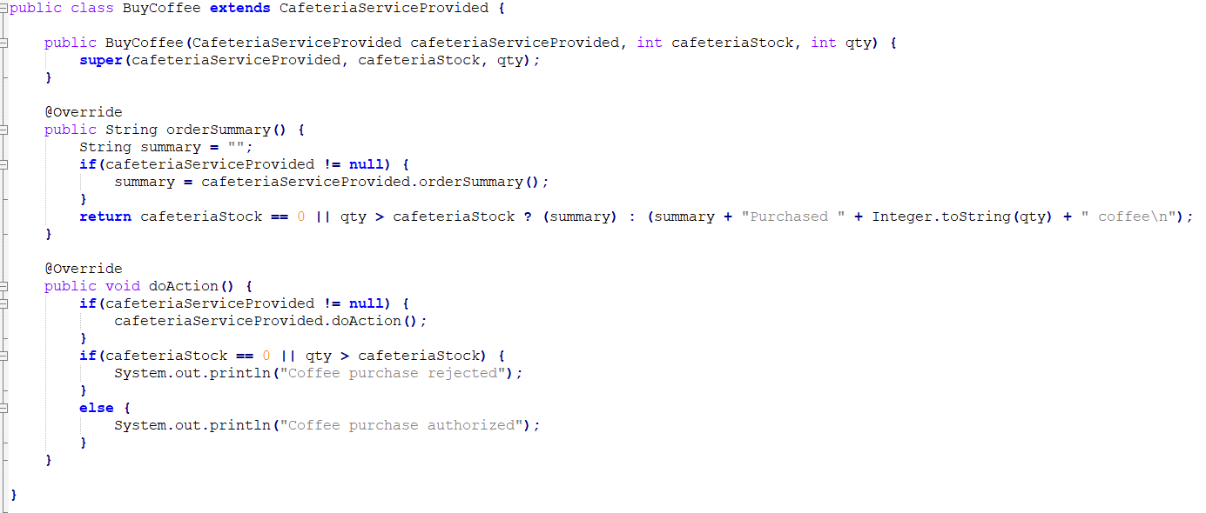
The Code (Part 3 of 3)

Slide 23
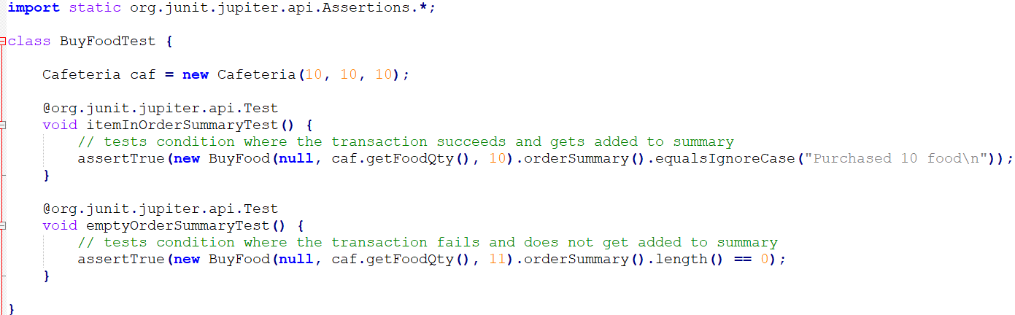
Unit and Component Tests
Component Test:
The cafeteria has 10 food and 0 soda in stock. User tries to buy 2 food and 1 soda. User should be informed that the soda order failed, and the food order succeeded. User's order summary should inform them of only their successful food order

Slide 24
Tanjinul Hoque Work – Observer
Files to implement pattern:
Cafeteria.java
CafeteriaStockObserver.java
Website.java
Supplier.java
SmartphoneApp.java
File for unit test: CafeteriaTest.java

Slide 25
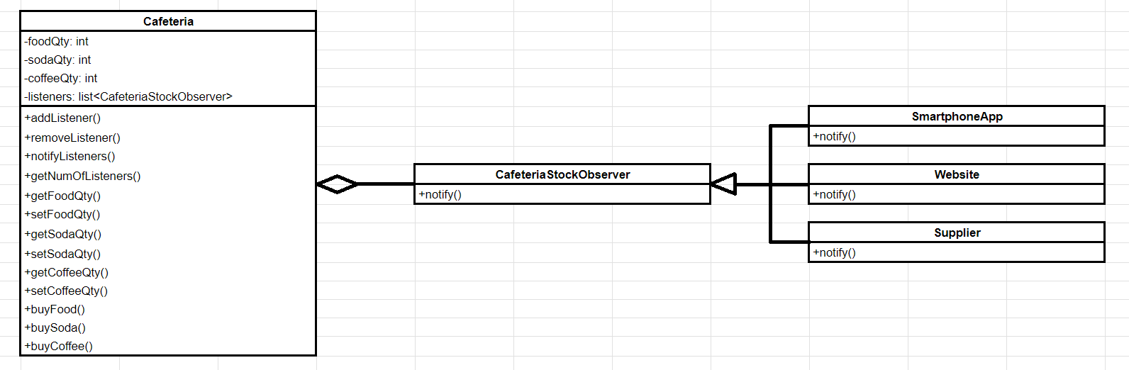
Observer UML

Slide 26

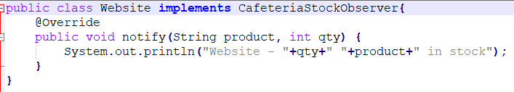
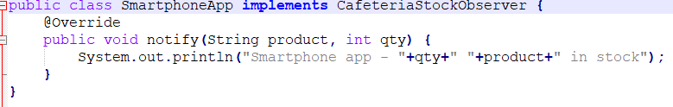
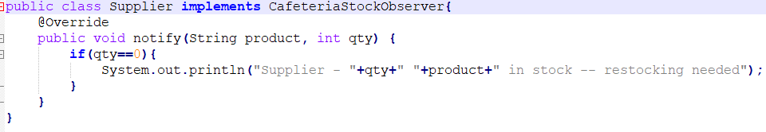
The Code (Part 1 of 3)

Slide 27
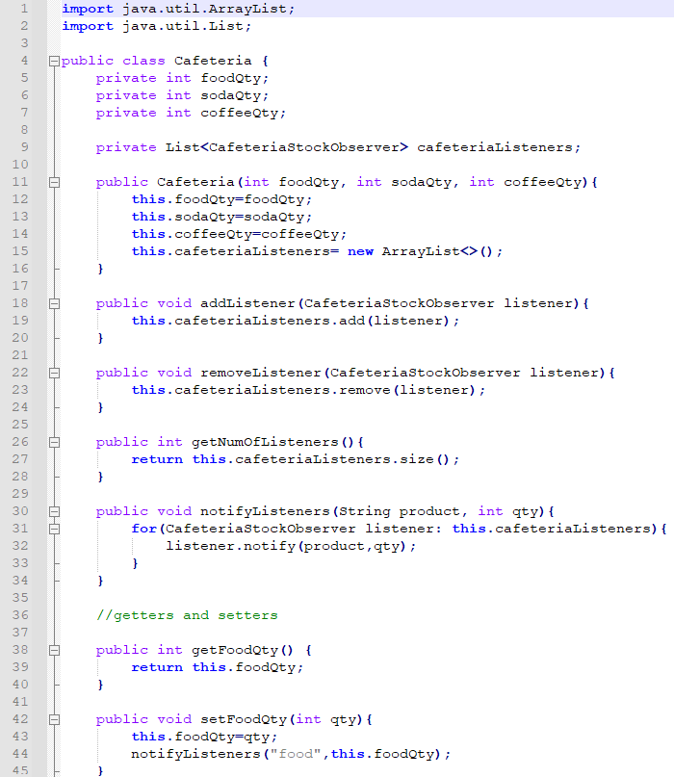
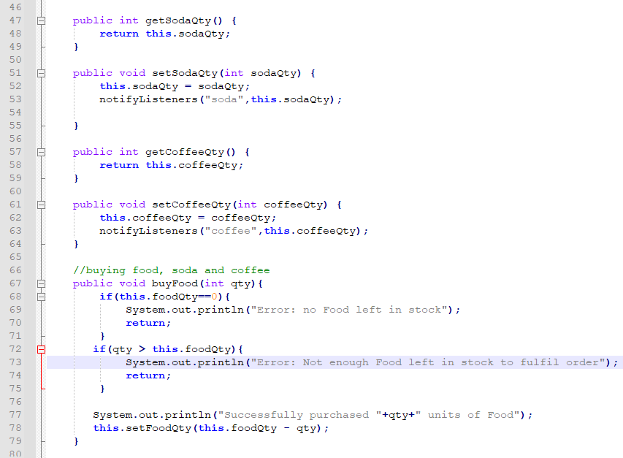
The Code (Part 2 of 3)

Slide 28
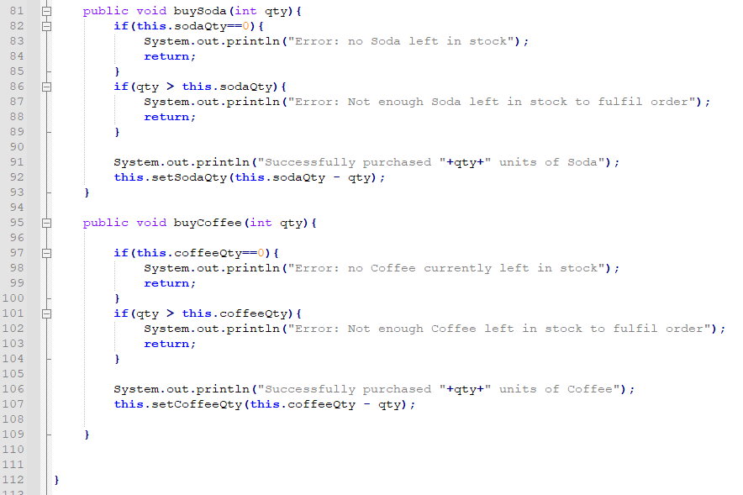
The Code (Part 3 of 3)

Slide 29
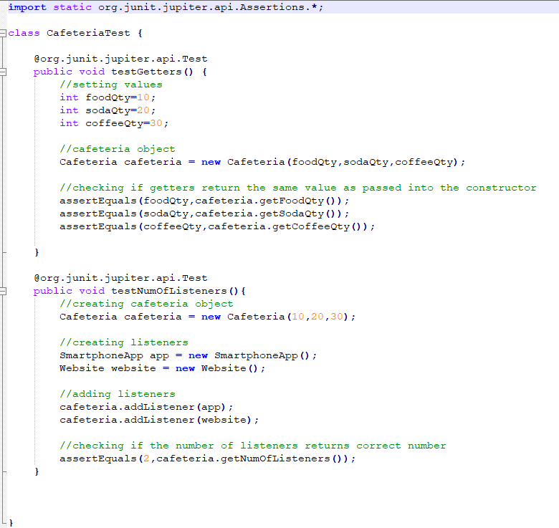
Unit and Component Tests
Component Test:
Cafeteria is stocked with 10 food, 20 soda and 30 coffee. When a customer buys 1 soda and the transaction is successful, it should set soda quantity to 19 and it should notify the website and app about the updated quantity.

Slide 30
Daniel Saavedra Work – Singleton
Files to implement pattern: CustomerId.java
Files for unit test: CustomerIdTest.java

Slide 31
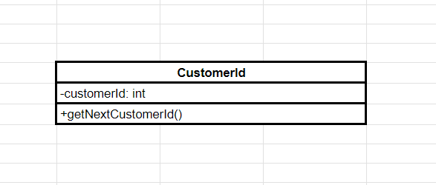
Singleton UML

Slide 32
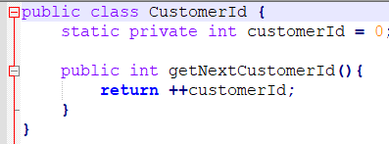
The Code (Part 1 of 1)

Slide 33
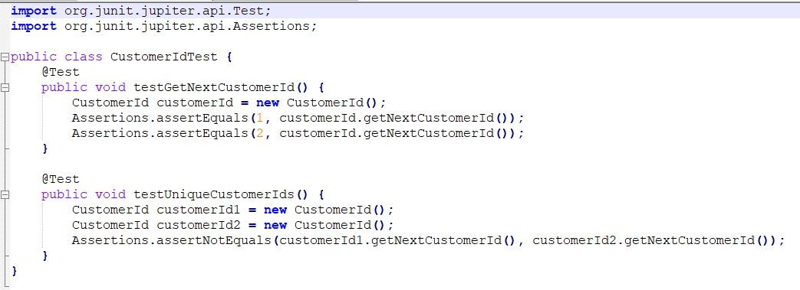
Unit and Component Tests
Component Test:
Each customer is given a unique ID number. The 5th customer to make a order should get the id of 5.

Slide 34
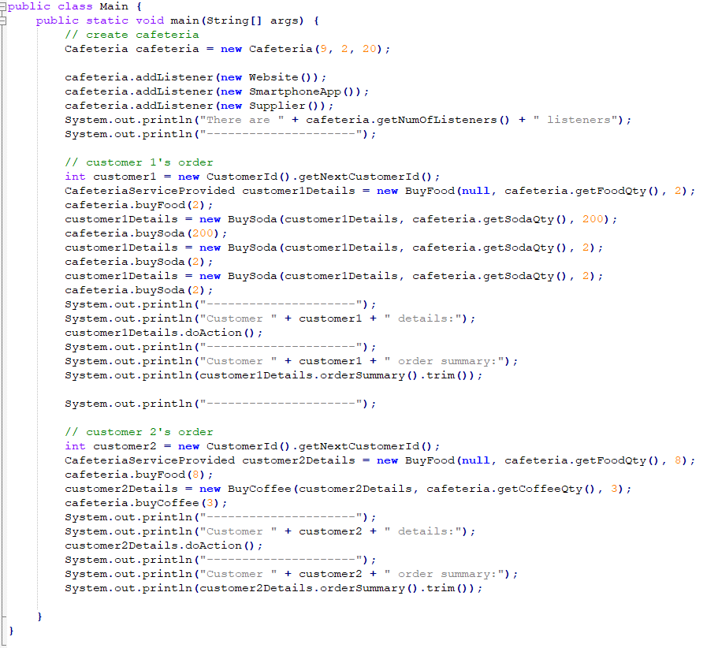
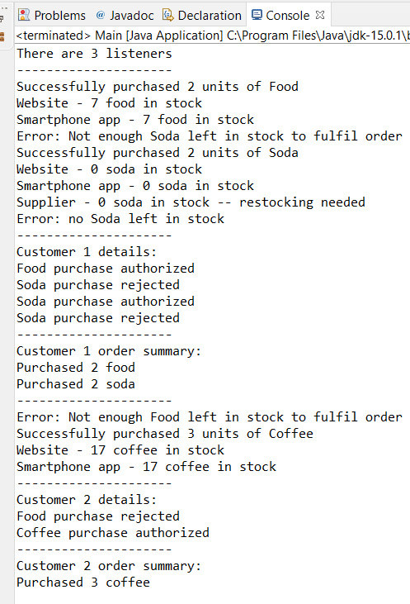
Tying it All Together in Main

