Slide 1
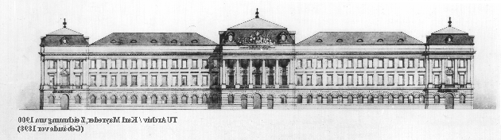
Student Projects 2005/2006
Stefan Mahlknecht

Slide 2
Main Topics
Wireless Communication Protocols and Networks
Autonomous Systems and Robotics
Linux Based Embedded Systems
Fieldbus Systems
Energy scavenging form the Environment

Slide 3
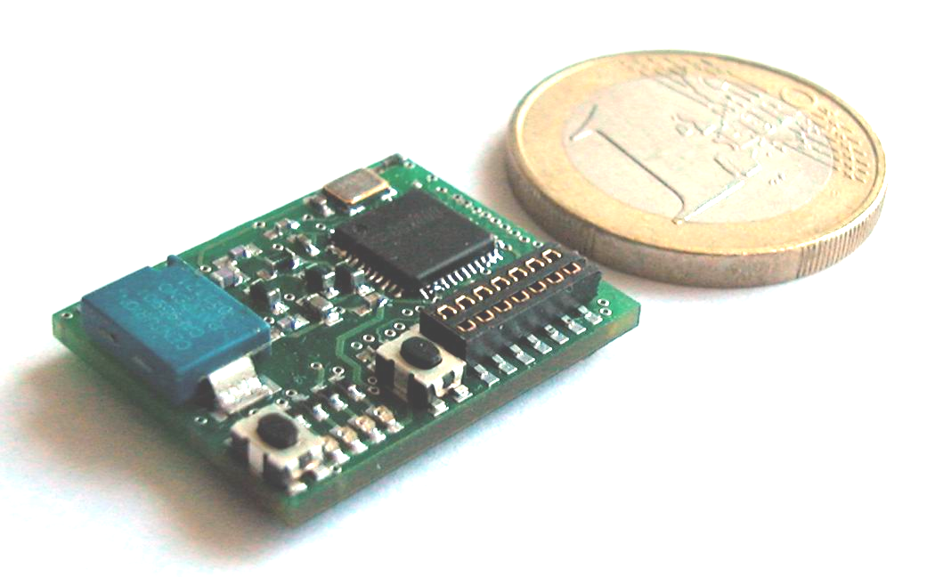
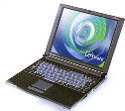
Wireless Sensor Networks
Protocol Design
  Routing Protocols
  MAC Protocols
  Low Power implementations
T
L
T
T
T
S
H
L… Light
T… Temperature
H… Humidity
S… Sink Node
L
H
L
www.ict.tuwien.ac.at/wireless

Slide 4
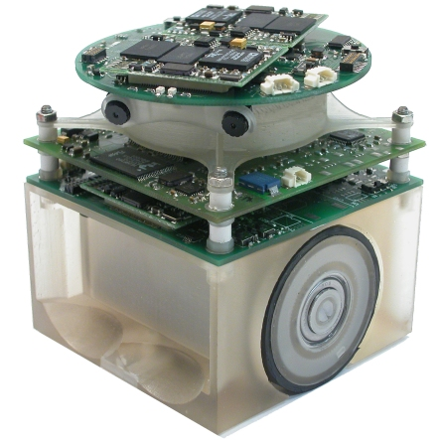
Robotics
Different Projects available
  Ultrasonic Sensors for tiny Robots
  Communication Protocols
  Stereo Vision Systems
  Wireless Communication
  Robotic Strategy Unit
www.tinyphoon.com

Slide 5
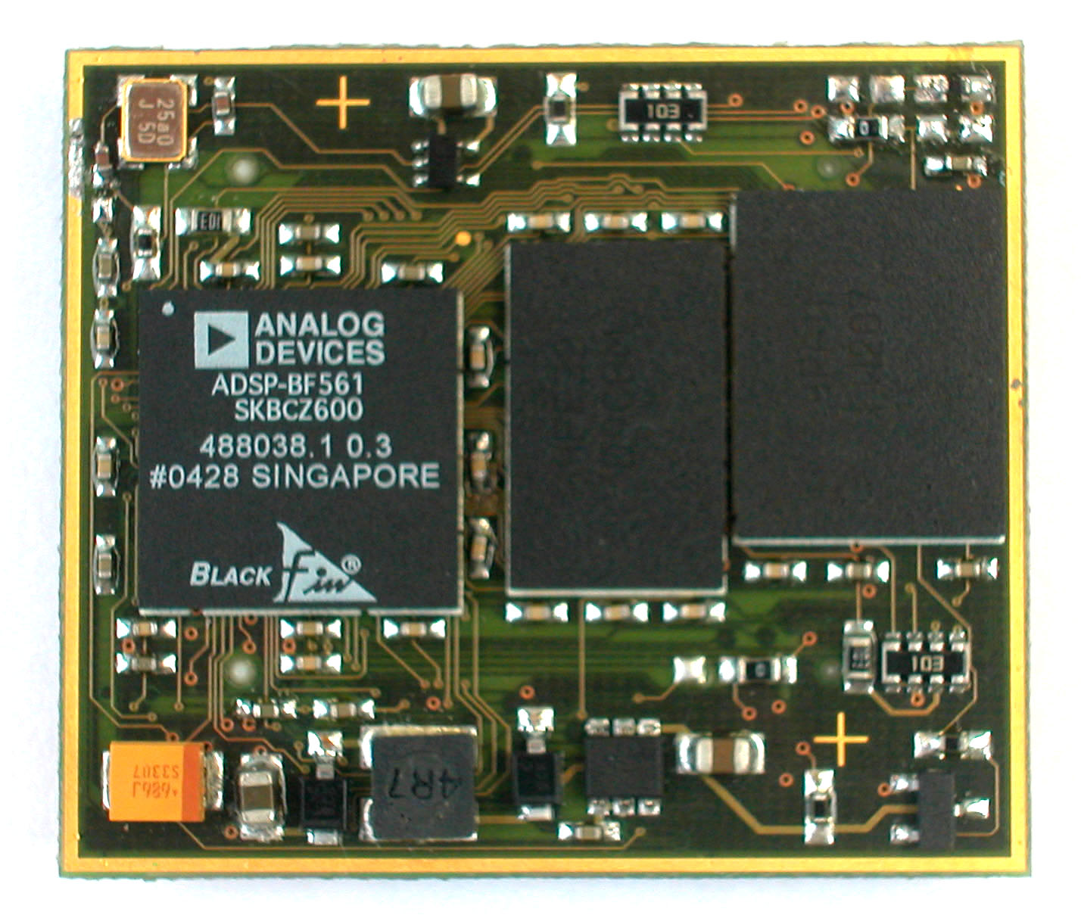
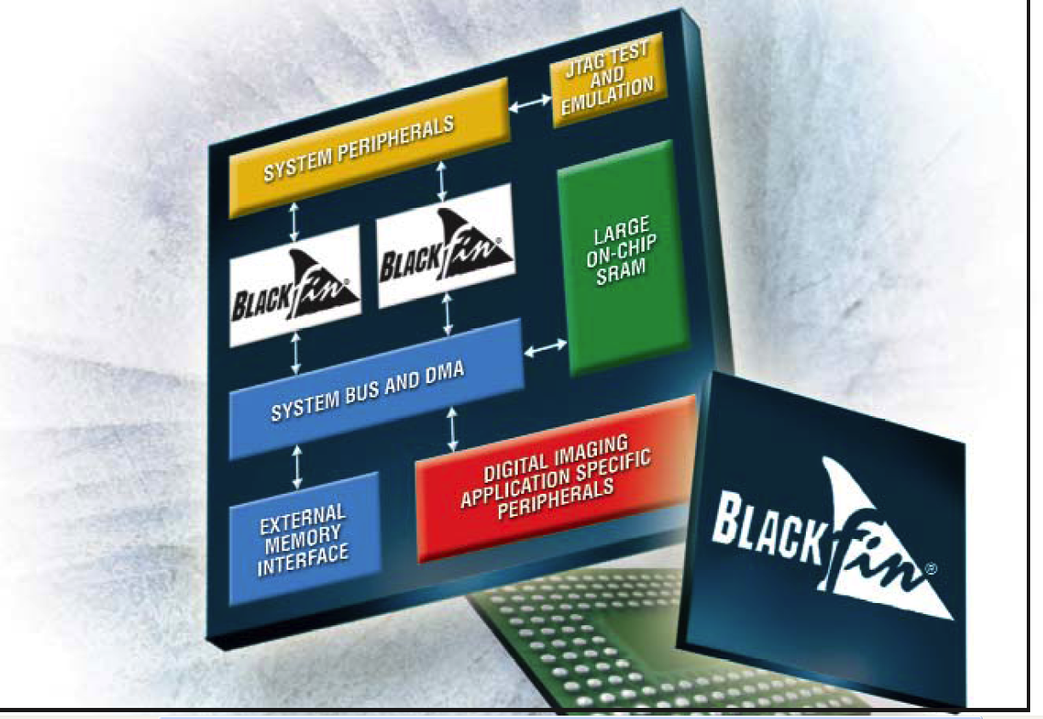
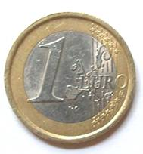

Embedded Systems & Linux
Tiny Embedded Boards
  Linux Port on Dual Core Processors
  Driver Development
CM_BF561

Slide 6
Fieldbus Systems
Fieldbus Competence Center at ICT:
  LonWorks
  EIB
  BACnet
Goal:
  Gain Practical experience with all these systems
  Communication between different networks

Slide 7
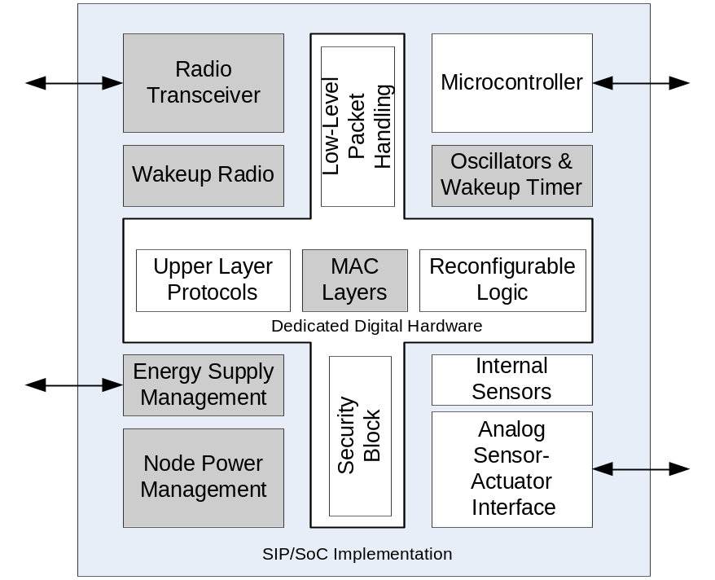
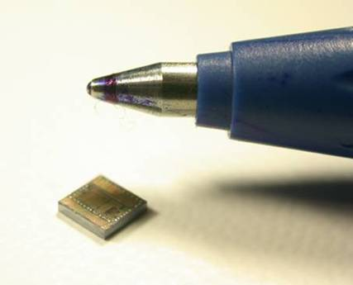
Power Aware Wireless Integrated Sensors
What Energy Supply for Sensor Nodes?
  Energy from Solar, Vibrations, Temperature Differences
?

Slide 8
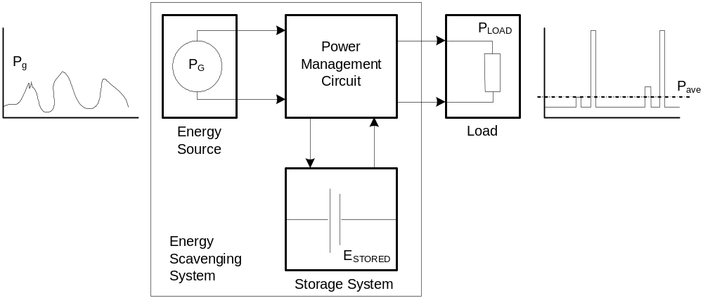
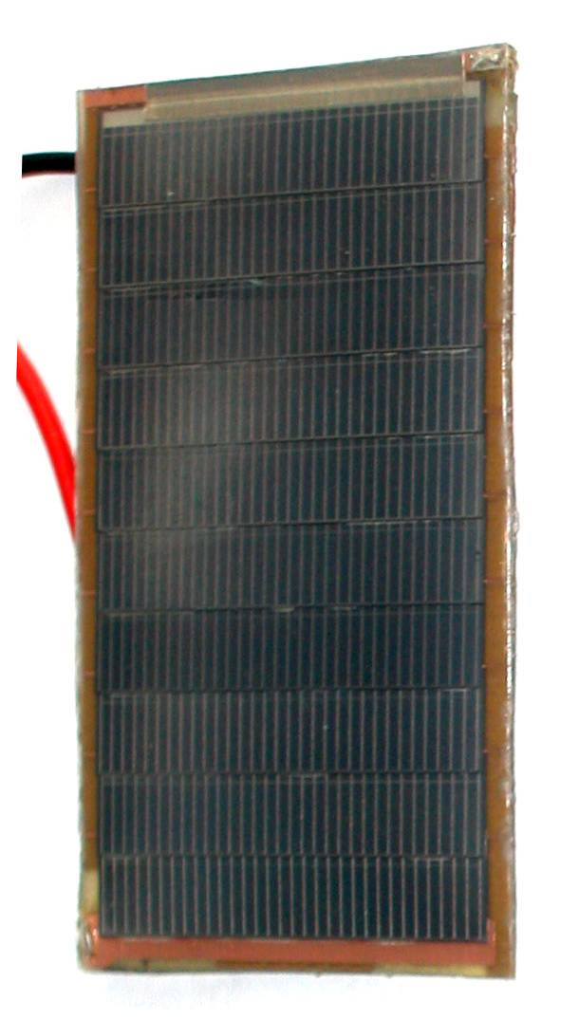
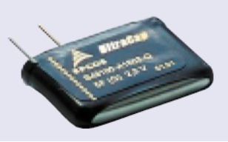
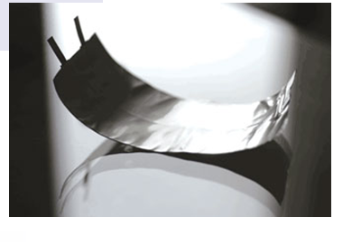
Example: Solar powered sensor node
Ultracapacitor
Battery foil
Research solar cell from ISE Fraunhofer
56 x 32 mm, High efficiency

Slide 9
Are you interested in joining TU-Vienna?
Prerequisite:
  Good knowledge of ENGLISH !!!
  Knowledge of basics in the field of research
What we are looking for:
  Master Theses (5th Year)
  Doctoral Students
Duration of stay in Vienna:
  4 Month (1 Semester)
  Summer Term: February – June
  Winter Term: September - January

Slide 10

Contact Information:
Dr. Dipl.-Ing. Stefan Mahlknecht
mahlknecht@ict.tuwien.ac.at
Tel: +43-1-58801-38447

