Slide 1
Lost in Translation
Reguläre Ausdrücke als Englische Sätze
Tim Bourguignon
tim.bourguignon@mathema.de www.mathema.de

Slide 2
The menu
Foreword
*Expression
VerbalExpression
SimpleExpression
MagicExpression

Slide 3
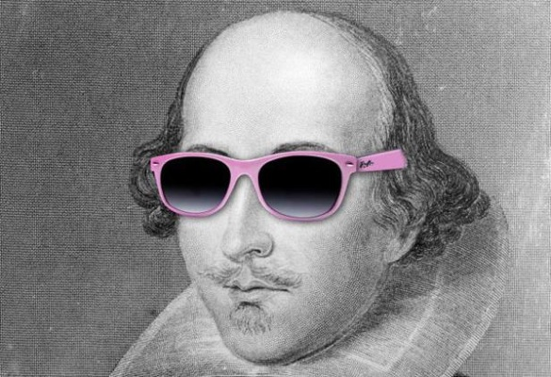
TL; DR;
Why express yourself like this?
When you can say it like Shakespeare?
A more coder friendly version maybe?
[A-Z0-9._%+-]+@[A-Z0-9.-]+\.[A-Z]{2,4}
“Thou shall match a string of letters follow'd by @ then some other characters, a dram dot and some moo stuff”
Thou.shallmatch(a-string-of-letters)
.followdby(@).then.someothercharacters()
.adram(dot).and.some(moostuff);

Slide 4
A regular expression DSL?
“SimpleExpression”
Fluent API
Close to the English language
Tailored for newbie's
Could it satisfy veterans too?
Outputs regular expressions
In practice
Implemented prototyped in C# for .NET
On Github (github.com/timothep/SimpleExpressions)

Slide 5
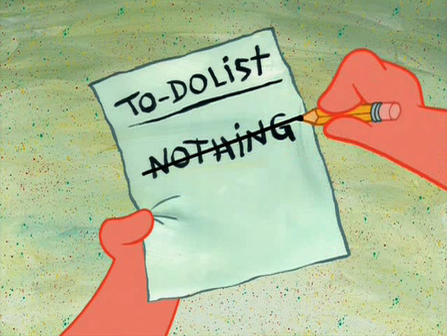
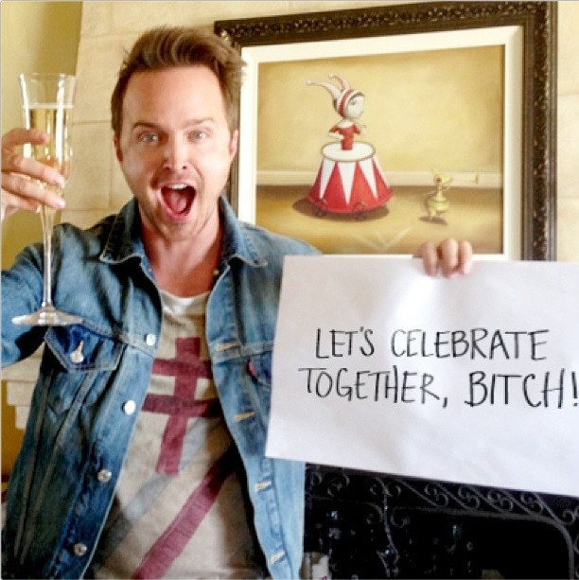
Why… Why… WHY?
Example for a “C# dynamics” talk
Write a real DSL (at least) once
See if it works…
Regular Expression knowledge refresh
Get rich and famous (bitches!)
Because I can!

Slide 6
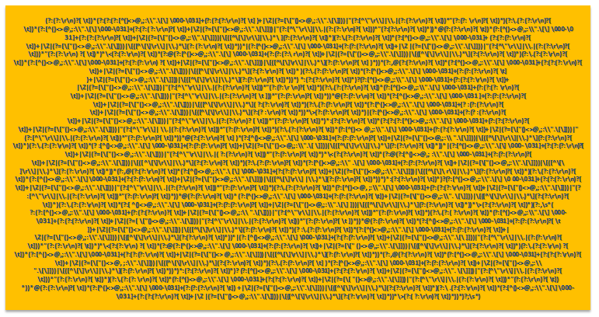
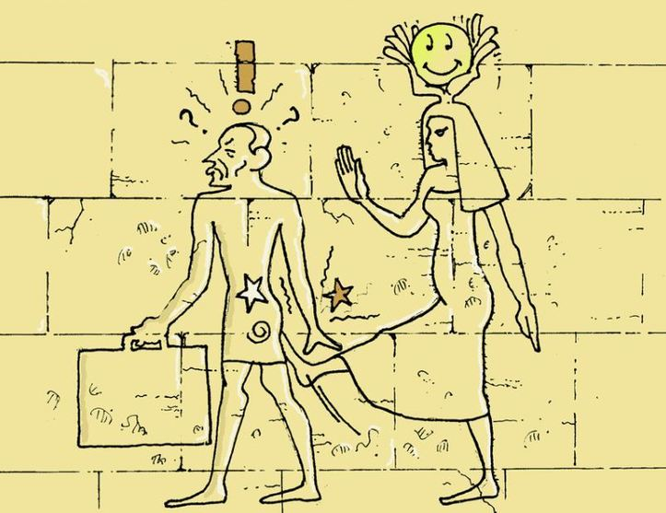
What we will NOT talk about
How to write regular expressions
Do’s and don’ts working with Regexes
Optimization & performance
Devise on the RFC822 Email Regex
?
==

Slide 7
Two Three Problems
“Some people, when confronted with a problem, think: ‘I know, I'll use regular expressions.' Now they have two problems”
“Some people, when confronted with a problem, think: ‘I know, I'll create a DSL that wraps regular expressions.' Now they have three problems”

Slide 8
What is there to lose?
(© Franck Mée, a “friend” that likes loves regular expressions)
The more complex the expression, the more surprised and god-like you’ll feel when it works.
When you write one that works and you know no-one will ever understand, feel like Houdini mystifying everyone.
You can strip down someone’s regex to pieces and yet never figure it out. Which makes you feel like looking at Houdini and God’s work combined.
Old regexes (of yours) are like teenage kids, you know they came out of you, but you don’t quite get them anymore.

Slide 9
VerbalExpression
https://github.com/VerbalExpressions

Slide 10
Prior-Art? Yes, “VerbalExpressions”
“JavaScript Regular expressions made easy”
On github (github.com/VerbalExpressions)
Forks for: Ruby, C#, Python, Java, Groovy, PHP, Haskell, C++ and Objective-C
var tester = VerEx()
.startOfLine()
.then( "http" )
.maybe( "s" )
.then( "://" )
.maybe( "www." )
.anythingBut( " " )
.endOfLine();

Slide 11
NotSoClearExpressions…
Inconsistent “Find()” function
Branching
var expression = VerEx()
.find( "http" )
.maybe( "s" )
.then( "://" )
.or()
.then( "ftp://" )
?
var expression = VerEx()
.find( "http" )
.maybe( "s" )
.then( "://" )
var expression = VerEx()
.find( "http" )
.maybe( "s" )
.then( "ftp://" )
Please get me a burger and fries or a pizza?

Slide 12
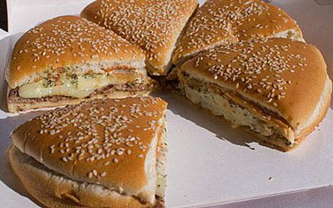
Logic & Linguistic
Could you please get me a burger and fries or a pizza?
…you’d better be hungry ;)
Beware
Can you tell what this VerbalExpression does?
Is this intuitive?
A programmer’s wife sends him to the grocery store with the instructions, “get a loaf of bread, and if they have eggs, get a dozen.” He comes home with a dozen loaf of bread and tells her, “they had eggs.”
VerEx().then( "." ).replace( my_paragraph, ". Stop." );

Slide 13
SimpleExpressions
https://github.com/timothep/simpleexpressions

Slide 14
C# 4.0 Dynamics
Implemented using C# 4.0 ‘dynamics’
e.g. ‘dynamic typing’ for C#
Introduced to use Ruby, Python and JS to .NET
Can be misused for API and flexible architecture design
This compiles
Inherit from ‘DnamicObject’, overwrite ‘TryGetMember()’ and ‘TryInvokeMember()’ and handle the call yourself!
dynamic someInt = 4;
someInt.ICanWriteHereWhateverIWantAndItCompiles(“doh”);

Slide 15
How to manipulate SimpleExpressions?
Here’s how you use a SimpleExpression
dynamic simpex = new SimpleExpression();
simpex.here.I.can.chain.my.commands
.Generate();
Console.Write(se.Expression);

Slide 16
The basics
Two chained commands implicitly mean “the first one, then the second”
Basic sets: Letters, Numbers & Alphanumerics
Text(string), One(char) & Maybe(string)
OneOf(string), EitherOf(string)
simpex.Letters.Numbers.Alphanumerics // [a-z]*, [0-9]*, [a-z0-9]*
simpex.Text("a_string_to_match") // a_string_to_match
simpex.One(‘c’) // c
simpex.Maybe(“something”) // (?:something)?
simpex.OneOf("aeiouy") // [aeiouy]
simpex.EitherOf("http|ftp") // (?:http|ftp)

Slide 17
Range & Modifiers
Express a Numeric Range
Modify a class
simpex.NumberInRange("0-255")
//Outputs "[0-9]|[1-9][0-9]|1[0-9][0-9]|2[0-4][0-9]|25[0-5]"
// e.g. a number in 0-9 or 10-99 or 100-199 or 200-249 or 250-255
simpex.Letters.And("-_~=%$&")
simpex.Letters.Except("a")

Slide 18
Modifiers
Capturing groups
simpex
.Group
.Text(http)
.Maybe(s)
.Together
.As("protocol") //Optional

Slide 19
Repetitions
simpex.Letters.AtLeast(3)
simpex.Letters.AtLeast(1).AtMost(5)
simpex.Letters.Exactly(4)
Simpex
.Group.Exactly(10)
.Numbers
.Together

Slide 20
Or operator
Or applies to the previous and next elements of the chain
simpex
.Text("http")
.Or
.Text("ftp")
.Text("://")

Slide 21
Roadmap
Maybe, And, Except as Operators

Slide 22
Examples
Email validation
string allowedChars = @"!#$%&'*+/=?^_`{|}~-";
simpex
.Group
.Letters.And(allowedChars).AtLeast(1)
.Group
.One(".") .Alphanumerics.And(allowedChars).AtLeast(1) . .Together.As("dotAndAfter")
.Together.As("afterAt„)
.Generate();

Slide 23
Examples
Another example?

Slide 24
Critics: Syntax Hunting Season
Isn’t the following gorgeous to read? (the answer is YES ;)
What about the following?
You wanted to say ‘twice’ instead of ‘two’, didn’t you?
simpex.Letters.AtLeast(3).AtMost(4)
simpex.Text("abcd").Except("a") simpex.Group.Text("aeiouy").Together.As("SomeLetters")
simpex.Group.Text("aeiouy").Together.Exactly(2)

Slide 25
Critics: Repetition Mess
What does this mean?
“4 to 5 groups of 2 numbers followed by at most 2 spaces“
“group at least 4 and at most 5 numbers, twice”
The problem here:
And no, pushing it after the ‘together’ wouldn’t solve the issue
Simpex
.Group.AtLeast(4).AtMost(5).Numbers.Exactly(2).Together.One(' ').AtMost(2)
Group.AtMost.X.Exactly.Together.Y.AtMost
Group.X.Exactly.Together.AtMost.Y.AtMost

Slide 26
Critics: Stuttering
“Stuttering”, one of the limits of that prose
Simpex
.Group
.Group
.Text(abcd)
.Group
.Letters.And("-")
.Together
.Together
.Text("cde")
.Together

Slide 27
SubExpressions
Create now, join later
That encapsulated grouping example
var abcd = new SimpleExpression().Text("abcd").Generate();
var efgh = new SimpleExpression().Text("efgh").Generate();
simpex.Sub(abcd).Or.Sub(efgh).Generate();
var innerMostGp = new SimpleExpression().
Goup.Letters.And("-").Together.Generate();
var innerGp = new SimpleExpression() .Group.Text(abcd).Sub(innerMostGp).Together.Generate();
var outerGp = new SimpleExpression() .Group.Sub(innerGp).Text("cde").Together.Generate();

Slide 28
Implicit Cardinality
What is meant here?
“a, b or c, at least two of them”
“twice a or twice b or twice c“
And
How do I do I express the other on?
simpex.EitherOf("a|b|c").AtLeast(2)

Slide 29
Experts, get lost!
Regular expression “experts” cannot help it, they have to fall back onto what they know
Does this create a class? A Group? Capturing or not?
The more you know what regular expressions can do, the more “screwed” you are with SimpleExpression
simpex.Letters.Except("aeiou").And("§$%&").AtLeast(2).AtMost(4)

Slide 30
C# Dynamics
Simple.Data (a C# model for this kind of architecture) has a true reason for using dynamics: the functions are not known at compile time
In SimpleExpression‘s case, everything is known beforehand
No reason for using dynamics :’(
Fully “implement-able” via a Fluent API
No Intellisense support

Slide 31
Abstract Syntax Tree
SimpleExpression commands cannot be linearly parsed
Simple repeat count
Named groups and repeat count
Simpex.One(“x“).AtLeast(3).AtMost(“5”)
// x => x{3,} => x{3,5}
Simpex.Group.AtLeast(3).Text("something").Together.As("theName")
// (<theName>something){3,})

Slide 32
Abstract Syntax Tree
Root Node
Concatenation
Node

Slide 33
What then?
SimpleExpression’s semantic is really nice
But it’s “death by 1000 paper cuts”
Many edge cases where the grammatic doesn't fit quite that well and tend to pull down the concept as a whole
Could be changed using parenthesis again, reordering some elements in a logical way instead of a grammatical order and thus losing some readability for the sake of precision

Slide 34
MagicExpression
https://github.com/ghusse/magicexpression

Slide 35
Objective

Slide 37
Fragen?
Vielen Dank!
Tim.bourguignon@mathema.de

