Slide 1
Lost in Translation
Reguläre Ausdrücke als Englische Sätze
Tim Bourguignon
tim.bourguignon@mathema.de
www.mathema.de
www.timbourguignon.fr

Slide 2
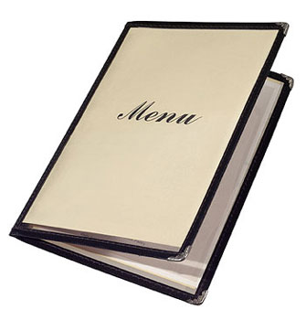
The menu
Foreword
* Expression
  VerbalExpression (Prior-Art)
  SimpleExpression (Nice try)
  MagicExpression (Masterpiece)
Wrap up
Image: internationalpointofsale.com

Slide 3
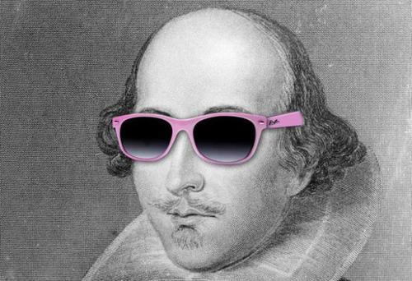
TL; DR;
Why express yourself like this?
When you can say it like Shakespeare?
A more coder friendly version maybe?
[A-Z0-9._%+-]+@[A-Z0-9.-]+\.[A-Z]{2,4}
  Thou shall match a string of letters
  follow'd by @
  then some characters
  a dram dot
  and some moo stuff
Thou.shallmatch(a-string-of-letters)
.followdby(“@“)
.then.somecharacters()
.adram(“.“)
.and.some(moostuff);

Slide 4

A regular expression DSL?
“SimpleExpression”
  Syntax close to the English language
  Build as a fluent API
  Outputs regular expressions
  Tailored for newbie's
    Could it satisfy veterans too?
Image: scilogs.com

Slide 5


Why… Why… WHY?
Example for a “C# dynamics” talk
Write a real DSL (at least) once
See if it works…
Regular Expression knowledge refresh
Get rich and famous (bitches!)
Because I can!

Slide 6
What is there to lose?
  (© Franck Mée, a “friend” who likes loves regular expressions)
The more complex the expression, the more surprised and god-like you’ll feel when it works
When you write one that works and you know no-one will ever understand, feel like Houdini mystifying everyone
You can strip down someone’s regex to pieces and yet never figure it out. Which makes you feel like looking at Houdini and God’s work combined
Old regexes (of yours) are like teenage kids, you know they came out of you, but you don’t quite get them anymore

Slide 7
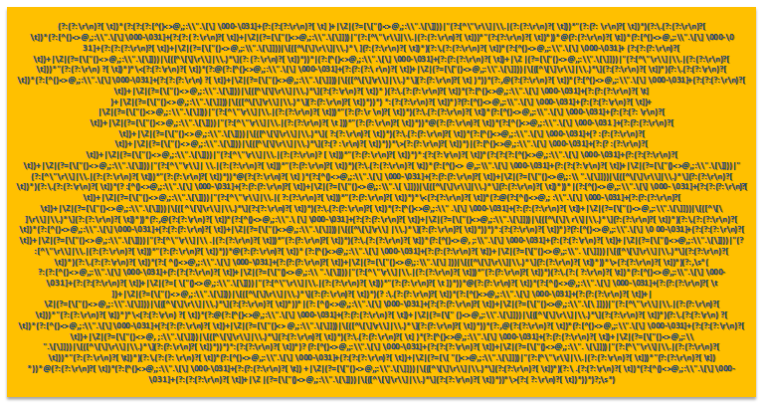
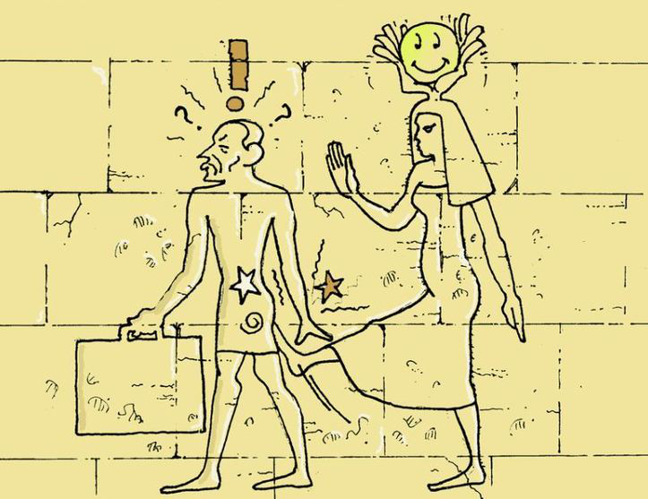
What we will NOT talk about
How to write regular expressions
Do’s and don’ts working with Regexes
Optimization & performance
Discuss the use of the RFC822 Email Regex
?
==

Slide 8


VerbalExpression

Slide 9
Prior-Art? Yes, “VerbalExpressions”
“JavaScript Regular expressions made easy”
  On github (github.com/VerbalExpressions)
  Forks for: Ruby, C#, Python, Java, Groovy, PHP, Haskell, C++ and Objective-C
var tester = VerEx()
.startOfLine()
  .then( "http" )
  .maybe( "s" )
  .then( "://" )
  .maybe( "www." )
  .anythingBut( " " )
  .endOfLine();

Slide 10
NotSoClearExpressions…
Inconsistencies
  find()
  or().then(X)
  Or() logic
var expression = VerEx()
.find( "http" )
.maybe( "s" )
.then( "://" )
.or()
.then( "ftp://" )

Slide 11
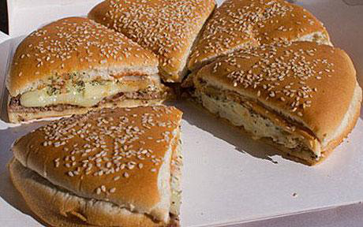
NotSoClearExpressions…
Branching
Could you please get me a burger and fries or a pizza?
var expression = VerEx()
.find( "http" ).maybe( "s" ).then( "://" )
.or()
.then( "ftp://" )
?
var expression = VerEx()
.(find( "http" ).maybe( "s" )
.then( "://" ))
.or()
.(then( "ftp://" ))
var expression = VerEx()
.find( "http" ).maybe( "s" )
.(then( "://" ))
.or()
.(then( "ftp://" ))

Slide 12
NotSoClearExpressions…
Can you tell what this VerbalExpression does?
  Is this intuitive?
  Why not something like the following?
VerEx().then( "." ).replace( my_paragraph, ". Stop." );
VerEx().find( "." ).in( my_paragraph).replaceWith(". Stop." );

Slide 13

SimpleExpression(s)
Emoticons: brusheezy.com/members/tijo

Slide 14
How to manipulate SimpleExpressions?
Here’s how you use a SimpleExpression
„dynamic“?
DynamicObject
dynamic simpex = new SimpleExpression();
simpex.here.I.can.chain.my.commands.Generate();
Console.Write(simpex.Expression);
dynamic someInt = 4;
someInt.ICanWriteHereWhateverIWantAndItCompiles(“doh”);
// … but will crash & burn in flames at runtime
dynamic someDynamic = new DynamicObject();
someDynamic.Something();
=> TryInvokeMember(„Something“)

Slide 15
Examples 1 & 2
Floating point number matching
Hexadecimal Color
simpex
.Maybe('-')
.Numbers //Default is „zero or more“
.One('.')
.Numbers.AtLeast(1)
.Generate();
simpex
.One('#')
.Numbers.And(“abcdef“).Exactly(3)
.Or
.Numbers.And(“abcdef“).Exactly(6)
.Generate();

Slide 16
Example 3: Email validation
string allowedChars = @"!#$%&'*+/=?^_`{|}~-";
simpex
.Group
.Alphanumerics.And(allowedChars).AtLeast(1)
.Together.As("beforeAt")
.One('@')
.Group
.Letters.And(allowedChars).AtLeast(1)
.Group
.One(".")
.Alphanumerics.And(allowedChars).AtLeast(1)
.Together.As("dotAndAfter")
.Together.As("afterAt")
.Generate();
Letters, Alphanumerics
Group.Cardinal.X.Together.As()

Slide 17
Example 4: IP
Regular Expression Range for 0-255
  [0-9]|[1-9][0-9]|1[0-9][0-9]|2[0-4][0-9]|25[0-5]
  e.g. a number in 0-9 or 10-99 or 100-199 or 200-249 or 250-255
IP Match
Simpex
.NumberInRange("1-255").One('.')
.NumberInRange("0-255").One('.')
.NumberInRange("0-255").One('.')
.NumberInRange("0-255")
.Generate();

Slide 18

Temperature check?
How do you like SimpleExpression sofar?
Any comments / suggestions / violent rant?
Let's criticize!
Image: halleballedog.com

Slide 19
Critics: Syntax Hunting Season
Isn’t the following gorgeous to read? (hint: the answer is YES ;)
What about the following?
  Isn't there an 'And' missing?
  'Two' or 'Twice'?
  .Letters.Exactly(1) or .Exactly(1).Letters ?
    .Group.Exactly(3).X.Together
    .Exactly(3).Group.X.Together ?
simpex.Letters.AtLeast(3).AtMost(4)
simpex.Letters.And("-_ ").Except("a") simpex.Group.Text("http").Maybe('s').Together.As("protocol")
simpex.Group.One('0').Letters.Exactly(1).Together.Exactly(2)

Slide 20
Critics: Repetition Mess
What does the following mean?
  “Group at least 5 numbers twice, followed by at least one space”
  “At least 5 groups of 2 numbers followed by at least one space“
The problem here:
  And no, pushing it after the ‘together’ wouldn’t solve the issue
Simpex
.Group.AtLeast(5).Numbers.Exactly(2).Together.One(' ').AtLeast(1)
Group.AtLeast.X.Exactly.Together.Y.AtLeast
Group.X.Exactly.Together.AtLeast.Y.AtLeast

Slide 21
Critics: Stuttering
“Stuttering”, one of the limits of that prose
Simpex
.Group
.Group
.Text(abcd)
.Group
.Letters.And("-")
.Together
.Together
.Text("cde")
.Together

Slide 22
SubExpressions, a sub solution
Create now, join later
That encapsulated grouping example
var abcd = new SimpleExpression().Text("abcd").Generate();
var efgh = new SimpleExpression().Text("efgh").Generate();
simpex.Sub(abcd).Or.Sub(efgh).Generate();
var innerMostGp = new SimpleExpression()
.Goup.Letters.And("-").Together.Generate();
var innerGp = new SimpleExpression()
.Group.Text(abcd).Sub(innerMostGp).Together.Generate();
var outerGp = new SimpleExpression()
.Group.Sub(innerGp).Text("cde").Together.Generate();

Slide 23
Critic: Implicit Cardinality
What is meant here?
  “a, b or c, at least two of them”
  “twice a or twice b or twice c“
    How do I do I express the other one?
simpex.EitherOf("a|b|c").AtLeast(2)

Slide 24
Critic: Experts, get lost!
Regular expression “experts” fall back onto what they know
Does this create a class? A Group? Capturing or not?
How can I do Backward & Forward Lookup?
  Well you can't
The more you know the more disturbing SimpleExpression is
simpex.Letters.Except("aeiou").And("§$%&").AtLeast(2).AtMost(4)

Slide 25
Critic: dynamics Architecture
All functions are known at compile time
  Fully “implement-able” via a Fluent API
Unnecessary lack of Intellisense support

Slide 26
Abstract Syntax Tree
SimpleExpression's commands cannot be linearly parsed
Simple repeat count
Inversion of named groups and repeat count
Simpex.One(“x“).AtLeast(3).AtMost(“5”)
// x => x{3,} => x{3,5}
simpex
.Group.AtLeast(3).Text("something").Together.As("theName")
// (<theName>something){3,}

Slide 27
Abstract Syntax Tree
simpex
.Group.AtLeast(3)
.Text("this").One(“!“)
.Together.As("theName")
.Text(“that“)
.Generate();
Root
Concat
Group
+ AtLeast-3
+ theName
“that“
“this“
“!“
//Recursively generated expression:
(<theName>this!){3,})that

Slide 28
What then?
SimpleExpression’s semantic is quite nice and in some cases can actually be helpful
Many edge cases where the grammatic doesn't fit that well and tend to pull down the concept as a whole ; it is like “death by 1000 paper cuts”
Using parenthesis & reordering elements logically instead of grammatically
→ Losing some readability for the sake of precision?

Slide 29
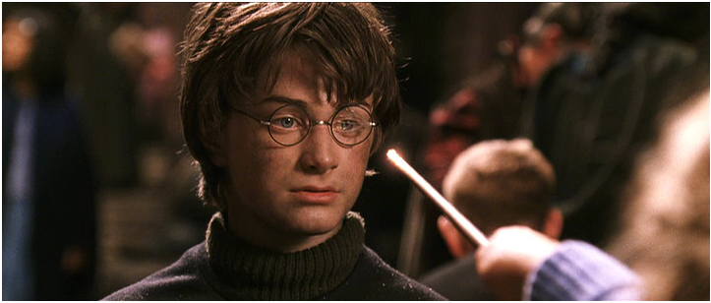
REGEXUS
OCCULTO!
MagicExpression

Slide 30
TL; DR;
Compared to SimpleExpression
  Loses the dynamics for a fluent API
  Less-funky but less ambiguous functions
  No more cumbersome Abstract Syntax Tree
  Way more functions!

Slide 31
„MagicExpression for Muggles“ (©Ghusse)
Install via Nuget
Instanciation
Install-Package MagicExpression
var magicWand = Magex.New();
magicWand.The.Functions.Here; //no lame .Generate() here
Console.WriteLine(magicWand.Expression);

Slide 32
Example 1: floating point match
var magicWand = Magex.New();
MagicWand
.Character('-').Repeat.AtMostOnce()
.CharacterIn(Characters.Numeral).Repeat.Any()
.Character('.')
.CharacterIn(Characters.Numeral).Repeat.AtLeastOnce();
// Creates the following regex: -?[0-9]*\.[0-9]+
// Matches "1.234", "-1.234", "0.0", ".01"
// Doesn't Match "0", "1,234", "0x234", "#1a4f66"
Character() & CharacterIn()
.Repeat trigger
Optional block handled via .AtMostOnce()
  .Any() or .Between(0, uint) would also do the trick
Simpex
.Maybe('-')
.Numbers
.One('.')
.Numbers.AtLeast(1)
.Generate();

Slide 33
Example 2: XML Tag Matching
var magicWand = Magex.New()
.Character('<')
.CaptureAs("tag",
x => x.CharacterNotIn('>').Repeat.AtLeastOnce())
.Character('>')
.Character().Repeat.Any().Lazy()
.String("</")
.BackReference("tag")
.Character('>');
// Matches "<strong>hello world</strong>" & "<h1>A title</h1>"
// Doesn't match "<h1>A tag mismatch</strong>"
Group() → Non-capturing group
Capture() → Capturing group
CaptureAs() → Named capturing group
BackReference(string) → Back reference on a named group

Slide 34
Example 3: URL Matching
var magicWand = Magex.New();
magicWand.Options = RegexOptions.IgnoreCase;
const string allowedChars = @"!#$%&'*+/=?^_`{|}~-";
MagicWand
.Alternative(
Magex.New().String("http"),
Magex.New().String("ftp"))
.Character('s').Repeat.AtMostOnce()
.String("://")
.Group(Magex.New().String("www."))
.Repeat.AtMostOnce()
.CharacterIn(Characters.Alphanumeric, allowedChars);
Alternative(params Magex[])
CharacterIn(params char[])

Slide 35
Example 4: Hexadecimal numbers
„0x12e5ad“
Hex Color
Magex.New()
.Character('0')
.CharacterIn("xX")
.CharacterIn(Characters.Numeral, "abcdefABCDEF").Repeat.Times(6);
Magex.New()
.Character('#')
.Alternative(
Magex.New().CharacterIn(Characters.Numeral, "abcdefABCDEF")
.Repeat.Times(6),
Magex.New().CharacterIn(Characters.Numeral, "abcdefABCDEF")
.Repeat.Times(3).EndOfLine());

Slide 36
Example 5: IP
Magex.New()
.Builder.NumericRange(1, 255).Character('.')
.Builder.NumericRange(0, 255).Character('.')
.Builder.NumericRange(0, 255).Character('.')
.Builder.NumericRange(0, 255);
Builder property to help you with predefined functions
  Currently only NumericRange()
Literal(string) function to add a predefined regular expression
Other functions?
  Email? Date with pseudo variable format → „yyyy-MM-dd“ ?
  Hex, Floating point number... ? Any ideas? Wishes?

Slide 37
Doc?
Readme
  https://github.com/ghusse/magicexpression

Slide 38
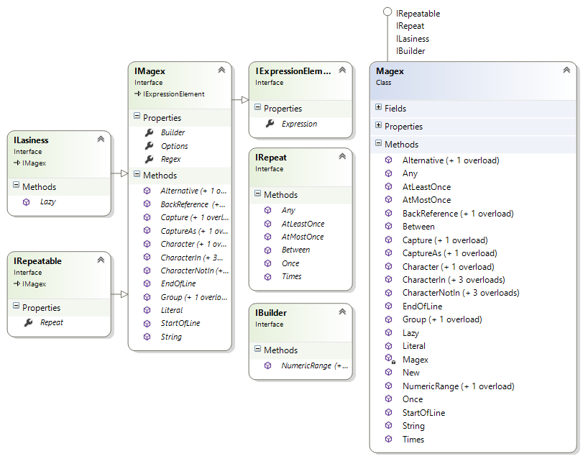
Architecture: Magex Interfaces

Slide 39
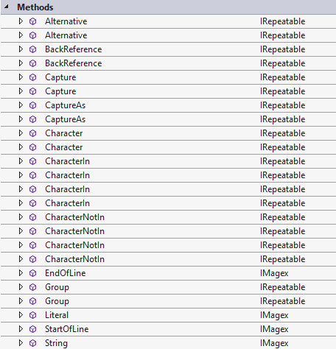

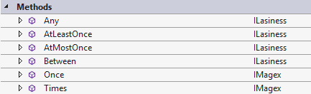
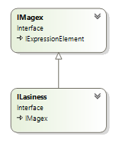
Architecture: Ghusse's Interfaces Game
magex.Character('s').Repeat.AtMostOnce().Character...
IMagex
IRepeatable
Only those methods
are available after
.Repeat
IRepeat
IMagex gives us
access to all those
Methods...
Gives an ILasiness
Back, i.e. an IMagex

Slide 40

Let's wrap up
Image: teenlibrariantoolbox.com

Slide 41

Wrap Up
It is possible to write such a DSL!
  I'm going to be rich and famous
  Our languages are not always a good thing to immitate
  But (in this case) a pinch of DSL doesn't hurt
SimpleExpression
  Semantically attractive, but not viable as is
MagicExpression
  Less sexy but useful
  Next big feature → Reverse engineer regular expressions?

Slide 42

Fragen?
  www.timbourguignon.fr
  tim.bourguignon@mathema.de
THANKS!
QUESTIONS?
SUGGESTIONS?
IDEAS?

