Slide 1
Lost in Translation
Reguläre Ausdrücke als Englische Sätze
Tim Bourguignon
tim.bourguignon@mathema.de www.mathema.de

Slide 2
The menu
Foreword
*Expression
VerbalExpression
SimpleExpression
MagicExpression

Slide 3
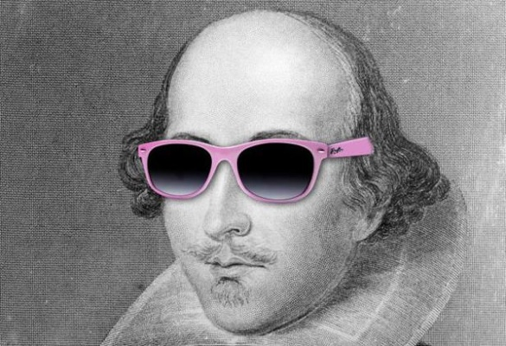
TL; DR;
Why express yourself like this?
When you can say it like Shakespeare?
A more coder friendly version maybe?
[A-Z0-9._%+-]+@[A-Z0-9.-]+\.[A-Z]{2,4}
“Thou shall match a string of letters follow'd by @ then some other characters, a dram dot and some moo stuff”
Thou.shallmatch(a-string-of-letters)
.followdby(@).then.someothercharacters()
.adram(dot).and.some(moostuff);

Slide 4
A regular expression DSL?
“SimpleExpression”
Fluent API
Close to the English language
Tailored for newbie's
Could it satisfy veterans too?
Outputs regular expressions
In practice
Implemented prototyped in C# for .NET
On Github (github.com/timothep/SimpleExpressions)

Slide 5

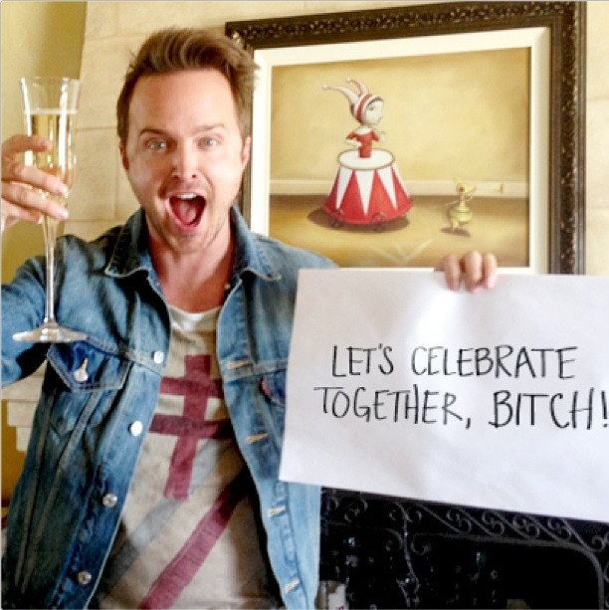
Why… Why… WHY?
Example for a “C# dynamics” talk
Write a real DSL (at least) once
See if it works…
Regular Expression knowledge refresh
Get rich and famous (bitches!)
Because I can!

Slide 6
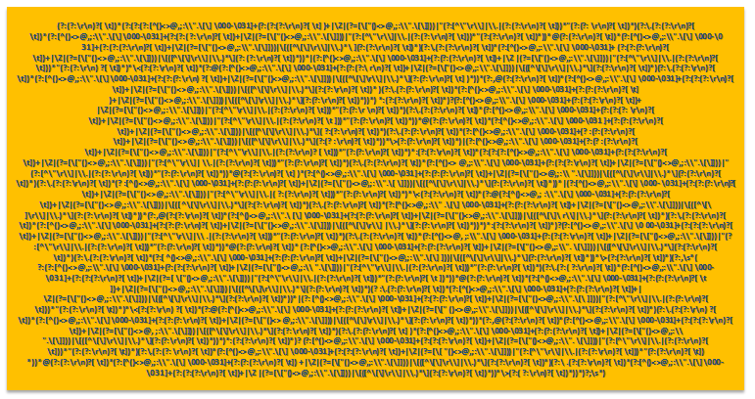
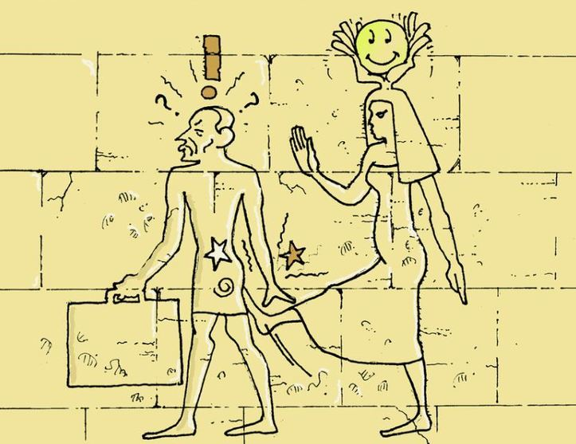
What we will NOT talk about
How to write regular expressions
Do’s and don’ts working with Regexes
Optimization & performance
Devise on the RFC822 Email Regex
?
==

Slide 7
Two Three Problems
“Some people, when confronted with a problem, think: ‘I know, I'll use regular expressions.' Now they have two problems”
“Some people, when confronted with a problem, think: ‘I know, I'll create a DSL that wraps regular expressions.' Now they have three problems”

Slide 8
What is there to lose?
(© Franck Mée, a “friend” that likes loves regular expressions)
The more complex the expression, the more surprised and god-like you’ll feel when it works.
When you write one that works and you know no-one will ever understand, feel like Houdini mystifying everyone.
You can strip down someone’s regex to pieces and yet never figure it out. Which makes you feel like looking at Houdini and God’s work combined.
Old regexes (of yours) are like teenage kids, you know they came out of you, but you don’t quite get them anymore.

Slide 9
VerbalExpression
https://github.com/VerbalExpressions

Slide 10
Prior-Art? Yes, “VerbalExpressions”
“JavaScript Regular expressions made easy”
On github (github.com/VerbalExpressions)
Forks for: Ruby, C#, Python, Java, Groovy, PHP, Haskell, C++ and Objective-C
var tester = VerEx()
.startOfLine()
.then( "http" )
.maybe( "s" )
.then( "://" )
.maybe( "www." )
.anythingBut( " " )
.endOfLine();

Slide 11
NotSoClearExpressions…
Inconsistent “Find()” function
Branching
var expression = VerEx()
.find( "http" )
.maybe( "s" )
.then( "://" )
.or()
.then( "ftp://" )
?
var expression = VerEx()
.find( "http" )
.maybe( "s" )
.then( "://" )
var expression = VerEx()
.find( "http" )
.maybe( "s" )
.then( "ftp://" )
Please get me a burger and fries or a pizza?

Slide 12
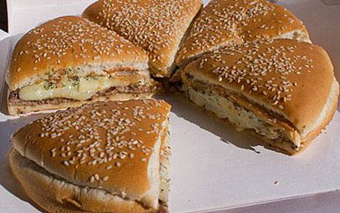
Logic & Linguistic
Could you please get me a burger and fries or a pizza?
…you’d better be hungry ;)
Beware
Can you tell what this VerbalExpression does?
Is this intuitive?
A programmer’s wife sends him to the grocery store with the instructions, “get a loaf of bread, and if they have eggs, get a dozen.” He comes home with a dozen loaf of bread and tells her, “they had eggs.”
VerEx().then( "." ).replace( my_paragraph, ". Stop." );

Slide 13
SimpleExpressions
https://github.com/timothep/simpleexpressions

Slide 14
C# 4.0 Dynamics
Implemented using C# 4.0 ‘dynamics’
e.g. ‘dynamic typing’ for C#
Introduced to use Ruby, Python and JS to .NET
Can be misused for API and flexible architecture design
This compiles
Inherit from ‘DnamicObject’, overwrite ‘TryGetMember()’ and ‘TryInvokeMember()’ and handle the call yourself!
dynamic someInt = 4;
someInt.ICanWriteHereWhateverIWantAndItCompiles(“doh”);

Slide 15
How to manipulate SimpleExpressions?
Here’s how you use a SimpleExpression
dynamic simpex = new SimpleExpression();
simpex.here.I.can.chain.my.commands
.Generate();
Console.Write(se.Expression);

Slide 16
The basics
Two chained commands implicitly mean “the first one, then the second”
Basic sets: Letters, Numbers & Alphanumerics
Text(string), One(char) & Maybe(string)
OneOf(string), EitherOf(string)
se.Letters.Numbers.Alphanumerics // [a-z]*, [0-9]*, [a-z0-9]*
se.Text("a_string_to_match") // a_string_to_match
se.One(‘c’) // c
se.Maybe(“something”) // (?:something)?
se.OneOf("aeiouy") // [aeiouy]
se.EitherOf("http|ftp") // (?:http|ftp)

Slide 21
MagicExpression
https://github.com/ghusse/magicexpression

Slide 23
Fragen?
Vielen Dank!
Tim.bourguignon@mathema.de

