Slide 1
Granuläres .NET-Web-Development
...mit Nancy- & Simple.Data- Frameworks
Timothée Bourguignon
MATHEMA Software GmbH

Slide 2
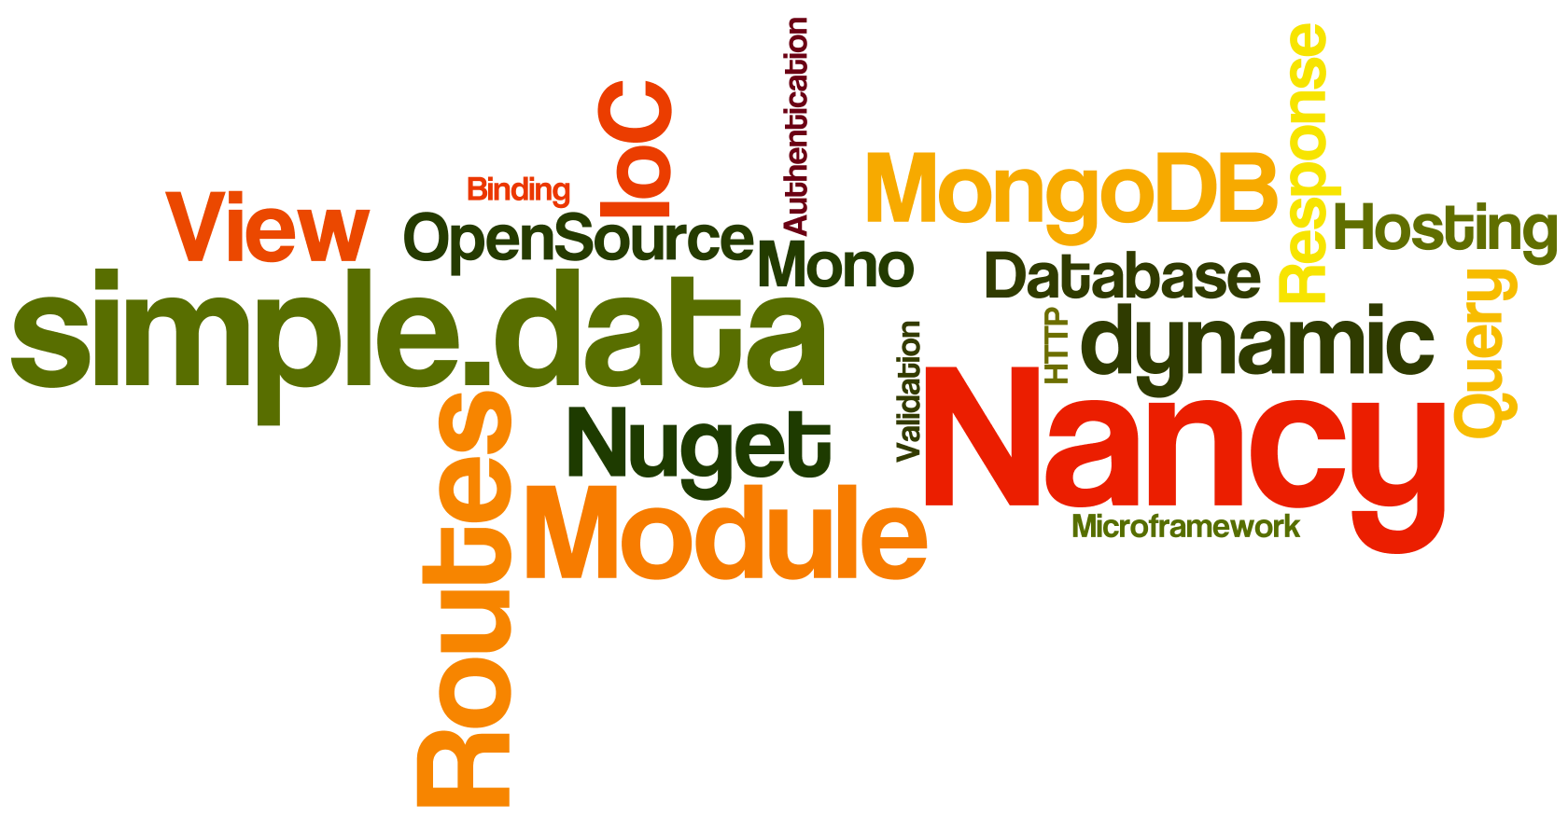

Slide 3
First Date with Nancy
„Lightweight Web Framework for .NET“
nancyfx.org | #nancyfx

Slide 4
Microframework
Serve up web content
Lean, Extensible API
Simple setup
“Close to the metal”

Slide 5
Why?
Simplicity & Readability
Modularity
OpenSource
"Close" to HTTP
Very explicit routing
Runs anywhere
„Super Duper Happy Path“

Slide 6

„Hello Nancy“
public class MyModule : NancyModule
{
public MyModule()
{
Get["/"] = _ => "Hello World";
}
}

Slide 7
Setting up a Nancy project
Install Nancy via Nuget:
  Adds Nancy assembly references
  Sets up web.config (if using IIS)
PM> Install-package Nancy.Hosting.Aspnet
Install-Package Nancy.Hosting.Owin
Install-Package Nancy.Hosting.Wcf
…

Slide 8
Module's Anatomy
public class MyModule : NancyModule
{
public MyModule()
{
Get["/"] = _ => { ... };
Get["/submit"] = _ => { ... };
Post["/submit"] = _ => { ... };
Get["/voteup/{id}"] = params => { ... };
Get["/login"] = _ => { ... };
Get["/logout"] = _ => { ... };
Post["/login"] = _ => { ... };
}
}

Slide 9
Route
Composed of
  Method (HTTP Methods: Get, Post, Put…)
  Pattern
  Action (+parameters & result object)
  Condition (optional)
Get["/voteup/{id}"] = x => {
return View["Voteup", x.id];
};

Slide 10
Pattern
Literal segments (10k): "/voteup"
Capture segments (1k): "/{id}“
Capture segments (Optional)(1k): "/{id?}“
Capture segments (Optional/Default)(1k): "{name?unnamed}“
Regex Segments (1k): /(?<id>[\d]+)
Greedy Regex Segments (100): ^(?<name>[a-z]{3,10}(?:/{1}))$
Greedy Segments (0): "/{id*}“
Get["/voteup/{id}"] = x => {
return View["Voteup", x.id];
};

Slide 11
Pattern Scoring
10K
Literal segments (10k): "/voteup"
Capture segments (1k): "/{id}“
Capture segments (Optional)(1k): "/{id?}“
Capture segments (Optional/Default)(1k): "{name?unnamed}“
Regex Segments (1k): /(?<id>[\d]+)
Greedy Regex Segments (100): ^(?<name>[a-z]{3,10}(?:/{1}))$
Greedy Segments (0): "/{id*}“
Get["/voteup/{id}"] = x => {
return View["Voteup", x.id];
};
1K
0

Slide 12
Action
Behavior invoked by a route
Get["/voteup/{id}"] = x => {
return View["Voteup", x.id];
};
<anything>
→ Content
Negociation
Action
Func<dynamic,
dynamic>
Dynamic
Dictionary
Nancy
.Response

Slide 13
Nancy.Response
Nancy.Response implicit casts
  Int32 → HTTP Status Code
  ‘HttpStatusCode’ enumerable value
  String → body of the response
  ‘Action<Stream>’
Response formatters:
  As File, Image, Json, Xml & Redirect

Slide 14
Serving up Views
Views are discovered
Supported View Engines
  SuperSimpleViewEngine
  Razor, Spark, DotLiquid...
  … any other IViewEngine
View Engine is selected dynamically, based on the view's file extension
Get["/products"] = _ => {
return View["products.cshtml"];
};

Slide 15
Model Binding
Data can be passed via „Query string“, „Captured parameters“ or „Body of a request“
Module → View
  Supports any object Type
  Use dynamics per default
Module ← View
  Model binding for all ways
Get["/products"] = _ =>
{
return View["prod.cshtml",
someModel];
};
Foo foo = this.Bind();
var foo = this.Bind<Foo>();
this.BindTo(foo);

Slide 16
Hands on Nancy
HackerNews meet Nancy

Slide 17
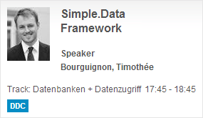
Simple.Data
...an O/RM without O, R or M

Slide 18
„Hello Simple.Data“
public void Greetings()
{
var conString = "…";
var db = Database.OpenConnection(conString);
var hello = db.Hello.FindById(1);
Console.WriteLine("{0}, {1}!",
hello.Greeting, hello.Subject);
}

Slide 19
What is Simple.Data?
Lightweight way of manipulating data
  Based on .NET 4.0's „dynamic“ keyword
  Interprets method and property names
  Maps them to your underlying data-store
  Prevents SQL Injection
  Inspired by Ruby’s ActiveRecord and DataMappers
  Open Source & runs on Mono
  V1.0 rc3 released in Nov. 2012

Slide 20








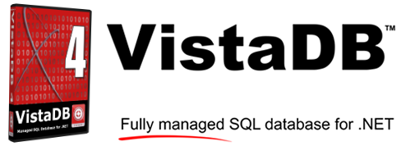
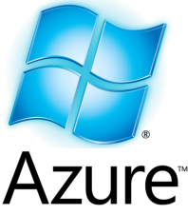


Database agnostic

Slide 21
Fluid Convention
db.album.FindAllByGenreId(3);
Column
Command
Parameters
Table/View

Slide 22
Simple CRUD operations
public void CRUD()
{
db.People.FindAllByName("Bob");
db.People.FindByFirstNameAndLastName("Bob", "X");
db.Users.All().OrderByJoinDateDescending();
db.Users.All().OrderByJoinDate().ThenByNickname();
db.People.Insert(Id: 1, FirstName: "Bob");
db.People.Insert(new Person {Id = 1, Name = "Bob"});
db.People.UpdateById(Id: 1, FirstName: "Robert");
db.People.DeleteById(1);
}

Slide 23
Barely less simple operations
//Ordering
db.Customers.All().OrderByLastName()
.ThenByFirstNameDescending();
//Paging
db.Users.All().OrderByNickname().Skip(10).Take(10);
//Table joins
db.Customers.FindAllByCustomerId(1).WithOrders();

Slide 24
Nancy, meet Simple.Data
Simple.Data, meet Nancy

Slide 25
Second date with Nancy
In case the SuperDuperHappyPath is not completely Super, Duper or Happy yet…

Slide 26
Content Negociation
Content Negociation

Slide 27
Authentication
Nancy.Authentication.Basic
  Basic HTTP authentication
Nancy.Authentication.Forms
  Proper authentication
  Facebook, oAuth etc. on their way

Slide 28
Authentication
public class MyBootstrapper : DefaultNancyBootstrapper
{
protected override void InitialiseInternal(TinyIoC.TinyIoCContainer container)
{
base.InitialiseInternal(container);
FormsAuthentication.Enable(this,
new FormsAuthenticationConfiguration
{
RedirectUrl = "~/login",
UsernameMapper = container.Resolve<IUsernameMapper>()
});}}
public class MyModule : NancyModule
{
public MyModule() : base("/secure")
{
this.RequiresAuthentication();
Get["/"] = _ => "Secure!";
}
}

Slide 29
Testing
Nuget: PM> Install-Package Nancy.Testing
„Browser“ class
var result = browser.Get("/", with => {
with.HttpRequest(); });
Assert
response.Body["#errorBox"]
.ShouldExistOnce()
.And.ShouldBeOfClass("floatingError")
.And.ShouldContain("invalid",
StringComparison.InvariantCultureIgnoreCase);

Slide 30
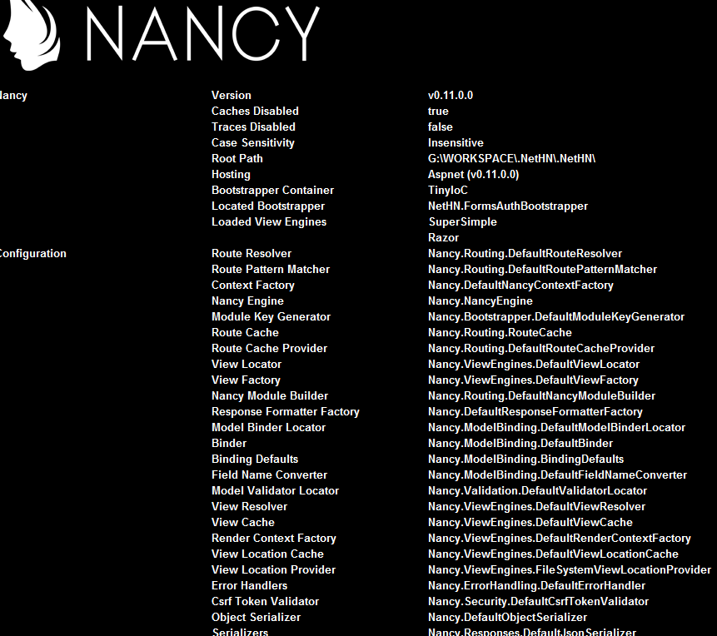
Nancy.Diagnostic
localhost/_nancy
  Information
  Interactive diagnostic
  Request Tracing
  Settings

Slide 31
Why use Nancy?
Easier Testing
Automatic Dependendy Resolution
Completely Customisable, extension points
Terse Syntax, Less ceremony
Runs on Mono
Content Negociation
No Config
Runs Anywhere
Pipeline hooks
No ties to System.Web
Plugins (http://nuget.org/packages?q=nancy)

Slide 32
Why use Simple.Data?

Slide 33
Wrap-up!
Pros
  It is incredibly simple, readable & flexible
  It runs everywhere (Self hosted on Mobile?)
  Great for Webservice or small / fast projects
Cons
  Hard to picture a large project with Nancy or Simple.Data
  Flexibility via „dynamic“ can be double edged
Nancy & Simple.Data cannot do more or less than the others… but they do it in a very elegant and efficient manner

Slide 34



Contacts
Andreas Håkansson (NancyFx)
  @TheCodeJunkie
  http://elegantcode.com/
Steven Robbins (NancyFx, TinyIoC)
  @Grumpydev
  http://www.grumpydev.com/
Mark Rendle (Simple.Data)
  @MarkRendle
  http://blog.markrendle.net/

Slide 35



Fragen?
tim.bourguignon@mathema.de
about.me/timbourguignon

Slide 36


Slide 37
Model Validation
Similar to MVC
using System.ComponentModel.DataAnnotations;
[Required]
public DateTime CreationDate { get; set; }
var result = this.Validate(model);
if (!result.IsValid)
{
  return View["CustomerError", result];
}

Slide 38
Architectural Overview
HTTP handler
Modules
Routes
Response
Views
View engines
Bootstrapping (IoC)
  Hosting
  ASP.NET
  WCF
  Azure
  Owin
  Self-hosted
Authentication

