Slide 1

EINFACH SIMPEL
Granuläres .NET-Web-Development mit Nancy- und Simple.Data- Frameworks
Timothée Bourguignon
Mathema Software GmbH
Notes:
Ich, einführung in Nancy & Simple.Data
=> Überblick der Vortrag

Slide 2
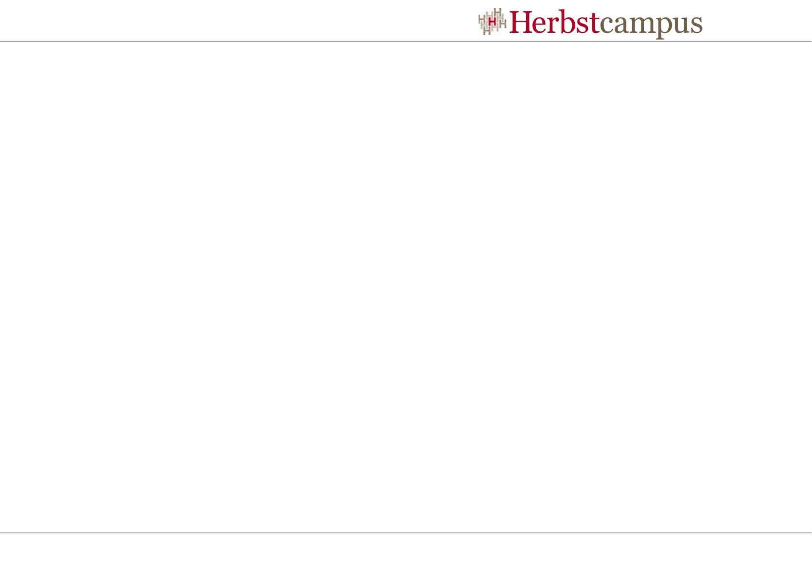
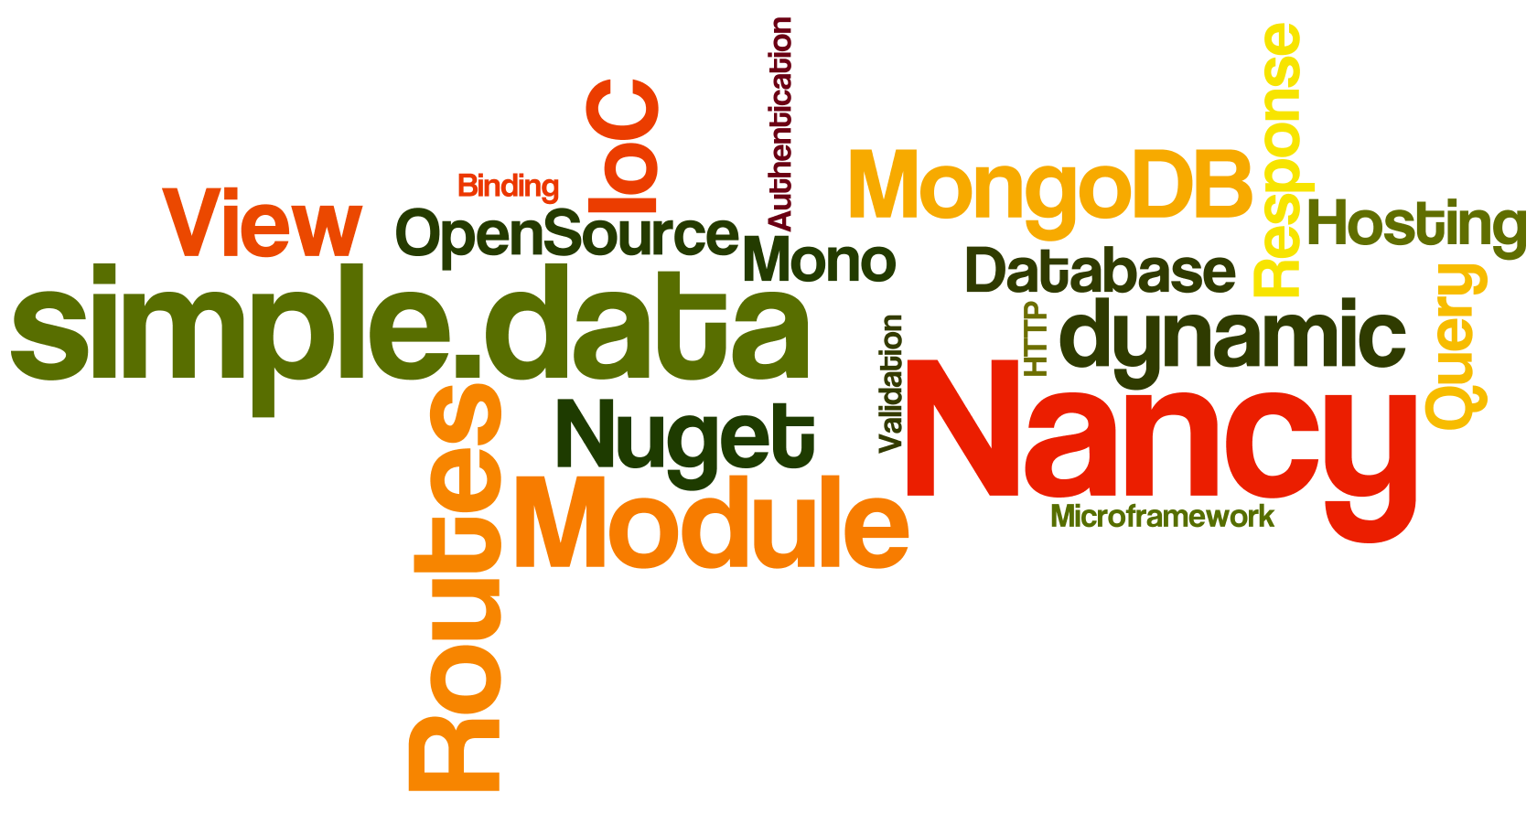
Notes:
Wer hat schon von Nancy/Simple.Data gehört/was damit gemacht?
=> Warum ich die gewählt habe?

Slide 3
Why?
Simplicity & Readability
Modularity
OpenSource
"Close" to HTTP
Very explicit routing
Runs anywhere
„Super Duper Happy Path“
Notes:
=> Starten wir mit Nancy

Slide 4
First date with Nancy
„Lightweight Web Framework for .NET“
nancyfx.org | #nancyfx

Slide 5
Microframework
Serve up web content
Lean
Extensible API
Simple setup
“Close to the metal”
Notes:
WebFramework: Web Inhalt bereit zu stellen
Lean – nur der minimum
Extensible API - erweiterbarkeit
Simple setup – wenig boilerplate code
=> Grundsätzlich ein Sinatra clone

Slide 6

„Hello Sinatra“
$ gem install sinatra
$ ruby –rubygems app.rb
require 'sinatra'
get '/hi' do
"Hello World!"
end
Notes:
=> So sieht der „Hello Nancy“ aus

Slide 7

„Hello Nancy“
namespace NancyDemo
{
public class MainModule : NancyModule
{
public MainModule()
{
Get["/hi"] = _ => "Hello Nancy!";
}
}
}
Notes:
=> Wie gesagt, ein Einfaches Setup ist gewünscht ; um das zu schaffen braucht man eigentlich fast nichts

Slide 8
Setting up a Nancy project
Create an empty web project
Install Nancy via Nuget:
PM> Install-package Nancy.Hosting.Aspnet
Or Install-Package Nancy.Hosting.Owin
Or Install-Package Nancy.Hosting.Wcf
…
    Adds Nancy assembly references
    Sets up web.config (if using IIS)
Create a module and define a route
Notes:
=> So einfach geht’s. Schauen wir uns Nancy‘s Innereien genauer an.

Slide 9
Architectural Overview
HTTP handler
Modules
Routes
Response
Views
View engines
Bootstrapping (IoC)
Hosting
    ASP.NET
    WCF
    Azure
    Umbraco
    Owin (~ Ruby’s ”Rack”)
    Self-hosted
Authentication
…
Notes:
HTTP handler: ASP.NET pipeline aufrufe behandeln
Modules: “controllers” artiges Komponente, der Kern von Nancy
Response: sehr spezielles objekt mit welche eine Route antworten muss
Bootstrapping (IoC): die linke-seite Komponente zu suchen, finden & instanzieren (IoC)
=> Der Module

Slide 10
Module‘s Anatomy
public class MyModule: NancyModule
{
  Public MyModule()
  {
  Get["/"] = _ => { ... };
  Get["/submit"] = _ => { ... };
  Post["/submit"] = _ => { ... };
  Get["/voteup/{id}"] = parameters => { ... };
  Get["/login"] = _ => { ... };
  Get["/logout"] = _ => { ... };
  Post["/login"] = _ => { ... };
  }
}
Notes:
=> Jede Linie hier beschreibt eine Route, schauen wir uns die Routen genauer an

Slide 11
Route
Composed of
  Method (HTTP Methods: Get, Post, Put, Delete…)
  Pattern
  Action (+parameters & result object)
  Condition (optional)
Get["/voteup/{id}"] = x => {
return View["Voteup", x.id];
};
Notes:
=> Die methoden sind selbst erklärend, schauen wir uns der Pattern an

Slide 12
Route pattern
Literal segments: "/voteup"
Variable segments: "/voteup/{id}“
Literal segments + regular expression back-references: "/voteup/(?<id>[\d]+)"
Get["/voteup/{id}"] = x => {
return View["Voteup", x.id];
};
Notes:
=> Der Route Resolving ist ein bisschen anders als in MVC, daher schauen wir uns das kurz an

Slide 13
Route resolver
Request method & Path matching
Picks highest number of static segments capture, then highest number of parameter captures
Lifecycle
"Before" pipeline is executed (if present)
Route's action is invoked
"After" pipeline is executed (if present)
Get["/voteup/{id}"] = x => {
return View["Voteup", x.id];
};
Notes:
=> Jetzt dass unsere route gewählt würde, können wir unsere Aktion aufführen

Slide 14
Route action, parameters & Response
Receives a .Net4.0 “dynamic” object packaging the request parameters
  x => x.id
Returns an“Nancy.Response” object
Get["/voteup/{id}"] = x => {
return View["Voteup", x.id];
};
Notes:
Was in der Aktion passiert ist uns hier relativ egal, was wichtig ist sind die input & output objekt
=> Der Nancy.Response objekt ist etwas speziell und wird eigentlich so verwendet:

Slide 15
Nancy.Response
Nancy.Response implicit casts
  Int32 ➔ HTTP Status Code (ex: 404, No Found)
  ‘HttpStatusCode’ enumerable value
  String ➔ body of the response
  ‘Action<Stream>’
Response formatters:
  As File, Image, Json, Xml & Redirect
Views
Get["/voteup/{id}"] = x => {
return View["Voteup", x.id];
};
Notes:
=> Views liegen außerhalb von Nancy‘s scope, 2 Wörter trotsdem dazu

Slide 16
Serving up views
Views are discovered in the project
Supported View Engines
  SuperSimpleViewEngine (basic HTML & iteration syntax)
  Razor
  Spark
  Django
  DotLiquid
  Any other implementation IViewEngine
  Selected dynamically, based on the view's file extension
Notes:
=> Mehr gibt’s nicht über Views selbst, Daten hin und zurück zu transferieren zwischen Views & Modules gibt’s aber

Slide 17
View model & Model Binding
Data passed via Query string, captured parameters on routes or body of a request
Module ➔ View
  Supports any object Type
  Uses “dynamic” per default
Module ⬅ View
  Model binding for all ways
Foo foo = this.Bind();
var foo = this.Bind<Foo>();
this.BindTo(foo);
Notes:
Solange wir über Model sprechen, sollten wir auch kurz über Model Validation reden. Model Validierung können wir nachwievor machen, mit [DataAnnotations] & .Validate() / IsValid(). Das ist ein Teil der .NET 4.0 Client Profile / 4.5 Framework.
=> Da haben wir fast alle wichtige Komponente von Nancy gesehen, genug um eine kleine Nancy schreiben zu können.

Slide 18
Model Validation
Similar to MVC
using System.ComponentModel.DataAnnotations;
[Required]
public DateTime CreationDate { get; set; }
var result = this.Validate(model);
if (!result.IsValid)
{
return View["CustomerError", result];
}

Slide 19
Demo: hands on Nancy
HackerNews meet Nancy

Slide 20
Simple.Data
A „/“, e.g. an O/RM without O, R or M

Slide 21
Simple.Data
Inspired by Ruby’s DataMapper & ActiveRecord
Based on the .NET 4.0 “dynamic” keyword
No SQL injection
Easy
Intuitive
Flexible
Database agnostic
Convention over Configuration
Not an O/RM
Notes:
=> Hello Simple.Data

Slide 22
Hello Simple.Data
public void Greetings()
{
var db = Simple.Data.Database.Open();
var hello = db.Hello.FindById(1);
Console.WriteLine("{0}, {1}!",
hello.Greeting, hello.Subject);
}
Notes:
=> Einfach zu installieren

Slide 23
Setting up a Simple.Data project
Install the driver you need via Nuget
PM> Install-Package Simple.Data.MongoDB
Create a “dynamic” Database object
Notes:
=> CRUD Operationen

Slide 24
Simple CRUD operations
public void CRUD()
{
db.People.FindAllByName("Bob");
db.People.FindByFirstNameAndLastName("Bob", "X");
db.Users.All().OrderByJoinDateDescending();
db.Users.All().OrderByJoinDate().ThenByNickname();
db.People.Insert(Id: 1, FirstName: "Bob");
db.People.Insert(new Person(){ Id = 1, Name = "Bob" } );
db.People.UpdateById(Id: 1, FirstName: "Robert");
db.People.DeleteById(1);
}
Notes:
=> Etwas komplexere Operationen?

Slide 25
Barely less simple operations
Complex criteria
db.Customers.Find(db.Customers.MoneyOwing > 0);
Paging
db.Users.All().OrderByNickname().Skip(10).Take(10);
Having
db.Posts.All().Having(db.Posts.Comments.CommentId
.Count() == 0);
Upsert (Update or Insert)
db.Users.Upsert(user);
Notes:
=> Noch komplexer?

Slide 26
Complex operations
Eager loading with the “with” operator
db.Customers.WithOrders().Get(1);
db.Customers.FindAllByCustomerId(1).WithOrders();
Implicit / Explicit Join, OuterJoin…
Notes:
=> Unterstutze Plateformen

Slide 27
Drivers & Supported DBs
ADO-based access to relational databases:
  SQL Server 2005 and later (including SQL Azure)
  SQL Server Compact Edition 4.0
  Oracle
  MySQL 4.0 and later
  SQLite
  PostgreSQL
  SQLAnywhere
  Informix
MongoDB
OData
Notes:
=> DEMO

Slide 28
Demo: Nancy, meet Simple.Data
Simple.Data, meet Nancy

Slide 29
Second date with Nancy
In case the SuperDuperHappyPath is not completely Super, Duper or Happy yet…

Slide 30
Authentication
Nancy.Authentication.Basic
  Basic HTTP authentication
Nancy.Authentication.Forms
  Proper authentication
  Facebook, oAuth etc. on their way

Slide 31
Authentication
public class MyBootstrapper : DefaultNancyBootstrapper
{
protected override void InitialiseInternal(TinyIoC.TinyIoCContainer container)
{
base.InitialiseInternal(container);
FormsAuthentication.Enable(this,
new FormsAuthenticationConfiguration
{
RedirectUrl = "~/login",
UsernameMapper = container.Resolve<IUsernameMapper>()
});}}
public class MyModule : NancyModule
{
public MyModule() : base("/secure")
{
this.RequiresAuthentication();
Get["/"] = _ => "Secure!";
}
}
Notes:
=> Testing

Slide 32
Testing
Nuget: PM> Install-Package Nancy.Testing
„Browser“ class
var result = browser.Get("/", with => {
with.HttpRequest(); });
Assert
response.Body["#errorBox"]
.ShouldExistOnce()
.And.ShouldBeOfClass("floatingError")
.And.ShouldContain("invalid",
StringComparison.InvariantCultureIgnoreCase);
Notes:
„Browser“ class to simulate the runtime composition of Nancy

Slide 33
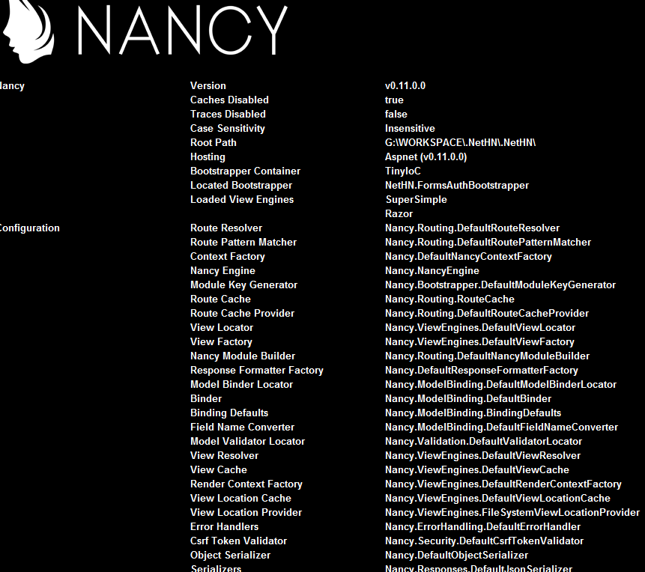
Nancy.Diagnostic
localhost/_nancy
Information
Interactive diagnostic
Request Tracing
Settings

Slide 34
My opinion
Pros
  It is incredibly simple, readable & flexible
  It runs everywhere (Self hosted on Mobile?)
  Great for Webservice or small / fast projects
Cons
  Hard to picture a large project with Nancy or Simple.Data
  Flexibility via „dynamic“ can be double edged
  Nancy & Simple.Data cannot do more or less than the others
  … but they do it in a very elegant and efficient manner
Notes:
Don‘t forget the next slide!

Slide 35



Links & Contacts
Andreas Håkansson (NancyFx)
  @TheCodeJunkie
  http://elegantcode.com/
Steven Robbins (NancyFx, TinyIoC)
  @Grumpydev
  http://www.grumpydev.com/
Mark Rendle (Simple.Data)
  @MarkRendle
  http://blog.markrendle.net/

Slide 36
Vielen Dank!
Tim Bourguignon
about.me/timbourguignon

Slide 37
Additional sources
„Simple.Data, .NET Database access made easier“, Mark Rendle, http://www.slideshare.net/markrendle/simple-data
Nancy (.NET Micro Web Frameworks), Nicholas Cloud, http://www.nicholascloud.com/2011/05/nancy-net-micro-web-frameworks-part-1/

Slide 38
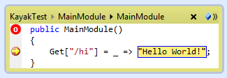
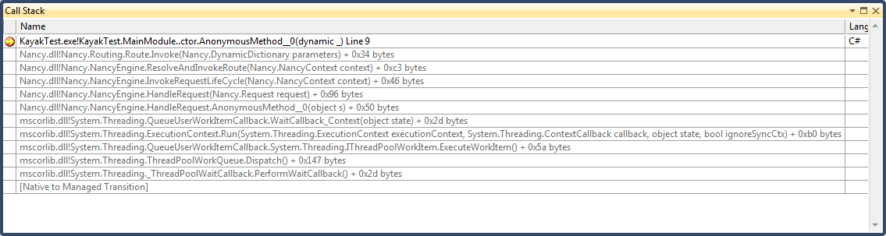

Slide 39
