Slide 1
Simple.Data
… an O/RM without O, R or M
Timothée Bourguignon

Slide 2
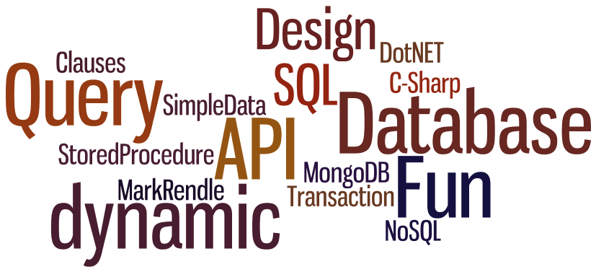
What's on the menu?

Slide 3
What is Simple.Data?
An O/RM without O, R or M!

Slide 4

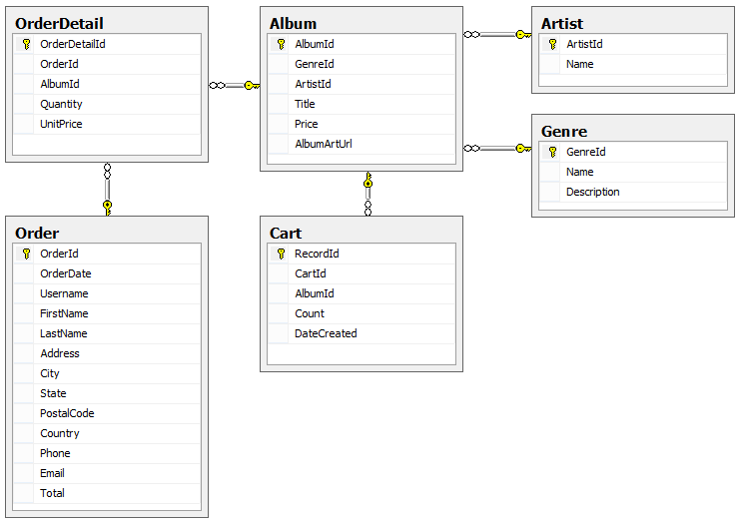

Hands-on!
SQL Server + MvcMusicStore DB
  http://mvcmusicstore.codeplex.com/

Slide 5
What is Simple.Data?
Lightweight way of manipulating data
  Based on .NET 4.0's „dynamic“ keyword
  Interprets method and property names
  Maps them to your underlying data-store
  Prevents SQL Injection
  Inspired by Ruby’s ActiveRecord and DataMappers
  Open Source & runs on Mono
  V1.0 rc3 released in Nov. 2012

Slide 6
The real menu
Hands-ons along the way
Generalities
Conventions
CRUD Operations
Objects Returned
Joins & Evaluation Strategies
Various Functions
Tool & Testing
Wrap-Up

Slide 7








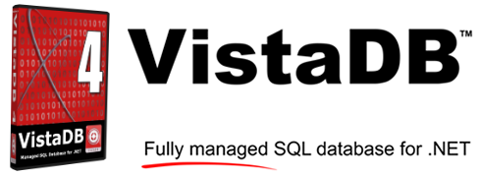



Database agnostic

Slide 8
Hands-on!
MongoDB
  + MvcMusicStore DB

Slide 9
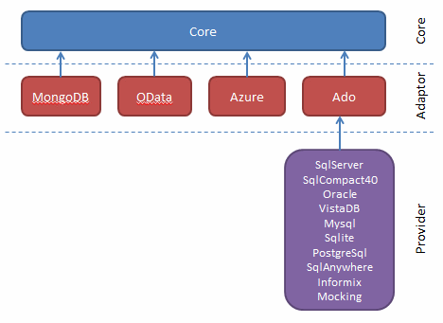
Package Architecture
Core
MongoDB
OData
Azure
Ado
SqlServer
SqlCompact40
Oracle
VistaDB
MySQL
SQLite
PostgreSQL
SQLAnywhere
Informix
Mocking

Slide 10
Nuget Packages
PM> Install-Package
Simple.Data.SqlServer
Simple.Data.Ado
Simple.Data.SqlCompact40
Simple.Data.Sqlite
Simple.Data.MongoDB
...

Slide 11
Conventions

Slide 12
Opening a Connection
var magicDb = Database
.OpenConnection("ConnectString");
var fileDb = Database
.OpenConnection("MyDB.sdf");
Per default connections are aggressively opened and closed for each query
Supports shared connections

Slide 13
Choose your weapon
The „Fluid“ Way
  Methods & properties convention-based mapping
The „Indexer“ Way
  Identification via an indexer syntax

Slide 14
The Fluid Way
db.album.FindAllByGenreId(3);
Column
Command
Parameters
Table/View

Slide 15
The Indexer Way
The problem
The solution
//Find by „Candy“ or find by „C and Y“?
db.sweets.FindAllByCAndY("Oreo");
//Full indexer way
db["sweets"].FindAllBy(Candy: "Oreo");
//Hybrid fluid + indexer
db.sweets.FindAllBy(Candy: "Oreo");
db["city"].FindAllByCityName("Paris");

Slide 16
Target Matching
Sequence
  Exact match
  Case-insensitive - non-alphanumeric chars
  Pluralized/Singularized version
The following are thus all identical
  Albums.GenreId
  Album.GenreId
  ALBUMS.GENREID
  ALBUM.GENREID
  [ALBUMS].[GENREID]
  [ALBUM].[GENREID]
  AlBuM.geNReId
  Al__*bum.Genr-eId
  ...

Slide 17

No IntelliSence
Dynamics => no member / function inferrence
Schema analyse planned for Simple.Data v2
Tool: Simple.Data.Pad
Still easy to get used to

Slide 18
CRUD OPERATIONS

Slide 19
Create
Insert(object or named parameters)

Slide 20
Read
Read
  All()
  Find(simple expressions)
  Get(primary key)
  FindAll(optional condition)
  FindAllByXXX(parameter)

Slide 21
Update
Update(object or named parameters)
  Update
  UpdateByXXX
  UpdateAll + optional condition
Upsert e.g. Update or Insert
Some kind of optimistic locking
  Update(modifiedObject, originalObject)
  Fails if the column(s) you are modifying changed
    Nota: does not work with Upsert

Slide 22
Delete
Delete
  Delete(object or named parameters)
  DeleteByXXX(parameters)
  DeleteAll(optional conditions)

Slide 23
Hands-on!
CRUD Operations
  Insert
  Update
  Delete
  Read
Notes:
-----INSERT--------
db.city.Insert(Name:"AAA"); //Throws an exception
-------------------
db.city.Insert(ID:42); //Throws an exception
-------------------
db.city.Insert(ID:0);
-------------------
internal class City
{
public string Name { get; set; }
}
db.city.Insert(new City{Name = "AAA"});
-------------------
internal class City
{
public Int32 ID { get; set; }
public string Name { get; set; }
}
db.city.Insert(new City{ ID = 42424242, Name = "AAA"});
----UPDATE---------
db.city.UpdateById(Id:42424242, Name:"BBB");
-------------------
var city = db.city.Get(42424242);
city.Name = "CCC";
db.city.Update(city);
----DELETE---------
db.city.DeleteByName("CCC");
-------------------
var city = db.city.Get(0);
db.city.Delete(city);

Slide 24
Objects Returned

Slide 25
SimpleRecord
Dynamic object
Contains a property for each of the columns requested whose values are those of the single row retrieved from the data store
„Cast-able“ to a concrete implementation

Slide 26
SimpleQuery
Dynamic object
Similar to LINQ structure
Executes when enumerated
Contains a SimpleRecord object for each row returned

Slide 27
Casting
Casting to objects
  Implicit
  Explicit: Cast<T>, ToList, ToList<T>, ToArray, ToArray<T>
Hands-On
  Implicit casting
  Explicit casting

Slide 28
Joins
& Evaluation Strategies

Slide 29
Hands-on!
Lazy natural evaluation
Casting + Lazy?
Eager evaluation

Slide 30
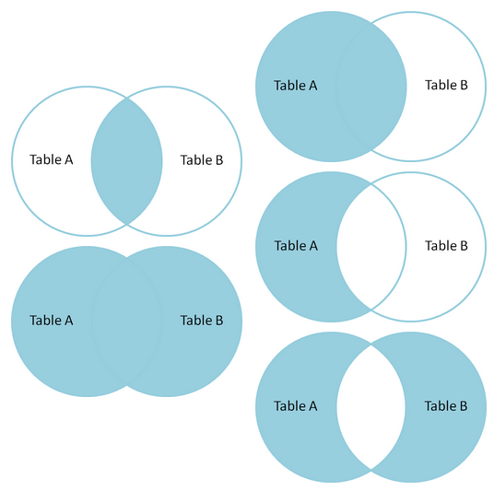
Joins
Lazy loading
  „Natural Joins“ e.g. „Table chaining“
Eager Loading
  „With Joins“
    With/WithXXX
    WithOne
    WithMany
  „Explicit Joins“
    Join
    LeftJoin
    OuterJoin
Foreign-Key relationship present
No Foreign-Key relationship necessary
(no referential integrity)
Natural joins can be used as part of an explicit join, the join is then eager loaded
Notes:
Simple.Data allows you to join two or more tables implicitly, rather than use the Join, OuterJoin or With commands, provided the tables have a foreign key constraint set up between them so referential integrity is enforced.
It does this by allowing you to define the chain of tables to be traversed from the ‘start’ table in the query within a column selection. For example, if you were querying the Albums table for an album’s details, and wanted to include the name of the album’s genre instead of its genreid, you could write:
var album = db.Albums.FindAllByGenreId(1)
.Select(
db.Albums.Title,
db.Albums.Genre.Name);

Slide 31
Hands-on!
Eager Joins
  Select + Natural Joins + As
  With

Slide 32
Various Functions

Slide 33
Ordering Results
OrderBy, OrderByDescending
ThenBy, ThenByDescending
db.Albums.All().OrderByGenreId()
.ThenByArtistIdDescending();

Slide 34
Scalar Queries
GetCount
GetCountBy
Exists, Any
ExistsBy, AnyBy
int albumCount = db.Albums.GetCount(
db.Albums.GenreId == 2);

Slide 35

Query Modifiers
Select
  Star & AllColumns
db.Albums.All().Select(db.Albums.Title,
db.Albums.ArtistId);

Slide 36
Query Modifiers
Column Aliasing: As(string)
var albums = db.Albums.All().Select(
db.Albums.AlbumId,
db.Albums.Title.As("AlbumName"));

Slide 37
Query Modifiers
Where clauses
  Operators (+, -, *, /, %)
  IN, BETWEEN, LIKE, IS NULL
var albums = db.Albums.FindAllByGenreId(1)
.Select(db.Albums.Title)
.Where(db.Albums.Price < 8);
db.Albums.All().Where(
db.Albums.Title.Like("%Side Of The%"));

Slide 38
Aggregate Functions
Grouping and Aggregates
  Having → Group By / Having
  Min, Max, Avg, Sum
var cheapAlbums = db.Albums.All()
.Having(db.Albums.Price < 9).ToList();
var totalCost = db.Albums.All().Select(
db.Albums.Price.Sum().As("TotalCost"));

Slide 39
Stored Procedures
Like a function...
CREATE PROCEDURE ProcedureWithParameters
@One VARCHAR(MAX),
@Two VARCHAR(MAX)
AS
SELECT * FROM Customers
WHERE Firstname = @One and Lastname like @Two
db.ProcedureWithParameters(1, 2);

Slide 40
Transactions
Wrap up the calls
using (var transaction = db.BeginTransaction())
{
transaction.albums.Insert(GenreId: 1...);
transaction.Commit();
}

Slide 41
Tool & Testing

Slide 42

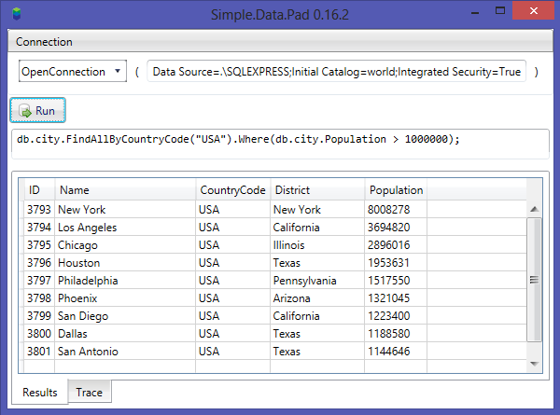
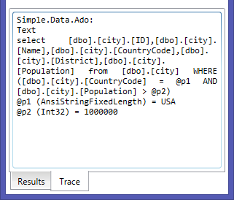
Tool: Simple.Data.Pad
Similar to LINQ-Pad... kind of...
  https://github.com/markrendle/Simple.Data.Pad

Slide 43

Testing: InMemoryAdapter
[Test]
public void Should_do_something()
{
var adapter = new InMemoryAdapter();
Database.UseMockAdapter(adapter);
var db = Database.Open();
db.Test.Insert(Id: 1, Name: "Alice");
//...
}
The InMemoryAdapter supports
  Joins, Transactions, Stored procedures...

Slide 44
InMemoryAdapter Configuration
Tweaking functions
  SetKeyColumn
  SetAutoIncrementColumn
  AddFunction (stored procedure)
  ConfigureJoin
  ...

Slide 45
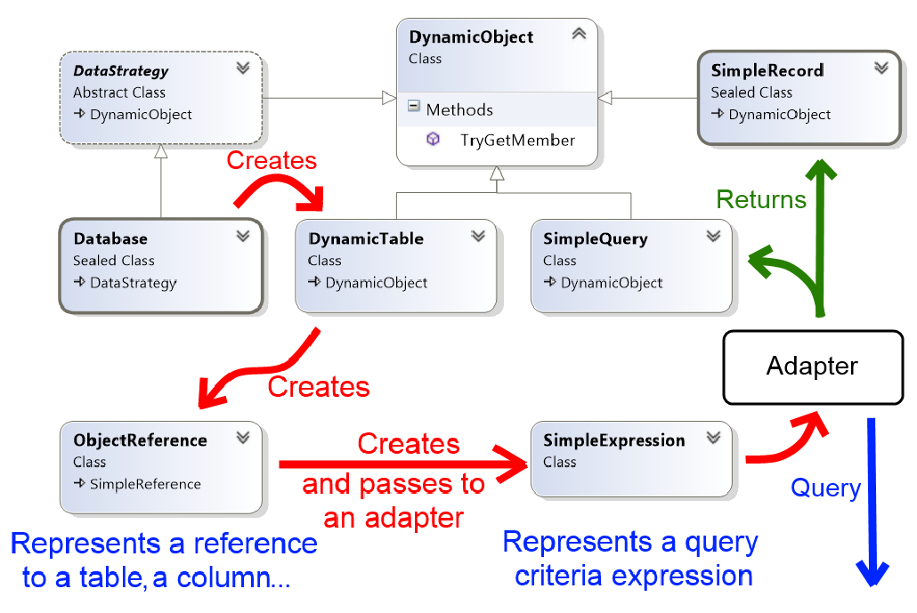
Design

Slide 46
Wrap-Up

Slide 47
Wrap up
OpenSource, Mono
Everything is dynamic
Fluid-, Indexer Way
CRUD
  FindXXX, DeleteXXX, UpdateXXX etc.
Dynamics Objects Returned
Joins, lazy, eager
  Natural, WithXXX, Join
Various Functions
  Group, Order, Scalar, Modifiers etc.
Tool & Testing
Design

Slide 48
Simple.Data in Short
Lightweight
Readable
Compelling
Fun to use
Interesing design
Dynamics extensive testing
Good understanding upfront
My Recommendation
  Try it and study it
  Take it for a spin for some tooling and/or prototyping
  ...and some projects?

Slide 49

Further Reading
Github
  https://github.com/markrendle/Simple.Data
Nuget
  http://nuget.org/packages?q=simple.data
GoogleGroup
  https://groups.google.com/forum/?fromgroups#!forum/simpledata
Framework Author: Mark Rendle
  @MarkRendle
  http://blog.markrendle.net/

Slide 50

Fragen?
tim.bourguignon@mathema.de
about.me/timbourguignon

Slide 51

Fragen?
tim.bourguignon@mathema.de
about.me/timbourguignon

Slide 52

Dapper Performance Analysis 1/2
The following metrics show how long it takes to execute 500 SELECT statements against a DB and map the data returned to objects
The performance tests are broken in to 3 lists:
  POCO serialization for frameworks that support pulling static typed objects from the DB. Using raw SQL.
  Dynamic serialization for frameworks that support returning dynamic lists of objects.
  Typical framework usage. Often typical framework usage differs from the optimal usage performance wise. Often it will not involve writing SQL.

Slide 53
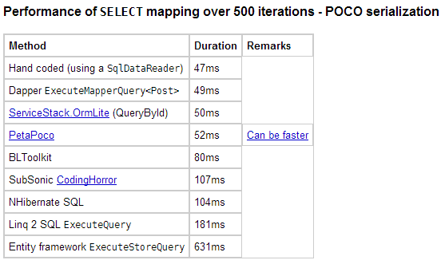
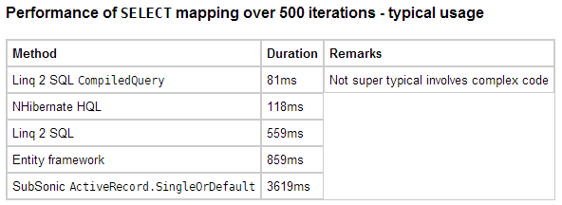
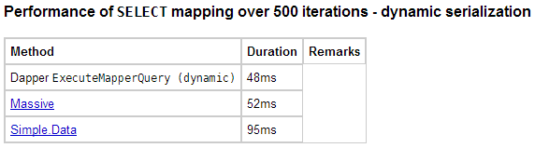
Dapper Performance Analysis 2/2

Slide 54
BACKUP

Slide 55
BACKUP
BACKUP

Slide 56

Simple.Data
… an ORM without O, R or M
Timothée Bourguignon

Slide 57
Fragen?
tim.bourguignon@mathema.de
about.me/timbourguignon

