Slide 1
FHA SORT-seq experiments
2022-10-18

Slide 2
Two SORT-seq experiments
Carolin Müller (one replicate – WT, fkh1-R80A, fkh1Δ). All samples normalized to WT-G2
In-house (multiple replicates for only WT & fkh1-R80A). Samples normalized to one G2 from the same genotype.

Slide 3
Relevant Rmd files (for Tim)
Müller
In-house
  ../2022_fha_sortseq/2022-10-18_smoothed_r80a_v_wt_sortseq_ratios.Rmd
  ../2022_fha_sortseq/2022-10-18_smoothed_chr_scans_r80a_v_wt_sortseq.Rmd
Manuscript drafts
  ../Manuscripts//FHA_sortseq/fha_figure_packet_v_2021-12-01.Rmd

Slide 4
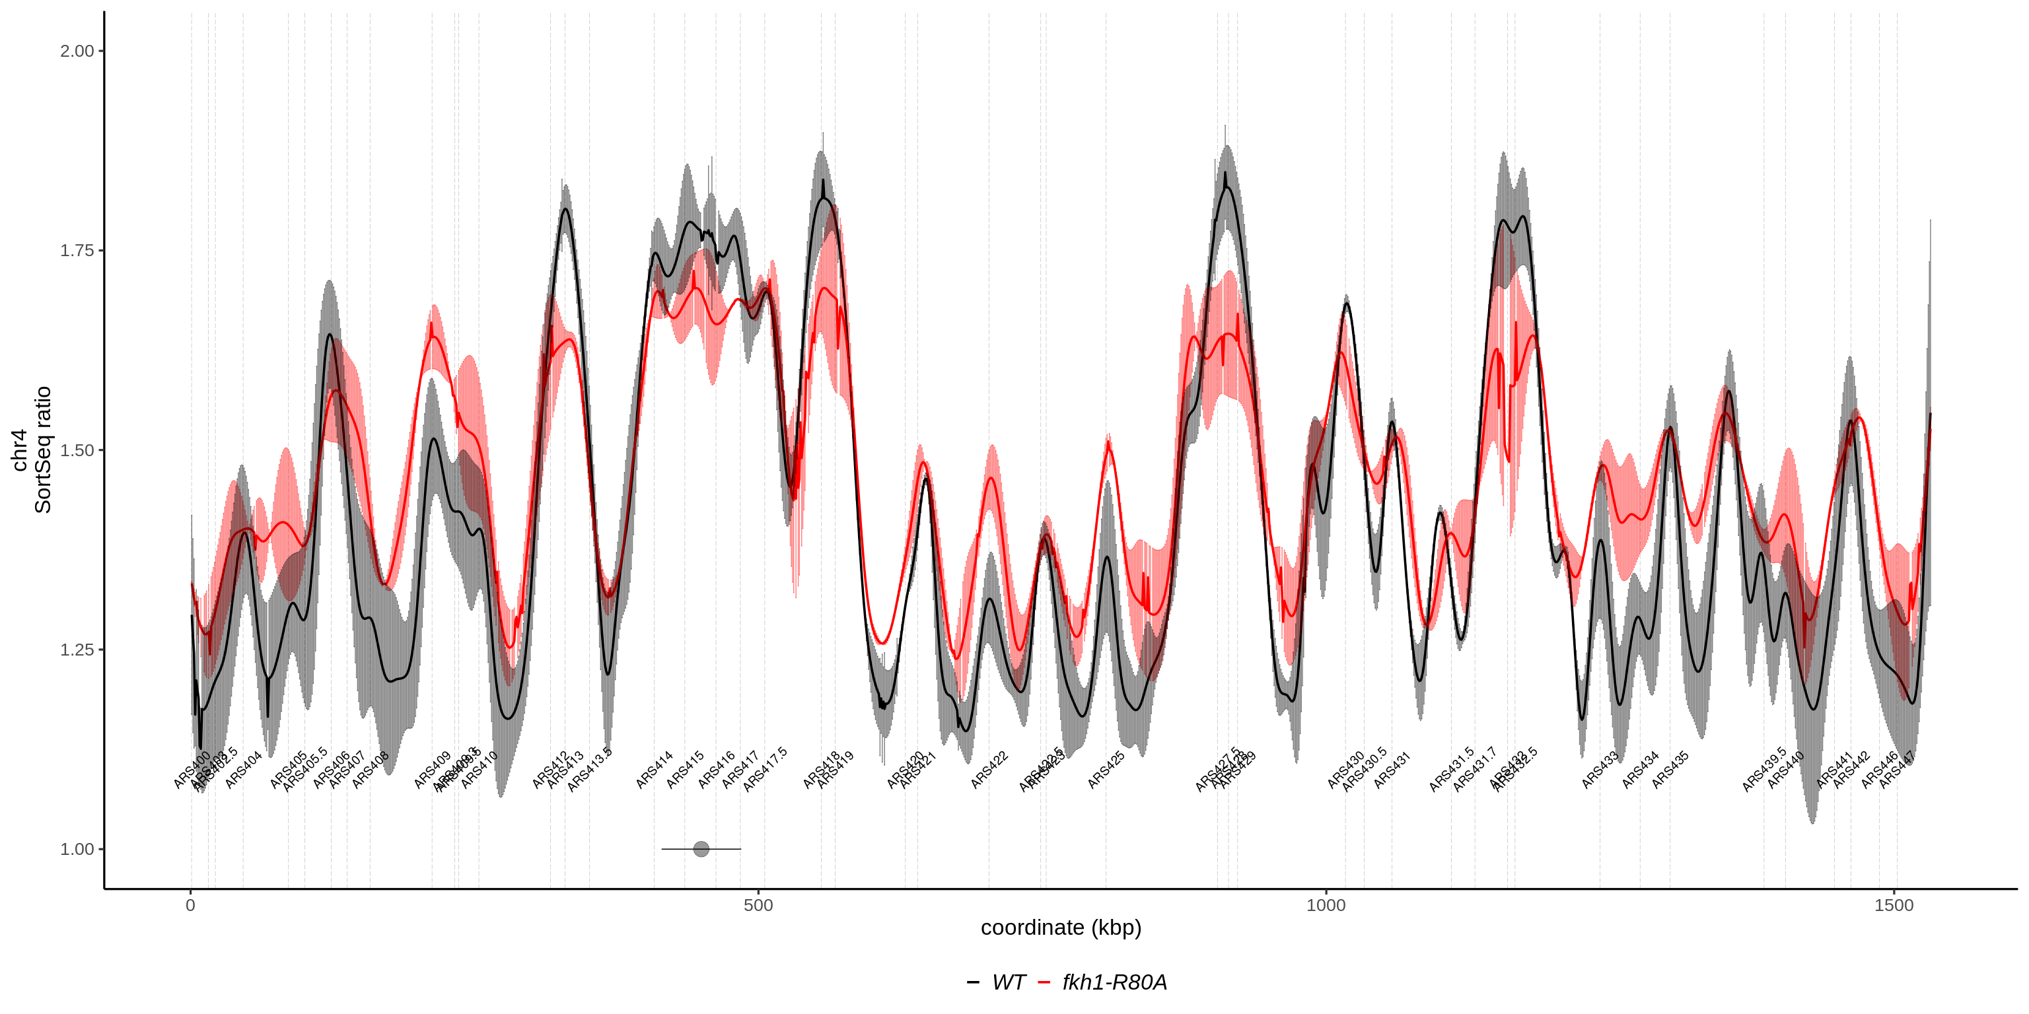
In-house scan along chr 4
-
-
-
-
-
+
+
+
+

Slide 5
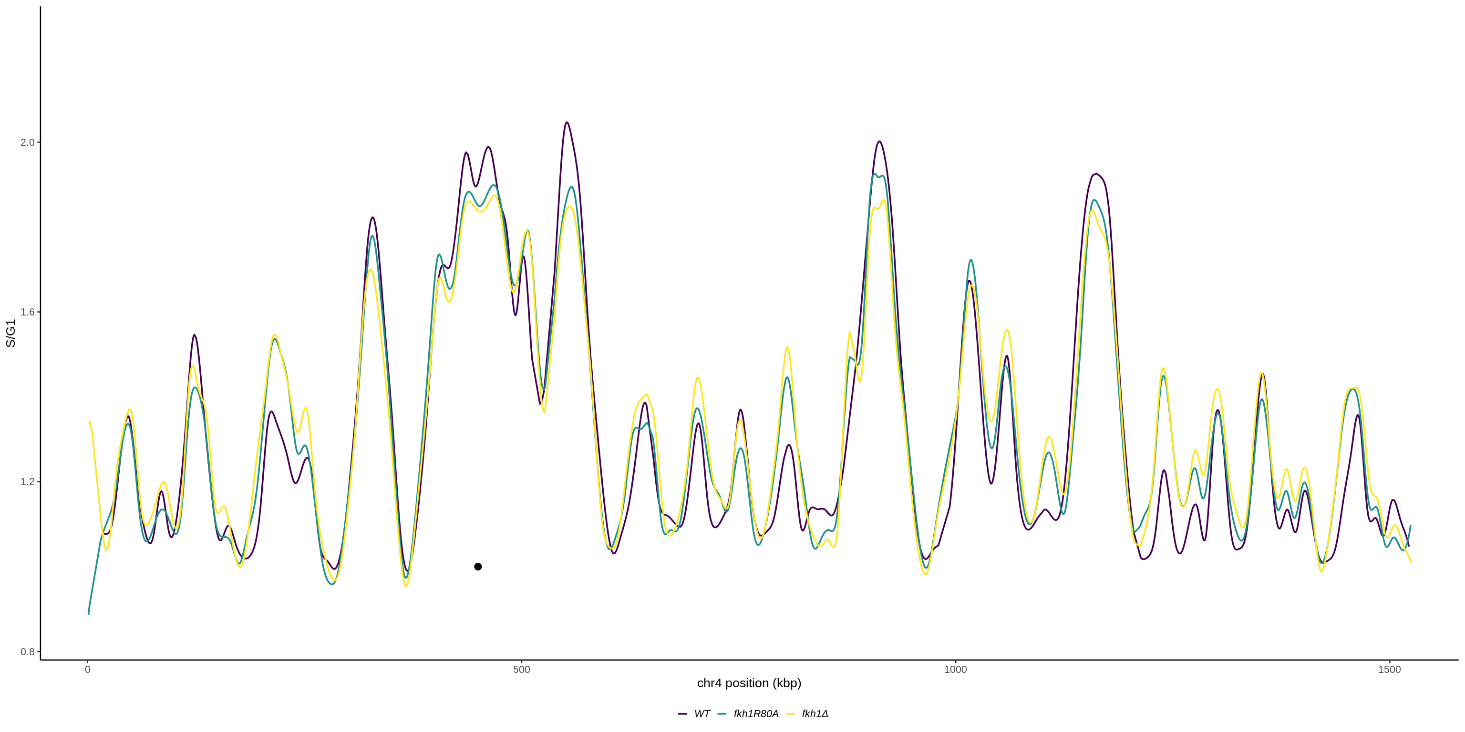
Müller scan along chr 4
-
-
-
-
-
-
+
+
+

Slide 6
MNase-seq outputs:
Q: Is there evidence of FHA-dependent chromatin signatures ?
Minimally processed:
Cohort heats ( & single-locus Vplots)
Modelled:
Nucleosome predictions for single-locus & cohort composites

Slide 7
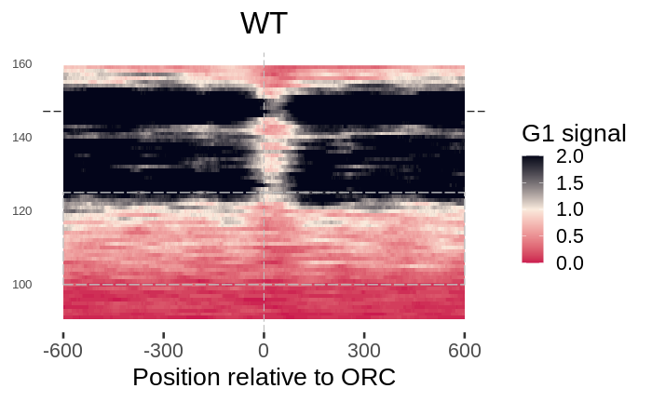
Cohort heats:
Relevant “anatomy”
Fixed scale
Hard upper limit…
(i.e. >2 = 2)
Nucleosome-consisent
“Sub-nucleosomes”
Small fragments

Slide 8
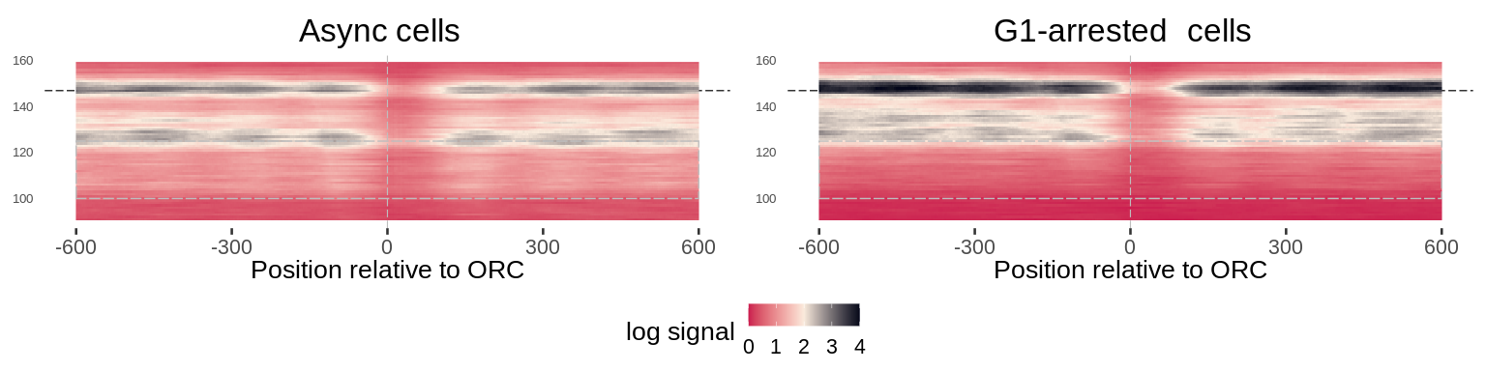
As expected confirmed oris exist in NFRs
What about the differences in levels? G1-arrested cells have more signal than async

Slide 9
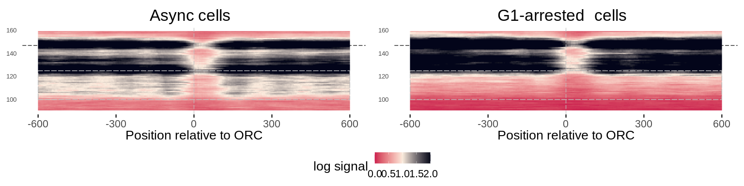
Yet, “small fragments” are enriched in async but not G1-arrested cells
WT cells

Slide 10
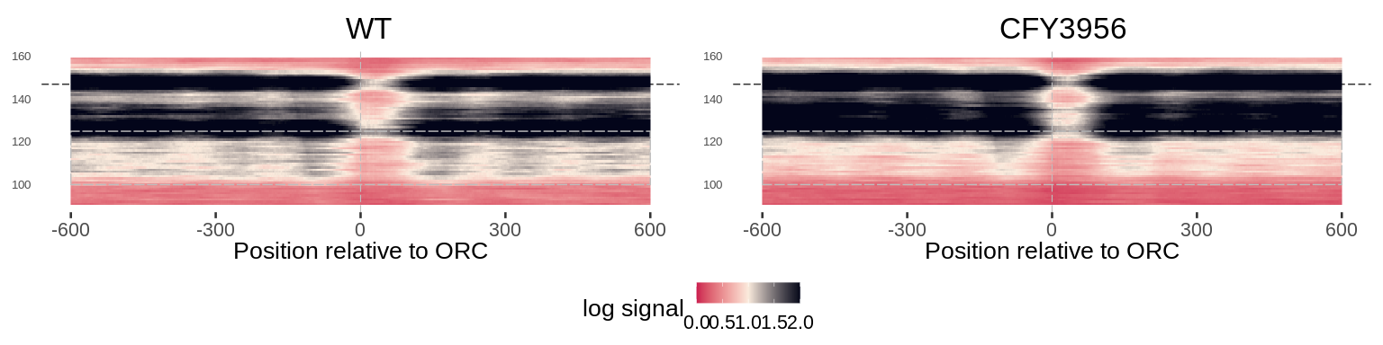
Small fragment enrichment is Fkh1FHA-dependent
Asynchronous cells

Slide 11
Small fragment enrichment at oris is Fkh1FHA-dependent.
Asynchronous cells

Slide 12
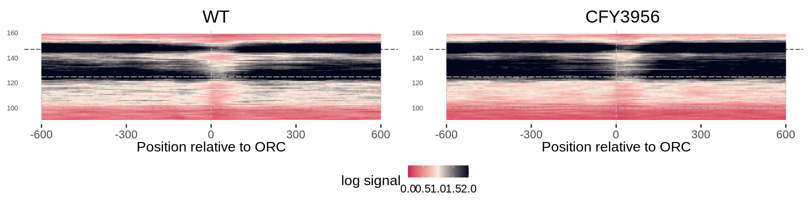
Small fragment enrichment at nonoris is Fkh1FHA-dependent.
Asynchronous cells

Slide 13
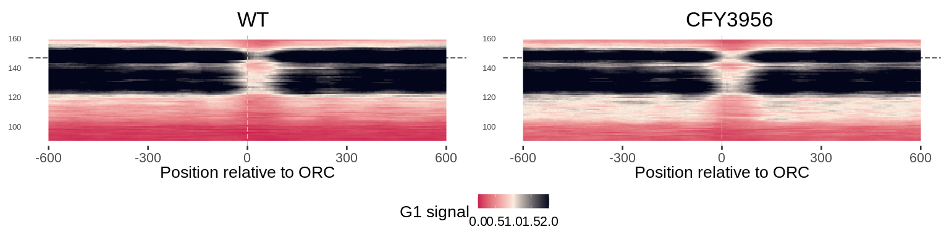
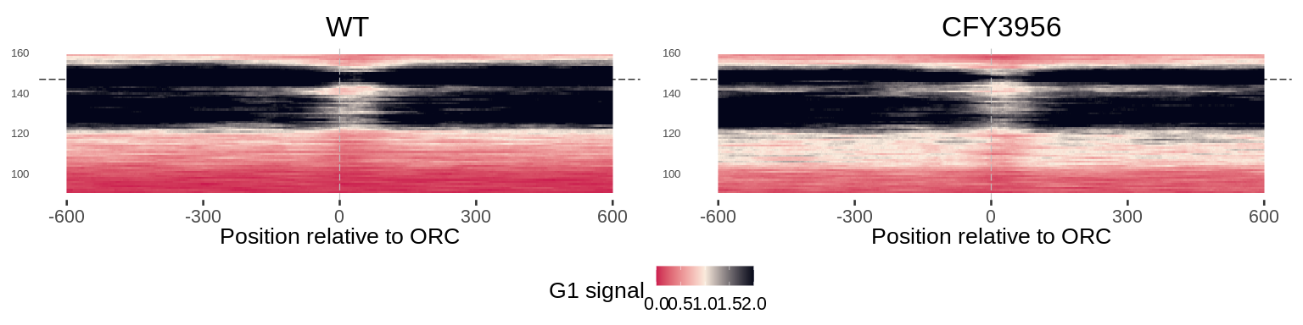
Fkh1-R80A increases small fragments in G1-arrested cells

Slide 14
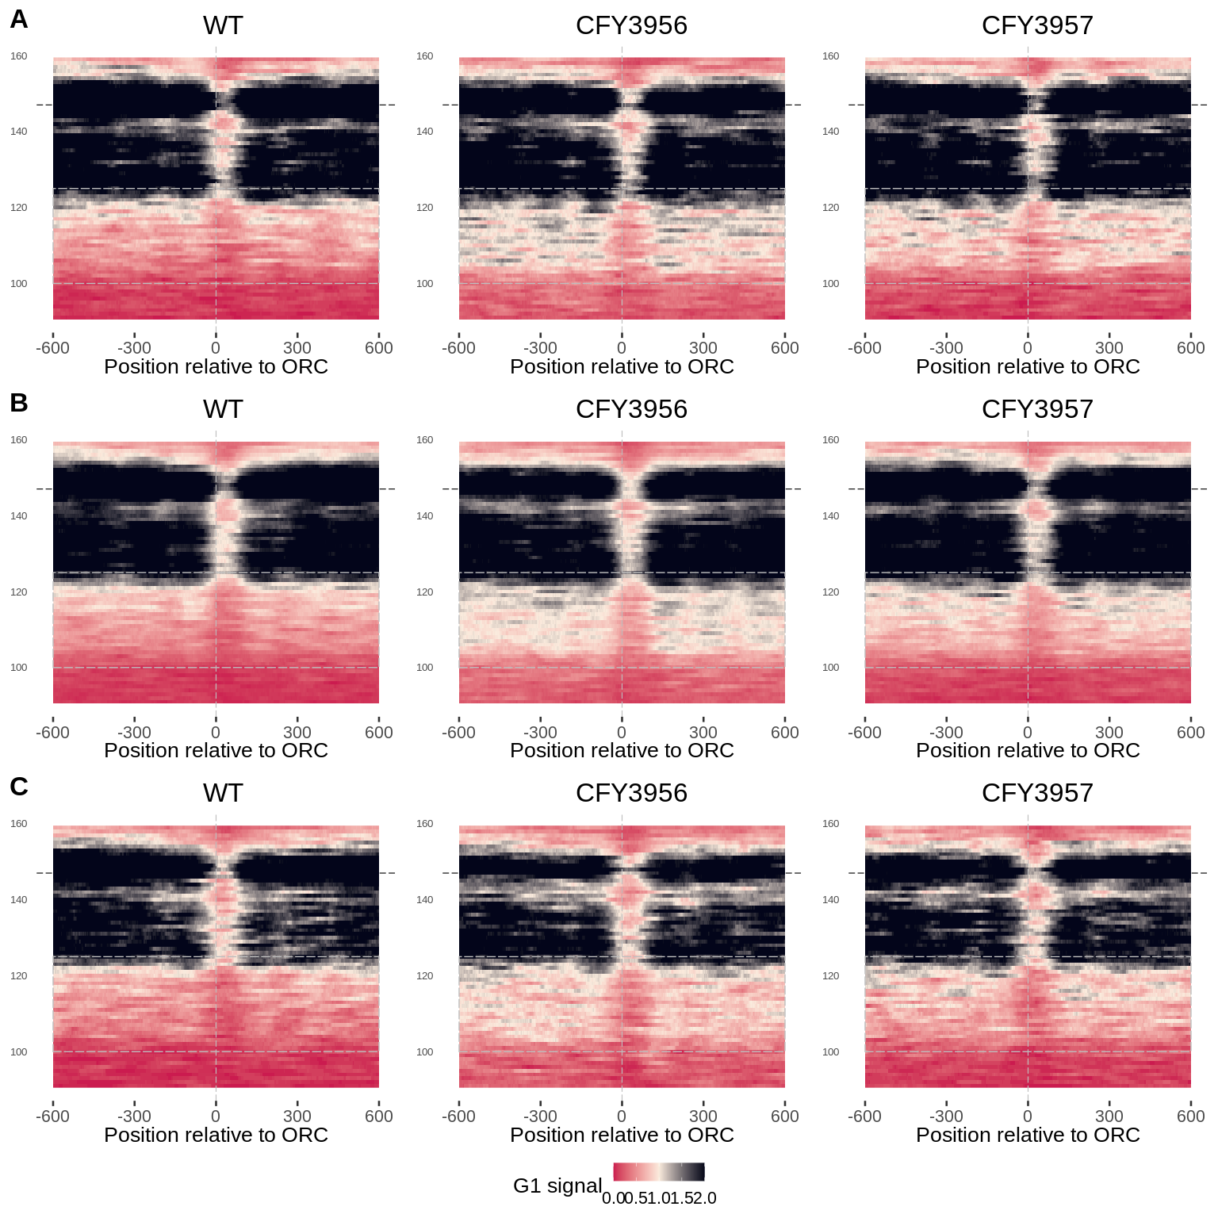
FHA-sort signatures in G1
Dependent
Other
Independent

Slide 15
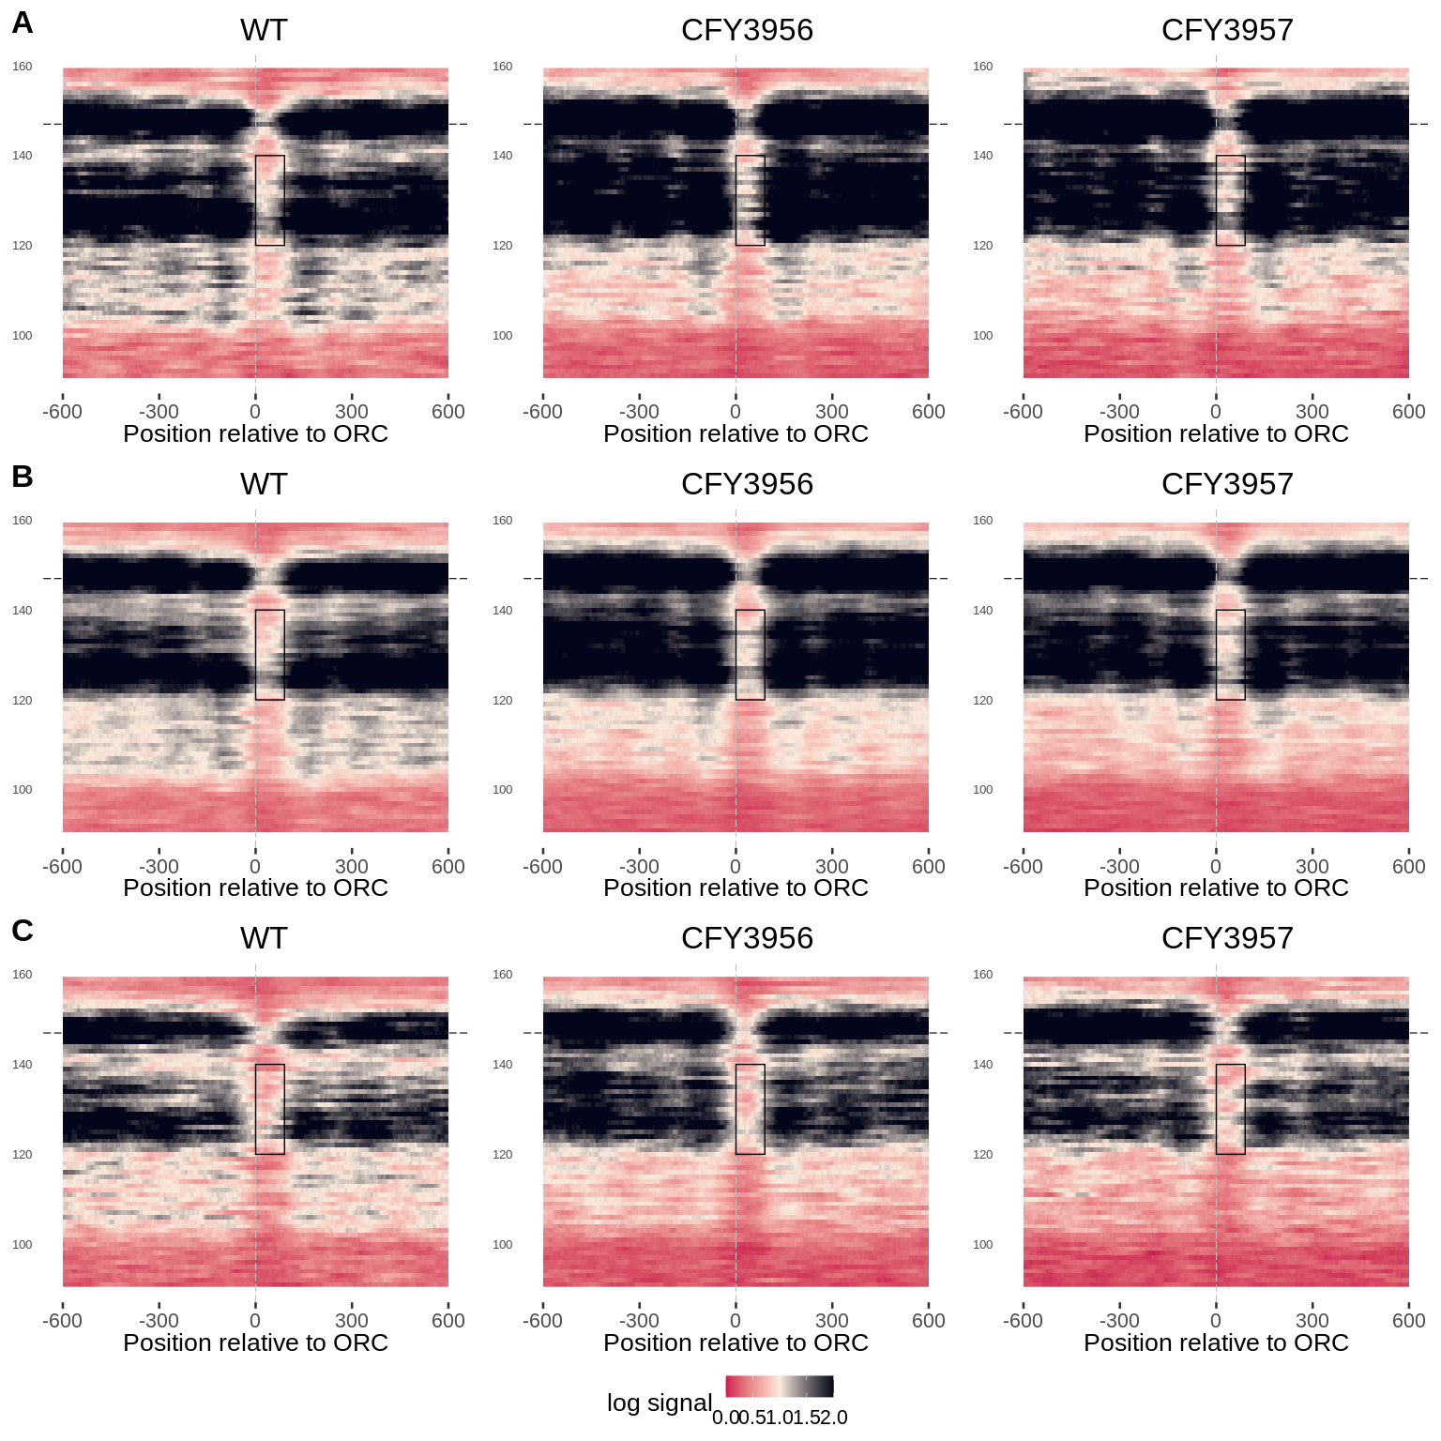
FHA-sort signatures in async.
Dependent
Other
Independent

Slide 16
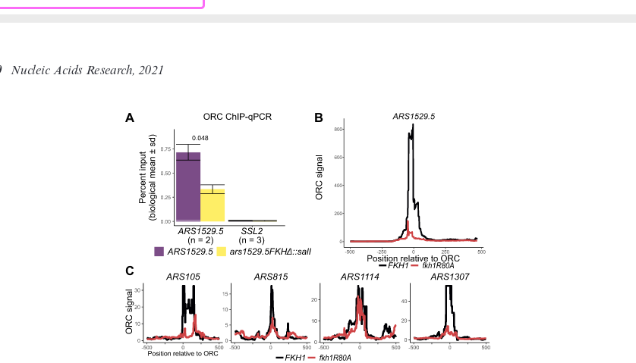
Using previously characterized oris

Slide 17
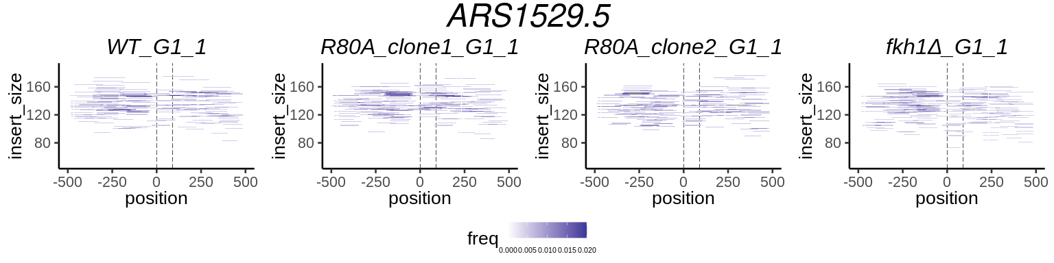
Using previously characterized oris

Slide 18
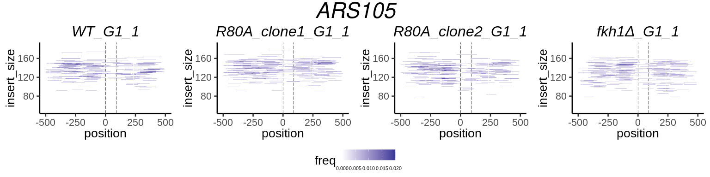
ARS105

Slide 19
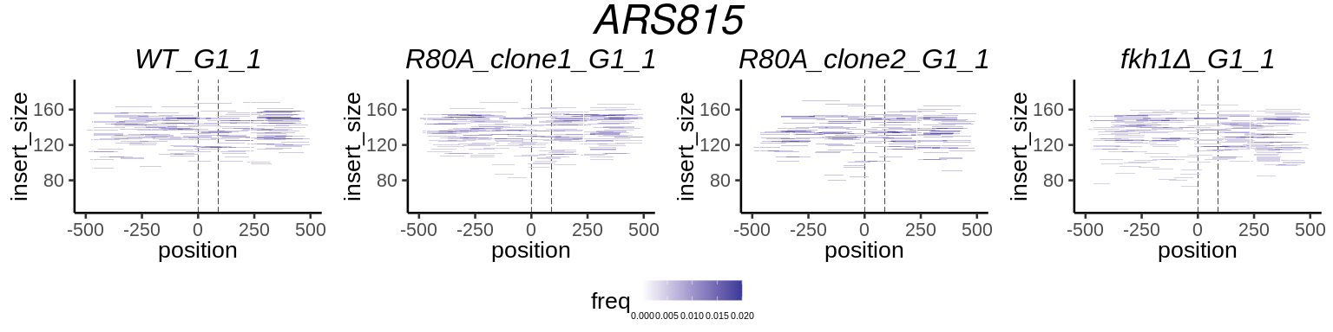
ARS815

Slide 20
ARS815

Slide 21
ARS815

Slide 22
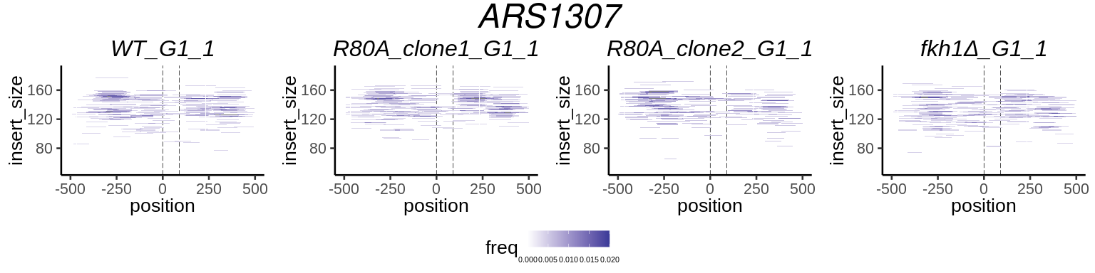
ARS1307

Slide 23
FHA-SORT-sensitive

Slide 24
FHA-SORT-sensitive

Slide 25

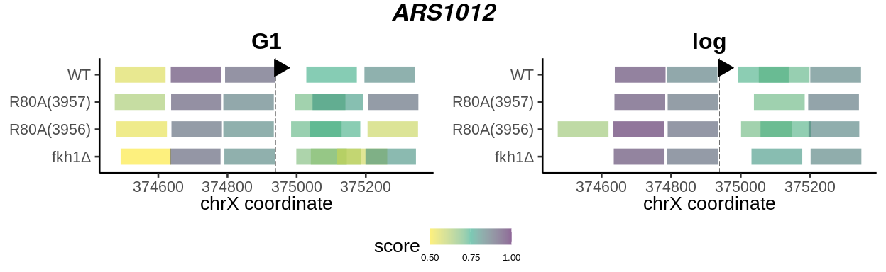

Slide 26
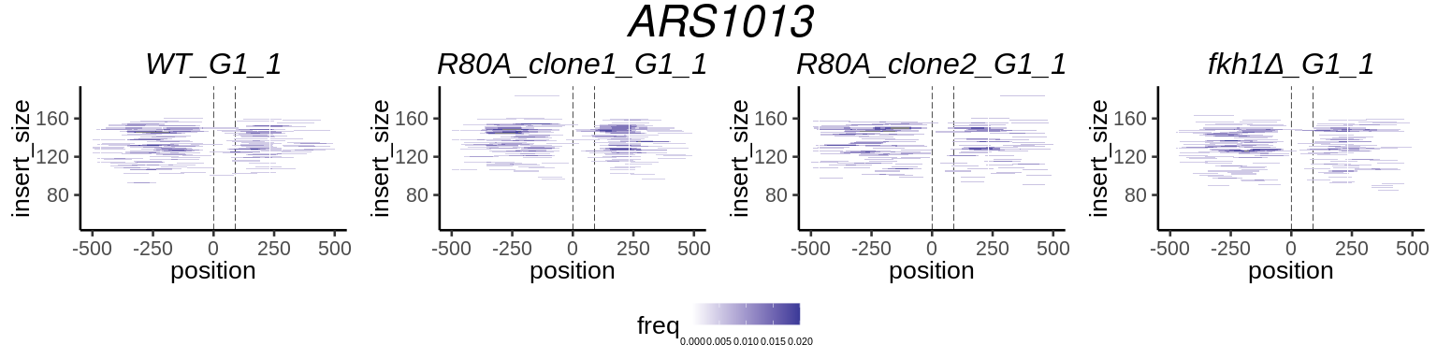
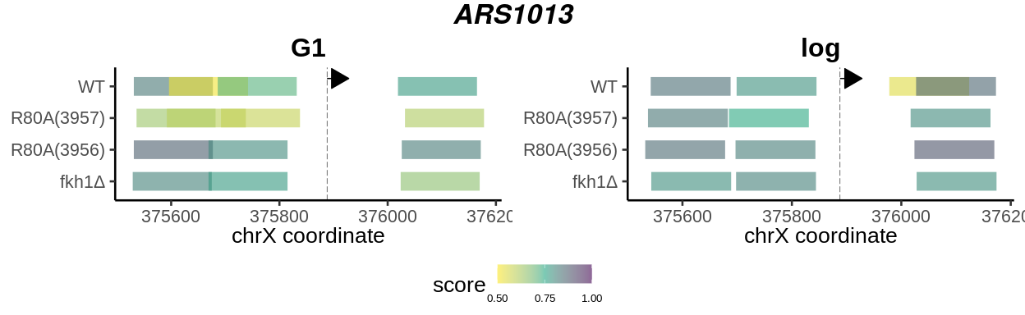

Slide 27
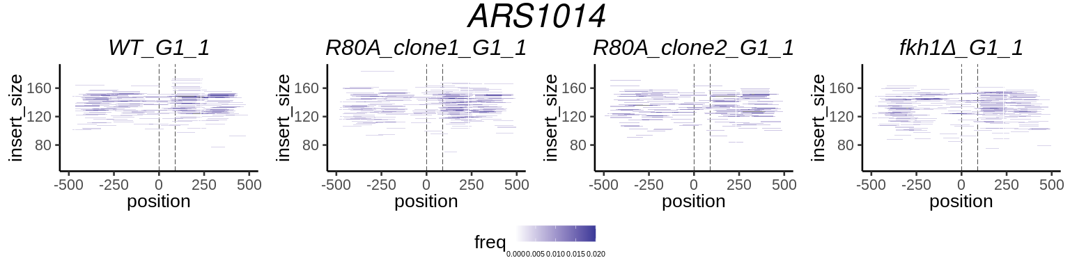
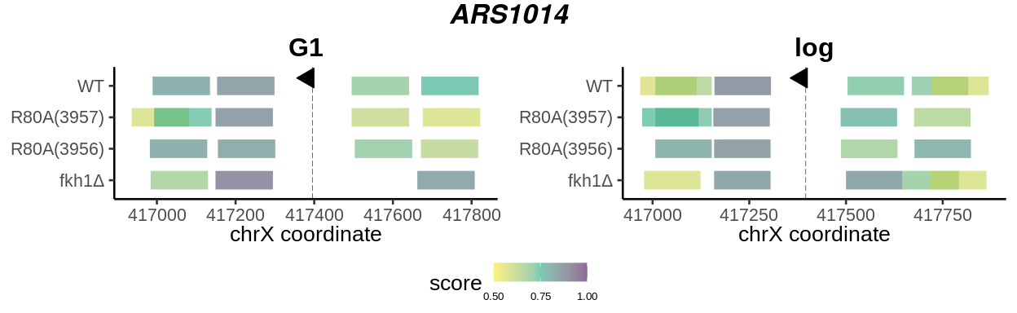

Slide 28
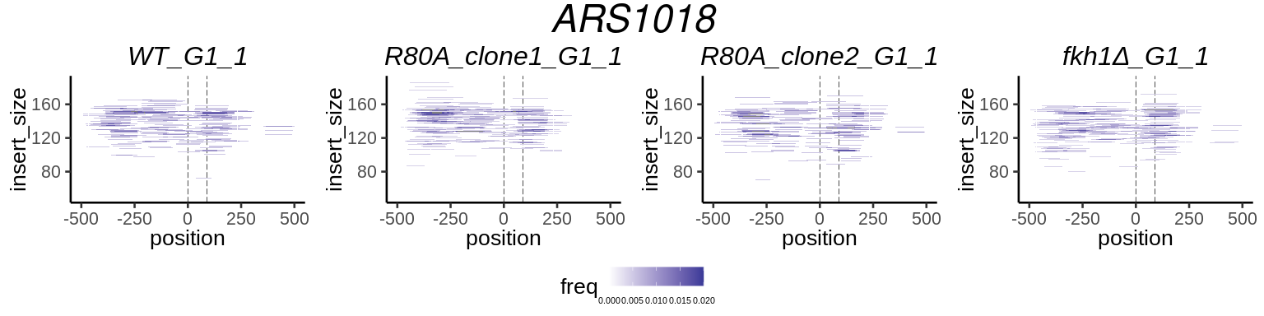
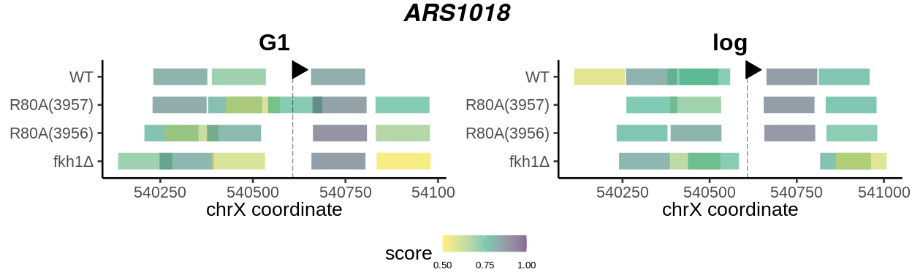

Slide 29
