Slide 1

A. Leftbest

Slide 2



B. First date

Slide 3
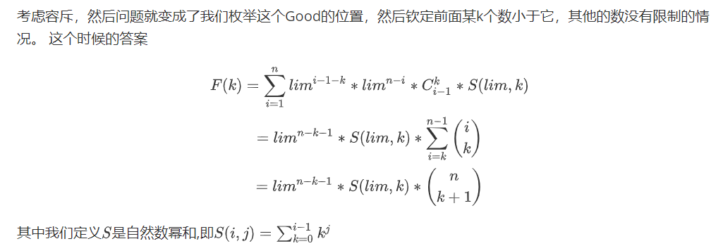

C. Sequence

Slide 4

C. Sequence

Slide 5
D. Quickpow

Slide 6
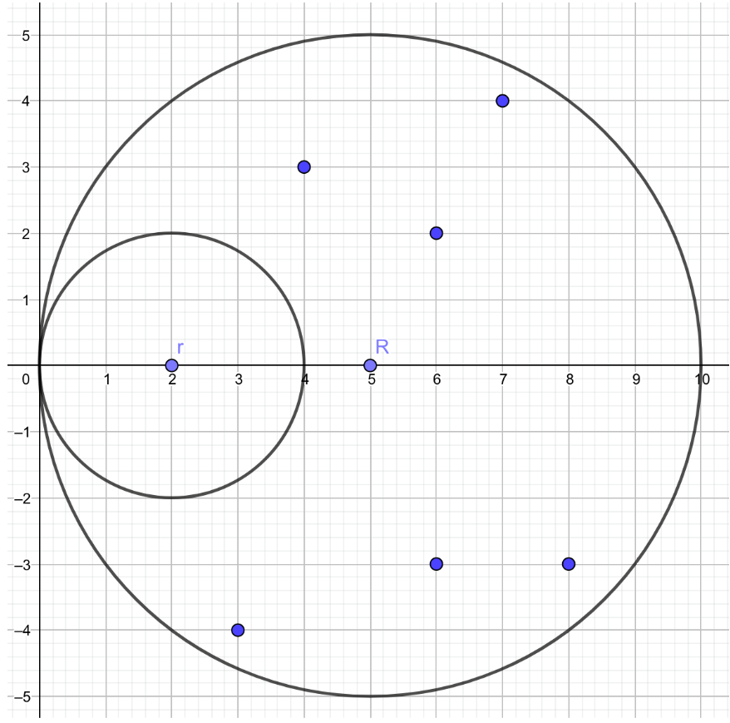
E. Capture Stars

Slide 7

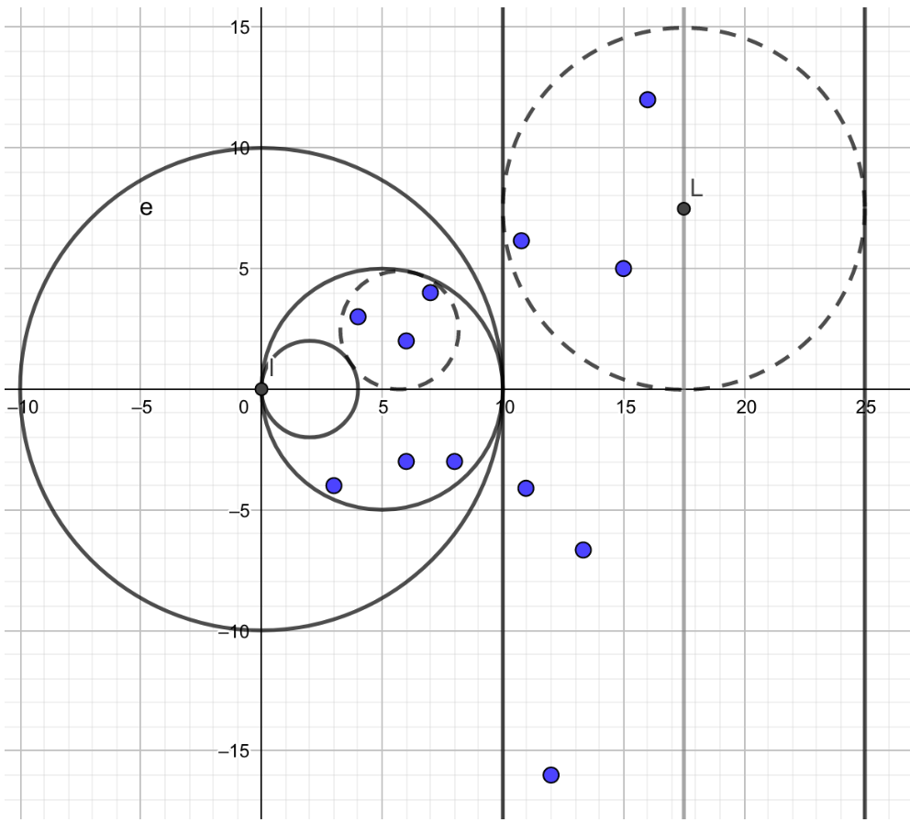
E. Capture Stars

Slide 8


F. Crossroad

Slide 9



F. Crossroad

Slide 10

G. Triangulation

Slide 11
H. Points
签到题，输出一棵树中度数为1的点的个数

Slide 12



I. Parallel

Slide 13
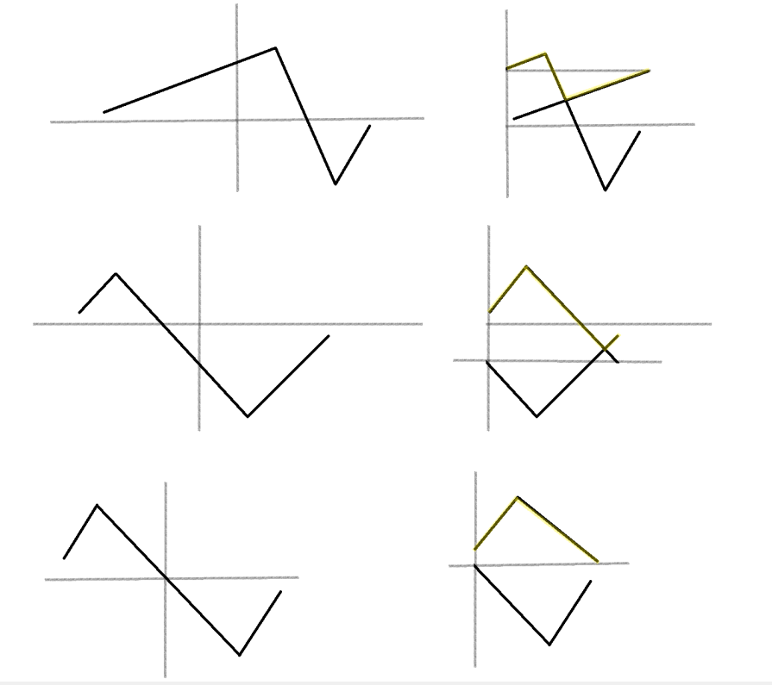
I. Parallel

Slide 14

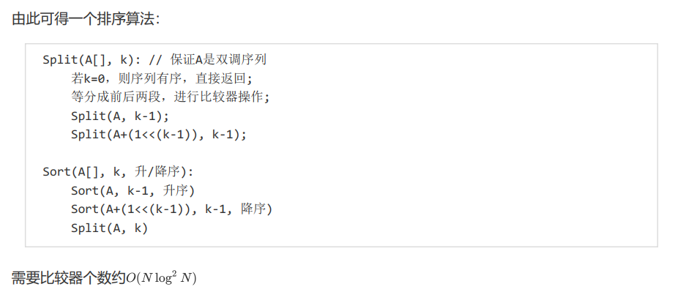
I. Parallel

Slide 15
J. Graph

Slide 16


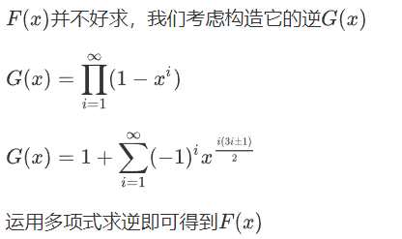
K. Rooted tree

Slide 17



L. Flowers

Slide 18
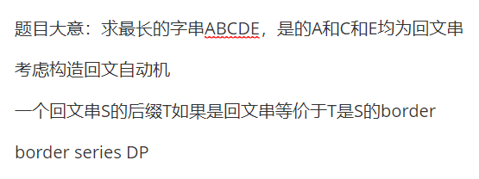
M. Interesting Strings

