Slide 1
Hierarchical Multi-Scale Attention for Semantic Segmentation
Jonathan Guo

Slide 2
Outline
Semantic Segmentation
Recent Approaches
Naive
Context
Explict Multi-Scale Attention
Hierarchical Multi-Scale Attention
Results on Cityscapes
Results on Mapillary

Slide 3
HiaRarchical Multi-Scale Attention

Slide 4
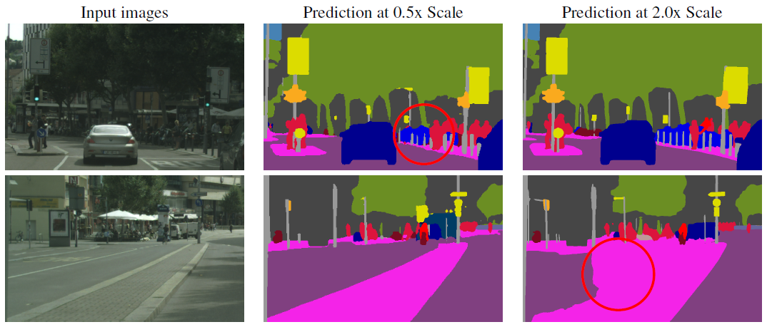
Different Tasks Need Different Scales
Notes:
Certain types of predictions are best handled at lower inference resolution and other tasks better handled at higher inference resolution

Slide 5
Pooling isn't The Best Way of Combing Information
1.5x scale
1.0x scale
0.5x scale
Average Pooling
Max Pooling
Optimal Answer 1
Optimal Answer 2
Notes:
One common way to extract multi-scale features is to feed multiple resized input images to a shared deep network and then merge the resulting features for pixelwise classification.

Slide 6
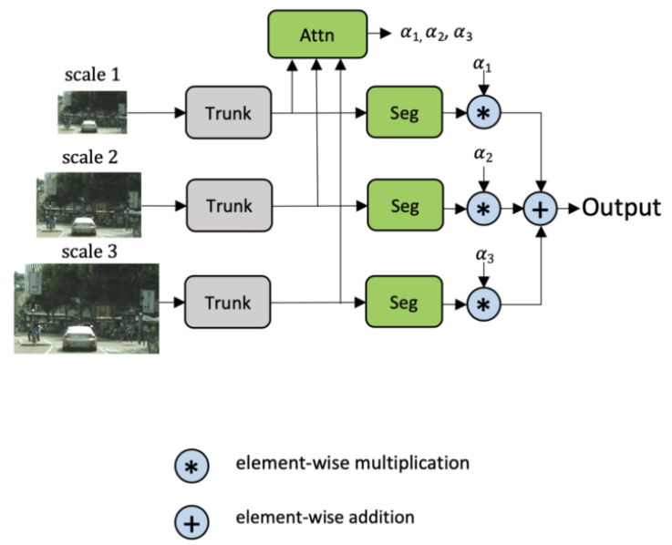
High Training Costs & Low Inference Flexibility
Current models requires each additional inference scale to be explicitly added during the training phase

Slide 7
Hierachical Malti-Scale Attention
Multi-Scaling | → | Solve class confusion and fine detail
Attention | → | Softly weight the multi-scale features
Hierarchy | → | 4x more memory efficient to train
Notes:
Multi-Scaling→Solve class confusion and fine detail
Attention→Softly weight the multi-scale features
Hierarchy→4x more memory efficient to train

Slide 8
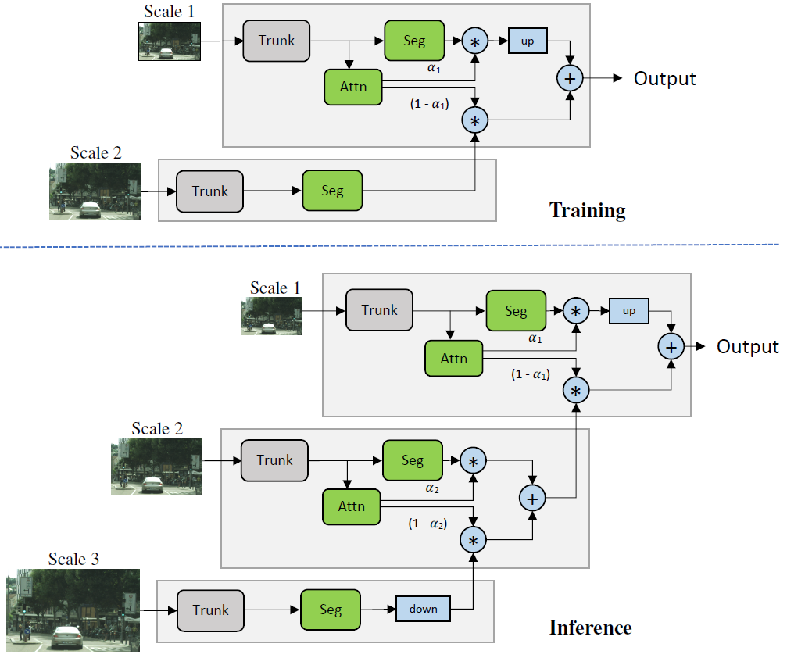
Relative Attention Mask

Slide 9
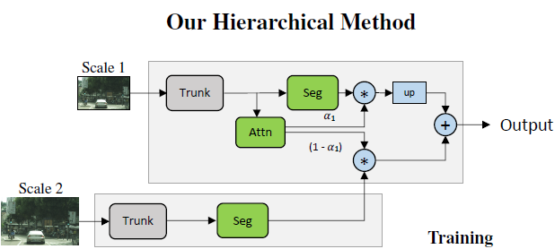
Network Architecture in Detail
Backbone (Trunk):
HRNet + OCR
Semantic Head:
(3x3 conv) → (BN) → (ReLU) → (3x3 conv) → (BN) → (ReLU) → (1x1 conv)
The final convolution outputs num_classes channels.
Attention Head:
Structurally identical to the semantic head, except for the final single channel convolutional output
Auxiliary semantic head (in OCR):
Takes its features directly from the HRNet trunk, before OCR
(1x1 conv) → (BN) → (ReLU) → (1x1 conv)

Slide 10
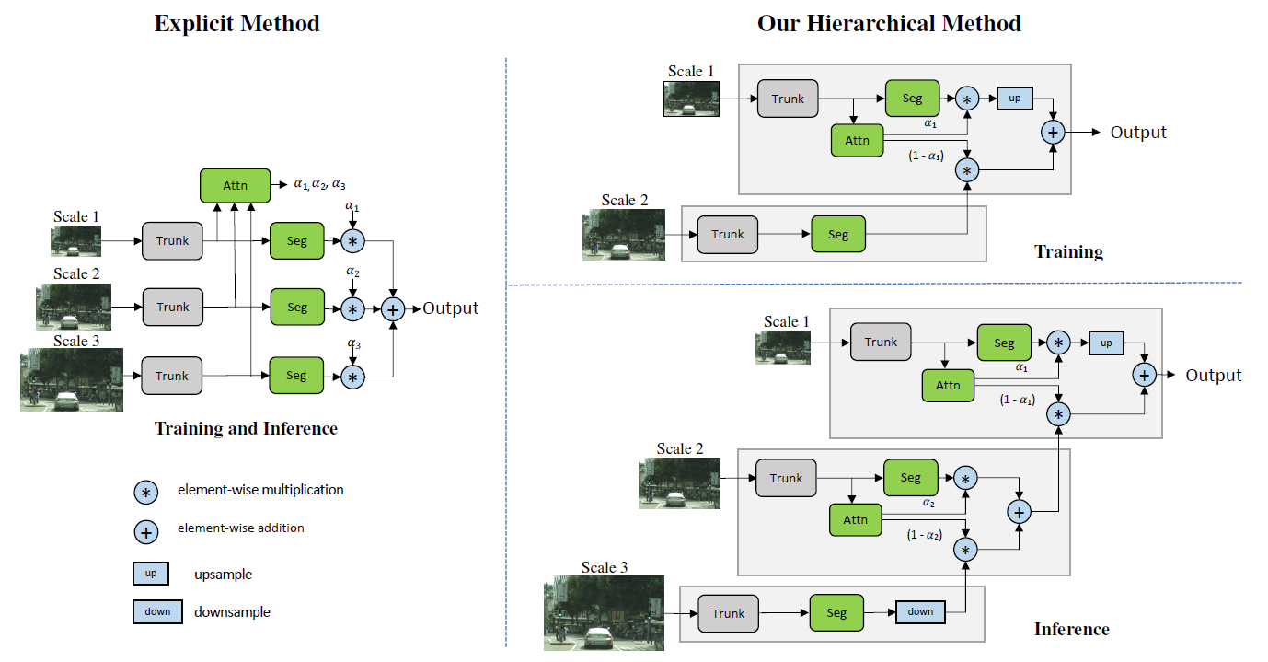
Comparing with Previous Works
Flexibility of choosing extra scales at inference time
Better training efficiency
Ex: Traning with scales 0.5, 1.0, 2.0
Explicit method cost: 0.5² + 1.0² + 2.0² = 5.25
Hierarchical method cost: 0.5² + 1.0² = 1.25

Slide 11
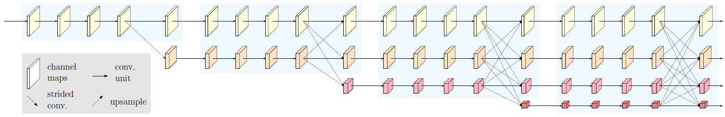
HRNet: Deep High-Resolution Representation Learning for Visual Recognition
Maintain high-resolution representations:
Start from a high resolution convolution stream, gradually add high-to-low resolution convolution streams one by one.
Connect the high-to-low resolution convolution streams in parallel.
Repeatedly exchange the information across resolutions.
The resulting representation is semantically richer and spatially more precise.
Previous
HRNet
https://github.com/HRNet/HRNet-Semantic-Segmentation/tree/master

Slide 12
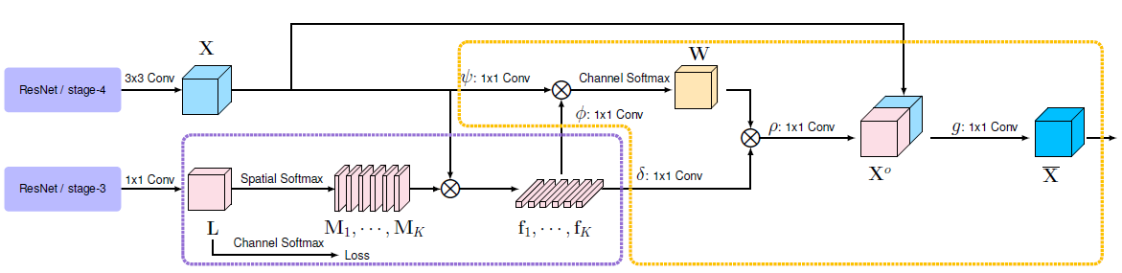
OCR: Object-Contextual Representations for Semantic Segmentation
Characterizing a pixel by exploiting the representation of the corresponding object class
Steps:
Learn object regions under the supervision of the ground-truth segmentation.
Compute the object region representation by aggregating the representations of the pixels lying in the object region.
Compute the relation between each pixel and each object region, and augment the representation of each pixel with the object-contextual representation.
https://github.com/HRNet/HRNet-Semantic-Segmentation/tree/HRNet-OCR
Notes:
https://zhuanlan.zhihu.com/p/145465507
https://www.cnblogs.com/xiangs/p/12863173.html
https://blog.csdn.net/qq_36268755/article/details/106542753

Slide 13
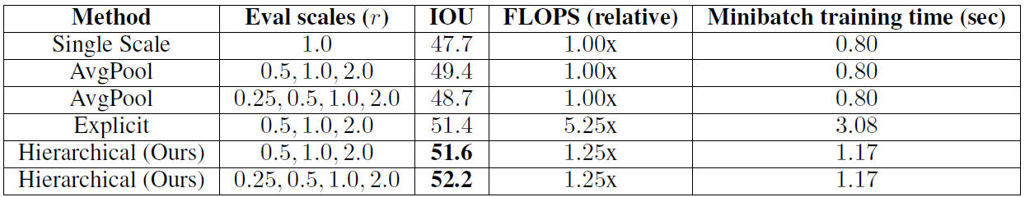
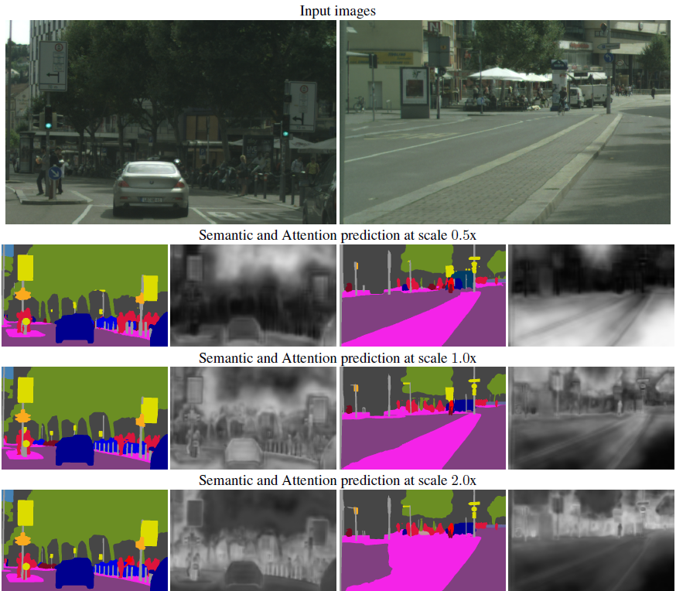
Multi-Scale Attention Mechanism
Adding 0.25x scale causes a 0.7 reduction in IOU for baseline method, whereas boosts accuracy by 0.6 IOU for multi-scale method.
For the fine posts in the image on the left, very little of the posts are attended to by the 0.5x prediction, but a very strong attention signal is present in the 2.0x scale.
For the very large region on the right, the attention mechanism learns to most leverage the lower scale (0.5x) and very little of the erroneous 2.0x prediction.

Slide 14
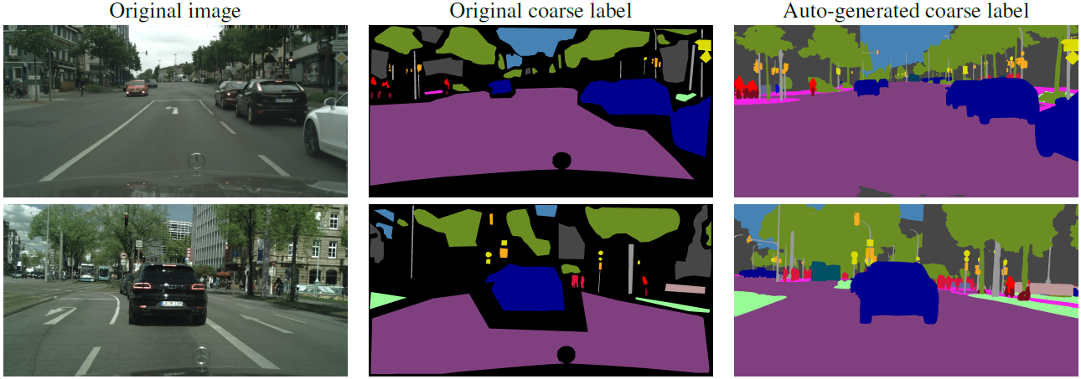
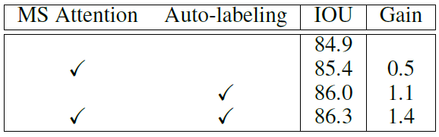
Auto-Labelling on Cityscapes
There 20,000 coarsely labelled images to go along with the 3,500 finely labelled images.
A teacher network provides a target probability for each of N classes for every pixel of every image. Teacher predictions that exceed the threshold become true labels, otherwise the pixel is labelled as ignore class. In practice we use a threshold of 0.9.
Perform a single iteration of full training of our teacher model with the default coarse and fine labelled provided images

Slide 15
Training Strategy
Optimization:
SGD, Batch size=8, Momentum=0.9, Weight decay=5e⁻⁴ (L2 penalty)
Learning rate Scheduling: (Polynomial policy)
Cityscapes: poly exponent=2.0, learning rate=0.01, epochs=175
Mapillary: poly exponent=1.0, learning rate=0.02, epochs=200
Loss:
Primary: regional mutual information (RMI)
https://papers.nips.cc/paper/9291-region-mutual-information-loss-for-semantic-segmentation.pdf
Auxiliary: cross-entropy
Data loader: class uniform sampling
Data augmentation:
Gaussian blur, color augmentation, random horizontal flip and random scaling

Slide 16
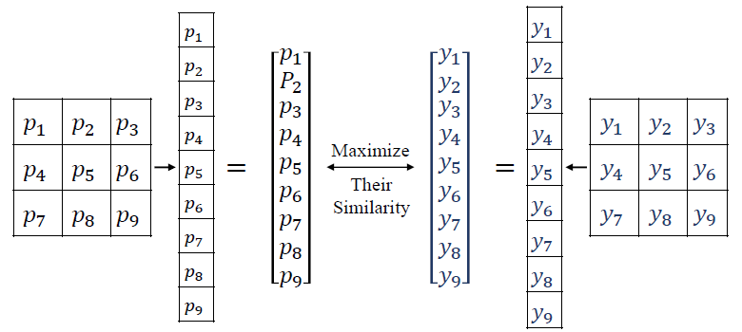
Regional Mutual Information
Problem:
Some approaches treat semantic segmentation as a pixel-wise classification problem. It ignores the relationship between pixels.
Solution:
Use the pixel and its 8-neighbours to represent this pixel.
Maximize the similarity Ι between two distributions of ground truth and the prediction given by the model.
Notes:
Consequently, models trained with a pixel-wise loss may struggle to identify the pixel when its visual evidence is weak or when it belongs to objects with small spatial structures

