Slide 1
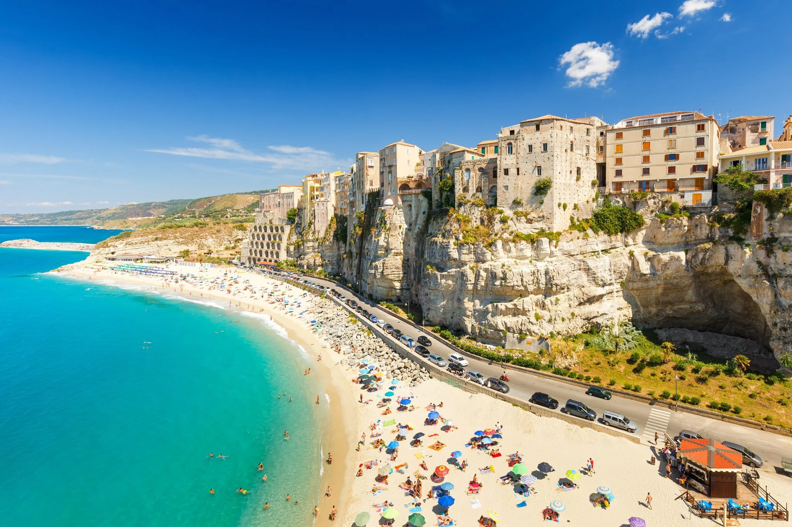
AGN on the beach
The many facets of fuelling and feedback in jetted AGN
Tropea, Italy - 11-15 September 2023
www.agnonthebeach.space

