Slide 1
High Performance Computing with Finite Element Analysis
Timothy Barrett
April 18, 2017

Slide 2



Finite Element Analysis (FEA):
Numerical method of simulating engineering structures.
Can be used to solve complex problems that don’t have an analytical solution.
Can be used for a variety of applications:
Heat Transfer
Stress-strain analysis
Contact analysis
Fatigue/fracture
Material processing
Notes:
Since there is no active control of the blank-holder, some
wrinkling occurs in the flange as it is drawn-in. Subsequently,
the wrinkled flange bends over the die-radius and enters the
die, where it is ironed in the narrow punch-die clearance (1.06
times the undeformed blank thickness). This gives rise to a
second increase in the force, as expected (e.g., [7]).
Since the blank-holder is pressed against the bottom-die
through the spacers shown in Fig. 9b, the blank-holder loadcell
readings are meaningless and will not be reported here.

Slide 3
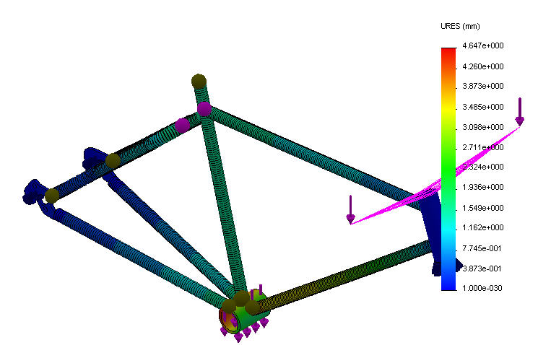
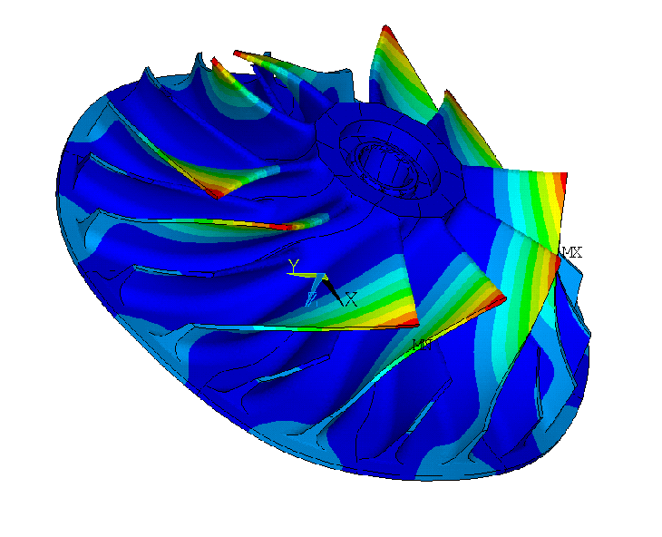
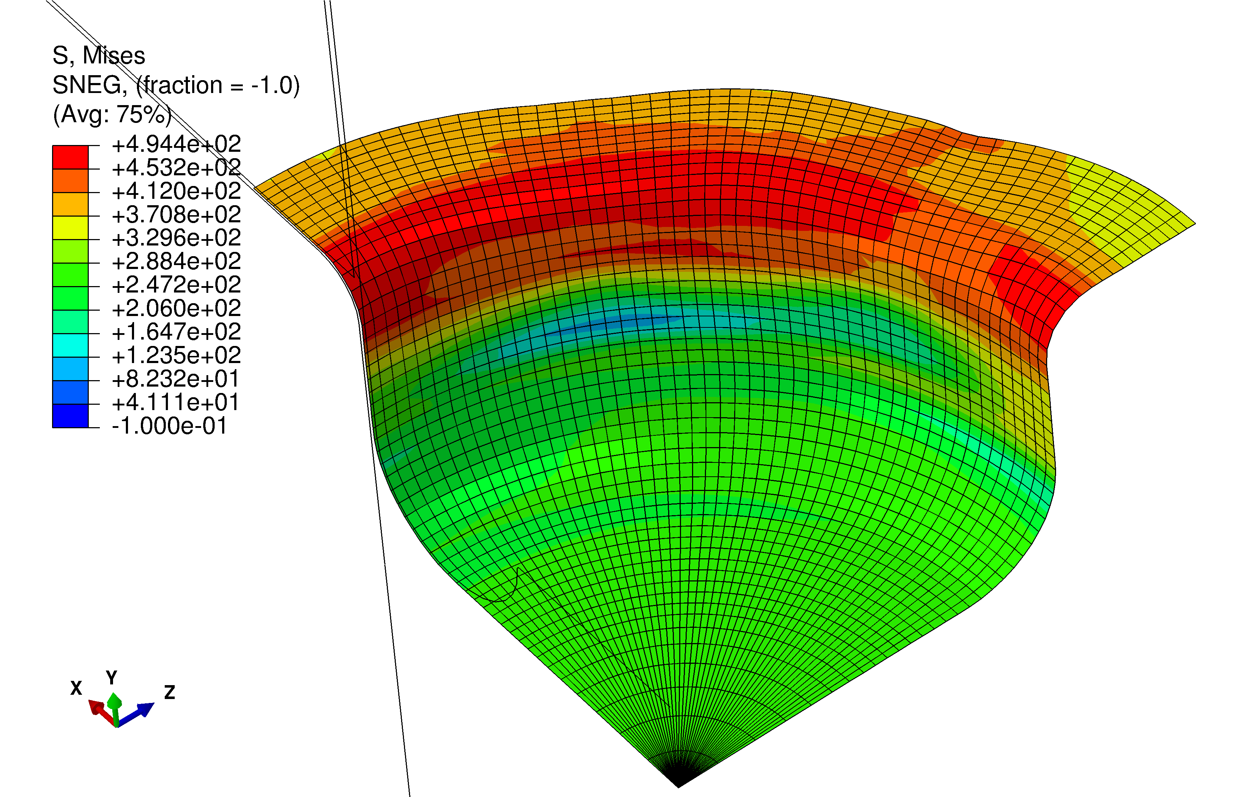
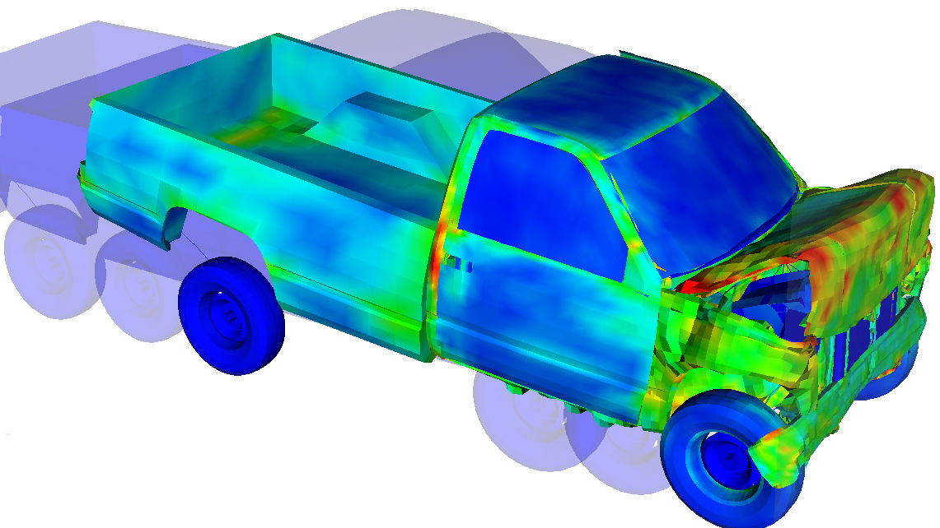
Why use FEA?
Notes:
Many problems cannot be solved analytically.
By breaking problem into smaller more manageable bits we can solve solve the problem at hand.
Car crash would be very difficult to analytically solve for.
Cup height variation due to difference in material properties with respect to orientation.

Slide 4
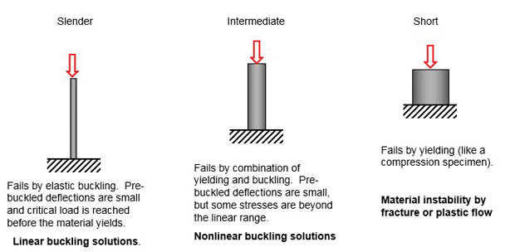
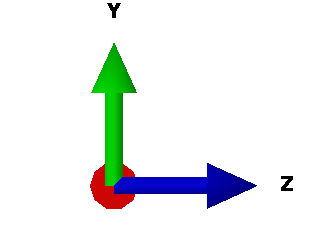
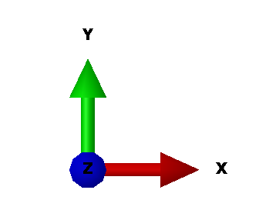
How FEA works:
Define Problem
Simplify the Problem
Create a model
Discretize the model
Simulate
Problem
Apply boundary conditions
Cylinder in tension:
Held on one end
Pulled on the other
Circular cross section
Mild steel material
L
P
d
Notes:
Case study: cylinder with length L, diameter d, pulled with force p and help on other end. We know all relavant material properties.

Slide 5
How FEA works:
Define Problem
Simplify the Problem
Create a model
Discretize the model
Simulate
Problem
Apply boundary conditions
Assumptions:
1-D problem
Deforms elastically and obeys Hooke’s law
Constant uniform area (A)
Only experiences axial force
L
P

Slide 6
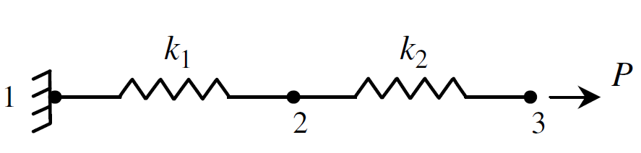
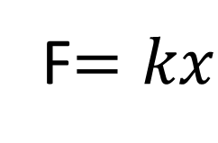
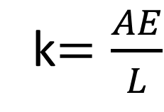
How FEA works:
Define Problem
Simplify the Problem
Create a model
Discretize the model
Simulate
Problem
Apply boundary conditions
1-D Spring Elements:
Hooke’s Law:
Material Stiffness:
k$=\frac{AE}{L}$
F$=kx$

Slide 7
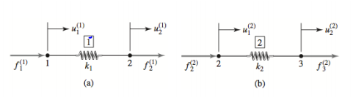
How FEA works:
Define Problem
Simplify the Problem
Create a model
Discretize the model
Simulate
Problem
Apply boundary conditions
Boundary Conditions:
U₁=0
F₃=P (Applied Force)

Slide 8
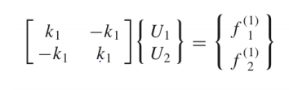
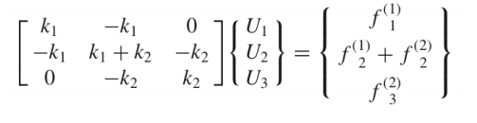
How FEA works:
Define Problem
Simplify the Problem
Create a model
Discretize the model
Simulate
Problem
Apply boundary conditions
Apply Hooke’s Law to each spring:
Assemble all equations:

Slide 9
