Slide 1
Tim Allen
Recovery ANALYTICS DIVISION

Slide 2
Why R?
Data Management
Obtain data from anywhere: Excel, Oracle, CSV, WinCATI, Free text, XML, PDF, HTML, MySQL, Hadoop, JSON, HDF5, SPSS, SAS, MiniTab…
Manipulate with readr & dplyr
Markdown: Script once, run many
Wide Support
6,962 free libraries–statistical methodologies, data formats, integration with software…
Built-in help, manuals, free online classes (Coursera)
Free, free, and free
Data Science is HOT, and R is the Lingua Franca

Slide 3
Top 10 Things (R does really, really well)
10. Download data
9. Read in CSV files
8. Slice and Visualize data
7. Explore the data graphically
6. Extend R with libraries
5. Load Excel data
4. Find missing data
3. Model missing values

Slide 4
2. Regression Modeling
One predictor variable (independent variable)
One response variable (dependent variable)
Model the underlying process
Understand relationship
Predict new values

Slide 5
1. Multiple Regression Modeling
Multiple predictor variables
One response variable
Watch out for overmodeling!

Slide 6
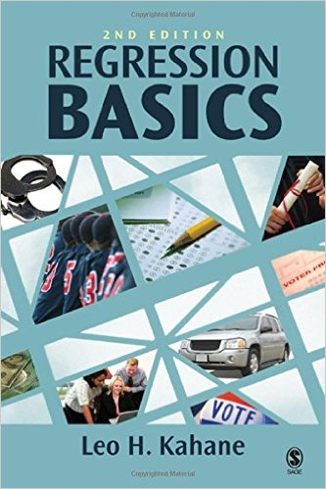
Books About Regression
Regression Basics – Leo H. Kahane – The best primer I’ve found
R Cookbook – Paul Teetor – Explains diagnostics well
Empirical Model-Building and Response Surfaces – Box & Draper – Definitive, great appendices for forgotten matrix math

Slide 7
Supercharging R
Learn more advanced packages
dplyr – data manipulation
ggplot2 – advanced graphics
sqldf – query dataframes with SQL
lubridate – sane data manipulation
NLP – Natural Language Processing/Text Mining
Take a Data Science course (free/cheap)
Learn more stats
What’s a p-value?

