Slide 1
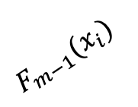




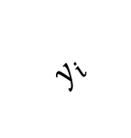
$$y_{i}$$
$$span(h)$$
$$\tilde{y_{i}}$$
$$β_{m}h\left(x_{i};a_{m}\right)$$
$$F_{m−1}(x_{i})$$
$$F_{m}(x_{i})$$

