Slide 1
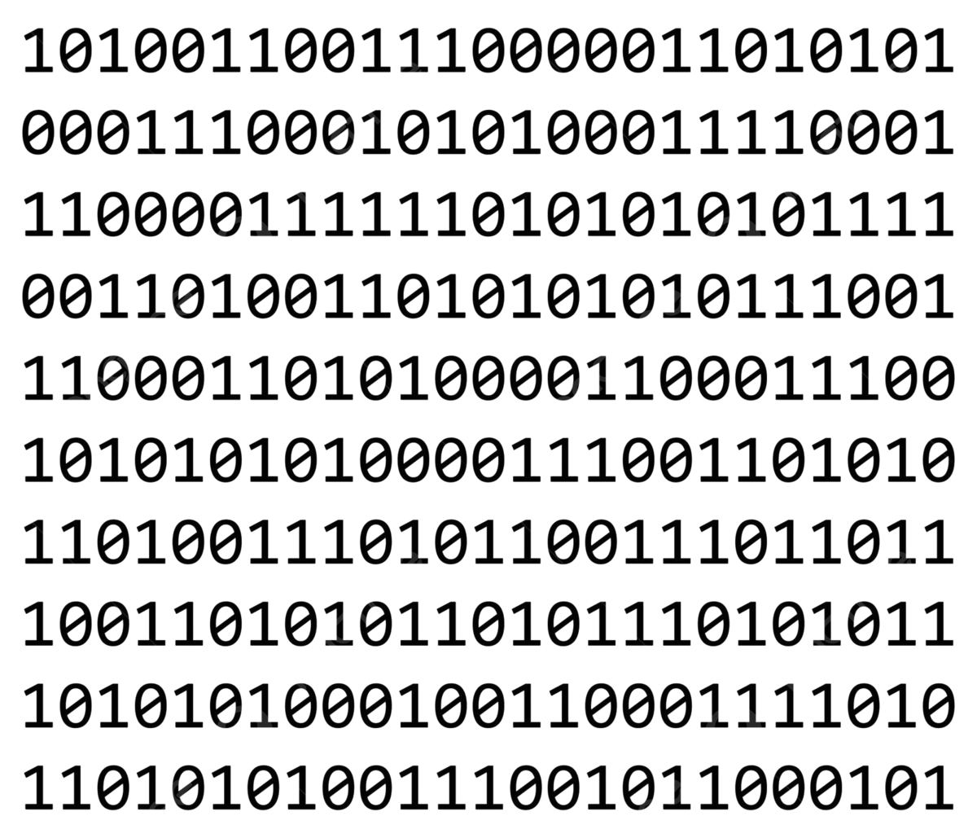
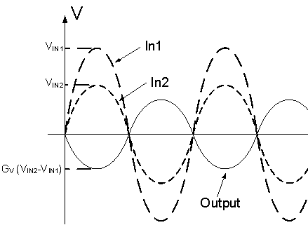

Open-Source Implementation of IEEE P2427
Defect Coverage Standard
Timothy Newman (EnSilica), Feng Shen Foo (Independent), Ashcharya Kela (Independent), Weizheng Wang (Independent), United Kingdom
Digital Test
Analog Test
Graded By
IEEE 1804
Fault Coverage Measurement
IEEE P2427
Defect Coverage Measurement
Open-Source

Slide 2
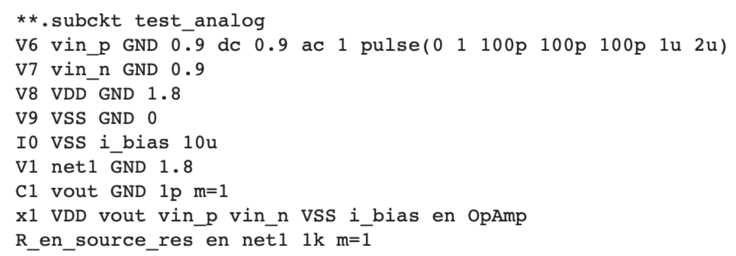
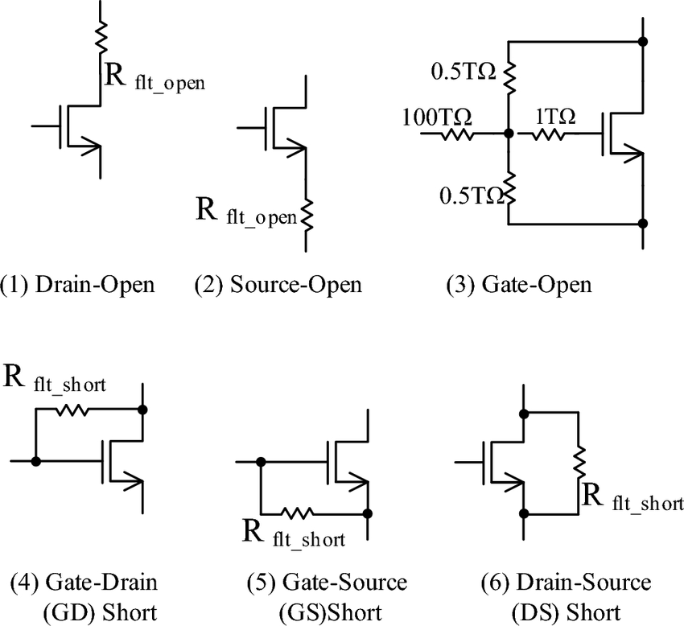
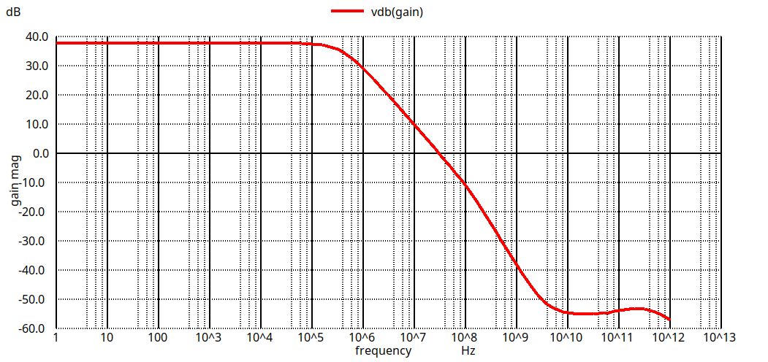
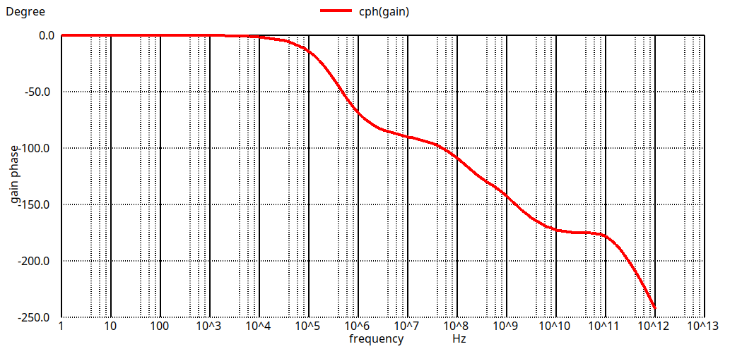
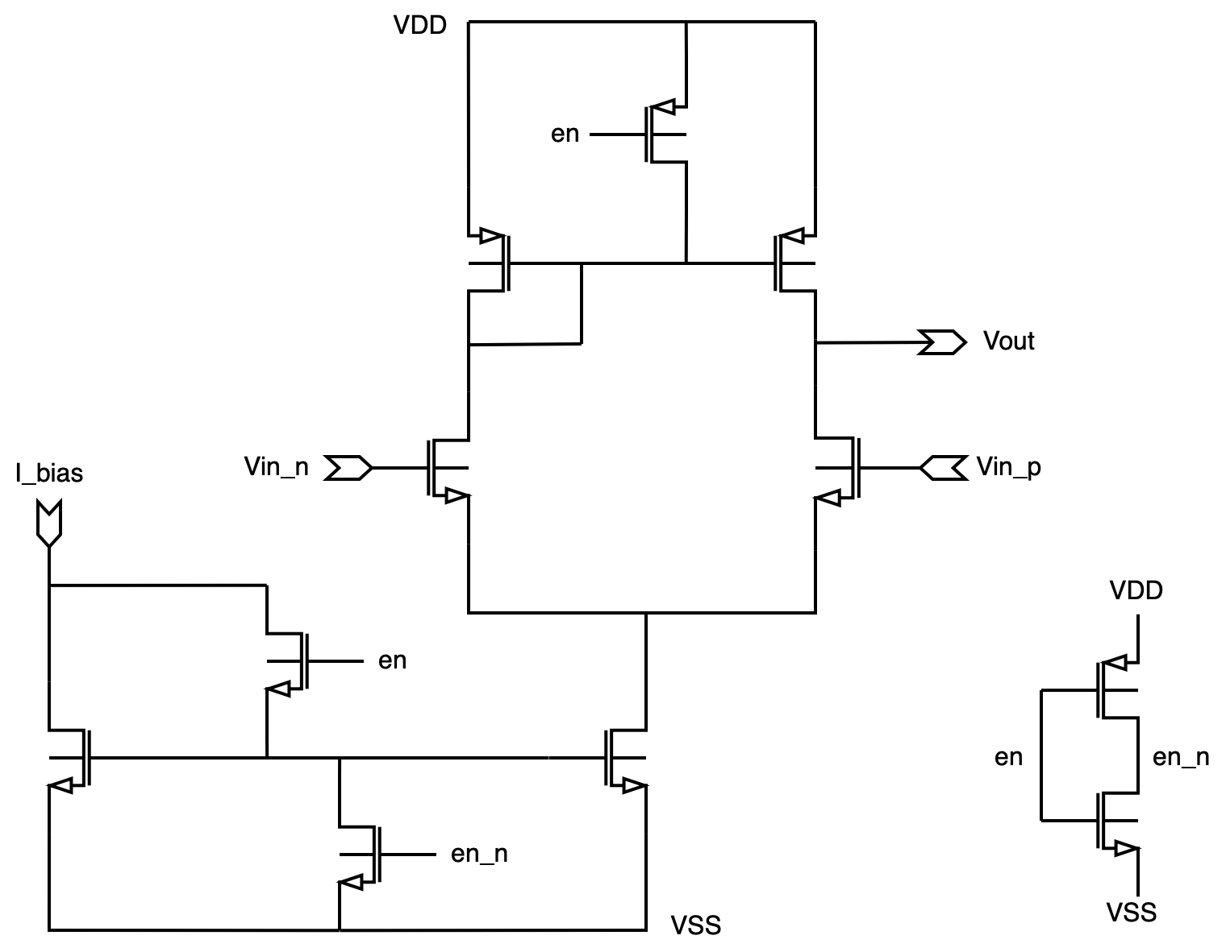

IEEE P2427 Defect Coverage Measurement Flow
1
2
3
4
Defect Models
Performance vs Specification
Pass
Source: [4] fig 3
Detected list
Short / Open / Parametric defects
Defect Coverage %
= Detected / n
Simulate and obtain performance parameters
Obtain and Parse netlist
Calculate and report defect coverage
Derive “defect universe” of size n and generate n netlists with 1 defect each

