Slide 1




Slide 2
Module 1
REST Big Picture
Notes:
<Intro>
REST.
Representational State Transfer.
It’s what we’re going to be looking at for the next four hours.
But the first thing we need to go over is what is it and how does it work.
So, let’s start with a high level, generalised big picture. Then we’ll delve into each component one by one.
Caution: There are going to be a LOT of acronyms. Most of these acronyms will already be familiar to you, but for each new acronym I’ll tell you what it stands for the first time I use it. If at any point I’m using an acryonym and you don’t know what I’m talking about, either:
Google it
or,
Check the powerpoint slide notes from when I first used it,
Or,
You can just ask me.
Right, now let’s get started.

Slide 3
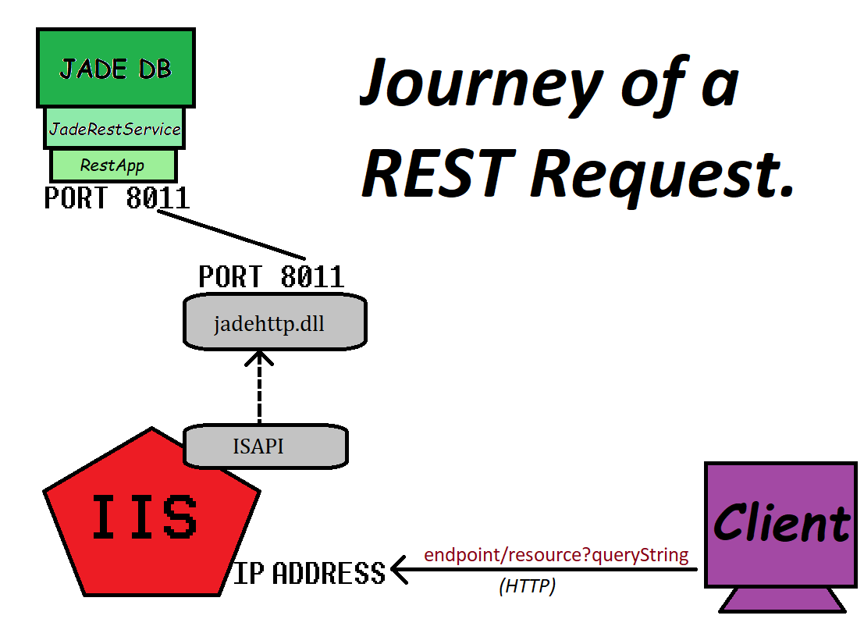
REST Overview
Notes:
REST is a type of web service.
As a web service, you have a server and a client, where the client sends the server a message and gets back a response over the web.
As such, we have three main things to get right:
The client has to send a message to the server,
The message has to get to the right place,
The server has to respond back to the client.
Let’s start with the various components and follow a REST request from the client to a JADE REST server.
Then we’ll look at each component one by one.
First up, the client sends out the request with a URL (Uniform Resource Locator) telling it where to go.
The first part of the URL is an IP address (or name that resolves to an IP address) which leads it to IIS (Internet Information Services). <Click>
Once the request arrives at IIS (we’ll look at what IIS is soon), it uses ISAPI (Internet Server Application Programming Interface) to send it to our jadehttp.dll. <Click>
Jadehttp.dll will look in its ini file to match the request to a JADE REST Application and assign it a port.
Our JADE REST Application is listening on that port and will accept that request and process it appropriately. <Click>
So let’s look at each of these one by one so we can see how we use the URL to get to the server:

Slide 4
Simplest thing that works - IIS
endpoint/resource?querystring
localhost/ExampleRest/jadehttp.dll
/Customer/3
?ExampleRestApp
Notes:
Starting with the URL itself.
A URL is made up of three main parts:
You have the endpoint, which is a description of “Where is the server” and will be used by the IIS component.
Then you have the resource, which is a description of “What particular resource on the server am I trying to interact with?” and will be used by the JADE REST application
Finally, the query string, which for JADE REST servers is used to tell jadehttp.dll which JADE REST application should handle the request.

Slide 5
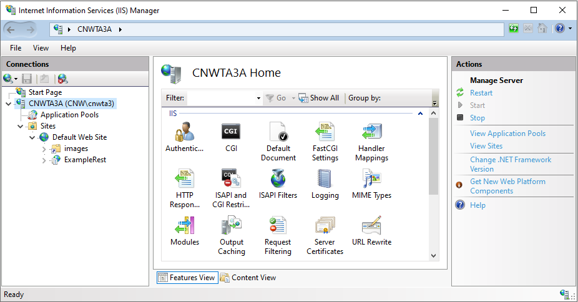
Simplest thing that works - IIS
localhost/ExampleRest/jadehttp.dll/Customer/3?ExampleRestApp
Request to IIS
Notes:
Next, we come to IIS.
We start with the very first part of the endpoint, the IP address or name that resolves to an IP address.
In this case, localhost, which just means “loop back to my own IP” – great for testing/learning because you can do webby stuff on a single PC.
Now that we’ve found the computer (or VM or container or server etc.) we arrive at IIS and IIS will attempt to figure out if it can do something sensible with the request based on the rest of the endpoint

Slide 6
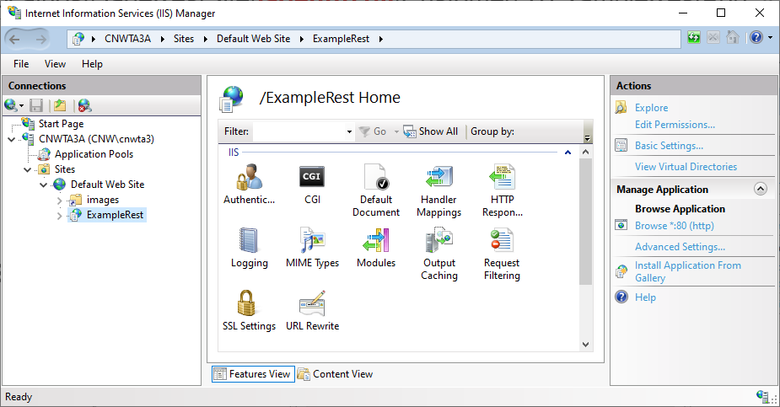
Simplest thing that works - IIS
localhost/ExampleRest/jadehttp.dll/Customer/3?ExampleRestApp
IIS Site = ExampleRest
Notes:
It will look at that second part of the endpoint, in this case ExampleRest. This points to an IIS “Application” (not to be confused with a JADE application) which is going to do the hard work of deciding what to do with the request.

Slide 7
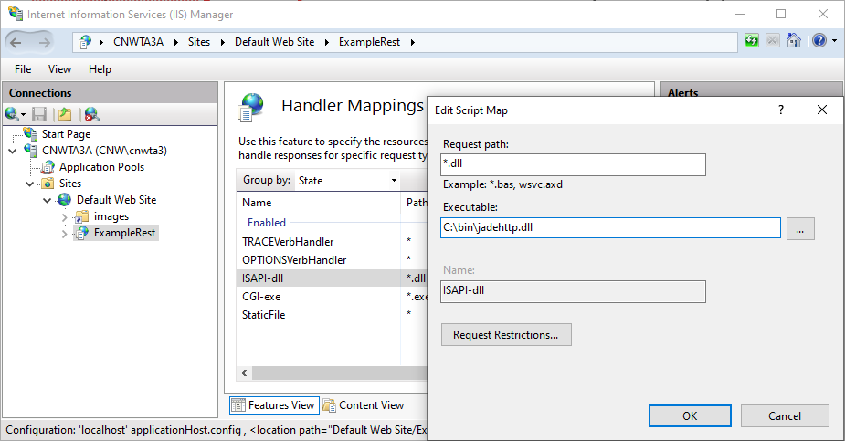
Simplest thing that works - IIS
localhost/ExampleRest/jadehttp.dll/Customer/3?ExampleRestApp
ISAPI-dll maps requests to dlls
Links to a jadehttp.dll
Notes:
And what it’s going to do is look at that third part of the endpoint, the jadehttp.dll, which is going to map to a jadehttp.dll on the filesystem. At this point it’s out of IIS’ hands and we are now it JADE-land.

Slide 8
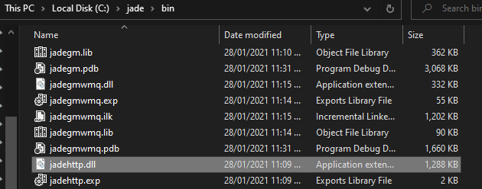
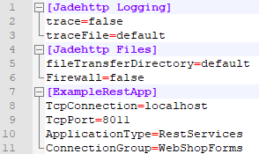
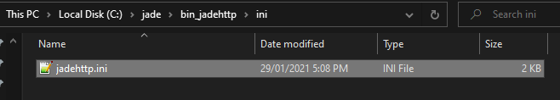
Simplest thing that works – jadehttp
localhost/ExampleRest/jadehttp.dll/Customer/3?ExampleRestApp
C:\jade\bin\jadehttp.dll
C:\jade\bin_jadehttp\ini\jadehttp.ini
Notes:
The jadehttp.dll is going to try and find a running JADE REST Services application to give it to. How it does that is it looks for a jadehttp.ini file, matches the REST App name header in the ini file to the query string (that third part of the URL), and then selects a tcp connection and port to send it on it’s merry way. In this case it’s going to port 8011 on localhost.

Slide 9
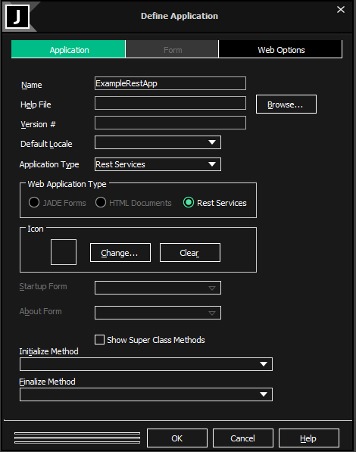
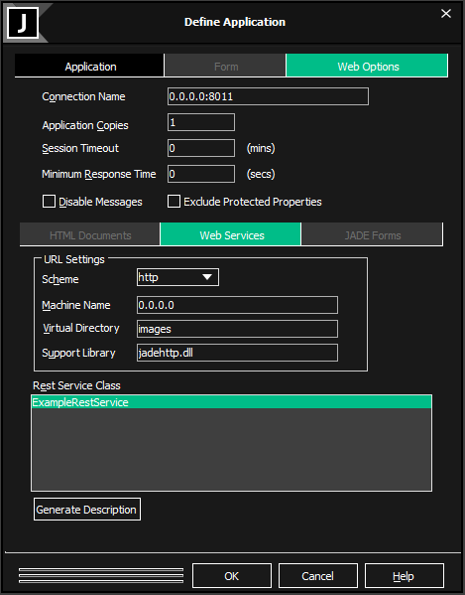
Adding a REST Services Application
localhost/ExampleRest/jadehttp.dll/Customer/3?ExampleRestApp
Notes:
Finally, we need to have a JADE REST application listening on that port, with the matching name.
It will listen on a connection/port as specified in “connection name” field of the web services tab, in the form name colon port. If we actually don’t really care where it’s come from, we can just use 0.0.0.0 to match anything, otherwise it needs to match the value in the jadehttp.ini file.
This app also points to a virtual directory as specified in IIS (just used for caching) and a REST Services class, which is going to perform the logic to handle the requests.

Slide 10
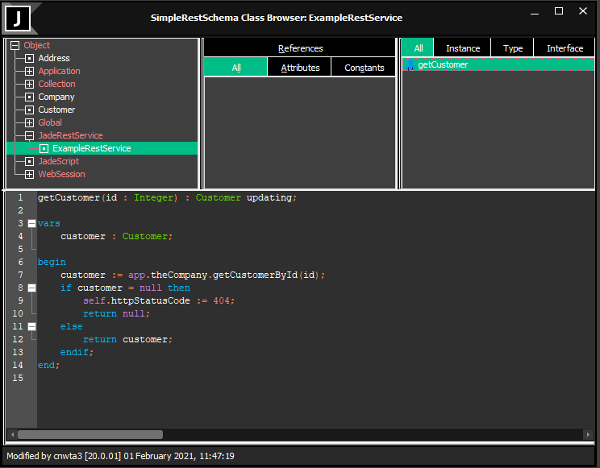
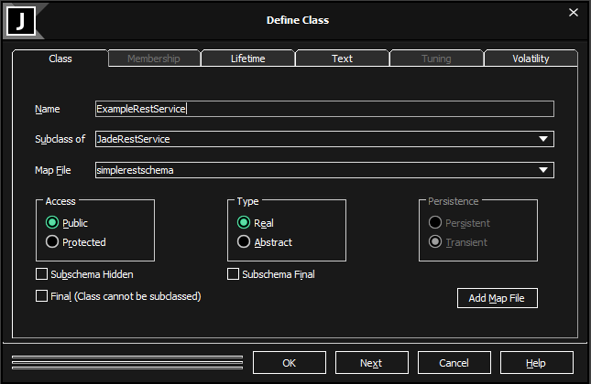
Defining a JadeRestService
localhost/ExampleRest/jadehttp.dll/Customer/3?ExampleRestApp
Notes:
And that logic is just going to be JADE methods of the form verb (like get, post, put or delete) then the name of the resource. That name of the resource is going to match that middle bit of the URL, and any additional parts will be the parameters, in this case we have 3 as an integer parameter.

Slide 11
Demo – A simple end-to-end
Notes:
IIS Setup:
First thing to know about IIS setup is that it is temperamental. You need to get everything just right or it won’t work at all.
Second thing to know about IIS setup is that you only really need to set it up once per machine.
Third thing is that it’s scriptable. For each of the steps you can do it in powershell or with the GUI. As we want to see what’s going on, we’ll use the GUI for this, but if you want to see how to do it in powershell you can check out the JADE container demo which has a script to setup IIS in a container. https://github.com/jadesoftwarenz/JADE-container-examples

Slide 12
Exercise – IIS setup
Exercises:
1a, 1b, 1c
Sing out when you’re done.
If you get stuck and/or if any of the steps don’t work, let me know and we can screenshare ☺

Slide 13
Module 2
REST Server-Side

Slide 14
A RESTful intent…
Resource-oriented …
Standard operations …
Stateless …

Slide 15
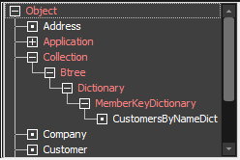
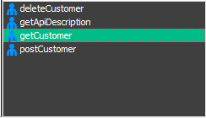
Resource-oriented
Classes vs Resources
Most Resources are Classes
Some Classes are Resources
API intent?
Notes:
Usually, a resource is just a class.
If I want to describe my Customer class in the REST API, I use a Customer resource.
However, you may have some resources that don’t map to classes, for example you might have a resource that represents a description or documentation of the REST API itself. You can also have multiple resources representing the same class, for example if you want to access it in a different way – you might have a Customers resource for accessing Customers one by one, and an AllCustomers resource which you can use to access all the customers at once. Or you might have different parameters for each one.
Now, not every class needs to be made into a resource. Usually, you will have many classes that don’t need to be directly accessed via a resource. They may be classes which you will access indirectly, for example in this case every “customer” has an “address” so you might manipulate addresses via the customer that has that address and not have any “address” resource.
Also, it’s important to consider the intent of the REST API – What do you want the consumer of the API to be able to do? Probably not access every single class in your schema. So you only need to create resources for the what you want the consumer of your API to be able to access.

Slide 16
Standard Operations
GET
POST
PUT
DELETE
SHOULD return something (an object?)
SHOULD NOT modify the database in any way
Success code = 200 (OK)
Idempotent

Slide 17
Standard Operations
GET
POST
PUT
DELETE
SHOULD NOT return the object
MAY return info about the operation
SHOULD modify the database
Success code = 201 (Created) or 204 (No Content)
Not Idempotent

Slide 18
Standard Operations
GET
POST
PUT
DELETE
SHOULD NOT return the object
MAY return info about the operation
SHOULD modify the database
Success code = 201 (Created)
Idempotent

Slide 19
Standard Operations
GET
POST
PUT
DELETE
SHOULD NOT return anything
SHOULD modify the database
Success code = 200
Idempotent?

Slide 20
Stateless
Sessions?
State? Client’s job!
Auth by token
Notes:
REST APIs should be stateless. This means that the server should not remember anything about any client – there are no sessions.
If you need any state information, that should be the client’s responsibility – each request should be able to be processed independently of any request that came before or after.
What if you need to authenticate the client? You can do that via JSON Web Tokens, which can be passed in every request to identify the client.

Slide 21
Gotchas - Inverses
Can’t serialize an inverse (why?)
What do?
Notes:
Let’s look at how serializing works when you have references.
Every time the JSON serializer hits a reference, it will put in a new { and serialize the object (or collection of objects) for the reference.
If the reference has a reference back, i.e., in an inverse, it will then try and serialize the original object for that reference, get stuck in a rut, and give up.
There are two ways around this:
Firstly, you can make it the client’s problem – if the client chooses the NewtonSoft version of JSON as their content type (they can do this for a JADE REST service by appending .JSONN to the end of the url, but before the query string then that can handle it.
Or, from the server side you can use Object.cloneSelf to create a new object of the same class with all the same properties EXCEPT the references are ignored and then you can re-add any non-inverse references, and/or add clones of the inverse relationships etc.

Slide 22
Gotchas – JavaScript and CORS
What is CORS?
Why is it relevant for us?
Notes:
Firstly, CORS stands for Cross-Origin-Resource-Sharing. Essentially that’s just when a website or web service calls uses a resource from another domain. When this happens, there are significantly more restrictions, basically the client has to opt-in to everything to avoid shenanigans.
Now why is this relevant? Well, this is going to be relevant for the next exercise in which we are going to use JavaScript to call a JADE REST service.
If you have a .html file on your local computer with some JavaScript in it that calls a REST service, that REST service must be on the same domain as the HTML.
Now, domain isn’t the same as computer – if I have my REST Service on localhost and run the HTML file from my file system, file system isn’t the same as localhost and we start getting CORS issues.
To fix this, all we need to do is host the .html file on the IIS and they will both be being accessed from localhost and everything will be happy again.

Slide 23
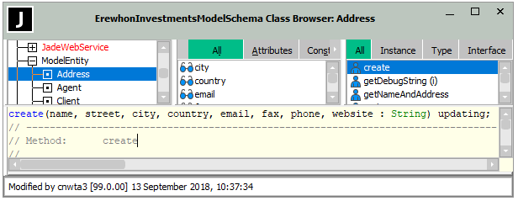
Gotchas – Create with Parameters
{an Address serialized in JSON …}
What’s wrong?

Slide 24
Demo – A more complex API
Notes:
Here I shall just go through the ErewhonClient.html part.

Slide 25
Exercise – Erewhon API
Exercise:
2
Sing out when you’re done.
If you get stuck and/or if any of the steps don’t work, let me know and we can screenshare ☺
For the questions at the end, you don’t need to write it down, just think of some answers.

Slide 26
Module 3
REST Client-Side
Notes:
So now that we’ve seen the server side, let’s have a bit of a quick look at how we consume REST services as a client. We’re not going to go super deep into client-side, but we will cover three example clients –
The JavaScript you used in the previous exercise;
Postman, an easy-to-use API testing tool;
And finally, JADE - both using the new JADE 2020 REST Client and how to do it if you are on an earlier release

Slide 27
REST Client-Side - JavaScript
Key points:
fetch()
.then()
JSON.stringify()
escape()
Notes:
First up, let’s look at the Javascript from the previous exercise.
There are four main tools we’ll use to consume REST APIs in JavaScript, all of which we can see in the ErewhonClient.html
We can use fetch to make the REST requests.
.then for dealing with the response
JSON.stringify will take an object and serialize it into JSON.
And escape will strip out any special characters that won’t play nicely in a URL

Slide 28
JavaScript - Fetch
Takes a URL and an (optional) init object
Returns a “Promise”( use .then to handle the async)
Notes:
Only two main things you need to know about Fetch:
Takes a URL and an init object, which is has a bunch of properties for all the possible config you might want to put in your request.
It’s async, so it will return you a promise and then when it’s done you get the result. Easiest way to deal with that is just use .then which waits for it to finish.

Slide 29
JavaScript - then
.then takes a function, performs that function, and returns the result
You can chain them.
What does this example do?
Notes:
In this example, the fetch has returned us a promise. When we use .then on that returned promise, it will execute the function on the result ONCE the async operation is done.
So here it will wait until the request is done, then the response => response.json is just an arrow function, which means the response is the parameter and it will return a promise again, this time trying to get the json object.
To that returned JSON we’re then going to do something.
We’re going to take that (now it’s the getResponse parameter) and shove it into our myText element, which makes the json turn up in the text box when you click the GET.

Slide 30
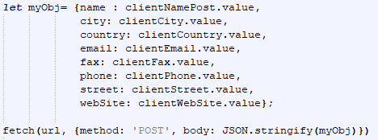
JavaScript – JSON.stringify
Stringify is just like JADE’s JadeJson::generateJson
Takes an object, returns a JSON string
We need that because we can’t send objects over the wire

Slide 31
JavaScript - Escape
Let’s not trust user input it might blow up
E.g., Space character -> %20
Notes:
Finally Escape replaces any character that have special meaning to a URL – spaces, slashes, colons etc. with a percent-encoding, for example a space turns into %20
This is important if you’re accepting input from a user, because you never know what those crazy users will put in your input box.

Slide 32
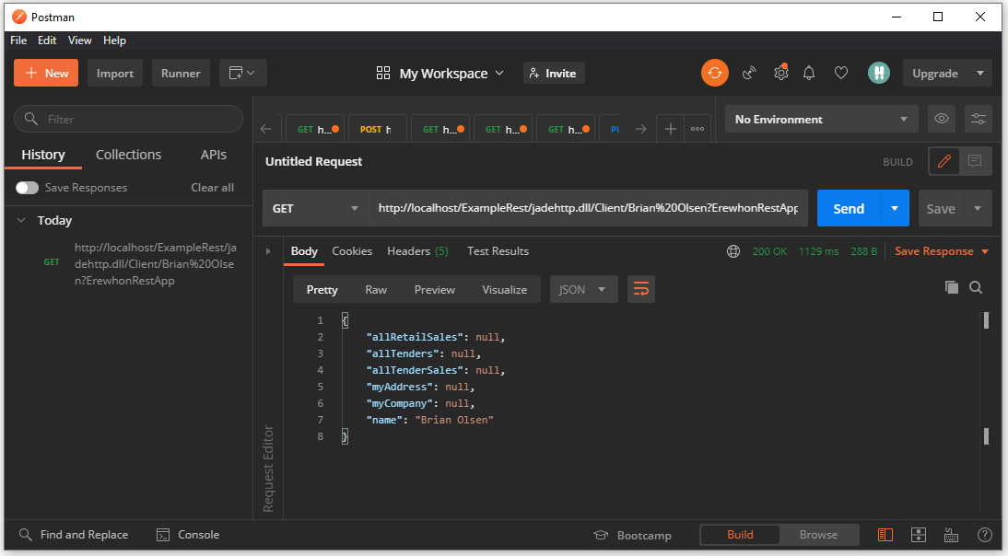
REST Client-Side - Postman
Notes:
For postman, I think the best way to cover this is just to show you.
There are many tools like it, postman is just my favourite – it’s just a tool for testing web services (e.g. REST) APIs.
Let’s open Postman and see how easy it is to make REST requests to make sure they work
- Make a GET and a POST request to the Erewhon API.

Slide 33

REST Client-Side - JADE
JADE
2018 and earlier
JADE
2020+
Notes:
Now to close out the REST clients, we’ve saved the best for last.
You can consume REST APIs from JADE.
In JADE2020 it’s a bit easier, as we have new dedicated RootSchema classes for making REST requests.
However, if you’re stuck on an earlier release, you can still consume REST from JADE using the JadeHTTPConnection class.
Let’s briefly go through each way.

Slide 34
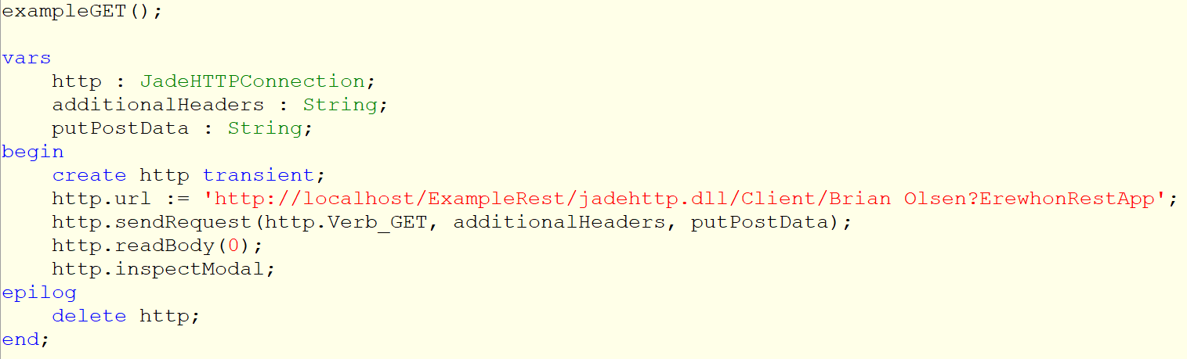
JADE – JadeHTTPConnection GET
Notes:
So first up, let’s say you’re on an earlier release and don’t have access to the new JADE2020 REST classes.
Since REST requests are just HTTP requests in a certain format, you can hand-roll your own REST client using the JadeHTTPConnection class, specifically its sendRequest method.

Slide 35
JADE
2020+
Notes:
Now onto JADE2020, we have three new classes;
JadeRestClient
JadeRestRequest
JadeRestResponse

Slide 36
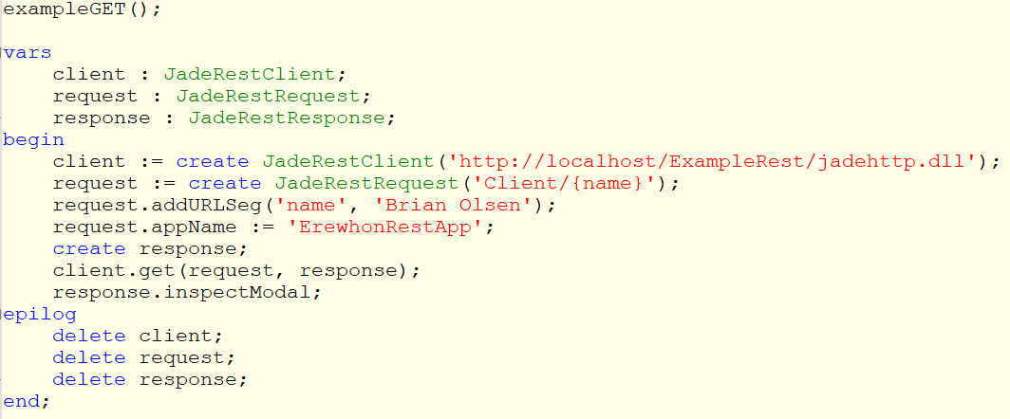
JADE – JadeRestClient GET
Notes:
And let’s see how we use them:
First up we create a client and pass it the endpoint – remember that’s the part of the URL that describes *where to find the api*
Next, we’ll create a request. This is kind of like the init object of javascript, in that it has all of the customisation for that particular request – here we’re setting the resource we’re trying to access in the create method
We’re setting the parameter for the GET with addURLSeg
And since it’s a JADE REST service, we’ll need the JADE application name in the query string, which we can do with request.appName.
Then we just need to create a response object and pass it and the request object to the client, and the response object will be populated with the results of the response.

Slide 37
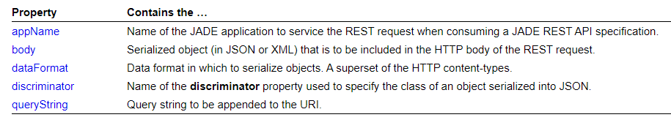
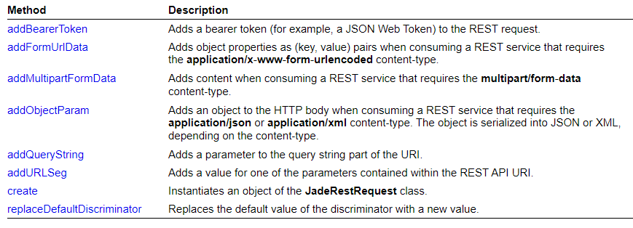
JadeRestRequest
Notes:
For reference, there’s more properties and methods that you can set on a request, as REST APIs can require the requests to provide content in all sorts of types. We won’t get into all that today though.

Slide 38
Interlude – Where are we up to?
Notes:
We’ve now covered the three main parts of the REST request journey – we’ve looked at how JADE provides REST services on the server-side <Click>
We’ve looked at how to consume the REST services as a client <Click>
And we have some basic wiring in the middle, just a simple IIS setup so that it works. <Click>
We’re now going to go a bit deeper. Starting with getting our URLs to not look so ugly.

Slide 39
++++++++++++++++++++++++++
Module 4
IIS Setup – URL Rewrite
Notes:
By default, your JADE URLs are going to look pretty ugly.
That’s mostly because of the wiring – the IIS and the jadehttp.dll.
Fortunately for us, we can fix it by getting a bit more sophisticated in our IIS setup, and by leveraging the IIS’ URL rewrite feature.

Slide 40
Parts of a URL - recap
endpoint/resource?querystring
localhost/ExampleRest/jadehttp.dll
/Customer/3
?ExampleRestApp
Notes:
As you hopefully remember, the URLs are made of three parts –
The endpoint, which describes where to find the REST server
The resource, which describes WHICH resource on the REST server we’re trying to interact with
And the query string, which is only used to tell the jadehttp.dll what the JADE REST server’s application name is.
We’re always going to need the green part, the which resource.
We’re going to need some amount of the endpoint, though if we only have one REST Server per IIS “website” we can simplify it a bit.
And the query string we can get rid of, if we know we have a 1:1 relationship between IIS website and JADE REST Application.
Let’s delve back into IIS and see how we can simplify the endpoint a bit first.

Slide 41
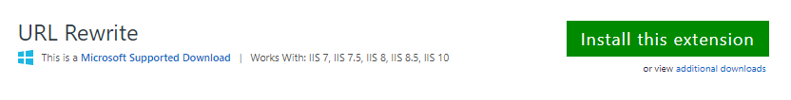
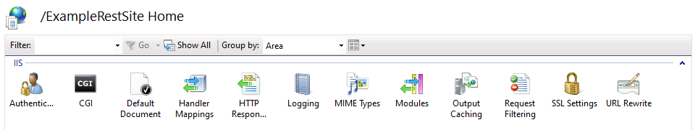
URL Rewrite
https://www.iis.net/downloads/microsoft/url-rewrite
IIS
Notes:
To make the URL user-friendly, we’re going to use URL Rewrite.
URL Rewrite is a feature of Microsoft IIS which allows you to modify the incoming URL with a regular expression.
If we can add the parts of the URL that will always be the same in IIS, the end user doesn’t have to provide them.
To install URL rewrite, you can download and install it directly from iis.net. Once installed, a new icon will appear in IIS for each of your applications.

Slide 42
URL Rewrite … The (first) Goal
localhost/ExampleRest/jadehttp.dll
/Customer/3
?ExampleRestApp
localhost/ExampleRest
/Customer/3
?ExampleRestApp
Notes:
So, we know we can rewrite the URLs. Before we see exactly how we’re going to do that, let’s make sure we know what our goal is.
The first thing we want to do is get rid of the jadehttp.dll, since
It’s the same every time
It looks a bit weird in the URL
We’re going to have our incoming URL rewrite rule add it in (so the user doesn’t have to include it) … what sort of regex will we need?

Slide 43

Parts of a URL - recap
localhost/ExampleRest/jadehttp.dll
/Customer/3
?ExampleRestApp
jadehttp.dll
/Customer/3
?ExampleRestApp
/Customer/3
?ExampleRestApp
Notes:
Our regex is going to be even easier than you might expect!
We don’t have to worry about the localhost (or IP address or domain name that maps to IP address) part, nor the Application name since IIS has already resolved that much. The URL we will need to make the rest of the journey is just this much… <Click>
And so, if we’re going to be adding the jadehttp.dll part in the rewrite, the partial URL we’ll be working with is just this: <Click>
And all we need to do is add jadehttp.dll to the start of it!

Slide 44
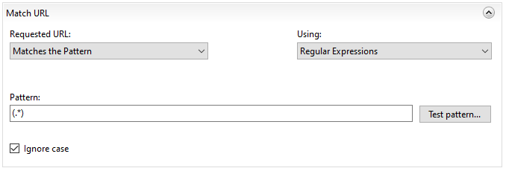
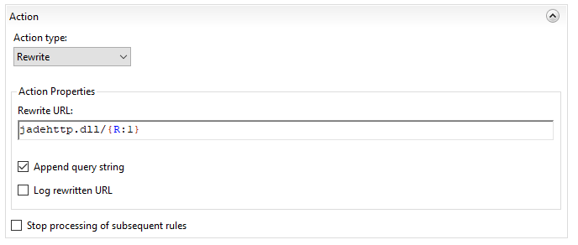
URL Rewrite
Notes:
Let’s look at how we can do that in IIS’ URL rewrite …
When creating a URL rewrite rule, there are two main parts: The Match and the Action.
The Match determines what URL format to do the rewrite on – it will only rewrite URLs that match the pattern.
In this example, we have said the pattern is just dot-star, which means any number of any character, then we surround that with rounded brackets to create a capturing group – that will be useful later.
If you’re unfamiliar with regular expressions, a good tool for learning about them and creating them to copy-paste in is regexr.com
Now the second part is the Action – what should we do when the URL is a match for the regex we specified in the Match?
In this case, it’s nice and simple, we want to insert jadehttp.dll/ and then put back the URL we captured in the Match. That {R:1} is just the contents of the first captured group.

Slide 45
URL Rewrite … The (second) Goal
localhost/ExampleRest
/Customer/3
?ExampleRestApp
localhost/ExampleRest
/Customer/3
Notes:
So, we’ve got rid of the jadehttp.dll and that’s a good start.
The next thing we want to do is get rid of that application name.
Partially because it’s more URLing for the client to do that could be avoided.
But also, it’s not ideal to be exposing your internal application name to the public.

Slide 46
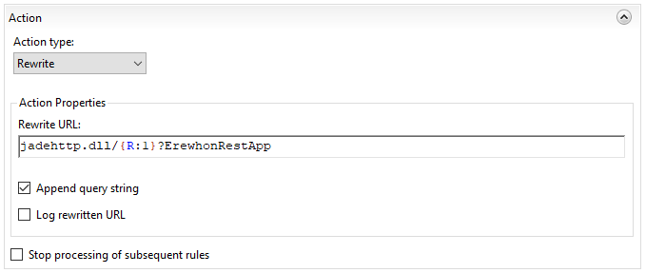
URL Rewrite
Notes:
Adding the app name into the query string is also pretty easy, we can just modify the rewrite URL a little to add ?ErewhonRestApp and voila!

Slide 47
Exercise – URL Rewrite
Exercise:
4
Sing out when you’re done.
If you get stuck and/or if any of the steps don’t work, let me know and we can screenshare ☺

Slide 48
Module 5
Documenting REST APIs
Notes:
Okay, so you’ve created a great REST API.
Some client is going to have to consume it at some point or there’s no point.
How will they know what resources they can access and what parameters they should pass to the methods? If they are making a POST, how do they know what properties to include in the JSON they are sending over? If they are making a GET request, how do they know what Class this serialized object is?
Documenting the REST API is important.

Slide 49

Documenting REST APIs
Notes:
Okay, so you’ve created a great REST API.
Some client is going to have to consume it at some point or there’s no point.
How will they know what resources they can access and what parameters they should pass to the methods? If they are making a POST, how do they know what properties to include in the JSON they are sending over? If they are making a GET request, how do they know what Class this serialized object is?
So, we want to document the API.

Slide 50
Documenting REST APIs
Good for Humans
Good for Computers
Easy to generate
Manually written documentation
Notes:
There are three main options for documenting REST APIs, and three main criteria to judge them against.
First, the criteria:
We want our documentation to be readable by people (developers) <click>
We want out documentation to be parsable by computers (i.e., auto-generating client classes from it) <click>
And finally, we want our documentation to be easy to generate with as little work as possible <click>
Now, the three options:
Next up, we could automatically generate a description in WADL – Web Application Description Language.
The advantage of this is it’s super easy

Slide 51
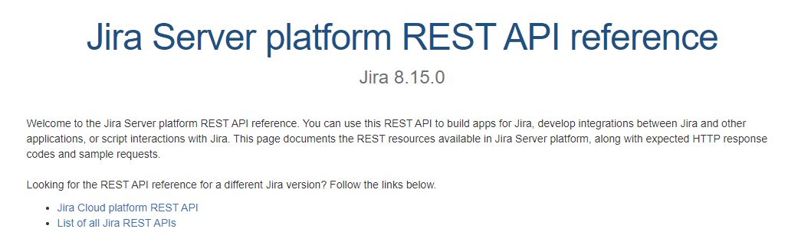
Documenting REST APIs
Notes:
First up, the simple/obvious way, is to manually write out documentation about your API with all the class definitions and resources. This is actually fairly common, for example Jira’s REST API has human-written API documentation for human developers.

Slide 52


Documenting REST APIs
Good for Humans
Good for Computers
Easy to generate
Manually written documentation
WADL
Notes:
This is good for humans to read (assuming it’s well written) but it won’t be parsable by computers and it takes significant time and effort to generate.
So, let’s see if we can auto-generate some documentation.
Next up is WADL – Web Application Description Language.

Slide 53
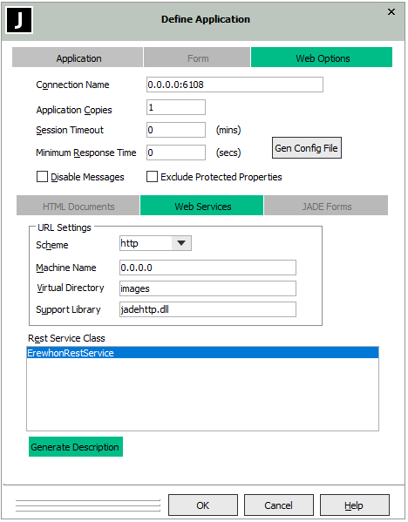
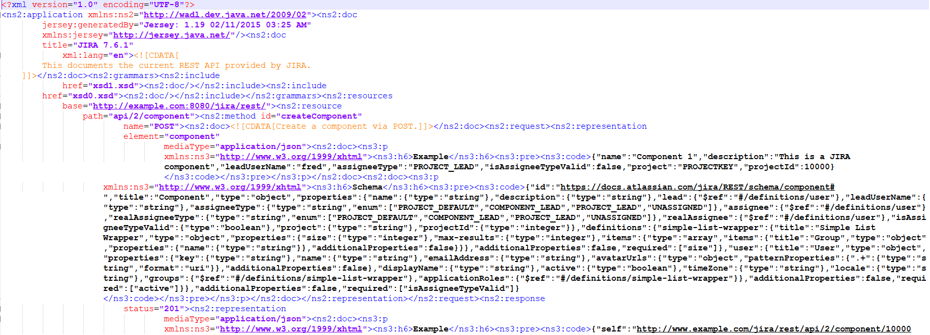
Documenting REST APIs
WADL
Notes:
WADL is a subset of XML and is used to describe web services in a precise, structured way.
As you can see, it’s not really readable by humans. It’s at least not binary data, so you technically can read it, but I’d pity anyone trying to generate client code based on this.
It’s KINDA computer readable – it’s certainly a standard format which is good, but it’s a pretty old one so many tools won’t play nicely with it.
That said, it’s trivially easy to generate – from JADE you can just go to your REST application definition and press the Generate Description button and it will spit one out to a file.

Slide 54
Documenting REST APIs
Good for Humans
Good for Computers
Easy to generate
Manually written documentation
?
WADL
OpenAPI
Notes:
So, WADL is no good for humans
It’s OKish for computers
And it’s easy to generate.
But now let’s look at our third option: OpenAPI

Slide 55
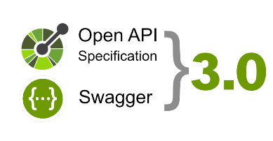
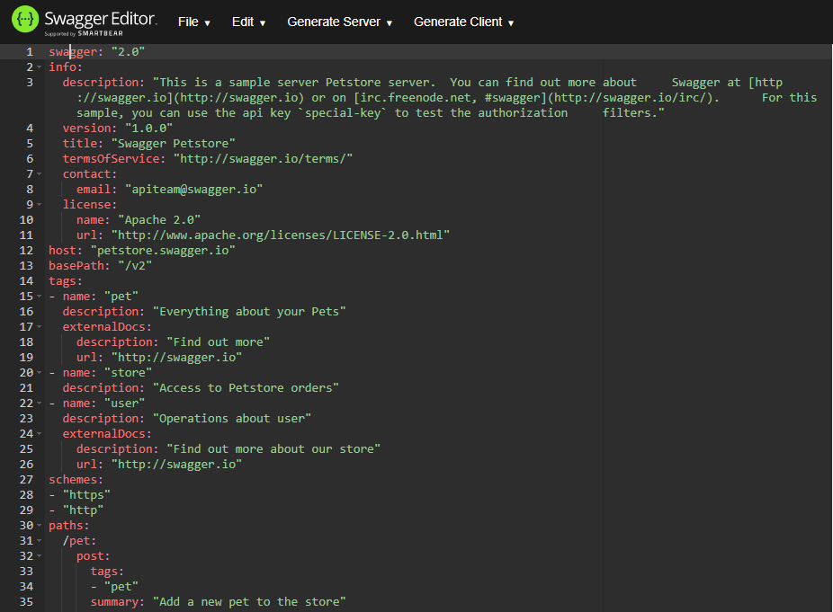
Documenting REST APIs
Notes:
OpenAPI specification is just like WADL but different. If anyone has heard of swagger spec, this is the same thing, it’s just changed its name.
First difference is that it’s written in JSON rather than XML (or YAML, which is a superset of JSON, and is basically like JSON without the squiggly brackets)
Second difference is that it’s a lot easier to read as a human
Third difference is that it’s a much newer format than WADL – but this means it’s also more likely to be compatible with modern REST Client generators (for example JADE2020)

Slide 56
Documenting REST APIs
Good for Humans
Good for Computers
Easy to generate
Manually written documentation
?
WADL
?
OpenAPI
Notes:
So, looking at that in the grid:
It’s kinda good for human-readability – nowhere near as good as something written by a human, but you can definitely see what’s going on
It’s great for computers – as a well-defined format with a standard structure, it can be parsed, and it’s a modern standard so fairly compatible with many modern REST Client generators.
And finally, it’s easy to generate, just like WADL.
So OpenAPI seems to be the winner. But!
JADE support for OpenAPI starts in JADE2020 – as of right now JADE2020 can parse OpenAPI specs and auto-generate client classes, and as of the upcoming JADE2020 service pack it will be able to generate them from existing REST APIs too.
If you’re on an earlier release, you’ll have to settle for either writing the documentation yourself or generating a WADL.

Slide 57
Demo – Importing OpenAPI
Notes:
Import an OpenAPI specification and show the classes. If time allows.

Slide 58
++++++++++++++++++++++++++
Module 6
RESTful Security
Notes:
Right, for our penultimate topic, let’s looks at security as it relates to REST services.

Slide 59
JADE2020 content follows …
Notes:
Warning: The following content is specific to JADE2020 and is not available in earlier releases.

Slide 60
RESTful Security Overview
To cover:
Encryption (IIS to JADE Application)
Authentication (JSON Web Tokens)
Notes:
There are two distinct aspects to REST security – Encryption, which is about making the messages be unreadable by nosy and/or malicious third parties; and Authentication, which is about verifying that a client is allowed to access a service.

Slide 61
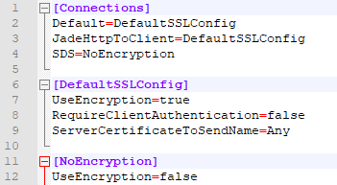
RESTful Security - Encryption
JADE SSL Configuration File
OR
Notes:
Firstly, we need to cover the scope of what needs to be encrypted – for https connections, the traffic between the client and IIS will be encrypted – this is nothing to do with JADE. As far as JADE is concerned, the only connection that needs to be encrypted is the connection between jadehttp.dll and the REST service.
This is actually pretty simple to set up, it’s just a couple of ini file settings.
The first ini file setting can be set in either jade.ini (your JADE’s ini file), or in the jadehttp.ini, which is found in the bin_jadehttp/ini folder (the same one we set up the ports for the web service in)
All that’s doing is pointing to the ini file that has the SSL config. This can be any file, you can even put the SSL config IN the jade.ini or jadehttp.ini file and just have it point to itself. It’s generally better to go to a separate file though, since that way you can more easily re-use the config.

Slide 62

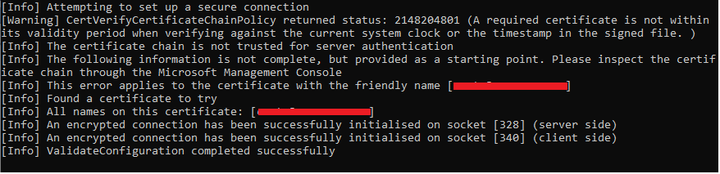
RESTful Security - Encryption
Is it working?
Notes:
Once you’ve set up your config, it’s something that’s going to just quietly encrypt the traffic between the jadehttp.dll and your REST App without you really noticing.
So that begs the question, how do you make sure it’s working.
Well, there’s a handy SslConfigurationTool which comes with JADE in your bin directory which will check that you have an encrypted connection with your current config settings.

Slide 63

RESTful Security - Authentication
Who you say you are can do the thing.
I am who I say I am.
Authentication
Authorization

Slide 64
RESTful Security – Authentication
I have a REST API method …
I want to control who can access it
BUT
REST is stateless – no logins allowed!
What do?

Slide 65
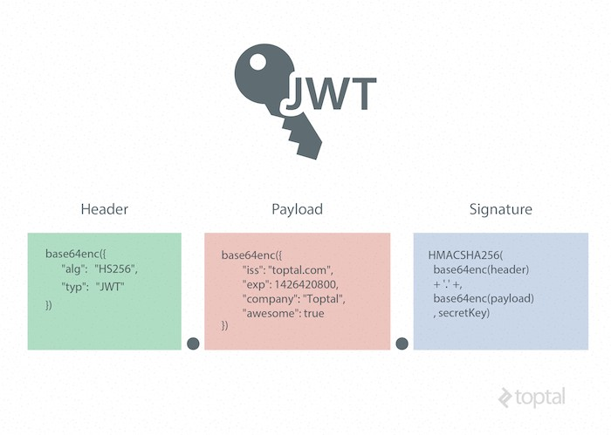
RESTful Security – JSON Web Tokens
Notes:
A JSON Web Token is essentially just a set of claims about a principle plus proof that the token came from a trustworthy source and hasn’t been tampered with.
How it works is that each token is made up of three parts, separated with dots.
The first part, the header, is just meta-information about the token – i.e. that it is a JSON Web Token as opposed to anything else, and the algorithm that was used to sign it.
The second part, the payload, is the set of claims that is being made.
The third part, the signature, is obtained by taking the header plus the payload, and encrypting it. When the server wants to make sure the token is legit, it simply decrypts the signature and makes sure it still matches the header+payload – if either has changed, or if it was signed with the wrong key, this won’t match and the token will be rejected.

Slide 66


RESTful Security – JSON Web Tokens
PRIVATE
PRIVATE
JADE
Auth0
PRIVATE
PUBLIC
JADE
JADE
Symmetrical Token
Asymmetrical Token
Notes:
As the server-side, there are two main ways of providing tokens to your client –
First way: You can generate them yourself and give them to your clients when they prove their identity (e.g. by signing in)
These are known as symmetrically signed tokens because it’s the same entity signing/encrypting the tokens as is validating/decrypting them.
Second way: You can have a trusted third party generate them and give them to your clients when they prove their identity to the third party.
These tokens are asymmetrically signed because they are encrypted/signed by the third party, but validated/decrypted by the server – there’s a private encryption key and a public decryption key

Slide 67
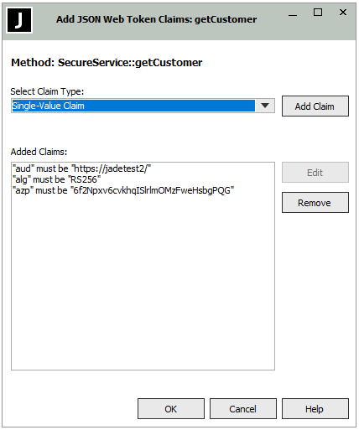
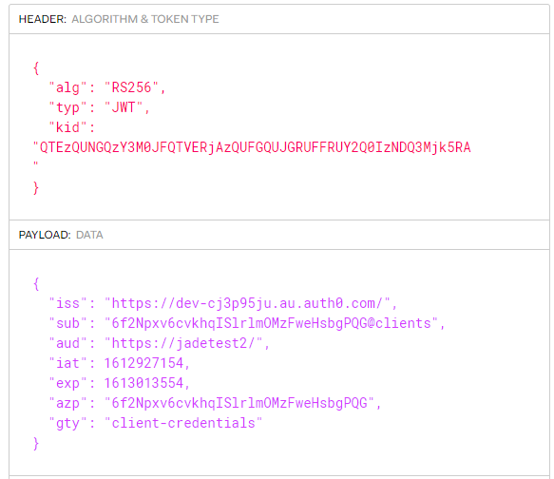
RESTful Security – JSON Web Tokens
Notes:
So, we can have our client prove who they are with a JSON Web Token, but how does that relate to keeping the hooligans out of my API?
If you take any REST method in your schema, right click on it in the Schema browser and select REST Security Options then you’ll get this here add claims dialog. From this you can add whatever claims you want to require of anyone using the method. As soon as ANY claim is required of a method, any client MUST have a JWT in their header or they won’t be able to access it (they will get a 403: Forbidden) – The signature will be automatically checked as well as claims like exp, the expiry will also be automatically checked.

Slide 68
JADE2020 content ends …

Slide 69
Module 7
Performance
Notes:
Now, for our final topic, we’re going to look at web service performance – both how to investigate when things are going slowly, and some tips and tricks to maximize performance.

Slide 70
RESTful Performance
Collecting Web Service Stats
The various log files
Transient handling
Notes:
We’ll cover off three things within performance as it relates to REST. Of course, all the usual best practices for normal JADE development still apply, such as minimising trips to the DB, but these are more rest-specific.
First, we’ll see how to measure performance for your REST app,
Then we’ll look at the various log files that can be useful for troubleshooting,
And finally, we’ll look at how transients are handled for REST services, as there’s nothing worse that getting a transient leak in a web service.

Slide 71

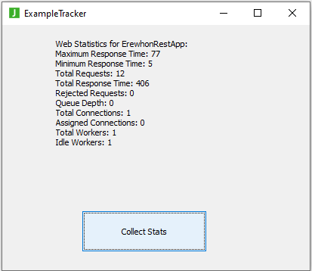
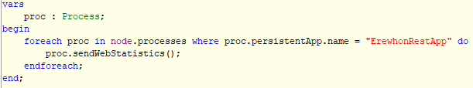
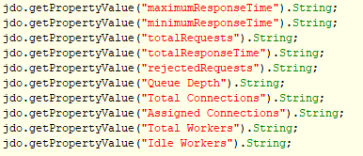
Web Service Stats
Notes:
First thing to say about Web service stats is they are available two ways – you can view them in the monitor, or you can access them programmatically.
Next thing to say is as of right now, the Web Service Stats in the monitor aren’t working for REST services, only for SOAP/Web Forms. Oops. There is a hotfix coming.
That said, programmatically can actually be a pretty good way of going about things anyway – you can spit out the results to log files, or display them as you want, or do with them what you will.
Essentially how this will work is that Process has two methods, sendWebStatistics and extractWebStatistics. The sendWebStatistics method causes the process to send out a notification that you can subscribe to. Then when you’re in the userNotify for that notification, the extractWebStatistics will populate a JadeDynamicObject with the web statistics of that process, based on the userInfo of the notification.
If you want to check out an example, the Erewhon Example you’ve been using has a simple form.

Slide 72
Log files
IIS logs
C:\inetpub\logs\LogFiles\W3SVC1
jadehttp.dll logs:
C:\jade\bin_jadehttp\logs
REST Application log
C:\jade\logs\RestApp.log

Slide 73
Log files
IIS logs
C:\inetpub\logs\LogFiles\W3SVC1
2021-02-28 21:28:39 ::1 POST /JadeRestSite/jadehttp.dll/Client ErewhonRestApp 80 - ::1 Mozilla/5.0+(Windows+NT+10.0;+Win64;+x64)+AppleWebKit/537.36+(KHTML,+like+Gecko)+Chrome/88.0.4324.182+Safari/537.36 http://localhost/jadeRestSite/ErewhonClient.html 200 0 0 9
HTTP Verb
URI Stem
Query String
Referer
Status code
Time taken (ms)
Notes:
The IIS logs give you information about requests received into IIS. Each requests will generate one line of the log, with space-delimited fields relevant to that request.
Some highlights are:
The HTTP verb of the request
The URI stem, which is what the URI looks like *after* processing – see that the http and localhost have been pulled off, and the jadehttp.dll was added from a URL rewrite.
Just a refresher while we’re here, URI and URL are often used interchangeably. All URLs are URIs but not all URIs are URLs. We are doing webby things, so we are using URLs, but since all URLs are URIs, either is acceptable.
That’s why we get this weird mix – URL rewrite is the name of the rewriting tool; URI Stem is what this field is labelled in the logs.
Next query string – That was added by the URL rewrite.
Down the bottom, we have some more usefuls
We have the URL that came into IIS, which we call the Referer. Between the Referer and the URI stem we can make sure URL rewrite is doing the right things.
Status code just lets us know what the server came back with – 200 means this was a successful request.
And finally, that number in gold is the time taken in MS.

Slide 74
Log files
jadehttp.dll logs:
C:\jade\bin_jadehttp\logs
2021/03/03 13:53:47.520 067d8-5418 *********** Starting jadehttp.dll Version 20.0.1.29
2021/03/03 13:53:47.525 067d8-5418 [Warning] No JadeSsl.ConfigurationStore section present in ini file [C:\jade\bin_jadehttp\ini\jadehttp.ini]. Reverting to NO ENCRYPTION
2021/03/03 13:53:47.526 067d8-5418 Application created: ErewhonRestApp ApplicationType: RestServices
2021/03/03 13:53:47.530 067d8-5418 Application ErewhonRestApp ConnectionGroup (unnamed) tcpPort=6111 minInuse=1 maxInUse=1 closeDelay=0
2021/03/03 13:53:47.531 067d8-5418 Attempting open of Tcp connection=127.0.0.1 port=6111 family=2
2021/03/03 13:53:47.531 067d8-5418 Opened a tcp connection for application ErewhonRestApp connectionGroup (unnamed) - tcp address=127.0.0.1 port=6111 family=2 (id=1)
Notes:
The jadehttp.dll logs are probably the least useful, but they log info about the application and connection the first time a request goes from jadehttp.dll to the REST app.
Probably three things you might care about here:
Firstly, <CLICK> you will get a warning logged if you don’t have SSL configured between jadehttp.dll and the app server (only in JADE2020)
Secondly, <CLICK> you will get information about the JADE REST Application
And finally, <CLICK> information about the settings set in the jadehttp.ini file for that application.

Slide 75
Log files
REST Application log
C:\jade\logs\RestApp.log
Unhandled NormalException on 2021/02/25 14:54:37 by [187.4] pid 05538, tid 323c
Computer= CNWTA3A, Application= RestApp, Schema= ExampleRestSchema
NormalException: 11102 (not continuable, resumable)
* Requested Rest Service method does not exist
Extended text: Method 'MyRestService::getAllClients' not found
Caused By:
Receiver: MyRestService/2051.1 (transient)
Method: JadeRestService::_processMessage(1189) -- 'jrestProcessRequest' in 'jadexpat' @ line# 1189
Call Stack History:
<<MyRestService/2051.1 (t)>> JadeRestService::_processMessage(1189) -- 'jrestProcessRequest' in 'jadexpat' @ line# 1189
<<MyRestService/2051.1 (t)>> JadeRestService::processRequest(1697) -- source position: 1697
<<JadeWebMessage/671.1 (t)>> JadeWebMessage::_processRestMessage(1731) -- source position: 1731
<<JadeWebMessage/671.1 (t)>> JadeWebMessage::processMessage(1029) -- source position: 1029
<<JadeWebAppExtension/753.1 (t)>> JadeWebAppExtension::mwtt_readReadyEvent(2069) -- source position: 2069
Notes:
Finally, the REST Application log, named after the application name, will give you logging information about any unhandled exceptions that occur. This is mostly useful for exceptions generated in system code, for example calling a REST method that doesn’t exist.
It’ll tell you what generated the exception, the details of the exception, and give you a call stack dump.

Slide 76
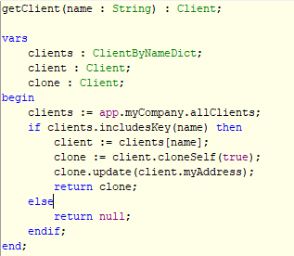
Transient handling
JADE REST will delete:
Any returned transient
Any object parameter to the method
Any transient you add to objectsToBeDeleted
Notes:
Consider this method.
We are creating this clone – a transient instance of Client and then returning it.
Will it cause a transient leak?
Normally it would, but fortunately for us, the JADE REST framework is going to handle it for us.
Here are the rules:
Firstly, anything going in or out gets deleted for you (if it’s transient)
That includes a returned object, or an object that’s turned up in the parameter after being deserialized from a JSON string.
In addition, if there are any other objects that you need to delete AFTER the REST processing (i.e. you can’t do it in the epilog), you can add the object to your JadeRestService’s objectsToBeDeleted collection

