Slide 1


CMPE 135 Object-Oriented Analysis and Design August 24 Class Meeting
Department of Computer Engineering San Jose State University Fall 2017 Instructor: Ron Mak
www.cs.sjsu.edu/~mak

Slide 2
Basic Info
Office hours
TuTh 3:00 – 4:00 PM
ENG 250
Website
Faculty webpage: http://www.cs.sjsu.edu/~mak/
Class webpage: http://www.cs.sjsu.edu/~mak/
Syllabus
Assignments
Lecture notes

Slide 3
Permission Codes?
If you need a permission code to enroll in this class, see the department’s instructions at https://cmpe.sjsu.edu/content/Undergraduate-Permission-Number-Requests
Complete the Google form at https://docs.google.com/a/sjsu.edu/forms/d/e/1FAIpQLSe9YgAea-QsgLZof-KIMmuQthoChL4micudyRukgWneiByN2A/viewform

Slide 4
Goals of the Course
Develop well-designed software applications that do what they're supposed to do.
Create applications that are flexible, reliable, and maintainable.
Use proven object-oriented techniques.
Learn important job skills that employers want.
Work as a member of a small programming team.
Employ modern industry-standard software engineering practices.

Slide 5
The Ultimate Goal
Become a better programmer!

Slide 6
Course Learning Outcomes
Requirements gathering
Gather the requirements for a software application, to distinguish between functional and nonfunctional requirements, and to express the requirements in the form of use cases.
Object-oriented analysis
Derive the appropriate objects from the requirements and to define their internal structures, behaviors, and interrelationships.

Slide 7
Course Learning Outcomes, cont’d
Unified Modeling Language (UML)
Draw UML use case, class, and sequence diagrams to document and communicate the analysis results.
Object-oriented design
Apply the results of analysis and write well-designed programs in an object-oriented language. Design classes and interfaces at various abstraction levels.

Slide 8
Course Learning Outcomes, cont’d
Object-oriented concepts and techniques
Apply important concepts such as inheritance and polymorphism, Programming by Contract, Programming to the Interface, the Open-Closed Principle, and the Liskov Substitution Principle. Learn key testing techniques and how to design code that is easily tested.
The C++ object model
Understand how C++ implements the object model, including the Standard Template Library (STL).

Slide 9
Course Learning Outcomes, cont’d
Design patterns
Know the major “Gang of Four” design patterns and recognize when it is appropriate to apply which design patterns.
Industry-standard best practices and tools
Follow the best practices and to use the software development tools that are standard in today’s software development industry.

Slide 10
Course Overview
Analysis
Gather requirements
Create use cases
Identify objects, behaviors, and dependencies
Functional Specification
Design
Encapsulation
Loose coupling and high cohesion
UML diagrams
Design Specification

Slide 11
Course Overview, cont’d
Object-oriented design techniques
Interfaces
Inheritance
Polymorphism
Midterm

Slide 12
Course Overview, cont’d
The C++ object model
Pointers and references
Constructors
Public, protected, and private members
Concrete, abstract, overridden, and overloaded member functions
Friend functions
Exception handling

Slide 13
Course Overview, cont’d
Testing
Unit testing
Test-driven design (TDD)

Slide 14
Course Overview, cont’d
Design patterns
Frameworks
C++ templates
The Standard Template Library (STL)
GUI programming
Inversion of control
Dependency injection
Multi-threaded programming

Slide 15
Required Textbooks
None!
Current textbooks on object-oriented analysis and design use Java programming examples.
This class will use C++.
You will receive reference material throughout the semester, or access it on the Internet.

Slide 16
Project Teams
Projects will be done by small project teams.
Projects will be broken up into assignments.
Form your own teams of 4 members each.
Choose your team members wisely!
Be sure you’ll be able to meet and communicate with each other and work together well.
No moving from team to team.
Each team member will receive the same score on each team assignment and team project.

Slide 17
Project Teams, cont’d
Each team email to ron.mak@sjsu.edu by Wednesday, August 30:
Your team name
A list of team members and email addresses
Subject: CMPE 135 Team Team Name
Example: CMPE 135 Team Hyper Hackers

Slide 18
Individual Responsibilities
You are personally responsible for participating and contributing to your team’s work, and for understanding each part of the work for every assignment whether or not you worked on that part.

Slide 19
Postmortem Assessment Report
At the end of the semester, each student will individually turn in a short (one page) report:
A brief description of what you learned in the course.
An assessment of your personal accomplishments for your project team.
An assessment of the contributions of each of your project team members.
This report will be seen only by the instructor.

Slide 20
Your Individual Overall Class Grade
Your final class grade will be adjusted up or down depending on your
level and quality of participation,
as reported by your
teammates’ postmortem reports.
30% assignments
35% project
15% midterm
20% final
During the semester, keep track of your progress in Canvas.
At the end of the semester, students with the median score will get the B grade.
Higher and lower grades will then be assigned based on how the scores cluster above and below the median.
Therefore, your final class grade will be based primarily on your performance relative to the other students in the class.

Slide 21
Take roll!

Slide 22
What Makes a Software Application Good?
It does what it’s supposed to do.
It’s well-designed.
reliable
robust
flexible
object-oriented architecture?
uses design patterns?
It’s easy to modify and maintain.

Slide 23
Change and Complexity
Software is becoming increasingly complex.
Requirements are always changing.
During requirements gathering.
During design.
During implementation.
After the product is already out in the field.
A key measure of good design is how well you manage change and complexity.

Slide 24
How Do You Achieve “Good Design”?
Sorry, there is no magic formula.
Learning lots of object-oriented tools and techniques alone won’t give you good design.
Just using design patterns won’t give you good design.
For a nontrivial application, good design won’t simply “happen”.

Slide 25
How Do You Achieve “Good Design”? cont’d
Good design is reached after a journey.
Every programmer must take this trip for every application.
The journey can be longer for less-experienced programmers.
false starts
meandering
wrong paths
backtracking

Slide 26
It’s an Iterative Process
Achieving good design is an iterative process.
As you’re developing the application, you will revisit your design several times.
Even the very best programmers cannot achieve a perfect good design the first time every time.
The journey to good design requires that you make corrections, refinements, and other improvements along the way.

Slide 27
It’s an Iterative Process, cont’d
The journeys will become shorter as you become more experienced.
Practice, practice, practice.
Learn object-oriented tools and techniques.
Learn when to use design patterns.
More practice, practice, practice.

Slide 28
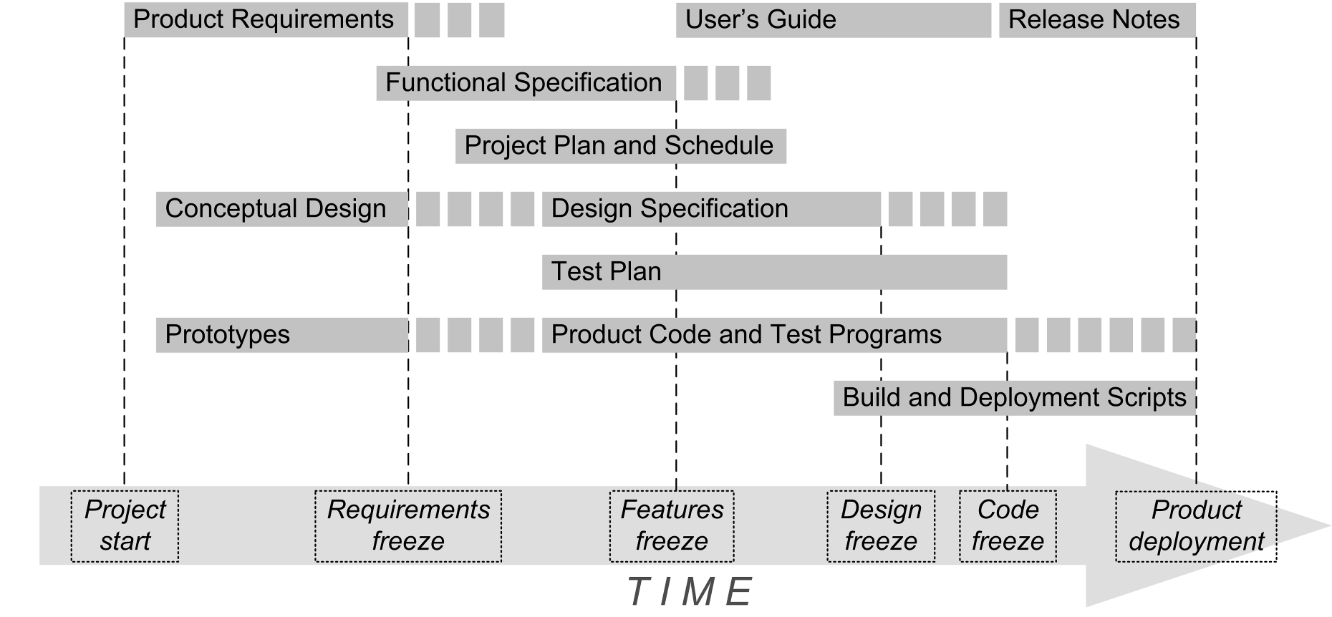
Application Development Big Picture

Slide 29
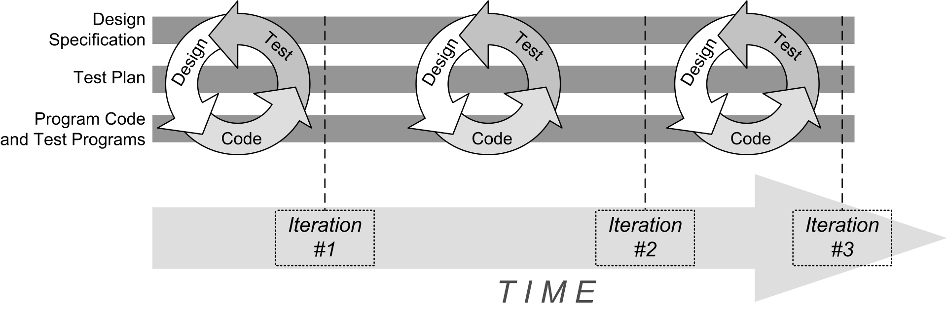
Iterative Development

Slide 30

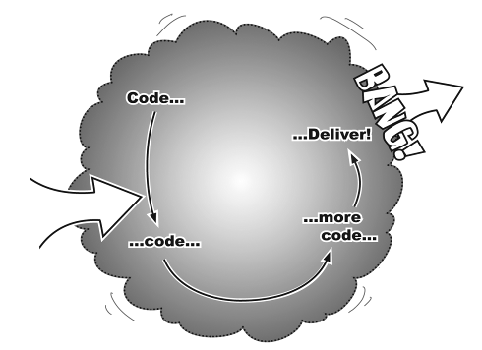
Incremental Development
Goal
Start
Each iteration adds functionality to code that already works.
No Big Bang!
From: Head First Object-Oriented Analysis & Design, O’Reilly, 2006.

Slide 31
A Poor Design is Not Necessarily a Failure ...
... if it soon leads to a better design.
Don’t paralyze yourself trying to come up with a perfect design right from the start.
Goal: Recognize a poor design early during development and start to improve it iteratively as soon as possible.
Even better: Try not to start with a really bad design.
You will learn quickly how not to do a bad design!

Slide 32
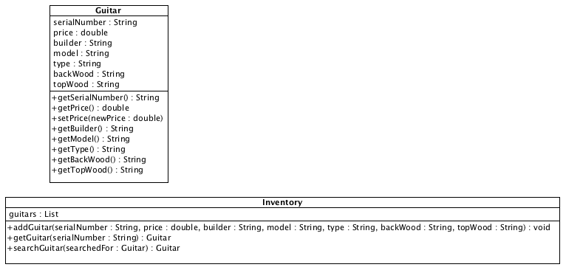
Example: Rick’s Guitars
Inventory Management Application for Rick’s Guitars
Maintain a guitar inventory.
Locate guitars for customers.
UML class diagrams
Head First Object-Oriented
Analysis & Design
by Brett D. McLaughlin, et al.
O’Reilly, 2006.

Slide 33
Iteration #1: The Guitar Class
#include <string>
using namespace std;
class Guitar
{
private:
string serial_number, builder, model, type, back_wood, top_wood;
double price;
public:
Guitar(string serial_number, double price,
string builder, string model, string type,
string back_wood, string top_wood);
string get_serial_number() const;
double get_price() const;
void set_price(float new_price);
string get_builder() const;
string get_model() const;
string get_type() const;
string get_back_wood() const;
string get_top_wood() const;
};
Guitar.h
Why
private?

Slide 34
The Guitar Class, cont’d
#include <string>
#include "Guitar.h"
using namespace std;
Guitar::Guitar(string serial_number, double price,
string builder, string model, string type,
string back_wood, string top_wood)
: serial_number(serial_number), builder(builder), model(model),
type(type), back_wood(back_wood), top_wood(top_wood), price(price)
{
}
string Guitar::get_serial_number() const { return serial_number; }
double Guitar::get_price() const { return price; }
void Guitar::set_price(float new_price) { price = new_price; }
string Guitar::get_builder() const { return builder; }
string Guitar::get_model() const { return model; }
string Guitar::get_type() const { return type; }
string Guitar::get_back_wood() const { return back_wood; }
string Guitar::get_top_wood() const { return top_wood; }
Guitar.cpp

Slide 35
The Inventory Class
#include <list>
#include "Guitar.h"
using namespace std;
class Inventory
{
private:
list<Guitar *> guitars;
public:
Inventory();
void add_guitar(string serial_number, double price,
string builder, string model, string type,
string back_wood, string top_wood);
Guitar *get_guitar(string serial_number);
Guitar *search(Guitar *search_guitar);
};
Inventory.h

Slide 36
The Inventory Class, cont’d
void Inventory::add_guitar(string serial_number, double price,
string builder, string model, string type,
string back_wood, string top_wood)
{
Guitar *guitar = new Guitar(serial_number, price, builder,
model, type, back_wood, top_wood);
guitars.push_back(guitar);
}
Guitar *Inventory::get_guitar(string serial_number)
{
list<Guitar *>::iterator it;
for (it = guitars.begin(); it != guitars.end(); it++)
{
Guitar *guitar = *it;
if (guitar->get_serial_number() == serial_number) return *it;
}
return nullptr;
}
Inventory.cpp

Slide 37
The Inventory Class, cont’d
Guitar *Inventory::search(Guitar *search_guitar)
{
list<Guitar *>::iterator it;
for (it = guitars.begin(); it != guitars.end(); it++)
{
Guitar *guitar = *it;
string builder = search_guitar->get_builder();
if (builder != guitar->get_builder()) continue;
string model = search_guitar->get_model();
if (model != guitar->get_model()) continue;
string type = search_guitar->get_type();
if (type != guitar->get_type()) continue;
string back_wood = search_guitar->get_back_wood();
if (back_wood!= guitar->get_back_wood()) continue;
string top_wood = search_guitar->get_top_wood();
if (top_wood != guitar->get_top_wood()) continue;
return *it; // found a match
}
return nullptr; // no match
}
Ignore serial number since that's unique.
Ignore price since that's unique.
Inventory.cpp

Slide 38
The FindGuitarTester Class
FindGuitarTest.h
#include "Inventory.h"
using namespace std;
class FindGuitarTester
{
public:
static void initialize_inventory(Inventory *inventory);
};

Slide 39
The FindGuitarTester Class, cont’d
void FindGuitarTester::initialize_inventory(Inventory *inventory)
{
inventory->add_guitar("11277", 3999.95, "Collings", "CJ", "acoustic",
"Indian Rosewood", "Sitka");
inventory->add_guitar("V95693", 1499.95, "Fender", "Stratocastor", "electric",
"Alder", "Alder");
inventory->add_guitar("V9512", 1549.95, "Fender", "Stratocastor", "electric",
"Alder", "Alder");
inventory->add_guitar("122784", 5495.95, "Martin", "D-18", "acoustic",
"Mahogany", "Adirondack");
inventory->add_guitar("76531", 6295.95, "Martin", "OM-28", "acoustic",
"Brazilian Rosewood", "Adriondack");
inventory->add_guitar("70108276", 2295.95, "Gibson", "Les Paul", "electric",
"Mahogany", "Maple");
inventory->add_guitar("82765501", 1890.95, "Gibson", "SG '61 Reissue",
"electric", "Mahogany", "Mahogany");
inventory->add_guitar("77023", 6275.95, "Martin", "D-28", "acoustic",
"Brazilian Rosewood", "Adirondack");
inventory->add_guitar("1092", 12995.95, "Olson", "SJ", "acoustic",
"Indian Rosewood", "Cedar");
inventory->add_guitar("566-62", 8999.95, "Ryan", "Cathedral", "acoustic",
"Cocobolo", "Cedar");
inventory->add_guitar("6 29584", 2100.95, "PRS", "Dave Navarro Signature",
"electric", "Mahogany", "Maple");
}
FindGuitarTest.cpp

Slide 40
The FindGuitarTester Class, cont’d
int main()
{
// Set up Rick's guitar inventory.
Inventory *inventory = new Inventory();
FindGuitarTester::initialize_inventory(inventory);
Guitar *what_erin_likes = new Guitar("", 0, "fender", "Stratocastor",
"electric", "Alder", "Alder");
Guitar *guitar = inventory->search(what_erin_likes);
if (guitar != nullptr)
{
cout << "Erin, you might like this "
<< guitar->get_builder() << " "
<< guitar->get_model() << " "
<< guitar->get_type() << " guitar:\n "
<< guitar->get_back_wood() << " back and sides,\n "
<< guitar->get_top_wood() << " top.\nYou can have it for only $"
<< guitar->get_price() << "!";
}
else
{
cout << "Sorry, Erin, we have nothing for you.";
}
}
FindGuitarTest.cpp
Demo

Slide 41
Problems!
Case-sensitive string comparisons.
Make them case insensitive.
Badly used string fields.
Replace them with enumerated types.
Assumes at most only one guitar match.
Return a list of matching guitars.

Slide 42
Reminder: By Wednesday, August 30
Form teams.
Email me your team information.
team name
team members and email addresses

