Slide 1


CMPE 135: Object-Oriented Analysis and Design August 31 Class Meeting
Department of Computer Engineering San Jose State University Fall 2017 Instructor: Ron Mak
www.cs.sjsu.edu/~mak

Slide 2
Encapsulation Success!
Now whenever the guitar characteristics change, we only have to modify the GuitarSpec class.
No other classes need to change.
We don’t count the test class FindGuitarTester.

Slide 3
Summary
Make sure your program works!
Fix bugs and minimize their occurrence.
Does your program do what the customer wants?
Apply good object-oriented principles.
Identify what changes and encapsulate it.
Isolate changes to one class from the other classes.

Slide 4
Summary, cont’d
Make your program flexible and maintainable.
Make it flexible so it can handle changes in requirements.
Use delegation to make your code more reusable.
Cohesion: Each object handles its own task.
Loosely coupled: Objects have few dependencies on each other.

Slide 5
OOA&D is about Satisfaction
Customers are satisfied when their apps work. Customers are satisfied when their apps keep working.
Customers are satisfied when their apps can be easily upgraded.
Programmers are satisfied when their apps can be reused.
Programmers are satisfied when their apps are flexible.
OOA&D is about writing great software!

Slide 6
Team Projects
Rock-Paper-Scissors game program.
Well-written using good object-oriented design principles, of course.
Human player vs. computer
The computer will apply simple machine-learning techniques to defeat human players.
Shared interfaces as contracts.
Each team’s game program should be able to play another team’s program.
It believes that it’s playing against a human player.

Slide 7
Requirements Elicitation
Requires communication between the developers and customers.
Customer: users, clients, and stakeholders
Client: who pays for your application
Stakeholder: whoever else is interested in the success of your application (e.g., shareholders)
Customers can validate the requirements.
Creates a contract between the customer and the developers.

Slide 8
Requirements Elicitation, cont’d
Result: a Functional Specification written non-technically so that the customers can read and understand it.

Slide 9
Bridging the Gap
Customers
Have a general idea of what the system should do.
Have little experience with software development.
Are experts in their domain.
Software developers
May have little knowledge of the application domain.
Have experience with software technology.
Are geeks with poor social skills.

Slide 10
Functional Requirements
What the system (the application) shall be able to do or allow users to do.
The application shall use GPS to determine the user’s location.
The application must default to the option most frequently chosen by the users.
The application must allow the user to choose between a text display or a graphics display.
The user shall be able to make an online withdrawal or deposit.

Slide 11
Functional Requirements, cont’d
Describe the interactions between the system and its environment independent of its implementation.

Slide 12
Nonfunctional Requirements
Usability, reliability, performance, supportability, etc.
The application must respond to user input within 5 seconds.
The application shall run on the Windows, Mac, and Linux platforms.
The new GUI must resemble the old GUI.
Error messages shall be displayed in English and Spanish.
Constraints that the system must meet.

Slide 13
Requirements are Strong Statements
Use strong declarative statements with “shall” and “must”.
The application shall use GPS to determine the user’s location.
The application must respond to user input within 5 seconds.

Slide 14
Requirements Must Be…
Complete
Are all system features and constraints described by requirements?
Consistent
No two requirements can contradict each other.
Clear
Each requirement must be unambiguous.
Correct
No errors in the requirements.

Slide 15
Requirements Must Be, cont’d
Realistic
Can the system be implemented?
Verifiable
Can the system be tested?
Traceable
Can each requirement be traced to an application function or constraint?
Can each application function or constraint be traced to a requirement?

Slide 16
Requirements Must Be, cont’d
Understandable
Requirements must be written in non-technical jargon-free language that is meaningful to both the application’s developers and the application’s customers.

Slide 17
How to Get Requirements
Interview future users of your application.
Observe how the users currently work.
Can you improve how they currently do things?
Can you make them more productive?
Stated requirements
The customer tells you want he or she wants.
Implied requirements
What do you think the customer wants?

Slide 18
How to Get Requirements, cont’d
Customers don’t always know what they want.
They will know more after you show them a prototype.
They will change their minds.
It’s an iterative process!

Slide 19
How to Get Requirements, cont’d
If the developers force the customers to come up with the requirements too soon, they may make something up!
Such requirements will most likely be wrong or incomplete and lead you astray.

Slide 20
Use Cases
A use case describes a single task that your application must allow an actor to accomplish or a single goal that an actor must achieve.
Actors are external agents that interact or communicate with the system.
actors = role abstractions
An actor can be a person or another system.

Slide 21
Use Cases, cont’d
Uses cases are an important way for the developers of a software application and its customers to communicate:
What functionality the application must have.
What steps to achieve the functionality.
An application’s use cases capture the bulk of the customer’s understanding of what the application is supposed to do.

Slide 22
Use Cases, cont’d
A use case includes:
A complete sequence of actions or events from the point of view of an actor.
A primary sequence
Alternate sequences (“exception paths”).
A sequence is triggered by an actor.
Focus on what the system must do, not how to do it.
A use case treats the system as a “black box”.

Slide 23
Example: Bank ATM System
system
Start up
ATM
system boundary
actor
Shut down
ATM
use cases
Operator
Log in
customer
interaction
When you draw a
use case diagram,
do not include the
red labels and arrows.
Log out
customer
Withdraw
cash
Customer
Display
balance
UML use case diagram
Bank

Slide 24
Example Use Case Description
Name: Withdraw Cash
Goal: Customer withdraws cash from ATM.
Summary: A customer who has logged in can withdraw up to $500 cash in $20 bills.
Actors: The customer and the bank

Slide 25
Example Use Case Description, cont’d
Preconditions:
The ATM has been started up.
See use case “Start up ATM”.
The customer has inserted a valid bank card.
The customer has entered a correct PIN.
Trigger: The customer selects the “Withdraw Cash” option.

Slide 26
Example Use Case Description, cont’d
Primary sequence:
The system prompts the customer for the amount.
The customer chooses from a list of amounts or enters a amount.
The customer confirms and submits the amount.
(The ATM communicates with the bank to check the customer’s account.)
The system dispenses the amount in $20 bills.
(The bank deducts the amount from the customer’s balance.)
The system displays the customer’s balance
See use case “Display balance”.
At most about 10 steps.
Another use case.

Slide 27
Example Use Case Description, cont’d
Alternate sequences:
3.1 The customer entered an amount that is not a multiple of $20.
3.1.1 The system displays a message to the customer .
3.1.2. The system prompts the customer for a new amount.
3.2 The customer’s bank balance is insufficient.
3.2.1 etc.

Slide 28
Example Use Case Description, cont’d
Postconditions:
The customer receives the desired amount of cash.
The amount is deducted from the customer’s account.
The customer sees the new account balance.
OR: The customer receives no cash.
The customer’s account is unchanged.
What must be true after the use case is done.

Slide 29
Example Use Case Description, cont’d
Nonfunctional requirements:
The system responds to each customer input within 15 seconds.
The system displays messages in either English or Spanish.
Glossary
customer = a person who wants to withdraw cash from the ATM.
bank = a system that maintains customer accounts and balances.
etc.

Slide 30
Use Case Description Guidelines
Use case names should be verb-object.
Each name should describe an achievable goal or doable task (e.g., “Withdraw Cash”).
Keep use cases short, simple, and informal.
Clients and users need to understand them.
No GUI or implementation details.

Slide 31
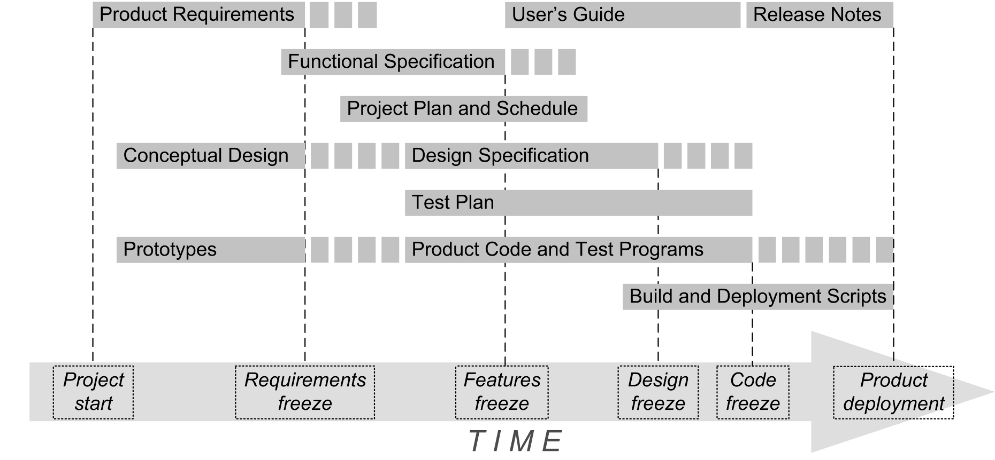
The Functional Specification
Product name
Clear problem statement
What is the problem?
Objectives
What is your application supposed to accomplish?
Functional requirements
Nonfunctional requirements
Use cases
Primary contents of a
Functional Specification

Slide 32
Assignment #1: Functional Specification
Each project team creates the first draft of the Functional Specification for its Rock-Paper-Scissors game program (human vs. computer).
Product name
Problem statement
Objectives
6 functional requirements
4 nonfunctional requirements
Use case diagram with 6 use cases
Use case descriptions of 3 of your use cases

Slide 33
Assignment #1, cont’d
Each team turns in one Functional Specification.
Microsoft Word document or PDF
Canvas: Assignment #1
Due Friday, September 8 at 11:59 PM.
Use case description form: http://www.cs.sjsu.edu/~mak/CMPE135/assignments/1/UseCaseForm.docx
Formal report rubrics: http://www.cs.sjsu.edu/~mak/CMPE135/assignments/1/FormalReportRubrics.pdf

