Slide 1


CMPE 135: Object-Oriented Analysis and Design September 19 Class Meeting
Department of Computer Engineering San Jose State University Fall 2017 Instructor: Ron Mak
www.cs.sjsu.edu/~mak

Slide 2
Last Thursday
Day class
Accessors and mutators
Dangerous setters
Immutable classes
Dangerous references to mutable objects
const fields
Separate accessors and mutators

Slide 3
Side Effects
A side effect is a change to an object’s state due to a method call.
Nasty side effects are unexpected by the programmer.

Slide 4
Nasty Side Effect Examples
Calling a getter function changes the value of some object field.
The setter functions of our original Day class.
A function call changes the value of an actual parameter that’s passed by the call.
A function call changes a global value, such as a static object.

Slide 5
Example Side Effect
Basic date string parser:
Advanced: Parse multiple dates in the string.
Side effect: Function parse() updates parameter index to the string index of the next date.
A better design: Add an index field to the data parser state.
DateParser *date_parser = new DateParser(); string date_string = "September 19, 2017"; Date *d = date_parser->parse(dateString);
int index = 0; Date *d = date_parser-> parse(dateString, index);

Slide 6
The Law of Demeter
“Principle of Least Knowledge”
More a rule of thumb than a hard law.
Summary (https://en.wikipedia.org/wiki/Law_of_Demeter)
Each unit should have only limited knowledge about other units: only units “closely” related to the current unit.
Each unit should only talk to its friends. Don't talk to strangers.
Only talk to your immediate friends.

Slide 7
The Law of Demeter, cont’d
A member function should only use:
Instance fields of its class
Parameters
Objects that it constructs with new
To obey this law:
A method should never return a reference to an object that is part of its internal representation.
A class should have sole responsibility to interact with objects that are part of its internal representation.

Slide 8
The Law of Demeter, cont’d
The law enables you to modify the internal structure of a class without modifying its public interface.
Encapsulation!
Loose coupling!

Slide 9
How Good is an Interface?
Who is the user of a class that you write?
Other programmers?
Perhaps you yourself, later!

Slide 10
How Good is an Interface? cont’d
Class designer priorities
Efficient algorithm
Convenient coding
etc.
Class user priorities
Easy to use
Don’t have to understand the implementation
etc.

Slide 11
How Good is an Interface? cont’d
Is there a “conflict of interest” if you’re both the class designer and the class user?
Can you make the right engineering tradeoffs?

Slide 12
Cohesion
A cohesive class implements a single abstraction or responsibility.
Member functions should be related to this single abstraction.

Slide 13
Cohesion
Why is this a badly designed class?
Method processCommand() doesn’t belong.
Delegate command processing to another class.
class Mailbox {
public: void add_message(Message *msg); Message *get_current_message(); Message *remove_current_message(); void process_command(string command); ... }

Slide 14
Completeness
Support operations for a well-defined abstraction.
A potentially bad example: The Date class:
How many milliseconds have elapsed?
No such operation in the Date class.
Does it fall outside the responsibility?
We have before(), after(), get_time()
Date start = new Date(); // do some work Date end = new Date();

Slide 15
Completeness
If you encounter an incomplete class:
Negotiate with the class designer.
Fill in what’s missing with a subclass.

Slide 16
Convenience
A good interface makes all tasks possible and common tasks simple.
Example of inconvience: The C++ string class
Why are stoi, stof, to_string, etc. individual functions and not member functions of class string?
To shift all the letters of a string to upper or lower case, you need to call the complicated transform function.
How to do a case-insensitive string comparison?

Slide 17
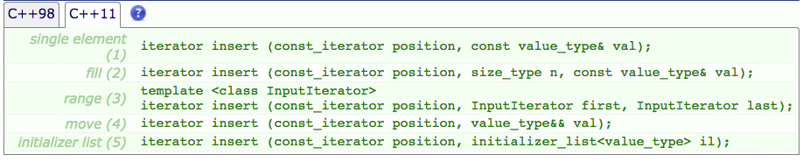
Clarity
Confused programmers write buggy code.
Example: The C++ list class has many ways to insert elements into a list. Confusing.
http://www.cplusplus.com/reference/list/list/insert/

Slide 18
Clarity, cont’d
Another example: The C++ vector class
A vector can be indexed using an integer value enclosed in [ and ] or by calling member function at with an integer value.
But other member functions such as insert() and erase() require iterators to indicate positions within the vector.

Slide 19
Consistency
Related features of a class should have matching
names
parameters
return values
behavior
A bad example: Why is month 0-based?
new GregorianCalendar(year, month - 1, day)

Slide 20
Programming by Contract
Metaphor promoted by Bertrand Meyer.
A pioneer of object-oriented programming.
Inventor of the Eiffel programming language.
Ensure that:
All class constructors only create objects with valid initial states.
All mutators preserve the valid states.

Slide 21
Programming by Contract, cont’d
Therefore:
We should never have invalid objects.
No need to waste run time checking for invalid objects.

Slide 22
Programming by Contract, cont’d
Member functions are agents that fulfill a contract.
The contract spells out the responsibilities
Of the caller (the class user)
Of the implementer (you, the programmer)
Involves preconditions, postconditions, and invariants.

Slide 23
Preconditions
The MessageQueue class
What should happen if the class user attempts to remove a message from an empty queue?
class MessageQueue
{
public:
void add(Message *msg);
Message *remove();
Message *peek();
int size();
...
private:
vector<Message *> elements;
}

Slide 24
Preconditions, cont’d
What should happen if the class user attempts to remove a message from an empty queue?
Class MessageQueue can declare this to be a runtime error.
Class MessageQueue can simply return null.
Which is better?

Slide 25
Preconditions, cont’d
Excessive error checking is costly.
Returning dummy values can complicate testing.

Slide 26
Preconditions, cont’d
A precondition is a condition that must be true before the service provider can promise to fulfill its part of the contract.
If the precondition is not true and the service is still requested, the provider can choose any action that is convenient for it, no matter how disastrous the outcome may be for the service requester.

Slide 27
Contract Metaphor
The service provider (i.e., the class) must specify preconditions.
If the precondition is true, the service provider must work correctly.
If the precondition is not true, the service provider can do anything.
Throw an exception?
Return a default or false answer?
Corrupt data?
Handle the error gracefully?

Slide 28
Preconditions, cont’d
/** * Remove the message at the head. * @return the message at the head * @precondition size() > 0 */ Message *MessageQueue::remove() { Message *r = elements[0];
elements->erase(0);
return r; }
What happens if the precondition not fulfilled?

Slide 29
Preconditions, cont’d
/** * Remove the message at the head. * @return the message at the head * @precondition size() > 0 */ Message *MessageQueue::remove() { Message *r = elements[0];
elements->erase(0);
return r; }
The remove() method makes no promises to do anything sensible if called on an empty queue.

Slide 30
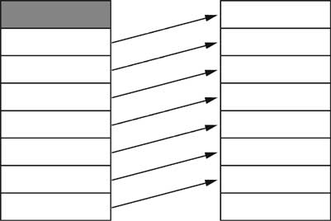
Example: Queue as a Circular Array
The current MessageQueue implementation removes messages inefficiently.
After the head message (element 0) is removed, all the remaining messages must shift one position:

Slide 31
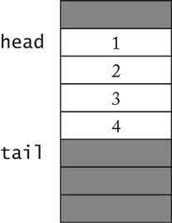
Queue as a Circular Array
Implement a queue as a circular array.
Two index variables, head and tail
head: Index of the next message to be removed
tail: Index of the position where the next new message will be inserted.

Slide 32
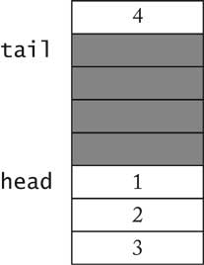
Queue as a Circular Array
As messages are added and removed:
head will chase after tail.
Both will wrap around to the beginning of the array (hence the name “circular”).

Slide 33
Queue as a Circular Array
Indexes head and tail must never cross each other.
Can head and tail be equal? What does that mean?

Slide 34
Queue as a Circular Array
/**
* Remove message at head.
* @return the message that was removed from the queue
* @precondition size() > 0
*/
Message *MessageQueue::remove()
{
Message *r = elements[head];
head = (head + 1) % elements->capacity();
count--;
return r;
}
What if the precondition is violated?
count becomes negative.
After head has wrapped around, remove() returns a previously removed message.

Slide 35
Queue as a Circular Array
The cost of violating a precondition can be very high!

Slide 36
Assignment #3
Begin your project implementation by coding an initial version of your application.
Only the most basic functions.
In a short written report, describe
What code is likely to change in your design, and how you are encapsulating that code.
Examples of cohesive classes.
Examples of loosely-coupled classes.
Due Friday, September 29

