Slide 1


CMPE 135: Object-Oriented Analysis and Design October 3 Class Meeting
Department of Computer Engineering San Jose State University Fall 2017 Instructor: Ron Mak
www.cs.sjsu.edu/~mak

Slide 2
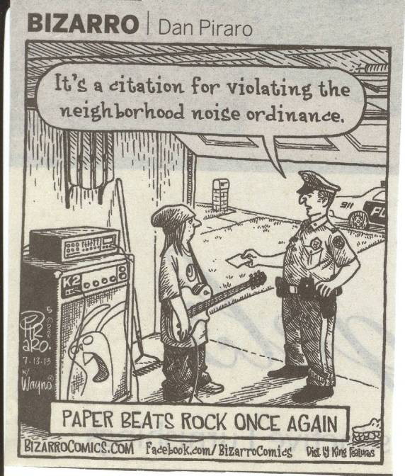

Slide 3
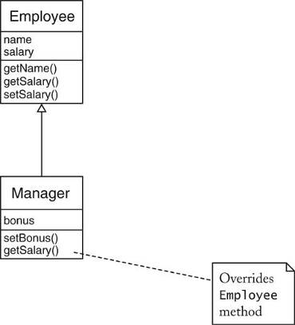
Inheritance
By now, inheritance should be a familiar concept.
Object-Oriented Design & Patterns
by Cay Horstmann
John Wiley & Sons, 2006.

Slide 4
Manager : public Employee
class Employee {
public: Employee(string nam) { name = nam; } void set_salary(double sal) { salary = sal; } string get_name() const { return name; } double get_salary() const { return salary; }
private: string name; double salary; }
What are the differences between
Manager and Employee?
class Manager : public Employee {
public: Manager(string aName) { ... } void set_bonus(double bon) { bonus = bon; } // new member function double get_salary() const { return salary + bonus } // overrides Employee
// member function
private: double bonus; // new member variable }

Slide 5
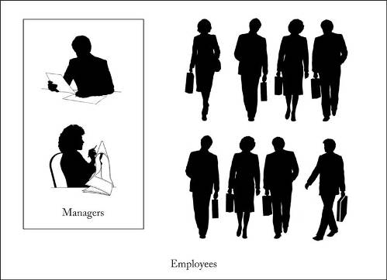
Superclasses and Subclasses
Employee is the superclass (or base class). Manager is the subclass.
A manager “is a” employee.
A manager is a specialized type of employee.
The set of Manager objects is a subset of the set of Employee objects.
Object-Oriented Design & Patterns
by Cay Horstmann
John Wiley & Sons, 2006.

Slide 6
Class Hierarchies
AKA inheritance hierarchies.
In the real world, hierarchies express general/specific relationships among concepts.
The most general concept is at the root of a tree.
More specific concepts are children.
The most specific concepts are leafs.

Slide 7
Class Hierarchies, cont’d
Object-oriented programming uses class hierarchies.
The most general superclass is at the root of a tree.
More specific subclasses are children.
The most specific subclasses are leafs.
Class hierarchies can be complex.
But they shouldn’t be.

Slide 8
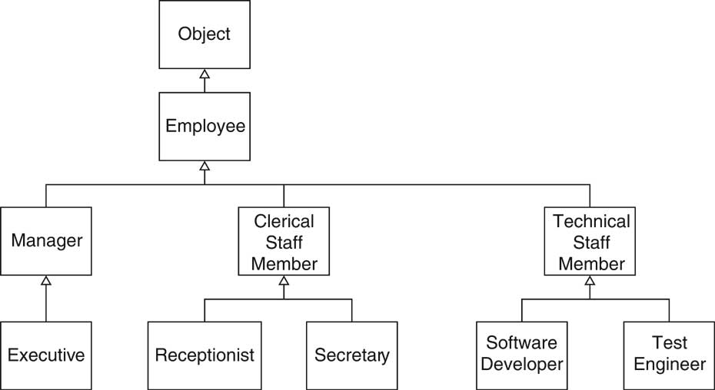
Class Hierarchies, cont’d
Object-Oriented Design & Patterns
by Cay Horstmann
John Wiley & Sons, 2006.

Slide 9
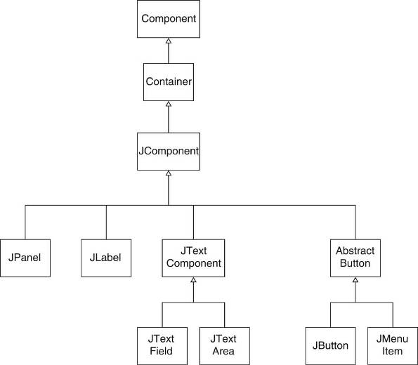
Class Hierarchies, cont’d
Java’s “Swing”
GUI classes.
Object-Oriented Design & Patterns
by Cay Horstmann
John Wiley & Sons, 2006.

Slide 10
The Liskov Substitution Principle
Named after Barbara Liskov.
MIT computer science professor
A pioneer in object-oriented programming.
In your C++ code, you should be able to substitute a superclass object by a subclass object.
Superclass object
Employee *e = new Employee("John Doe"); cout << "salary = " << e->get_salary() << endl;
Subclass object
Employee *e = new Manager("Mary Jane"); cout << "salary = " << e->get_salary() << endl;

Slide 11
Overridden Member Functions
Employee *e = new Manager("Mary Jane"); cout << "salary = " << e->get_salary() << endl;
Assign an object value to a variable.
The data type of variable e is Employee*.
The data type of the object value is Manager*.
At run time, which member function is called?
Employee::get_salary()
Manager::get_salary()
In C++, that depends on how you declare the get_salary() member functions.

Slide 12
Overridden Member Functions, cont’d
class Employee {
public: ...
double get_salary() const { return salary; }
private: string name; double salary; }
Employee:: get_salary() will be called.
Determined by the data type Employee of variable e.
class Manager : public Employee {
public: ... double get_salary() const { return ... } // overrides Employee
// member function
private: double bonus; // new member variable }
Employee *e = new Manager("Mary Jane"); cout << "salary = " << e->get_salary() << endl;

Slide 13
Polymorphism
Employee *e = new Manager("Mary Jane"); cout << "salary = " << e->get_salary() << endl;
Since the value that e points to is a Manager object, we really want to get a manager’s salary, not that of a general employee.
We want which get_salary() member function to call to be determined by the data type of the runtime value of e.
This is the principle of polymorphism.

Slide 14
Polymorphism, cont’d
To make get_salary() polymorphic in C++, we must declare it to be virtual.
You only need to declare it virtual in the base class.
class Employee {
public: ...
virtual double get_salary() const { return salary; } ...
}
class Manager : public Employee {
public: ... double get_salary() const { return ... }
... }

Slide 15
Polymorphism, cont’d
Polymorphism is not free.
C++ must consult a virtual table at run time for every class or subclass that contains a virtual function.
C++ cannot tell at compile time what the value (and hence value’s data type) of the variable will be.
Consulting the virtual table to determine which member function to call will affect performance.
Use polymorphism judiciously.
Demo

Slide 16
The Liskov Substitution Principle, cont’d
Employee *e = new Manager("Mary Jane"); cout << "salary = " << e->get_salary() << endl;
How is the Liskov Substitution Principle related to Programming to the Interface?
The type of variable e is the superclass Employee instead of the more specific subclass type Manager.
Variable e can point to an object instantiated from another subclass of Employee without causing further code changes.
Variable e is not restricted to the Manager class.

Slide 17
Invoke a Superclass Member Function
Suppose a manager’s salary is his regular employee salary plus a bonus that only managers get.
class Manager : public Employee {
public: double get_salary() const { return salary + bonus; } ... }
What’s wrong
with this solution?
A subclass cannot access the
private fields of its superclass.
What’s wrong
with this solution?
public:
double get_salary() const { return get_salary() + bonus; }
Infinite recursion!

Slide 18
Invoke a Superclass Member Function, cont’d
Name the superclass and use the scope resolution operator :: .
Turns off polymorphism.
class Manager : public Employee {
public: double get_salary() const { return Employee::get_salary() + bonus; } ... }

Slide 19
Invoke a Superclass Constructor
Name the superclass in the subclass constructor to call the superclass constructor.
Pass any required parameters.
class Manager : public Employee {
public: Manager(string name) : Employee(name), bonus(0) { ... } ... }

Slide 20
Invoke a Superclass Constructor, cont’d
If a subclass constructor does not explicitly call a superclass constructor, the superclass’s default constructor (the one without parameters) is called automatically.
In this case, the superclass must have a default constructor.

Slide 21
Invoke a Constructor from Another
A class can invoke one of its constructors from another constructor.
Called delegating constructors.
First became available
with C++11.
class Manager : public Employee {
public: Manager(string name) : Employee(name), bonus(0) { ... }
Manager(string name, double bon) : Manager(name), bonus(bon)
{
...
} }

Slide 22
Preconditions and Inheritance
Recall that a precondition of a function is a condition that must be true before the method can be called.
The caller is responsible for making sure the precondition is true before making the call.
Suppose a subclass overrides a superclass member function.
The precondition of the subclass member function cannot be stronger than the precondition of the overridden superclass member function.

Slide 23
Preconditions and Inheritance, cont’d
class Employee {
public: /** * Sets the employee salary to a given value. * @param aSalary the new salary * @precondition sal > 0 */ public void set_salary(double sal) { salary = sal; }
... }
Suppose for the Manager class’s override of set_salary(), we have
@precondition sal > 100000

Slide 24
Preconditions and Inheritance, cont’d
Suppose for the Manager class’s override of set_salary(), we have
Suppose also that we have the statements
What if variable e points to a Manager object?
The manager’s precondition is violated, but you have no way to check that when writing the code.
@precondition sal > 100000
Employee *e = ... ; e->set_salary(50000);

Slide 25
Postconditions and Inheritance
When a subclass overrides a member function, the subclass function’s postcondition must be at least as strong as the postcondition of the superclass function.
Suppose Employee::set_salary() has a postcondition that it does not decrease the employee’s salary.
Then Manager::set_salary() must have a postcondition that is at least as strong.
For example, the subclass function must increase the manager’s salary.

Slide 26
More Inheritance Conditions
When a subclass overrides a superclass member function, it cannot make the function less visible.
Example: If a superclass member function is public, you cannot override the function in a subclass and make it private.
An overridden member function cannot throw more exceptions than are declared in the superclass member function.

Slide 27
Point-Circle-Rectangle
class Point
{
public:
Point(int x, int y) : x(x), y(y) {}
virtual ~Point() {}
int get_x() const { return x; }
int get_y() const { return y; }
void move(int dx, int dy) { x += dx; y += dy; }
private:
int x, y;
};
Is there anything
wrong with this
code?
class Circle : public Point
{
public:
Circle(Point center, int radius)
: Point(center.get_x(), center.get_y()),
radius(radius)
{}
private:
int radius;
};
A Circle has a center Point.
But a Circle is not a Point.

Slide 28
Point-Circle-Rectangle, cont’d
Even worse!
The upper-left corner is kept in the superclass.
The lower-right corner is a member variable.
class Rectangle : public Point
{
public:
Rectangle(Point upper_left, Point lower_right)
: Point(upper_left.get_x(), upper_left.get_y()),
lower_right(lower_right)
{}
void move(int dx, int dy) // override Point::move()
{
Point::move(dx, dy);
lower_right.move(dx, dy);
}
private:
Point lower_right;
};
A Rectangle
has two Points.
But a Rectangle
is not a Point.

Slide 29
Vector-Stack
#include <string>
#include <vector>
using namespace std;
template<typename T>
class Stack : public vector<T>
{
public:
Stack();
void push(T item);
T pop();
};
template<typename T>
void Stack<T>::push(T item)
{
this->push_back(item);
}
template<typename T>
T Stack<T>::pop()
{
T top_item = this->at(this->size() - 1);
this->pop_back();
return top_item;
}
int main()
{
Stack<string> stk;
stk.push("A");
stk.push("B");
stk.push("C");
stk.erase(stk.begin() + 1); // remove "B"
}
What is wrong
with this code?
A stack is not a special case of a vector.
Violates the Liskov Substitution Principle:
You cannot substitute a vector by a stack.

